Slide 1
Nontariff Trade Barriers
PowerPoint slides prepared by:
Andreea Chiritescu
Eastern Illinois University

Slide 2
Import Quota
Import quota
Physical restriction on the quantity of goods that can be imported during a specific time period
Require an import license
Specifies the total volume of imports allowed
On manufactured goods
Outlawed by the World Trade Organization

Slide 3
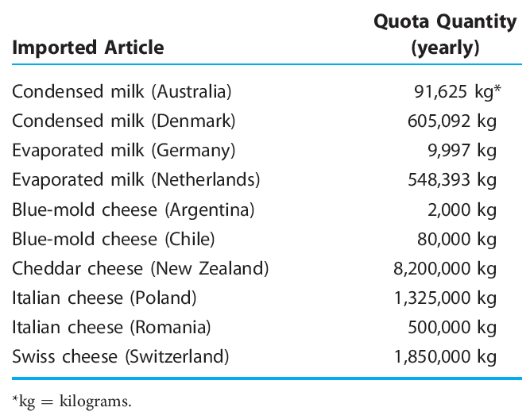
Examples of U.S. import quotas*
TABLE 5.1

Slide 4
Import Quota
Global quota
Permits a specified number of goods to be imported each year
Does not specify from where the product is shipped or who is permitted to import
Plagued by accusations of favoritism
Selective quota
Import quota allocated to specific countries
May lead to a domestic monopoly of production and higher prices

Slide 5
Import Quota
Effects of import quota on economy’s welfare
Price increase
Decrease in consumer surplus
Redistributive effect
Deadweight loss
Protective effect
Consumption effect
Revenue effect
Windfall profit
Quota rent

Slide 6
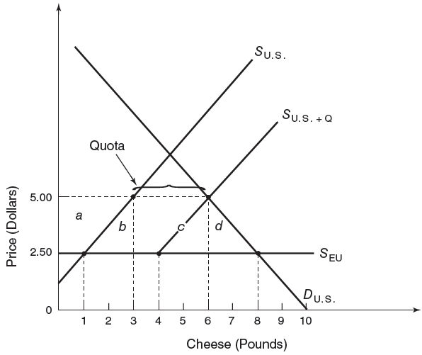
Import quota: trade and welfare effects
FIGURE 5.1
By restricting available supplies of an imported product, a quota leads to higher import prices. This price umbrella allows domestic producers of the import-competing good to raise prices. The result is a decrease in the consumer surplus. Of this amount, the welfare loss to the importing nation consists of the protective effect, the consumption effect, and that portion of the revenue effect that is captured by the foreign exporter.

Slide 7
Import Quota
Allocating quota licenses
Historical share of import market
Oil and dairy products
Discriminates against importers seeking to import goods for the first time
Pro rata basis
U.S. importers receive a fraction of their demand
= Ratio of the import quota to the total quantity demanded collectively by U.S. importers

Slide 8
Import Quota
Allocating quota licenses
Auctioning of import licenses
To the highest bidder in a competitive market
Government - capture the windfall profits
Considered by U.S.

Slide 9
Quotas Versus Tariffs
During periods of growing demand
An import quota restricts the volume of imports
By a greater amount than does an equivalent import tariff
Quota
More restrictive than a tariff
Suppresses competition

Slide 10
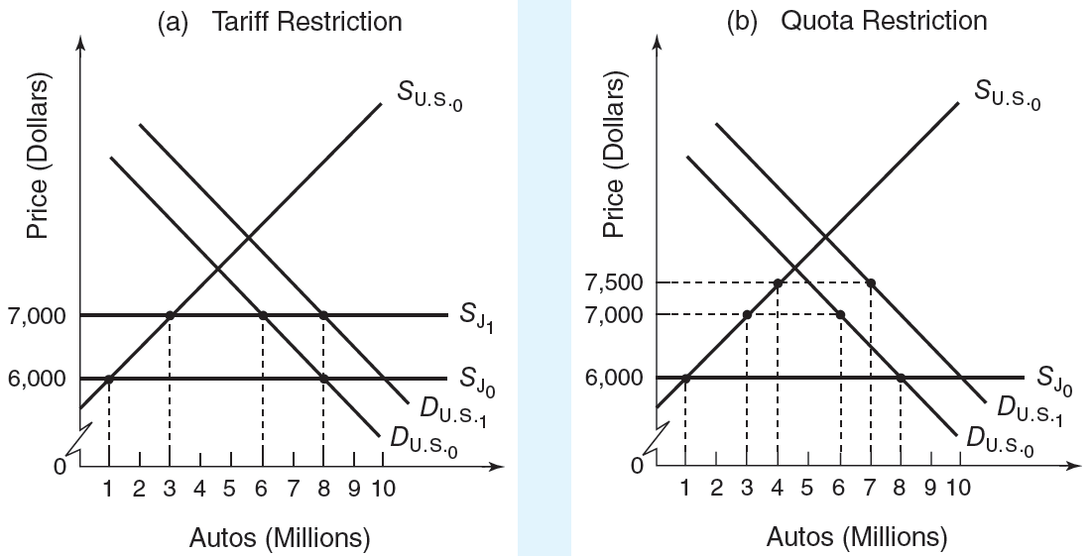
Trade effects of tariffs versus quotas
FIGURE 5.2
In a growing market, an import tariff is a less restrictive trade barrier than an equivalent import quota. With an import tariff, the adjustment that occurs in response to an increase in domestic demand is an increase in the amount of the product that is imported. With an import quota, an increase in demand induces an increase in product price. The price increase leads to a rise in production and a fall in consumption of the import-competing good, while the level of imports remains constant.

Slide 11
Tariff-Rate Quota: A Two-Tier Tariff
Tariff-rate quota
Two-tier tariff
A quota that defines the maximum volume of imports
And charges the within-quota tariff
Any imports above this level face a higher tariff rate
Over-quota tariff

Slide 12
Examples of U.S. tariff-rate quotas
TABLE 5.2
Product | Within-Quota Tariff Rate | Import-Quota Threshold | Over-Quota Tariff Rate
Peanuts Beef Milk Blue cheese Cotton | 9.35 cents/kg 4.4 cents/kg 3.2 cents/L 10 cents/kg 4.4 cents/kg | 30,393 tons 634,621 tons 5.7 million L 2.6 million kg 2.1 million kg | 187.9 percent ad valorem 31.1 percent ad valorem 88.5 cents/L $2.60/kg 36 cents/kg

Slide 13
Tariff-Rate Quota: A Two-Tier Tariff
Administration of tariff-rate quotas
License on demand allocation
If demand exceeds the quota, the import volume requested is reduced proportionally among all applicants
Historical market share
Auctions

Slide 14
Tariff-Rate Quota: A Two-Tier Tariff
U.S. sugar industry
Government subsidies
Price support
Tariff-rate quota
Sugar tariff-rate quota
Raw cane sugar
Allocated on a country-by-country basis among 41 countries
Refined sugar
Allocated in a global first-come, first-serve basis

Slide 15
Tariff-Rate Quota: A Two-Tier Tariff
Sugar tariff-rate quota
Restrict the supply of foreign sugar from entering U.S.
Higher domestic sugar price
2006, U.S. price = 20.94 cents per pound
World price = 10.42 cents per pound
American consumers - spend extra $2 billion a year on sugar

Slide 16
Tariff-Rate Quota: A Two-Tier Tariff
Sugar tariff-rate quota
Concentrated benefits
Enormous revenues for a very small number of domestic growers and refiners
Dispersed costs
Spread across the U.S. economy

Slide 17
Export Quotas
Export quotas
Market sharing pact, voluntary export restraint agreement
To moderate the intensity of international competition
Tend to be more costly than tariffs

Slide 18
Export Quotas
Export quotas
Study: three major U.S. voluntary export restraint agreements of the 1980s
Automobiles, steel, and textiles and apparel
67% of the costs to American consumers - captured by foreign exporters as profit

Slide 19
Domestic Content Requirements
Domestic content requirements
By organized labor
To limit the practice of outsourcing
Minimum percentage of product’s total value
That must be produced domestically
If the product is to qualify for zero tariff rates
Pressure domestic and foreign firms
To use domestic inputs (workers)

Slide 20
Domestic Content Requirements
Domestic content requirements
Higher input prices
Higher product prices
Loss of competitiveness
Subsidizing by domestic consumers of the domestic producer

Slide 21
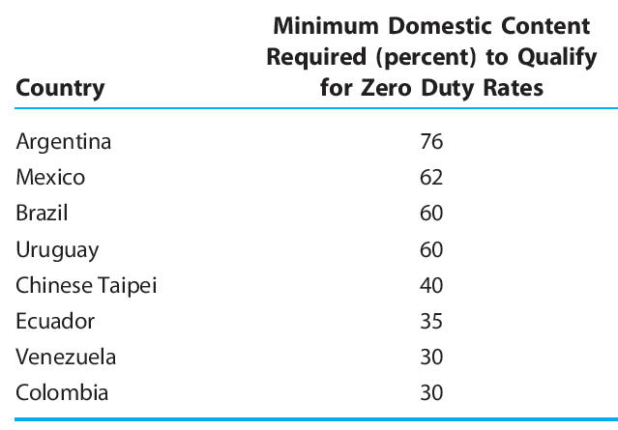
Domestic content requirements applied to automobiles in selected countries
TABLE 5.3

Slide 22
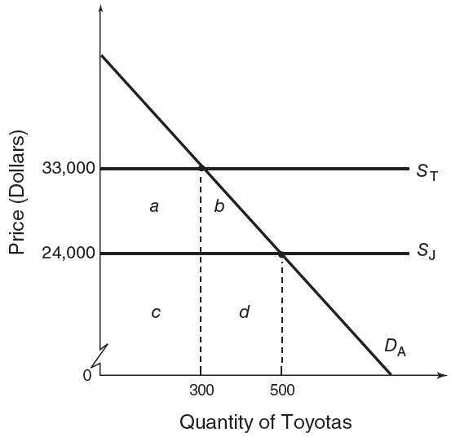
Welfare effects of a domestic content requirement
FIGURE 5.3
A domestic content requirement leads to rising production costs and prices to the extent that manufacturers are “forced” to locate production facilities in a high-cost nation. Although the content requirement helps preserve domestic jobs, it imposes welfare losses on domestic consumers.

Slide 23
Subsidies
Subsidies
Outright cash disbursements, tax concessions, insurance arrangements, and loans at below-market interest rates
From the government for producers
To help improve their market position
Provide domestic firms a cost advantage
Market products at prices lower than warranted by their actual cost or profit considerations

Slide 24
Subsidies
Domestic production subsidy
Granted to producers of import-competing goods
Export subsidy
Granted to producers of goods that are to be sold overseas
Subsidy
Net price received by the producer = price paid by the purchaser + subsidy

Slide 25
Subsidies
Welfare effects of domestic production subsidy
Higher output
Subsidy revenue – some redistributed to the more efficient producers - producer surplus
Deadweight loss
Protective effect
Lower welfare loss than a tariff or a quota
Direct cost of the subsidy
Financed out of tax revenues paid by the public

Slide 26
Subsidies
Welfare effects of export subsidy
Higher output and price
Higher exports; Lower domestic consumption
Domestic producers gain at the expense of the domestic consumer and taxpayer
Decrease in the consumer surplus
Increase in the producer surplus
Taxpayer - bears the cost of export subsidy
Deadweight loss of welfare

Slide 27
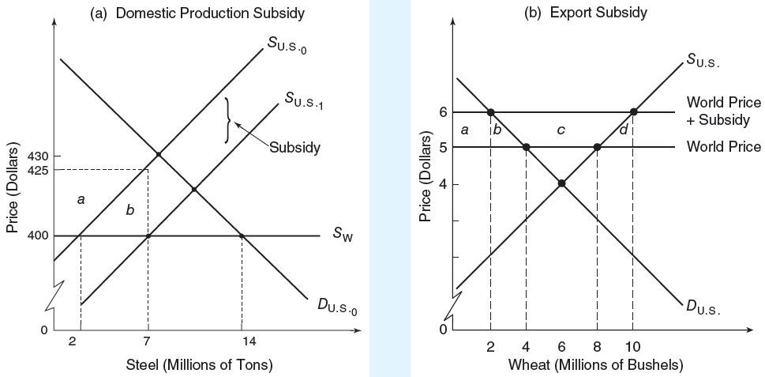
Trade and welfare effects of subsidies
FIGURE 5.4
A government subsidy granted to import-competing producers leads to increased domestic production and reduced imports. The subsidy revenue accruing to the producer is absorbed by producer surplus and high-cost production (protective effect). A subsidy granted to exporters allows them to sell their products abroad at prices below their costs. However, it entails a deadweight welfare loss to the home country in the form of the protective effect and the consumption effect.

Slide 28
How “foreign” is your car?
Buyers of cars and light trucks
Can learn how American or foreign their new vehicle is
Content labels - where the parts of the vehicle were made
Measured by the dollar value of components
Not the labor cost of assembling vehicles

Slide 29
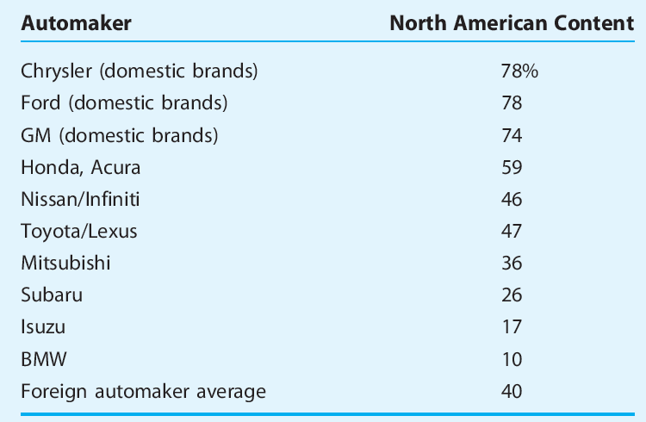
North American content of automobiles sold in the United States, 2007 (sales weighted)
TABLE 5.4

Slide 30
Dumping
Dumping
International price discrimination
Foreign producers charge lower prices than domestic producers for an identical product
After allowing for transportation costs and tariff duties
Selling in foreign markets at a price below the cost of production

Slide 31
Dumping
Sporadic dumping (distress dumping)
A firm disposes of excess inventories on foreign markets
Selling abroad at lower prices than at home
May be the result of misfortune or poor planning
Beneficial to importing consumers
Disruptive to import-competing producers

Slide 32
Dumping
Predatory dumping
A producer temporarily reduces the prices charged abroad to drive foreign competitors out of business
Acquiring a monopoly position
New higher prices – to offset any losses that occurred during the period of cutthroat pricing
Prevent the entry of potential competitors
Home governments - concerned
Retaliate with antidumping duties

Slide 33
Dumping
Persistent dumping
Goes on indefinitely
A producer may consistently sell abroad at lower prices than at home
International price discrimination
Different demand elasticity
Domestic market
Foreign market
Charge different prices - Higher profits

Slide 34
Dumping
Successful international price discrimination
Submarkets’ demand conditions must differ
Ensure different demand elasticities
Firm must be able to separate the two submarkets
Prevent any significant resale of commodities
Markets – easier to separate internationally
High transportation costs
Governmental trade restrictions

Slide 35
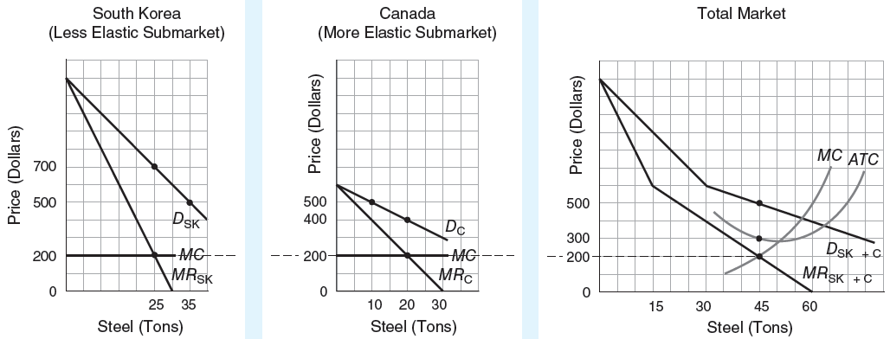
International price discrimination
FIGURE 5.5
A price-discriminating firm maximizes profits by equating marginal revenue, in each submarket, with marginal cost. The firm will charge a higher price in the less-elastic-demand (less competitive) market and a lower price in the more-elastic-demand (more competitive) market. Successful dumping leads to additional revenue and profits for the firm compared to what would be realized in the absence of dumping.

Slide 36
Antidumping Regulations
Antidumping duty
U.S. Department of Commerce
Foreign merchandise is being sold at less than fair value (LTFV)
U.S. International Trade Commission (ITC)
Determines that LTFV imports are causing/threatening material injury
Imposed in addition to the normal tariff

Slide 37
Antidumping Regulations
Margin of dumping
Amount by which the foreign market value exceeds the U.S. price
Foreign market value
Priced-based definition
Dumping occurs whenever a foreign company sells a product in the U.S. market
At a price below that for which the same product sells in the home market

Slide 38
Antidumping Regulations
Foreign market value
Cost-based definition
Cost of manufacturing the merchandise
+ general expenses (at least 10% of cost of manufacturing)
+ profit on home-market sales (at least 8% of manufacturing cost + general expense)
+packaging the merchandise for shipment to U.S.

Slide 39
Antidumping Regulations
Smith Corona, Inc.
Won several antidumping cases from the 1970s to the 1990s
Ferocious competition from Brother Industries Ltd. of Japan
1989, Canadian government
U.S. Delicious apples - dumped on the Canadian market
Injury to 4,500 commercial apple growers

Slide 40
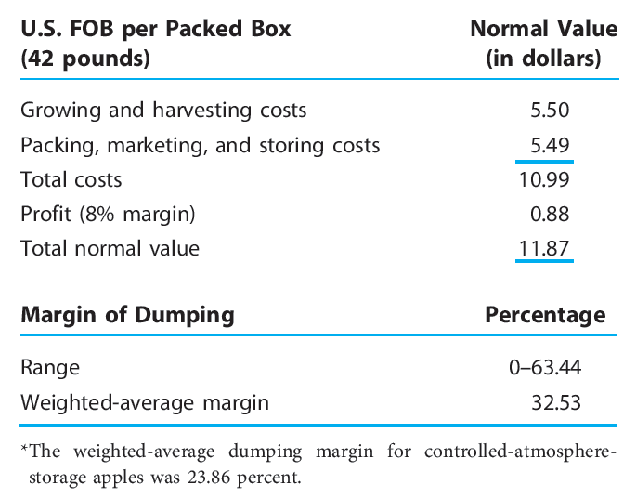
Normal value and the margin of dumping: Delicious apples, regular storage, 1987–1988*
TABLE 5.5

Slide 41
Swimming upstream: the case of Vietnamese catfish
Vietnamese catfish
Comparative advantage
Vietnam’s Mekong Delta and cheap labor
Half-million Vietnamese earn income from the catfish trade
20% of the frozen catfish-fillet market in U.S.
Lower prices

Slide 42
Swimming upstream: the case of Vietnamese catfish
Catfish farmers in Mississippi
Trade war: product labeling, antidumping tariffs
Persuade the U.S. government to close the catfish market to Vietnamese farmers
Out of 2,000 types of catfish, only the American-born family could be called “catfish”
Disinformation campaign - Vietnamese catfish
“slippery catfish wannabe”
“probably not even sporting real whiskers”
“floating around in Third World rivers nibbling on who knows what”

Slide 43
Swimming upstream: the case of Vietnamese catfish
Catfish farmers in Mississippi
Antidumping case against Vietnamese catfish
U.S. Department of Commerce
Did not have strong evidence that the imported fish were being sold in America more cheaply than in Vietnam, or below their cost of production
Declared Vietnam a “nonmarket” economy
Dumping tariffs: 37-64% (permanent)

Slide 44
Swimming upstream: the case of Vietnamese catfish
This nonmarket designation
Should not have been used
Because the U.S. government was encouraging Vietnam to become a market economy

Slide 45
Is Antidumping Law Unfair?
Antidumping laws
Ensure a level playing field by offsetting artificial sources of competitive advantage
Protected industries gain
Consumers of the protected good lose more
Whole economy lose more
Dumping
When a foreign producer sells goods in U.S. at less than fair value

Slide 46
Is Antidumping Law Unfair?
Fair value
Average total cost
+ 8% allowance for profit
Average variable cost
Better measure than average total cost
Firms facing excess production capacity
Incentive to stimulate sales
Cutting prices charged to foreigners
To levels that just cover average variable cost

Slide 47
Dumping and excess capacity
TABLE 5.6

Slide 48
Is Antidumping Law Unfair?
Antidumping law – unfair
Uses average total cost to determine fair value
Under competitive conditions
Firms price their goods at average variable costs,
Punish firms that are simply behaving in a manner typical of competitive markets
U.S. firms selling at home are not subject to the same rules

Slide 49
Is Antidumping Law Unfair?
Antidumping law - does not account for currency fluctuations
Fluctuations in exchange rates can cause prices to “dump” according to the legal definition
American firms are not required to meet the standard imposed on foreign firms selling in the United States

Slide 50
Other Nontariff Trade Barriers
Government procurement policies
Buy-national policies
1933, Buy American Act
Federal agencies
Purchase materials and products from U.S. suppliers
If their prices are not “unreasonably” higher than those of foreign competitors
Domestic product
At least 50% domestic component content
Manufactured in the United States

Slide 51
Other Nontariff Trade Barriers
Government procurement policies
1933, Buy American Act
U.S. suppliers of civilian agencies – preferences over foreign firms
6-12% preference margin
50% preference margin for Department of Defense. These preferences are
Waived if the U.S.-produced good is not available in sufficient quantities or is not of satisfactory quality

Slide 52
Other Nontariff Trade Barriers
Government procurement policies
Barrier to free trade
Higher cost for government projects
Deadweight welfare losses
Protective and consumption effects

Slide 53
U.S. fiscal stimulus and Buy American legislation
$787 billion fiscal stimulus legislation
During the recession of 2007–2009
Federal agencies can waive Buy American preferences
If they inflate the cost of a construction project by more than 25% or are deemed to be against the public interest
Buy American preferences are waived if they violate past trade agreements

Slide 54
U.S. fiscal stimulus and Buy American legislation
$787 billion fiscal stimulus legislation
City and state (municipal) governments in U.S. are not obligated to honor the trade agreements of the federal government
Can enact Buy American

Slide 55
Other Nontariff Trade Barriers
Social regulations
Correct a variety of undesirable side effects markets ignore
Health, safety, and the environment
CAFÉ Standards
Corporate average fuel economy standards
Passenger cars: 27.5 miles per gallon
European Union
Ban on hormone-treated meat

Slide 56
Other Nontariff Trade Barriers
Sea transport and freight regulations
U.S. shipping companies serving Japanese ports
Highly restrictive system of port services
Clear every detail of its visit with Japan’s stevedore-company association
Dockworkers – available 18 hours a day or less
Expensive

Slide 57
Other Nontariff Trade Barriers
Sea transport and freight regulations
Ships docking in U.S. port
U.S. dockworkers
Unload and load 24 hours a day
30% less time
Half the price
Notify port authorities
Notify the Coast Guard

