Slide 1
International Factor Movements and Multinational Enterprises
PowerPoint slides prepared by:
Andreea Chiritescu
Eastern Illinois University

Slide 2
The Multinational Enterprise
Multinational enterprise (MNE)
Operating in many host countries
Research and development (R&D) activities, and
Manufacturing, mining, extraction, and business-service operations
Cross national borders
Directed from a company planning center
Distant from the host country

Slide 3
The Multinational Enterprise
Multinational enterprise (MNE)
Multinational stock ownership
Multinational company management
High ratio of foreign sales to total sales
Vertical diversification
Parent MNE - establish foreign subsidiaries
To produce intermediate goods or inputs that go into the production of a finished good

Slide 4
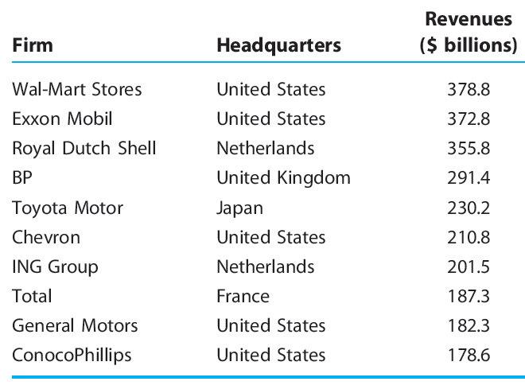
The world’s largest corporations, 2008
TABLE 9.1

Slide 5
The Multinational Enterprise
Horizontal diversification
Parent company producing a commodity in the source country
Sets up a subsidiary to produce an identical product in the host country
Conglomerate diversification
Diversify into nonrelated markets

Slide 6
The Multinational Enterprise
Foreign direct investment
Parent company obtains sufficient common stock in a foreign company to assume voting control
Parent company acquires or constructs new plants and equipment overseas
Parent company shifts funds abroad to finance an expansion of its foreign subsidiary
Earnings of the parent company’s foreign subsidiary are reinvested in plant expansion

Slide 7
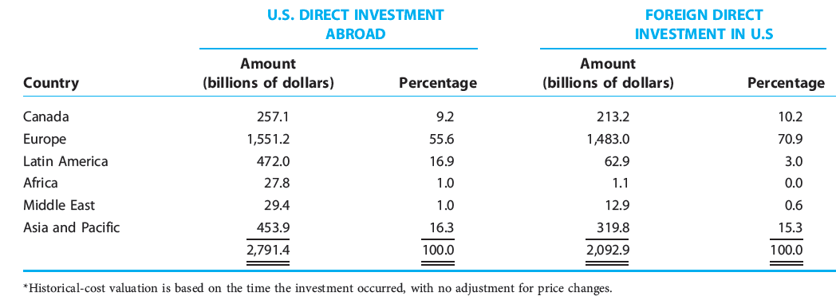
Direct investment position of the United States on an historical cost basis, 2007*
TABLE 9.2

Slide 8
Motives for Foreign Direct Investment
Opening markets to foreign direct investment
Higher rates of private investment
Economic growth and job creation
Generates spillovers
Improved management and better technology
Higher average labor productivity
Higher wages
Stimulates exports of machinery and other capital goods

Slide 9
Motives for Foreign Direct Investment
Foreign direct investment
Conducted in anticipation of future profits
Investment flows from regions of low anticipated profit to those of high anticipated profit
Other factors
Market-demand conditions, trade restrictions,
Investment regulations,
Labor costs, and transportation costs

Slide 10
Motives for Foreign Direct Investment
Demand factors
New markets and sources of demand
Tap foreign markets that cannot be maintained adequately by export products
Parent company - productive capacity already sufficient to meet domestic demands
Market competition

Slide 11
Do U.S. multinationals exploit foreign workers?
Critics
Maximizing profits - only thing that matters to multinationals
Workers in developing countries are underpaid
Workers in developing countries
Compete to work for them
They prefer it to the alternative
The new jobs make them better off
Multinationals - pay a wage premium

Slide 12
Average annual wage paid by foreign affiliates of U.S. multinationals and average annual domestic manufacturing wage by host-country*
TABLE 9.3

Slide 13
Motives for Foreign Direct Investment
Cost factors
Reductions in production costs
Essential raw materials
Labor costs
Transportation costs
Government policies

Slide 14
Supplying Products to Foreign Buyers
Foreign demand exists
Lowest-cost method of supplying goods abroad
Direct exporting
Foreign direct investment
License the rights to a foreign factory to produce and market goods in the foreign market

Slide 15
Supplying Products to Foreign Buyers
Economies of scale
Direct exporting
When the foreign quantity demanded is relatively small
Licensing agreement or foreign direct investment
When the foreign quantity demanded is relatively large

Slide 16
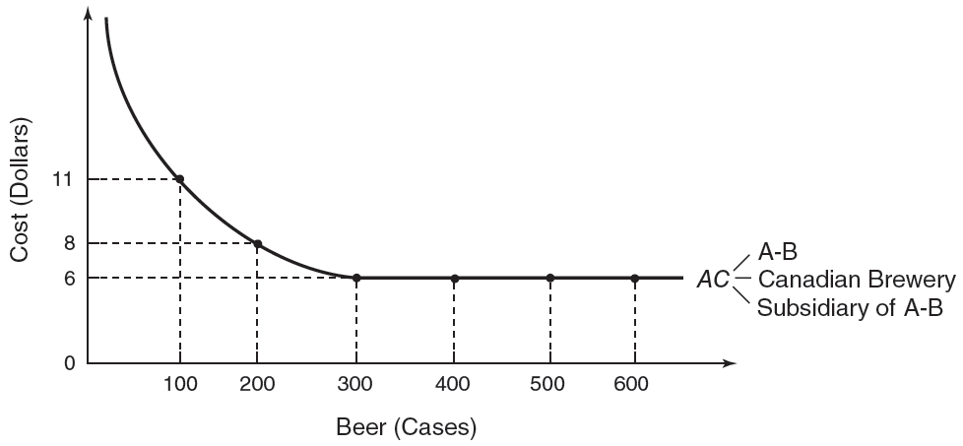
The choice between direct exporting and foreign direct investment/licensing
FIGURE 9.1
When the Canadian market’s size is large enough to permit efficient production in Canada, a U.S. firm increases profits by establishing a Canadian production subsidiary or licensing the rights to a Canadian firm to produce and market its product in Canada. The U.S. firm increases profits by exporting its product to Canada when the Canadian market is too small to permit efficient production

Slide 17
Supplying Products to Foreign Buyers
Foreign direct investment vs. licensing
Licensing
For a relatively small market
Foreign direct investment
For a relatively large market

Slide 18
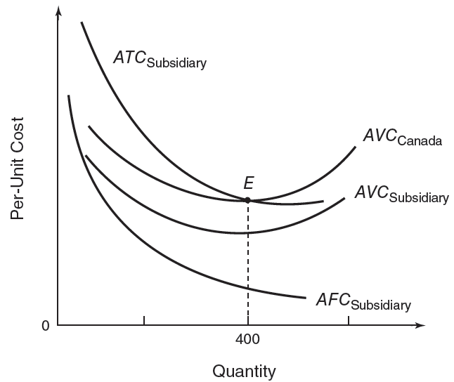
The choice between foreign direct investment and licensing
FIGURE 9.2
The decision to establish foreign operations through direct investment or licensing depends on (1) the extent to which capital is used in the production process, (2) the size of the foreign market, and (3) the amount of fixed cost a business must bear when establishing an overseas facility.

Slide 19
Country Risk Analysis
Political risk analysis
To assess the political stability of a country
Government stability, corruption, domestic conflict, religious tensions, and ethnic tensions
Financial risk analysis
Investigates a country’s ability to finance its debt obligations
Foreign debt as a percentage of GDP, loan default, and exchange rate stability

Slide 20
Country Risk Analysis
Economic risk analysis
Determines a country’s current economic strengths and weaknesses
Rate of growth in GDP, per capita GDP, inflation rate
Composite country risk rating
Overall assessment of the risk of doing business in some country

Slide 21
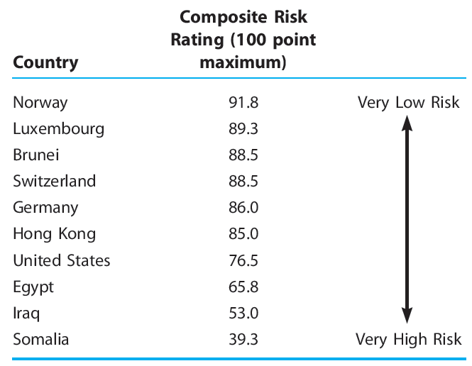
Selected country risks ranked by composite ratings, July 2008
TABLE 9.4

Slide 22
Country Risk Analysis
International Country Risk Guide
Political risk factors - weighting of 50%
Financial and economic risk factors – 25% each
Low risk, 80–100 points
Moderate risk, 50–79 points
High risk, 0–49 points

Slide 23
International Trade Theory and Multinational Enterprise
Conventional trade model
Movement of merchandise among nations
Goods are exchanged between independent organizations
On international markets
At competitively determined prices

Slide 24
International Trade Theory and Multinational Enterprise
Multinational-enterprise analysis
International movement of factor inputs
Aggregate welfare of both the source and host countries is enhanced
Vertically diversified companies
Subsidiaries manufacture intermediate and finished goods
Sales can be intrafirm
Value may be determined by factors other than a competitive pricing system

Slide 25
Japanese Transplants in the U.S. Automobile Industry
Benefits to Japanese automakers
Silence critics who insist that autos sold in the United States must be built there
Avoid the potential import barriers of the U.S.
Gain access to an expanding market
Japanese market is nearing saturation
Provide a hedge against fluctuations in the yen–dollar exchange rate

Slide 26
Japanese auto plants in the United States
TABLE 9.5
Plant Name/Parent Company | Location
Honda of America, Inc. (Honda) Nissan Motor Manufacturing Corp. (Nissan) New United Motor Manufacturing, Inc. (Toyota/General Motors) Toyota Motor Manufacturing, USA, Inc. (Toyota) Mazda Motor Manufacturing, USA, Inc. (Mazda) Ford Motor Co. (Nissan/Ford) | Marysville, Ohio East Liberty, Ohio Smyrna, Tennessee Fremont, California Georgetown, Kentucky Flat Rock, Michigan Avon Lake, Ohio

Slide 27
Japanese Transplants in the U.S. Automobile Industry
Growth of Japanese investment
Fosters improvement in the overall competitive position of the domestic auto-assembly and parts industries
Generates jobs
Provides consumers with a wider product choice at lower prices
United Auto Workers (UAW) union
Job losses in the auto-assembly and parts-supplier industries

Slide 28
Japanese Transplants in the U.S. Automobile Industry
Japanese-affiliated auto companies
Fewer job classifications
3-4 job classifications: one team leader, one production technician, and one or two maintenance technicians
Work teams
Each team member is trained to do all the operations performed by the team
Jobs are rotated among team members
Superior labor productivity

Slide 29
Japanese Transplants in the U.S. Automobile Industry
Traditional U.S. auto plants
More than 90 different job classifications
Employees perform only those operations specifically permitted for their classification
The U.S. Big Three
GM, Ford, and Chrysler
Lower labor productivity

Slide 30
International Joint Ventures
Joint venture
Business organization established by two or more companies
Combines their skills and assets
Limited objective (research or production)
Short lived
Multinational in character
Several domestic and foreign companies
Creation of a new business firm

Slide 31
Joint ventures between U.S. and foreign companies
TABLE 9.6

Slide 32
International Joint Ventures
Types of international joint ventures
Joint venture by two businesses that conduct business in a third country
Joint venture with local private interests
Joint venture with participation by local government

Slide 33
International Joint Ventures
Justifications for joint ventures
Some functions can involve costs too large for any one company to absorb by itself
Restrictions some governments place on the foreign ownership of local businesses
Prevent excessive political influence
Help minimize dividend transfers abroad
Strengthen the nation’s balance of payments
Forestalling protectionism against imports

Slide 34
International Joint Ventures
Disadvantages of joint ventures
Cumbersome organization
Divided control
Different objectives, corporate cultures, and ways of doing things
Deadlocks in decision making
Negotiation must establish a hierarchical command

Slide 35
International Joint Ventures
Joint ventures lead to welfare gains
Productivity gains
Increased productive capacity and additional competition
Enter new markets that neither parent could have entered individually
Cost reductions that would have been unavailable if each parent performed the same function separately

Slide 36
International Joint Ventures
Joint venture lead to welfare losses
Market-power effect
Increased market power
Greater ability to influence market output and price

Slide 37
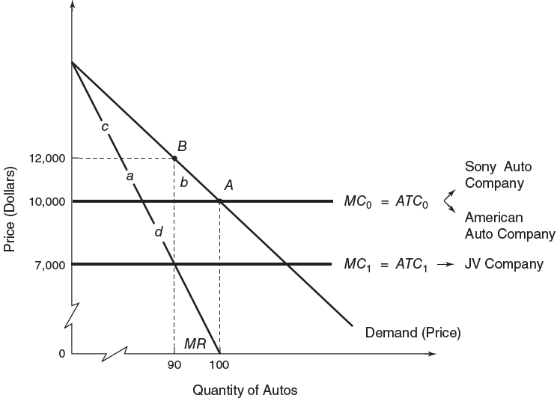
Welfare effects of an international joint venture
FIGURE 9.3
An international joint venture can yield a welfare-decreasing market-power effect and a welfare-increasing cost-reduction effect. The source of the cost-reduction effect may be lower resource prices or improvements in technology and productivity. The joint venture leads to improvements in national welfare if its cost-reduction effect is due to improvements in technology and productivity and if it more than offsets the market-power effect.

Slide 38
Multinational Enterprises as a Source of Conflict
Effects on employment
Recipient country
Employment increase
Source country
Employment decline, in the short term
Other industries - foreign sales rising over time

Slide 39
Multinational Enterprises as a Source of Conflict
Technology transfer
Demonstration effect
Competition effect
Increase the productivity and competitiveness of recipient nations
Donor nations may react against it because it is detrimental their economic base
General Electric: trade-off for entry into the Chinese market
Short-term sales for long-term competition

Slide 40
Multinational Enterprises as a Source of Conflict
National sovereignty
Effect on the economic and political policies
Host and source governments
Balance of payments
Account of the value of goods and services, capital movements, and other items
That flow into or out of a country
Positive contribution
Exports of goods and services
Capital inflows

Slide 41
Multinational Enterprises as a Source of Conflict
Balance of payments
U.S. foreign direct investments
Outflow of capital
Negative factor on the U.S. payments position
Short term
Positive effects on trade flows and earnings
Long term
Transfer pricing
The pricing of goods within an MNE
May be unrelated to costs incurred or to operations carried out

Slide 42
Does the U.S. tax code send American jobs offshore?
Tax concessions on foreign direct investment
Disincentive to invest at home
Unions: shipping of American jobs overseas
Foreign tax credits
MNEs headquartered in the United States should not be subject to double taxation

Slide 43
Does the U.S. tax code send American jobs offshore?
Tax concessions on foreign direct investment
Tax deferrals
Parent organization can defer U.S. taxes paid on the income of its foreign subsidiary
As long as that income is retained overseas
Interest-free loan extended by the U.S. government to the parent

Slide 44
International Labor Mobility: Migration
United States
Favorite target for international migration
Melting pot of the world
Western Europe:
Germany, Italy, and the United Kingdom
Mexican immigrants
Asian immigrants
Migrants - motivated by
Better economic opportunities
Noneconomic factors: politics, war, and religion

Slide 45
International Labor Mobility: Migration
International labor movements
Enhance the world economy’s efficiency
Restricted by government controls
Immigration Act of 1924
Restricting the overall flow of immigrants
Quota - limited the number of immigrants from each foreign country

Slide 46
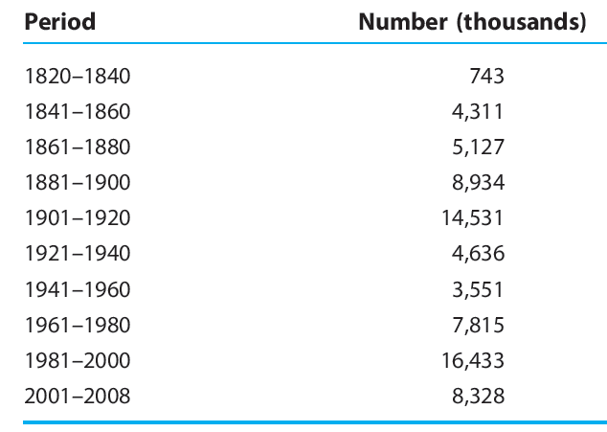
U.S. immigration, 1820–2008
TABLE 9.7

Slide 47
International Labor Mobility: Migration
Mexican workers immigrate to the U.S.
Workers migrate from uses of lower productivity to higher productivity
World output expands
Mexican labor supply decreases
Wages increase
U.S. labor supply increases - Wages decrease
Hurts native U.S. workers
Helps Mexican workers

Slide 48
International Labor Mobility: Migration
Mexican workers immigrate to the U.S.
Helps U.S. owners of capital
Hurts Mexican owners of capital
Increase overall world income
Redistribute income from labor to capital in the United States
Redistribute income from capital to labor in Mexico

Slide 49
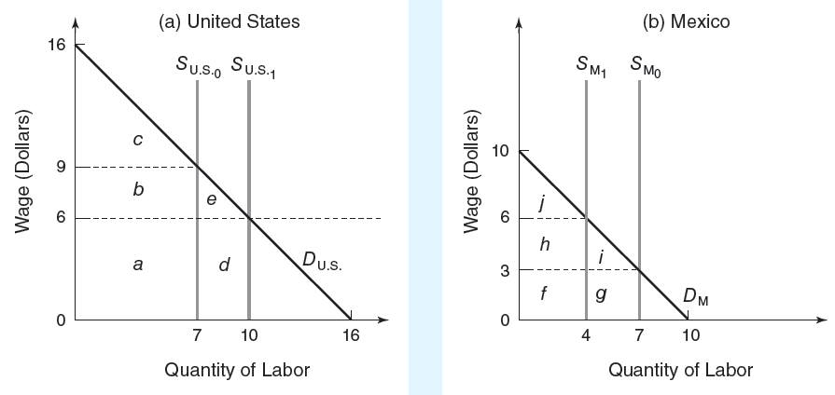
The effects of labor migration from Mexico to the United States
FIGURE 9.4
Prior to migration, the wage rate in the United States exceeds that of Mexico. Responding to the wage differential, Mexican workers immigrate to the United States; this leads to a reduction in the Mexican labor supply and an increase in the U.S. labor supply. Wage rates continue to rise in Mexico and fall in the United States until they eventually are equalized. The labor migration hurts native U.S. workers but helps U.S. owners of capital; the opposite occurs in Mexico. Because migrant workers flow from uses of lower productivity to higher productivity, world output expands.

Slide 50
International Labor Mobility: Migration
Immigration as an issue
Domestic labor groups prefer restrictions on immigration
Domestic manufacturers favor unrestricted immigration as a source of cheap labor
Drain on government resources
Long-term calculations: immigrants make a net positive contribution to public coffers

Slide 51
International Labor Mobility: Migration
Immigration as an issue
Developing nations fear the brain drain
Emigration of highly educated and skilled people from developing nations to industrial nations
Limiting the growth potential of the developing nations
Guest workers
Temporary migration
Illegal migration

Slide 52
International Labor Mobility: Migration
Immigrants
Diversify an economy
Contribute to economic growth
Lower prices for consumers
Domestically produce a wider variety of goods
Increase the supply of labor in the economy
Similar skills – lower wage
Complementing skills – higher wage
Human capital formation costs – native country
Contribution to social security

Slide 53
Does U.S. immigration policy harm domestic workers?
Unions - more restrictive immigration policy
Immigration lowers the wage and employment levels for domestic residents
Quota Law of 1921
Set quotas on the number of immigrants based on the country of origin

Slide 54
Does U.S. immigration policy harm domestic workers?
Immigration and Nationality Act Amendments of 1965
Eliminated the country-specific quota system
Established a limit on the maximum number of immigrants allowed into the United States.
Preferential treatment
Family reunification
Possessors of exceptional skills
Political refugees – no limit

Slide 55
Does U.S. immigration policy harm domestic workers?
Immigration Reform and Control Act of 1986
Addresses the issue of illegal immigration
Substantial fines on employers that hire illegal immigrants
Illegal Immigration Reform and Immigrant Responsibility Act of 1996
Several new restrictions to immigration
Stricter records by the Immigration and Naturalization Service

Slide 56
International Labor Mobility: Migration
National Bureau of Economic Research
Wage effect of immigration
Mainly of Mexican origin
During 1980–2000
Short term
Immigration lowered the average wage of competing U.S. workers by 3%

Slide 57
International Labor Mobility: Migration
National Bureau of Economic Research
Long term
Wages depend on the supply of capital and labor
Wage of the average competing worker was not affected by immigration in the long term
Wage of high school dropouts still decreased by 5%
Immigration had only a small negative effect on the pay of America’s least skilled workers

Slide 58
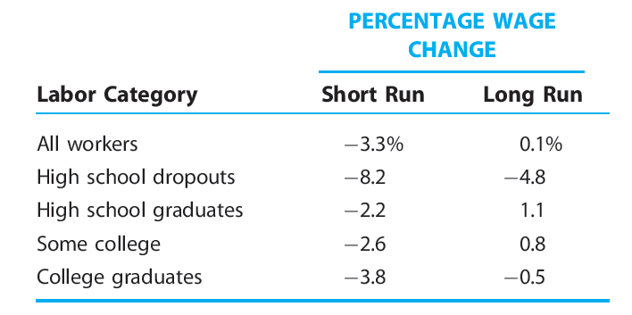
Labor markets work: percentage wage change due to 1980–2000 immigration influx (in percent)
TABLE 9.8

