Slide 1
The Balance of Payments
PowerPoint slides prepared by:
Andreea Chiritescu
Eastern Illinois University

Slide 2
Double-Entry Accounting
Balance of payments
Record of the economic transactions
Between the residents of one country and the rest of the world
Double-entry accounting system
International transaction
Exchange of goods, services, or assets
Between residents of one country and those of another

Slide 3
Double-Entry Accounting
Residents
Businesses, individuals, and government agencies
That make the country in question their legal domicile
Credit transaction (+)
Receipt of a payment from foreigners
Debit transaction (-)
Payment to foreigners

Slide 4
Double-Entry Accounting
U.S. credit transaction (+)
Merchandise exports
Transportation and travel receipts
Income received from investments abroad
Gifts received from foreign residents
Aid received from foreign governments
Investments in the United States by overseas residents

Slide 5
Double-Entry Accounting
U.S. debit transaction (-)
Merchandise imports
Transportation and travel expenditures
Income paid on the investments of foreigners
Gifts to foreign residents
Aid given by the U.S. government
Overseas investment by U.S. residents

Slide 6
Double-Entry Accounting
Total balance-of-payments account
Must always be in balance
Surplus
Balance on a subaccount (subaccounts) is positive
Deficit
Balance on a subaccount (subaccounts) is negative

Slide 7
International payments process
In theory
Importers in a country pay the exporters in that same country in the national currency
In reality
Importers and exporters in a given country do not deal directly with one another
To facilitate payments, banks carry out these transactions

Slide 8
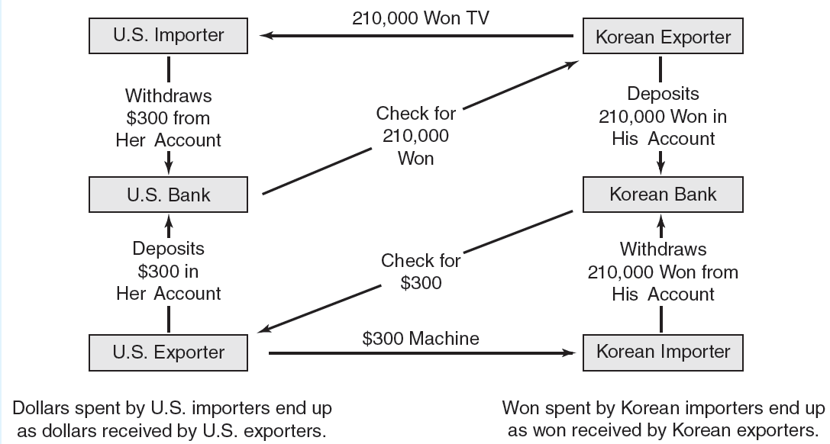
International payments process
FIGURE 10.1

Slide 9
Balance-of-Payments Structure
Current account of the balance of payments
Monetary value of international flows:
Transactions in goods, services, income flows, and unilateral transfers
Merchandise trade
All of the goods the United States exports or imports
Agricultural products, machinery, autos, petroleum, electronics, textiles

Slide 10
Balance-of-Payments Structure
Merchandise trade balance
Credit (+): the dollar value of merchandise exports
Debit (-): the dollar value of merchandise imports
If negative: merchandise trade deficit
If positive: merchandise trade surplus

Slide 11
Balance-of-Payments Structure
Services
All the services the U.S. exports or imports
Goods and services balance
Services and merchandise trade account
If positive:
Surplus of goods and services transactions
If negative:
Deficit of goods and services transactions

Slide 12
Balance-of-Payments Structure
Goods and services balance
Net export of goods and services
Positive:
Excess exports over imports
Add to GDP
Negative:
Excess imports over exports
Subtracted from GDP

Slide 13
Balance-of-Payments Structure
Income receipts and payments
Net earnings (dividends and interest) on U.S. investments abroad
Earnings on U.S. investments abroad
Minus payments on foreign assets in the U.S.
Compensation to employees

Slide 14
Balance-of-Payments Structure
Unilateral transfers
Transfers of goods and services (gifts in kind) or financial assets (money gifts)
Between the U.S. and the rest of the world
Private transfer payments
Governmental transfers
Current account balance
Balance on goods and services
Investment income
Unilateral transfers

Slide 15
Balance-of-Payments Structure
Capital and financial account
Capital and financial transactions in the balance of payments
All international purchases or sales of assets
Private-sector and official transactions
Private-sector financial transactions
Direct investment
Securities
Bank claims and liabilities

Slide 16
Balance-of-Payments Structure
Balance-of-payments statement
Credit (+): capital and financial inflows
Leads to the home country’s receiving payments from foreigners
Export of goods and services
Debit (-): capital and financial outflows
Leads to foreigners’ receiving payments
Import of goods and services

Slide 17
Balance-of-Payments Structure
Official settlements transactions
Movement of financial assets among official holders
Official reserve assets
Liabilities to foreign official agencies
Statistical discrepancy
Errors and omissions
Information – some is collected, some is estimated

Slide 18
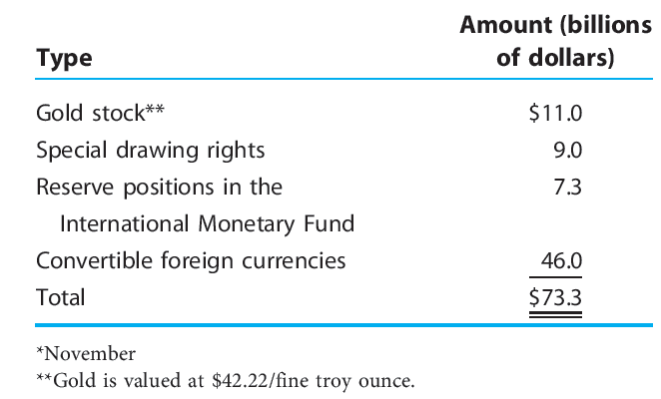
U.S. reserve assets, 2008*
TABLE 10.1

Slide 19
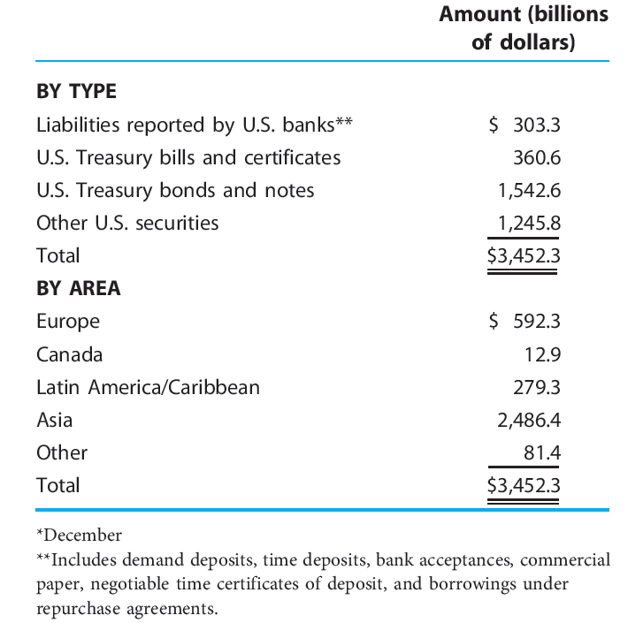
Selected U.S. liabilities to foreign official institutions, 2008*
TABLE 10.2

Slide 20
U.S. Balance of Payments
2008, U.S. - merchandise trade deficit
Exports < Imports
Not popular - adverse consequences on
Terms of trade
Employment levels
Stability of the international money markets

Slide 21
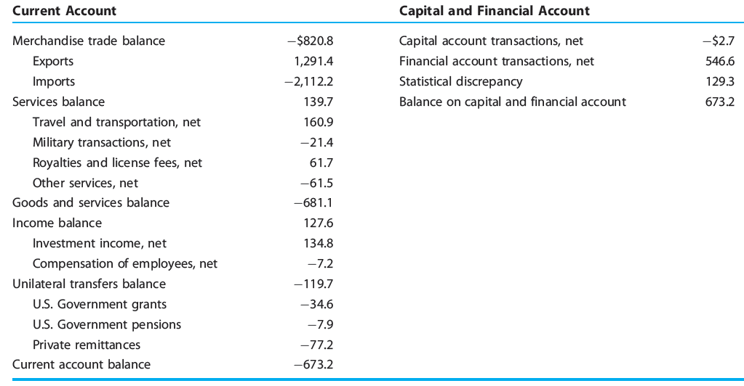
U.S. balance of payments, 2008 (billions of dollars)*
TABLE 10.3

Slide 22
U.S. Balance of Payments
2008, U.S. – goods and services balance
Surplus on service transactions
Merchandise trade deficit
Overall: deficit
2008, U.S. – current account deficit
Excess of imports over exports
Goods, services, income flows, and unilateral transfers

Slide 23
U.S. balance of payments, 1980–2008 (billions of dollars)
TABLE 10.4

Slide 24
The paradox of capital flows from developing to industrial countries
Sources of the net capital flow out of the developing economies
China, Japan, Russia
OPEC
Divergent patterns of growth and investment
Structural differences
Between developing and industrial economies

Slide 25
The paradox of capital flows from developing to industrial countries
Current account deficits in the industrial countries
Increases in both public and private consumption
Declines in national savings rates

Slide 26
What Does a Current Account Deficit (Surplus) Mean?
Balance of payments
Double-entry accounting system
Total debits = Total credits
If the current account registers a deficit
The capital and financial account must register a surplus
If the current account registers a surplus
The capital and financial account must register a deficit

Slide 27
What Does a Current Account Deficit (Surplus) Mean?
Current account balance
Net foreign investment in national income accounting
Current account surplus
Excess of exports over imports
Goods, services, investment income, unilateral transfers
Net receipt of financial claims
Improved net foreign investment position
Capital outflows
Net supplier of funds (lender)

Slide 28
What Does a Current Account Deficit (Surplus) Mean?
Current account deficit
Excess of imports over exports
Goods, services, investment income, unilateral transfers
Increase in net foreign claims upon the home nation
Foreign capital inflows
Net demander of funds from abroad
Worsening of the home nation’s net foreign investment position

Slide 29
What Does a Current Account Deficit (Surplus) Mean?
Net borrowing of an economy
Net borrowing by government
Budget deficit: excess of outlays (G) over taxes (T)
Private-sector net borrowing
Excess of private investment (I) over private saving (S)

Slide 30
What Does a Current Account Deficit (Surplus) Mean?
Capital flows
Are financing the current account deficit
Current account deficit
Driven by capital flows
Capital inflows keep the dollar stronger than it otherwise would be
Boost imports
Suppress exports

Slide 31
What Does a Current Account Deficit (Surplus) Mean?
Current account deficit
Not efficiently reversed by trade policies that attempt to alter the levels of imports or exports
Tariffs
Quotas
Subsidies

Slide 32
What Does a Current Account Deficit (Surplus) Mean?
Business cycle
Rapid growth of production and employment
Associated with large or growing trade and current account deficits
Slow output and employment growth
Associated with large or growing surpluses

Slide 33
Economic downturn of 2007–2009: effect on foreign investment in U.S.
Large capital inflows into the U.S.
Many benefits for Americans
Global economic downturn of 2007–2009
Decrease in the supply of credit that net-saver countries provide to the rest of the world?
Increase of the cost of foreign savings to the United States?

Slide 34
What Does a Current Account Deficit (Surplus) Mean?
U.S. current account deficit
Financed by
Borrowing from foreigners
Selling assets to foreigners
Large net debtor
Paradox in U.S. international transactions
U.S. residents have consistently earned more income from their foreign investments
Than foreigners earn from their larger U.S. investments

Slide 35
What Does a Current Account Deficit (Surplus) Mean?
U.S. current account deficit
Might be less burdensome than often portrayed
Not a threat to total employment for the economy as a whole
Deficit = net inflow of foreign investment
Change the composition of output and employment

Slide 36
What Does a Current Account Deficit (Surplus) Mean?
U.S. current account deficit
Arises mainly because foreigners desire to purchase American assets,
May continue indefinitely
No automatic forces will cause either a current account deficit or a current account surplus
Problem
If foreigners lose confidence in the ability of the U.S. to generate the resources necessary to repay the funds borrowed from abroad

Slide 37
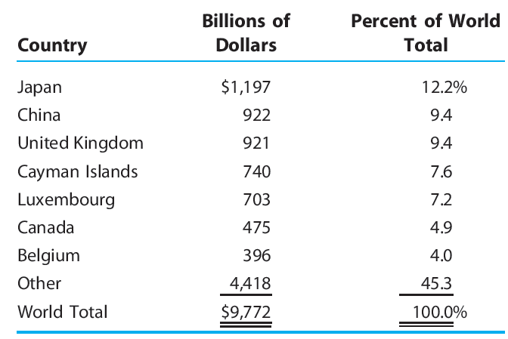
Foreign holders of U.S. securities as of 2007
TABLE 10.5

Slide 38
What Does a Current Account Deficit (Surplus) Mean?
To reduce the deficit
Policies that stimulate foreign growth
Better to reduce the current account deficit through faster growth abroad than through slower growth at home
Better achieved through increased national saving
Than through reduced domestic investment

Slide 39
Balance of International Indebtedness
Balance of international indebtedness
A fixed stock of assets and liabilities against the rest of the world
Record of the international position of the U.S. at a particular time
Accumulated value of U.S.-owned assets abroad

Slide 40
Balance of International Indebtedness
Net creditor to the rest of the world
Accumulated value of U.S.-owned assets abroad
Exceeds the value of foreign-owned assets in the U.S.
Net debtor
Value of foreign-owned assets in the U.S.
Exceeds the accumulated value of U.S.-owned assets abroad

Slide 41
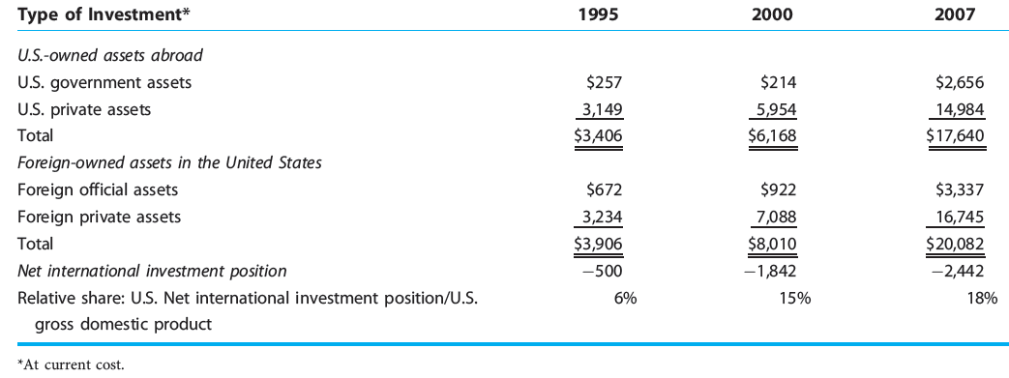
International investment position of the U.S. at year-end (in billions of dollars)
TABLE 10.6

Slide 42
Balance of International Indebtedness
Balance of international indebtedness
Breaks down international investment holdings into several categories
Policy implications can be drawn from each separate category about the liquidity status of the nation
U.S. transition from net creditor to net debtor
Foreign investors placed more funds in the U.S. than U.S. residents invested abroad

