Slide 1
Exchange-Rate Determination
PowerPoint slides prepared by:
Andreea Chiritescu
Eastern Illinois University

Slide 2
What Determines Exchange Rates?
Factors that cause the supply and demand schedules of currencies to change
Market fundamentals (economic variables)
Productivity, inflation rates, real interest rates, consumer preferences, and government trade policy
Market expectations
News about future market fundamentals
Traders’ opinions about future exchange rates

Slide 3
What Determines Exchange Rates?
Factors affecting exchange rates
Short term: transfers of assets
Differences in real interest rates and to the shifting expectations of future exchange rates
Interim: cyclical factors
Fluctuations in economic activity
Long term: flows of goods, services, and investment capital
Inflation rates, investment profitability, consumer tastes, productivity, and government trade policy

Slide 4
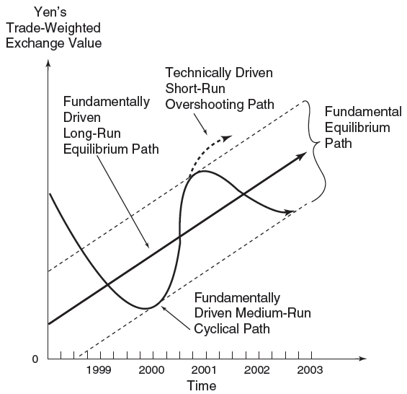
The path of the Yen’s exchange rate
FIGURE 12.1
This figure views the exchange value of a nation’s currency as being determined by long-term structural, interim cyclical, and short-term speculative forces.

Slide 5
Determining Long-Term Exchange Rates
Exchange rate changes
Reactions of traders in the foreign-exchange market to changes in
Relative price levels
Relative productivity levels
Consumer preferences for domestic or foreign goods
Trade barriers

Slide 6
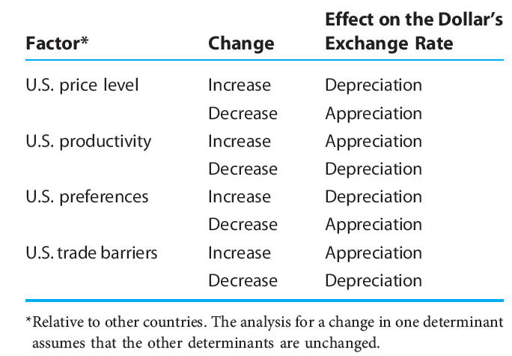
Determinants of the dollar’s exchange rate in the long term
TABLE 12.1

Slide 7
Determining Long-Term Exchange Rates
Increase in the U.S. price level relative to price levels in other countries
Increase in the demand for foreign currency
Decrease in the supply of foreign currency
Depreciation of the dollar

Slide 8
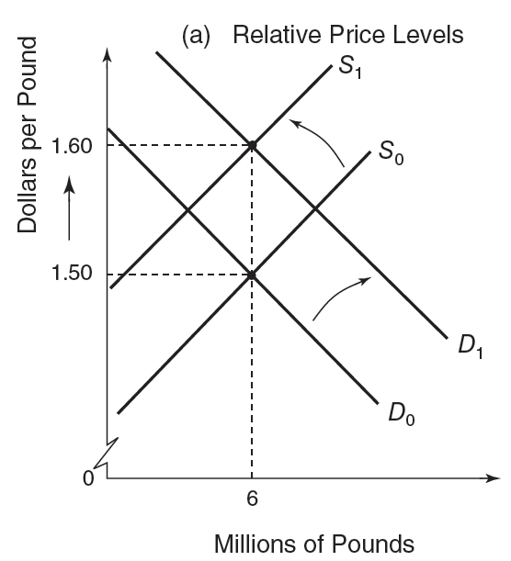
Market fundamentals that affect the dollar’s exchange rate in the long term (a)
FIGURE 12.2
In the long term, the exchange rate between the dollar and the pound reflects relative price levels, relative productivity levels, preferences for domestic or foreign goods, and trade barriers.

Slide 9
Determining Long-Term Exchange Rates
U.S. productivity growth is faster than that of other countries
Increase in the supply of foreign currency
Decrease in the demand for foreign currency
Appreciation of the dollar

Slide 10
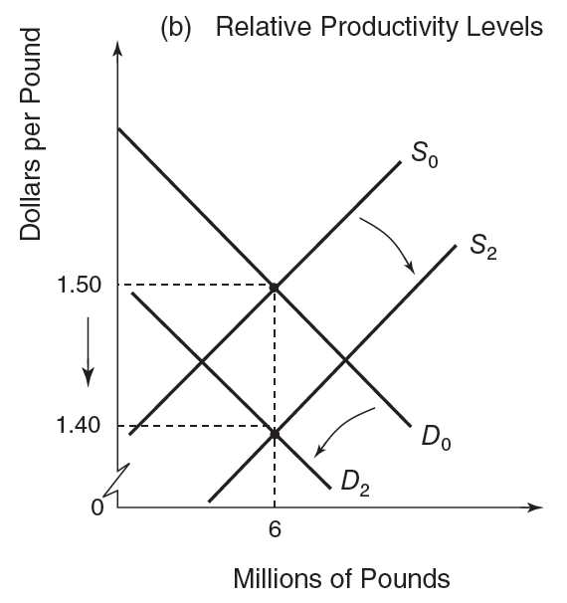
Market fundamentals that affect the dollar’s exchange rate in the long term (b)
FIGURE 12.2
In the long term, the exchange rate between the dollar and the pound reflects relative price levels, relative productivity levels, preferences for domestic or foreign goods, and trade barriers.

Slide 11
Determining Long-Term Exchange Rates
An increased demand for U.S. exports
Appreciation of the dollar
An increased demand for U.S. imports
Depreciation of the dollar
U.S. imposes trade barriers
Appreciation of the dollar

Slide 12
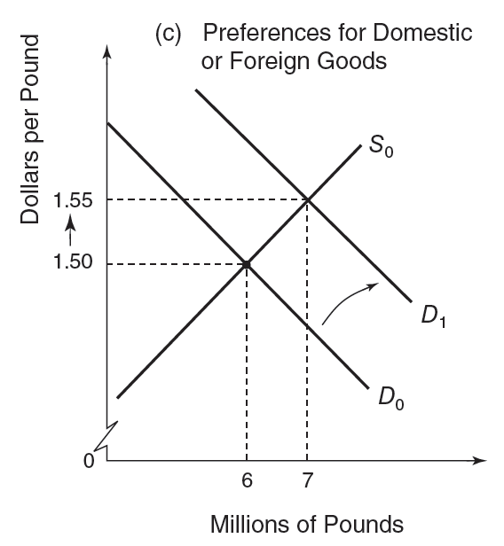
Market fundamentals that affect the dollar’s exchange rate in the long term (c)
FIGURE 12.2
In the long term, the exchange rate between the dollar and the pound reflects relative price levels, relative productivity levels, preferences for domestic or foreign goods, and trade barriers.

Slide 13
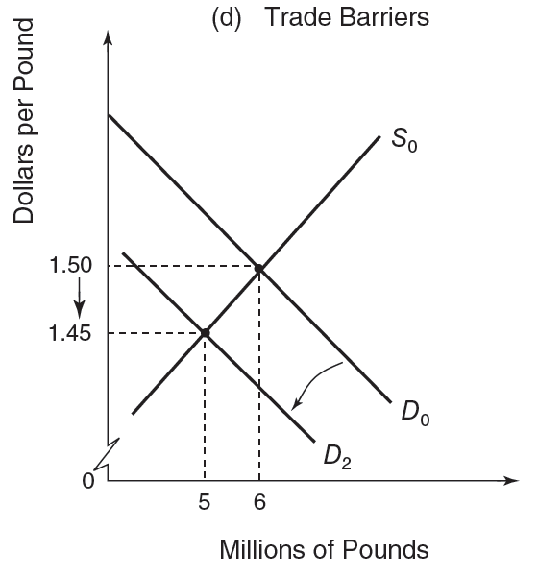
Market fundamentals that affect the dollar’s exchange rate in the long term (d)
FIGURE 12.2
In the long term, the exchange rate between the dollar and the pound reflects relative price levels, relative productivity levels, preferences for domestic or foreign goods, and trade barriers.

Slide 14
Inflation Rates, Purchasing Power Parity, and Long-Term Exchange Rates
Law of one price
Identical goods should be sold everywhere at the same price
When converted to a common currency
Assuming that it is costless to ship the good between nations, there are no barriers to trade, and markets are competitive
Prevailing market-exchange rate is the true equilibrium rate

Slide 15
Inflation Rates, Purchasing Power Parity, and Long-Term Exchange Rates
The Big Mac Index
An attempt to measure the true equilibrium value of a currency based on one product, a Big Mac
Can be used to determine the extent to which the market exchange rate differs from the true equilibrium exchange rate

Slide 16
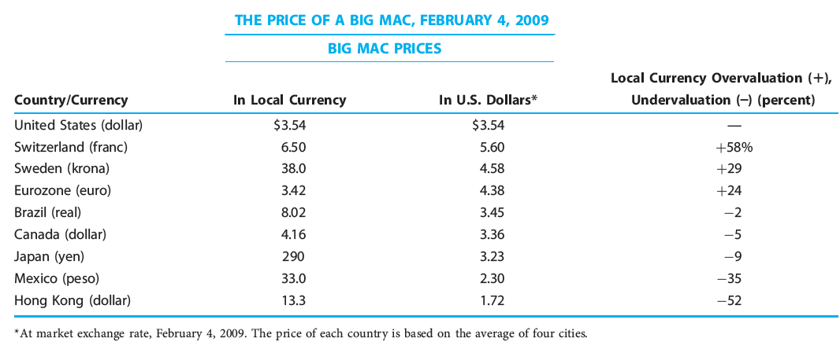
Big Mac Index
TABLE 12.2

Slide 17
Inflation Rates, Purchasing Power Parity, and Long-Term Exchange Rates
Purchasing-power-parity theory
Exchange rates adjust to make goods and services cost the same everywhere
An application of the law of one price
If the rate of inflation is much higher in one country
Its money has lost purchasing power over domestic goods
Currency depreciation to restore parity with prices of goods abroad

Slide 18
Inflation Rates, Purchasing Power Parity, and Long-Term Exchange Rates
Purchasing-power-parity theory
Trade flows = mechanism that makes a currency depreciate or appreciate
Changes in relative national price levels
Determine changes in exchange rates over the long term
Foreign-exchange value of a currency tends to appreciate or depreciate
At a rate equal to the difference between foreign and domestic inflation

Slide 19
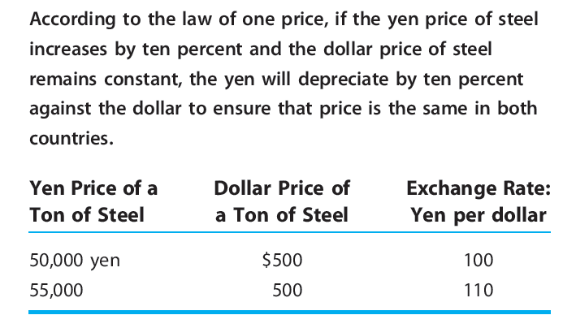
The law of one price applied to a single product, steel
TABLE 12.3

Slide 20
Inflation Rates, Purchasing Power Parity, and Long-Term Exchange Rates
Purchasing-power-parity theory
Used to predict long-term exchange rates
P - price indexes of the U.S. and Switzerland
0 - the base period
1 - period 1
S₀ - equilibrium exchange rate in the base period
S₁ - estimated target at which the actual rate should be in the future

Slide 21
Inflation Rates, Purchasing Power Parity, and Long-Term Exchange Rates
Purchasing-power-parity theory
Overlooks: exchange-rate movements may be influenced by investment flows
Problems
Choosing the appropriate price index to be used in price calculations
Determining equilibrium period to use as a base
Government policy may interfere with the operation of the theory
Trade restrictions

Slide 22
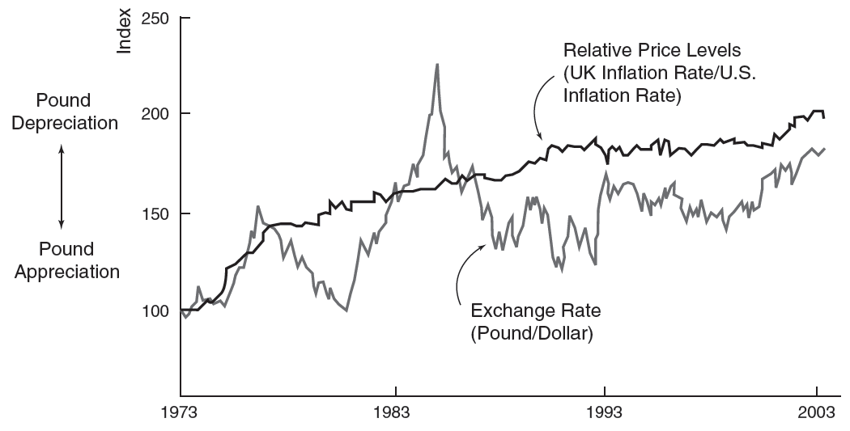
Purchasing power parity: United States - United Kingdom, 1973–2003
FIGURE 12.3
This figure suggests that the predictive power of the purchasing-power-parity theory is most evident in the long term. In the short term, the theory has negligible predictive power.

Slide 23
Determining Short-Term Exchange Rates: The Asset-Market Approach
Foreign-exchange market activity
Dominated by investors in assets
Treasury securities, corporate bonds, bank accounts, stocks, and real property
Asset-market approach
Investors deciding between domestic and foreign investments
Relative levels of interest rates
Expected changes in the exchange rate itself over the term of the investment

Slide 24
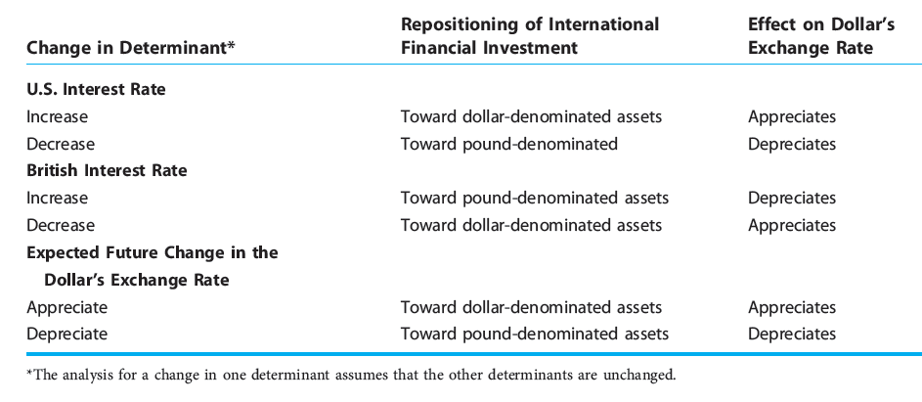
Determinants of the dollar’s exchange rate against the pound in the short term
TABLE 12.4

Slide 25
Inflation differentials and the exchange rate
Purchasing-power-parity theory
Changes in relative national price levels
Determine changes in exchange rates, long term
A currency is expected to depreciate
By an amount equal to the excess of domestic inflation over foreign inflation
A currency is expected to appreciate
By an amount equal to the excess of foreign inflation over domestic inflation

Slide 26
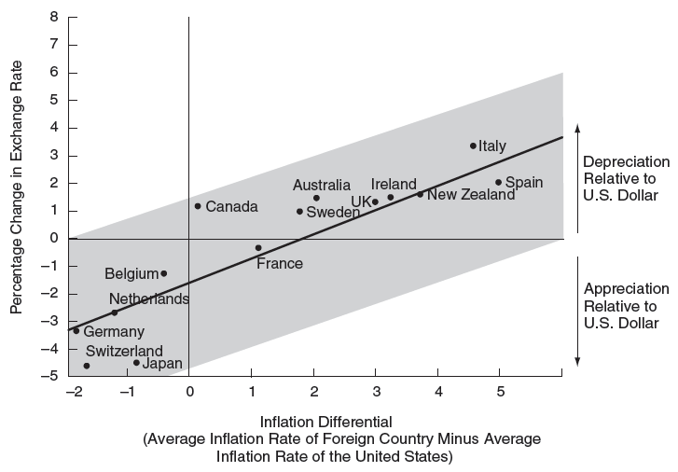
Inflation differentials and the dollar’s exchange value
FIGURE 12.4

Slide 27
Determining Short-Term Exchange Rates: The Asset-Market Approach
Level of the nominal (money) interest rate
A first approximation of the rate of return on assets that can be earned in a particular country
Differences in the level of nominal interest rates between economies
Likely to affect international investment flows
Investors seek the highest rate of return

Slide 28
Determining Short-Term Exchange Rates: The Asset-Market Approach
If interest rates in U.S. > interest rates abroad
Increase in the demand for dollars
Dollar appreciation
If interest rates in U.S. < interest rates abroad
Decrease in the demand for dollars
Dollar depreciation
Real interest rate
Nominal interest rate minus the inflation rate

Slide 29
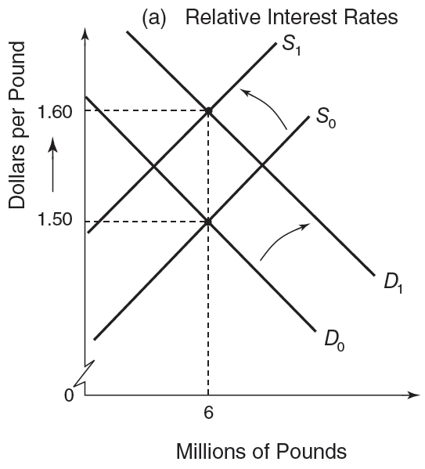
Factors affecting the dollar’s exchange rate in the short term (a)
FIGURE 12.5
In the short term, the exchange rate between the dollar and the pound reflects relative interest rates and expected changes in the exchange rate.

Slide 30
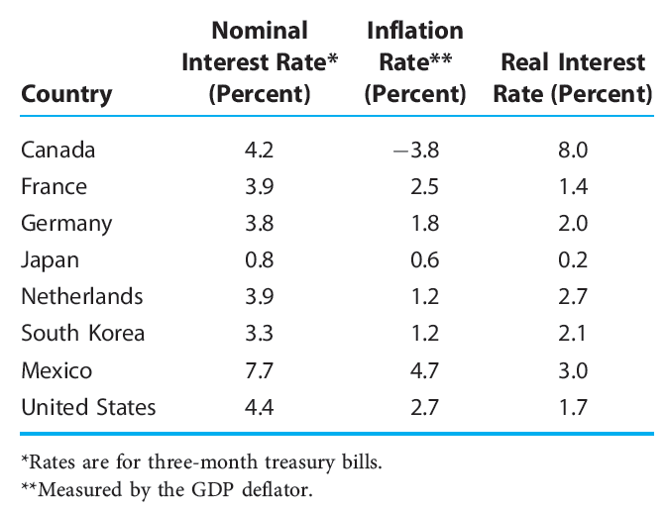
Short-term nominal and real interest rates, 2007
TABLE 12.5

Slide 31
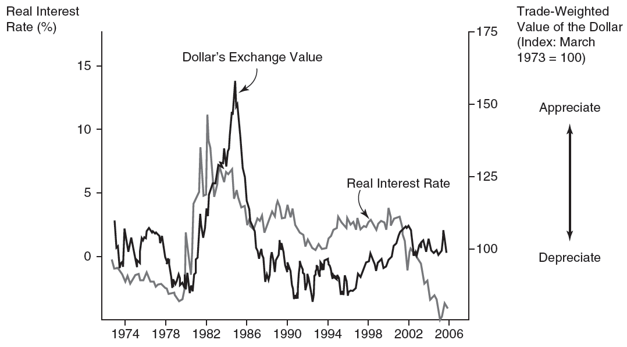
Interest rate differentials and exchange rates
FIGURE 12.6
An increase in the U.S. real interest rate increases the expected return on dollar assets, such as Treasury bills and certificates of deposit. This increase encourages flows of foreign investment into the United States, thus causing the dollar’s exchange value to appreciate. Conversely, a decrease in the U.S. real interest rate reduces the expected profitability on dollar assets, which promotes a depreciation of the dollar’s exchange value.

Slide 32
Determining Short-Term Exchange Rates: The Asset-Market Approach
Expected change in the exchange rate
Future expectations of an appreciation of the dollar can be self-fulfilling for today’s value of the dollar

Slide 33
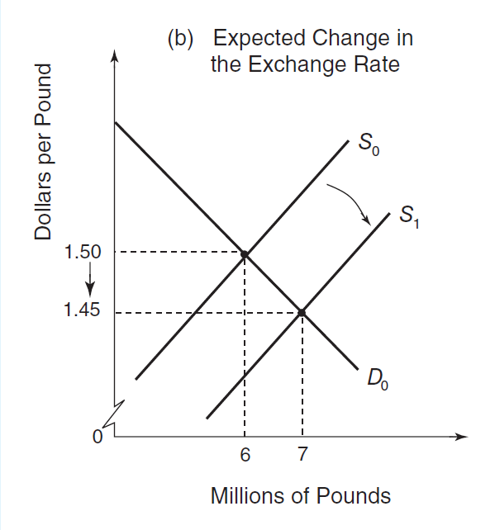
Factors affecting the dollar’s exchange rate in the short term (b)
FIGURE 12.5
In the short term, the exchange rate between the dollar and the pound reflects relative interest rates and expected changes in the exchange rate.

Slide 34
Determining Short-Term Exchange Rates: The Asset-Market Approach
Other factors affecting investment flows among economies
Size of the stock of assets denominated in a particular currency in investor portfolios
Significant safe-haven effect behind some investment flows

Slide 35
The Ups and Downs of the Dollar
The 1980s, appreciation and then depreciation
1979, dollar appreciation
Sharp tightening of monetary policy
Reagan administration - sizable tax cuts along with increased government spending
Peak in1985

Slide 36
The Ups and Downs of the Dollar
The 1980s, appreciation and then depreciation
Second half of the 1980s, dollar depreciation
Speculators – expected dollar depreciation
Sizable currency interventions aimed at weakening an overvalued dollar
Expansionary monetary policy
Fiscal policy - to reduce the size of budget deficits

Slide 37
The Ups and Downs of the Dollar
The 1990s
Weakening economy, recession in 1991
Expansionary monetary policy
Fiscal policy - increased government spending and dampened tax receipts
Dollar depreciation

Slide 38
The Ups and Downs of the Dollar
The 1990s
Mid-1990s, the U.S. economy was growing rapidly
Sharp increase in the pace of investment spending by business
Market acceleration in productivity growth
Strong consumer demand
Deregulation; Trade liberalization; Computer era
Declining rate of inflation
Dollar appreciation

Slide 39
The Ups and Downs of the Dollar
First decade of the 2000s
2002-2004, depreciation of the dollar
Weakening of the demand for dollar-denominated assets
Recession in the U.S. in 2001
Declining stock market
Uncertainty about corporate accounting practices
Steady decline in interest rates
Uncertainty due to the ongoing war on terrorism and the war with Iraq

Slide 40
The Ups and Downs of the Dollar
First decade of the 2000s
By 2005, dollar appreciation
Current and prospective strong performance of the U.S. economy
Restrictive monetary policy – higher interest rates
2006–2007, weakening dollar
Slackening of private investment flows
By 2008, stronger dollar
U.S. - safe haven; economic crisis of 2007–2008
2009, weakening dollar

Slide 41
Exchange-Rate Overshooting
Exchange-rate overshooting
When exchange-rate short-term response (depreciation or appreciation)
To a change in market fundamentals
Is greater than its long-term response
Helps explain why exchange rates depreciate or appreciate so sharply from day to day

Slide 42
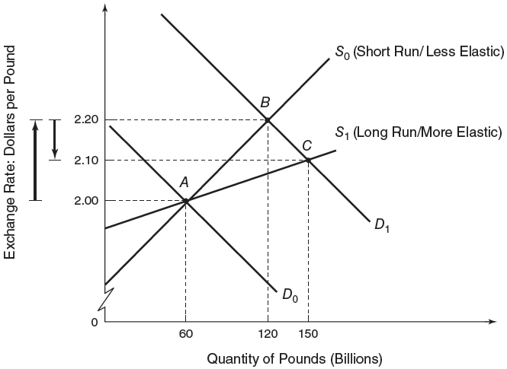
Short-term/long-term equilibrium exchange rates: overshooting
FIGURE 12.7
Given the short-term supply of pounds (S₀), if the demand for pounds increases from D₀ to D₁, then the dollar depreciates from $2 per pound to a short-term equilibrium of $2.20 per pound. In the long term, the supply of pounds is more elastic (S₁), and the equilibrium exchange rate is lower, at $2.10 per pound. Because of the difference in these elasticities, the short-term depreciation of the dollar overshoots its long-term depreciation.

Slide 43
Exchange-Rate Overshooting
Exchange-rate overshooting
Can be explained by
Tendency of elasticities to be smaller in the short term than in the long term
Exchange rates tend to be more flexible than many other prices

Slide 44
Forecasting Foreign-Exchange Rates
Forecasting exchange rates
Is very tricky, especially in the short term
Necessary for exporters, importers, investors, bankers, and foreign-exchange dealers
Consulting firms

Slide 45
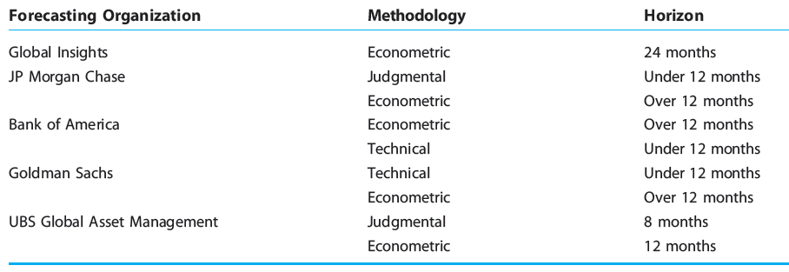
Exchange-rate forecasters
TABLE 12.6

Slide 46
Forecasting Foreign-Exchange Rates
Judgmental forecasts
Subjective or common sense models.
Require
Wide array of political and economic data
Interpretation of these data in terms of the timing, direction, and magnitude of exchange-rate changes
Projections based on a thorough examination of individual nations
Economic indicators; Political factors
Technical factors; Psychological factors

Slide 47
Forecasting Foreign-Exchange Rates
Technical forecasts
Technical analysis
Use of historical exchange-rate data to estimate future values
Ignoring economic and political determinants of exchange-rate movements
“History repeats itself”

Slide 48
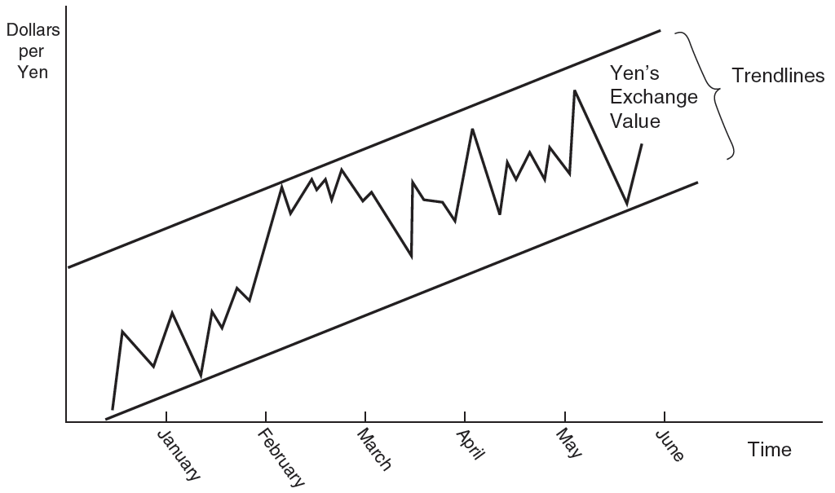
Technical analysis of the Yen’s exchange value
FIGURE 12.8
When forecasting exchange rates, technical analysts watch for new highs and lows, broken trend lines, and patterns that are thought to predict price targets and movement.

Slide 49
Forecasting Foreign-Exchange Rates
Fundamental analysis
The opposite of technical analysis
Considerations of economic variables that are likely to affect the supply and demand of a currency
Computer-based econometric models
For individual nations
Attempt to incorporate the fundamental variables that underlie exchange-rate movements
Interest rates, balance of trade, productivity, inflation rates

Slide 50
Forecasting Foreign-Exchange Rates
Limitations of econometric models used to forecast exchange rates
Rely on predictions of key economic variables
Factors affecting exchange rates that cannot easily be quantified
Precise timing of a factor’s effect on a currency’s exchange rate may be unclear

Slide 51
International comparisons of GDP: purchasing power parity
Gross domestic product (GDP)
Add up the market values of the goods and services its economy produces
Use market exchange rate
Misleading: not all goods and services are traded in a world market

Slide 52
International comparisons of GDP: purchasing power parity
Exchange rates
Overstate the size of economies with relatively high price levels
Understate the size of economies with relatively low price levels
Subject to sizable fluctuations

Slide 53
International comparisons of GDP: purchasing power parity
Purchasing power parity
Takes into account the relative cost of living and the inflation rates of different countries
GDPs of countries converted into a common currency using purchasing power parities
Are valued at a uniform price level
Reflect only differences in the volumes of goods and services produced in countries

Slide 54
Comparing GDPs internationally, 2008: top 8 countries (billions of dollars)
TABLE 12.7

Slide 55
Comercial Mexicana gets burned by speculation
October 2008, Comercial Mexicana was prospering
Mexico’s third largest retailer and a competitor of discount giant Wal-Mart
Few days later, it went bankrupt,
Foreign currency losses

Slide 56
Comercial Mexicana gets burned by speculation
Comercial Mexicana
Made bad bets using currency contracts - linked to the dollar/peso exchange rate
Expectations of a stronger peso
World credit crisis of 2008 – depreciation of the peso

