Slide 1
Mechanisms of International Adjustment
PowerPoint slides prepared by:
Andreea Chiritescu
Eastern Illinois University

Slide 2
Adjustment Mechanisms
Adjustment mechanism
Works for the return to equilibrium after the initial equilibrium has been disrupted
Current-account adjustment
Automatic adjustment
Discretionary government policies
Automatic adjustment of the current-account
Under a fixed exchange-rate system
Adjustment variables: prices and income

Slide 3
Price Adjustments
Gold standard, late 1800s to early 1900s
Conditions for each member nation
Money supply = gold or paper money backed by gold
Official price of gold – defined in terms of national currency
Buy and sell gold at that price
Free import and export of gold
Money supply - directly tied to current -account

Slide 4
Price Adjustments
Quantity theory of money
Classical price-adjustment mechanism
Equation of exchange: MV=PQ
M – money supply
V – velocity of money
P - average price at which each of the final goods is sold
Q – physical volume of all final goods produced

Slide 5
Price Adjustments
MV=PQ identity
Total monetary expenditures on final goods = monetary value of the final goods sold
Amount spent on final goods = amount received from selling them

Slide 6
Price Adjustments
Classical economists
Assumptions
Q is fixed at the full employment level in the long term
V was constant
A change in M must induce a direct and proportionate change in P

Slide 7
Price Adjustments
Criticisms against the price-adjustment mechanism
Classical linkage between changes in a nation’s gold supply and changes in its money supply no longer holds
Full employment – doesn’t always exist
Prices and wages are inflexible in a downward direction
Stability and predictability of V - questioned

Slide 8
Financial Flows and Interest-Rate Differentials
Factors affecting a nation’s capital and financial account
Interest-rate fluctuations in domestic and foreign markets
Investment profitability
National tax policies
Political stability

Slide 9
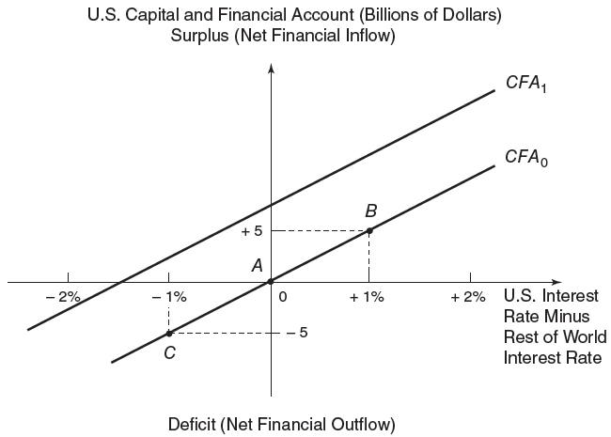
Capital and financial account schedule for the U.S.
FIGURE 13.1
Interest-rate differentials between the United States and the rest of the world induce movements along the U.S. capital and financial account schedule. Relatively high (low) U.S. interest rates trigger net financial inflows (outflows) and an upward (downward) movement along the capital and financial account schedule. The schedule shifts upward/downward in response to changes in noninterest rate determinants such as investment profitability, tax policies, and political stability.

Slide 10
Income Adjustments
Income adjustment mechanism
John Maynard Keynes, 1930s
Focus on automatic changes in income to bring about adjustment in a nation’s current account
Under fixed exchange rates
Influence of income changes in nations with current-account surpluses and deficits would help restore equilibrium automatically

Slide 11
Income Adjustments
Income adjustment mechanism
Under fixed exchange rates
Persistent current-account surplus
Rising income - Increasing imports
Current-account deficit
Fall in income - Declining imports
Effects of income changes on import levels will reverse the disequilibrium in the current account

Slide 12
Income Adjustments
The foreign repercussion effect
Income adjustment mechanism
And include the impact that changes in domestic expenditures and income levels have on foreign economies
Both the rise in income of the surplus nation and the fall in income of the deficit nation are dampened

Slide 13
Income Adjustments
Importance of the foreign repercussion effect
Depends on the economic size of a country
A small nation that increases its imports from a large nation
Little impact on the large nation’s income level
Major trading nations
Significant foreign repercussion effect

Slide 14
Disadvantages of Automatic Adjustment Mechanisms
An efficient adjustment mechanism
Requires central bankers to forgo their use of monetary policy
To promote the goal of full employment without inflation
Each nation must be willing to accept inflation or recession
When current-account adjustment requires it

Slide 15
Monetary Adjustments
Monetary approach to balance of payments
Balance of payments - affected by discrepancies between
The amount of money people desire to hold
The amount supplied by the central bank
Excess demand for money - fulfilled by inflows of money from another country
Excess supply of money - eliminated by outflows of money to another country

