Slide 1
Networked Applications
Revised August 2013
Chapter 11
Panko and Panko
Business Data Networks and Security, 9th Edition
© 2013 Pearson

Slide 2
Basic Networked Application Concepts
E-Mail
Voice over IP
HTTP and HTML
Peer-to-Peer (P2P) Applications
Cloud Computing
Service-Oriented Architectures

Slide 3
11.1: Networked App Concepts
Important Networked Applications
E-mail, voice over IP, the World Wide Web, cloud computing, peer-to-peer (P2P) computing, and mobile applications
Importance of the application layer to users
Contains all of the functionality that users see directly
What happens at lower layers should simply happen

Slide 4
Terminal-Host v Client/Server Processing
E-Mail
Voice over IP
HTTP and HTML
Peer-to-Peer (P2P) Applications
Cloud Computing
Service-Oriented Architectures

Slide 5
11.4: E-Mail Standards
There are separate transmission and document standards.
Document standards: New standard RFC 5322
RFC 822/2822 for plain text messages.
HTML bodies for formatting.
UNICODE can represent text in any language.

Slide 6
11.4: E-Mail Standards
Many applications have two types of standards.
Delivery standards
SMTP, POP, IMAP
Message format standards
RFC 822/2822, HTML, UNICODE
RFC 5332 (not in the book) see here.
It does no good to deliver messages if the receiver cannot understand them.

Slide 7
11.6: Web-Based E-Mail
Either or both clients can use web-based e-mail instead of SMTP and POP or IMAP.
All interactions for that client take place via HTTP instead.
Message documents are HTML webpages.
POP/ IMAP
HTML
HTTP
SMTP
SMTP

Slide 8
11.5: Simple Mail Transfer Protocol (SMTP)
SMTP Process | Command | Explanation
Receiver | 220 mail.panko.com Ready | When the sending host establishes a TCP session, the receiver signals that it is ready.
Sender | HELO voyager.shilder.hawaii.edu | Sender indicates that it wishes to communicate.
Receiver | 250 mail.panko.com | Receiver signals it is ready to begin message.

Slide 9
11.5: Simple Mail Transfer Protocol (SMTP)
SMTP Process | Command | Explanation
Sender | MAIL FROM david@voyager.shidler.hawaii.edu | Sender identifies the mail author.
Receiver | 250 OK | Receiver signals that will accept a message from this person.

Slide 10
11.5: Simple Mail Transfer Protocol (SMTP)
SMTP Process | Command | Explanation
Sender | RCTP TO: ray@panko.com | Sender identifies a recipient.
Receiver | 250 OK | Receiver will accept mail for this recipient.

Slide 11
11.5: Simple Mail Transfer Protocol (SMTP)
SMTP Process | Command | Explanation
Sender | RCTP TO: lee@panko.com | Sender identifies a recipient.
Receiver | 550 No such user here | Receiver will NOT accept mail for this recipient.

Slide 12
11.5: Simple Mail Transfer Protocol (SMTP)
SMTP Process | Command | Explanation
Sender | DATA | Message will follow.
Receiver | 354 Start mail input; end with <CRLF> <CRLF> | Permission to send the message body.

Slide 13
11.5: Simple Mail Transfer Protocol (SMTP)
SMTP Process | Command | Explanation
Sender | When in the course… | Sends the body, which ends with a blank line.
Receiver | 250 OK | Accepts the body.

Slide 14
11.5: Simple Mail Transfer Protocol (SMTP)
SMTP Process | Command | Explanation
Sender | QUIT | Ending the connection.
Receiver | 221 mail.panko.com Service closing transmission channel | Receiver terminates the session.

Slide 15
11.7: E-Mail
Viruses, Worms, and Trojan Horses
Widespread problems; often delivered through e-mail attachments
Use of antivirus software is almost universal, but only partially effective, given the number of malware infections.
“Antivirus” programs are not limited to viruses. They scan for many types of malware.

Slide 16
11.7: Scanning Locations for E-Mail
Filtering in two or more locations gives defense in depth.

Slide 17
Terminal-Host v Client/Server Processing
E-Mail
Voice over IP
HTTP and HTML
Peer-to-Peer (P2P) Applications
Cloud Computing
Service-Oriented Architectures

Slide 18
Voice over IP
Transmit voice telephone calls over IP networks
Saves money because the company does not have to maintain separate internal voice and data networks
Saves money because the voice signal is compressed as it is digitized

Slide 19
VoIP Signaling and Transport
Signaling versus Transport
A core concept in telecommunications
Telephony and video
Signaling
Setting up a connection, breaking it down afterward, billing, and so on
Transport
The actual transmission of the voice or video signal

Slide 20
11.8: Voice over IP (VoIP)
Multimedia PC or
VoIP telephone that plugs into an IP network (Internet)

Slide 21
11.8: Voice over IP (VoIP)
Media gateway connects an IP network to the Public Switched Telephone Network.
Handles both transport and signaling conversion.

Slide 22
11.9: VoIP Signaling and Transport
SIP is a signaling protocol.
This figures shows connection establishment.

Slide 23
11.9: VoIP Signaling and Transport
Session Initiation Protocol Signaling Standard
Not just for initiating connections
Opens connections
Closes connections
Handles charges and bookkeeping
In other words, ALL signaling tasks

Slide 24
11.9: VoIP Signaling and Transport
Transport takes place directly between the caller and called party.

Slide 25
11.9: VoIP Signaling and Transport
UDP
There is no time to wait for the transmission of lost packets.
UDP makes more sense because of its lightweight processing and traffic volume requirements.
Real-Time Protocol (RTP) Header
Makes up for two UDP limits.
It adds sequence numbers.
It adds a time stamp for when its codec octets should be played back.

Slide 26
11.10: Codecs
Codecs translate analog voice to digital transmission signals.
Codec Transmission Rate
G.711 64 kbps (initial telephony standard)
G.722 48, 56, 64 kbps
G.721 32 kbps
G.722.1 24, 32 kbps
G.726 16, 24, 32, 40 kbps
G.728 16 kbps
G.729AB 8 kbps
G.723 5.33, 6.4 kbps
G.723.1A 5.3, 6.3 kbps
In general, greater compression means poorer sound quality.

Slide 27
Terminal-Host v Client/Server Processing
E-Mail
Voice over IP
HTTP and HTML
Peer-to-Peer (P2P) Applications
Cloud Computing
Service-Oriented Architectures

Slide 28
11.11: HTTP and HTML
Again, we see an application with transmission and document standards.

Slide 29
11.12: Downloading a Complex Webpage
This webpage has text and two graphics. The HTML file has the text and tags for the graphics.

Slide 30
11.12: Downloading a Complex Webpage
Based on tags in the HTML file, the graphics files are downloaded and rendered on the page.

Slide 31
11.12: Downloading a Complex Webpage
Question: How many files will a browser have to download if the webpage has three graphics and plays music when it is downloaded?

Slide 32
11.13: Examples of HTTP Request and Response Messages
HTTP Request Message
GET /panko/home.htm HTTP/5[CRLF]
Host: voyager.shidler.hawaii.edu[CRLF]
Note:
GET is the method. It asks for a file.
/panko/home.htm is the path to the file.
The browser speaks HTTP version 5.
CRLF means “carriage return/line feed.” It means to start a new line.

Slide 33
11.13: Examples of HTTP Request and Response Messages
200 and OK both mean that the request was complied with.
HTTP Response Message:
HTTP/5 200 OK[CRLF]
Date: Tuesday, 9-AUG-2013 18:32:15 GMT[CRLF]
Server: name of server software[CRLF]
MIME-version: 1.0[CRLF]
Content-type: text/plain[CRLF]
[CRLF]
File to be downloaded. A string of bits that may be text, graphics, sound, video, or other content.

Slide 34
11.13: Examples of HTTP Request and Response Messages
Note that most fields (lines) have a variable name, a colon, and then the value of the variable.
Example:
MIME-version: 1.0[CRLF]
MIME is a standard for describing file contents.
The browser speaks MIME version 1.0.
This is like e-mail headers with To:, From:, and other fields
In fact, deliberately patterned after e-mail

Slide 35
Terminal-Host v Client/Server Processing
E-Mail
Voice over IP
HTTP and HTML
Peer-to-Peer (P2P) Applications
Cloud Computing
Service-Oriented Architectures

Slide 36
Cloud Computing
A Shared Project (Figure 11-15)
Google Docs
Shea and Melinda can share documents.
Before, they had used e-mail attachments.
There was often confusion over who had the most recent version.

Slide 37
11.14: Traditional Sharing
Before Google Docs, they used corporate servers running the corporate mail system.

Slide 38
11.15: Cloud Computing: Software as a Service (SaaS)
With Google Docs, both the application program and data are on Google servers.

Slide 39
Cloud Computing
For users, showing the network as a cloud indicates that they do not have to understand it.
In cloud computing, there is a second cloud—a cloud service provider.
In cloud computing, the company outsources some combination of servers, server applications, and client PC software to a cloud service provider. If client PC software is outsourced, the client PC needs only a browser.

Slide 40
Cloud Computing
Google Docs is a cloud provider of Software as a Service.
Usually metered service—pay as you go.

Slide 41
Cloud Computing
Software as a Service
In Software as a Service (SaaS), an application service provider (ASP) supplies an application to customers on demand.
In cloud SaaS, the user typically has a browser only.
The application and data are downloaded to the client PC as needed.
With cloud SaaS today, there is a broad range of applications available.

Slide 42
Cloud Computing
SaaS
Attractions of SaaS
Reduces cost and risk because user only pays for software as needed
Saves money because company does not have to manage the application
Mobility—users can access the software wherever there is Internet access
Collaboration: sharing is easy

Slide 43
Cloud Computing
SaaS
Issues with SaaS
If there is no Internet access, the application is unusable.
Loss of control: may be locked into proprietary vendor software.
The cloud SaaS provider may go out of business.

Slide 44
Cloud Computing
SaaS
Issues with SaaS
Security: will company’s data be vulnerable if cloud service provider is attacked or has software vulnerabilities?
Legal complications: if user company is required by law to be secure, how can this be satisfied with SaaS?

Slide 45
Cloud Computing
Cloud Utility Computing
In traditional utility computing, a company offloads server processing work to another company at a remote site.
In cloud utility computing, the company that receives this processing job is a cloud service provider, and the data is sent over the Internet to be processed.
Unlike in SaaS, the application is not managed by the cloud provider—only processing power and storage.

Slide 46
11.16: Cloud Utility Computing
No SaaS Application

Slide 47
Cloud Utility Computing
Attractions
No need to hire staff to run the servers
No need to purchase and manage servers

Slide 48
Cloud Utility Computing
Attractions
Flexibility—can get extra capacity quickly when needed for a short period of time
Scalability—will not outgrow the service provider’s capacity
Issues
As in cloud SaaS, loss of control and legal and security concerns

Slide 49
Cloud Utility Computing
Why Is Cloud Utility Computing a Hot Topic Now?
Internet is now fast, reliable, and accessible nearly everywhere
Web services (discussed later)
Virtualization (discussed later)

Slide 50
11.17: Virtualization
Traditional Computer
User
User
Application
Operating System
Hardware

Slide 51
11.17: Virtualization
Each operating system is like a separate computer.
Virtualized Computer
App 1a
App 3a
App 3b
OS 1
OS 2
OS 3
Hypervisor
Hardware

Slide 52
11.14: Cloud Computing
Managing Cloud Computing
Many advantages
Loss of control
Must consider security
Must have Service Level Agreements (SLAs) for performance

Slide 53
Terminal-Host v Client/Server Processing
E-Mail
Voice over IP
HTTP and HTML
Peer-to-Peer (P2P) Applications
Cloud Computing
Service-Oriented Architectures

Slide 54
Service-Oriented Architectures
Service-Oriented Architectures (SOAs)
Traditionally, in client/server computing, a single client program calls a single server program.
In service-oriented architectures, a client program may contact many small service objects on many different machines to do the work the client needs.
In addition, a service object may serve multiple clients.
Service objects usually do small chunks of work, like computing a currency exchange rate.

Slide 55
Service-Oriented Architectures
Calling
Program
Call
Service
Object
(Provides
Service)
Call
Call

Slide 56
11.18: Service-Oriented Architectures (SOA)
SOAs use requests and responses.

Slide 57
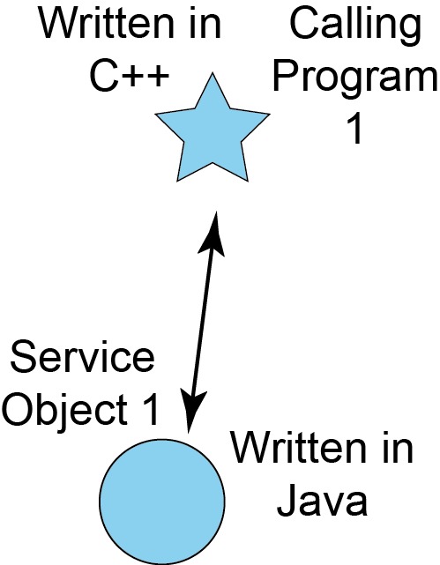
11.18: Service-Oriented Architectures (SOA)
Service objects provide services to programs that call them.
SOAs are language-independent.
The calling program and the service objects may be written in different languages.

Slide 58
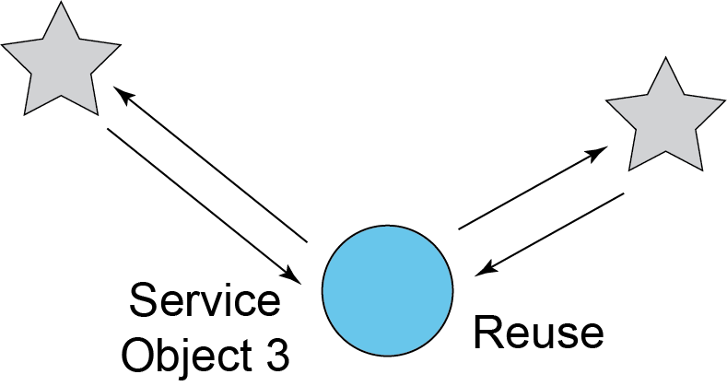
11.18: Service-Oriented Architectures (SOA)
Individual service objects can provide service to multiple calling programs.

Slide 59
11.18: SOA versus Web Services
SOAP-Based SOAs
Web services SOAs
All SOAs
SOA is the general concept.

Slide 60
11.19: SOA versus Web Services
SOAP-Based SOAs
Web services SOAs
All SOAs
Web service SOAs are SOAs that use WWW standards such as HTTP

Slide 61
11.19: SOA versus Web Services
SOAP-Based SOAs
Web services SOAs
All SOAs
SOAP-Based SOAs are Web services that use the SOAP message syntax

Slide 62
11.20: SOAP Messages
SOAP is a common way to format requests for services and responses.
Simple Object Access Protocol
Quite simply, a general way to access (use) service objects
Specifically, SOAP standardizes the syntax of request and response message syntax and semantics in SOA interactions.

Slide 63
11.20: SOAP Messages
SOAP messages are written in XML instead of HTML.
In HTML, you cannot create your own tags.
In XML (eXtensible Markup Language), communities can add their own tags.
SOAP messages can be delivered by
HTTP, e-mail, and so on

Slide 64
11.20: SOAP Messages
SOAP Request Message
<SOAP Envelope>
<Soap BODY>
<Service=PriceQuote>
<PartNum>T2000</PartNum>
<Quantity>47</Quantity>
<Shipping>Rush</Shipping> </Service=PriceQuote>
</SOAP BODY>
</SOAP Envelope>
XML Tag

Slide 65
11.20: SOAP Messages
SOAP Response Message
<SOAP Envelope>
<Soap Body>
<Service=PriceQuote>
<Price>$25,892</Price>
</Service=PriceQuote>
</SOAP BODY>
</SOAP Envelope>

Slide 66
11.21: WSDL and UDDI
UDDI
Problem: How do you find the Web services you need?
Universal Description, Discovery, and Integration
Allows calling program to find a suitable Web service
Like a telephone directory
Yellow pages: find by category of service
White pages: find by name

Slide 67
11.21: WSDL and UDDI
WSDL
Problem: How do you use a particular Web service?
Web Service Description Language (WSDL)
Describes how to use a specific Web service
User first decides what Web service to use
User then sends a WSDL request to the vendor of the Web service
The WSDL response describes how to use the Web service

Slide 68
Terminal-Host v Client/Server Processing
E-Mail
Voice over IP
HTTP and HTML
Peer-to-Peer (P2P) Applications
Cloud Computing
Service-Oriented Architectures

Slide 69
Peer-to-Peer (P2P) Architectures
Clients provide services to other clients.
Servers are not used or are used only for secondary tasks such as helping a client find another client.
Made possible by growing desktop processing power
Terminal-Host: no desktop processing power
Client/server: some desktop processing power
P2P: extensive desktop processing power

Slide 70
11.22: Traditional Client/Server Application

Slide 71
11.23: Simple Peer-to-Peer (P2P) Application

Slide 72
11.24: Traditional Client/Server File Retrieval
In traditional client/server file retrieval, a request is sent directly to the server containing the file.

Slide 73
11.24: P2P File Sharing
PCs share files with one another.

Slide 74
11.25: BitTorrent Protocol for P2P File Sharing
BitTorrent is a sophisticated PC file sharing standard.
The client first contacts an index webserver with a file request.

Slide 75
11.25: BitTorrent Protocol for P2P File Sharing
The index server directs the client to a tracker server.

Slide 76
11.25: BitTorrent Protocol for P2P File Sharing
The swarm consists of client PCs that have parts of the desired file.

Slide 77
11.25: BitTorrent Protocol for P2P File Sharing
4. Client PC downloads pieces from the swarm.
5. Client PC reassembles the file.

Slide 78
11.25: BitTorrent Protocol for P2P File Sharing
Question: What do you think is the advantage of downloading the file from multiple sources instead of a single source?

Slide 79
Skype
Description and Main Features
P2P VoIP service
Very popular due to low costs
Free calling among Skype customers (computer-to-computer)
Reduced-cost calling to and from Public Switched Telephone Network customers

Slide 80
Skype
Recap
Signaling versus Transport
Signaling
Supervisory communication
Set up connection, break down connection
Billing, and so on
Transport
The actual carriage of voice signals between the caller and the called party

Slide 81
Skype
How Skype Works
Skype Network
Skype login server: the only centralized component in the Skype network
Host node: a Skype application that runs on a user’s computer
Super node: a host node that takes on the work of signaling

Slide 82
11.26: Skype Network Operation
Users must log into the network before they receive service.

Slide 83
11.26: Skype Network Operation
Call set-up signaling is done P2P via supernodes, which are powerful user computers.
Powerful clients automatically become supernodes.

Slide 84
11.26: Skype Network Operation
Once connected, signaling ends
The two parties communicate entirely via P2P.
This is transport.
So most transmission is P2P.

Slide 85
Skype
Skype Security
Many corporations ban use of Skype because:
Skype’s proprietary software and protocols are not revealed to security professionals, change frequently.
Detailed method of Skype encryption is unknown.

Slide 86
Skype
Skype Security
Many corporations ban use of Skype because:
Registration is open and uncontrolled, so usernames mean nothing from a security standpoint.
Skype is almost impossible to control at firewalls.
Skype’s file transfer mechanism does not work with most antivirus products.

Slide 87
11.27: Skype vs Traditional VoIP
Stage | Skype | Traditional VoIP
Registration | Server-based | Server-based
Signaling | P2P | Server-based
Transport | P2P | P2P
Skype differs from traditional P2P only in signaling.
Signaling costs are borne by Supernodes

Slide 88
11.28 SETI@home Processor Sharing
SETI@home uses idle PC processing power.

Slide 89
P2P in Perspective
Made possible by growing desktop processing power on PCs
Types
File sharing
Communication
Processor sharing
Potential cost savings by using idle PC resources
Management and security issues

