Slide 1
Integer Optimization
Summer 2013

Slide 2
Integer Optimization
In integer optimization, at least one variable is restricted to integer values. But the decision variables can be linear and / or nonlinear. We will consider only linear variables.
Linear Optimization Classification
No | Model Type | Decision variables
1 | Linear Programming (LP) | Can take continuous value.
2 | Integer Linear Programming (ILP) | At least one variable is integer valued.
Within ILP, we can have either “all integer” or “mixed integer” model. A variable restricted to 0 or 1 values is called a binary variable.
Solver can solve all ILP models but it takes longer compared to the LP model without integer restriction. Solver can also be used for many nonlinear optimization models.

Slide 3
LP example
Maximize | x₁+ 8x₂ = Z
Subject to x₁ & x₂ ≥ 0 | x₁ ≤ 2.0 x₁ + 10x₂ ≤ 20.5
What if x₁and x₂ must be integers?
We can try four closest points.
3
2
1
x₁= 0.00, x₂ = 2.05
LP optimal: Z = 16.80 x₁= 2.00, x₂ = 1.85
(1, 2), (2, 2) are infeasible.
At (1, 1), Z = 9 . At (2, 1) , Z = 10
Integer optimal : (0, 2), Z = 16!
1 2 3 4 X₁
Optimal may not be a corner point

Slide 4
A simple LP example
Maximize | 7x₁+ 11x₂ = Z
Subject to x₁ & x₂ ≥ 0 | x₁ + x₂ ≤ 6 18x₁+ 34x₂ ≤ 154
Optimal LP: x₁= 3.125, x₂ = 2.875 with Z = 53.5
Optimal ILP: x₁= 1, x₂ = 4 with Z = 51
9
8
7
6
5
4
3
2
1
Many approaches: Start with LP.
Cutting Plane: Add one constraint at a time till you get an optimal solution.
Branch and Bound: If the current solution is not integer, split the problem into two problems (with one constraint added to each) and solve again. Repeat till you get integer optimal solution. Solver uses this approach.
….
There is no efficient procedure (like Simplex) available to find the optimal solution.
1 2 3 4 5 6 7 8 9

Slide 5
ILP: B&B
Maximize | 7x₁+ 11x₂ = Z
Subject to x₁ & x₂ ≥ 0 | x₁ + x₂ ≤ 6 18x₁+ 34x₂ ≤ 154
Start with the LP solution.
9
8
7
6
5
4
3
2
1
Add two branches with extra constraints if there is a non-integer value and solve the two sub-problems.
LP: Z = 53.5. (3.125, 2.875)
x₂ ≤ 2
x₂ ≥ 3
Z = 50.
(4, 2)
Z = 53.222
(2.889, 3)
x₂ ≥ 3
Feasible! No need to expand this branch. This is a lower bound.
Add two branches
x₂ ≤ 2
1 2 3 4 5 6 7 8 9

Slide 6
ILP: B&B
Maximize | 7x₁+ 11x₂ = Z
Subject to x₁ & x₂ ≥ 0 | x₁ + x₂ ≤ 6 18x₁+ 34x₂ ≤ 154
Start with the LP solution.
9
8
7
6
5
4
3
2
1
Add two branches with extra constraints if there is a non-integer value and solve the two sub-problems.
LP: Z = 53.5. (3.125, 2.875)
x₂ ≤ 2
x₂ ≥ 3
Z = 50.
(4, 2)
Z = 53.222
(2.889, 3)
x₂ ≥ 3
Feasible! No need to expand this branch. This is a lower bound.
Add two branches
x₂ ≤ 2
1 2 3 4 5 6 7 8 9

Slide 7
Branch and bound methodology
Root node
LP: Z = 53.5
(3.125, 2.875)
B & B methodology can be applied to many other problems besides ILP.
x₂ ≤ 2
x₂ ≥ 3
Z = 50
(4, 2)
Z = 52.222
(2.889, 3)
Excel solver uses B & B methodology.
x₁ ≤ 2
x₁ ≥ 3
Z = 52.176
(2, 3.47059)
Infeasible!
Optimum!
x₂ ≤ 3
x₂ ≥ 4
Z = 51.
(1, 4)
Z = 47.
(2, 3)

Slide 8
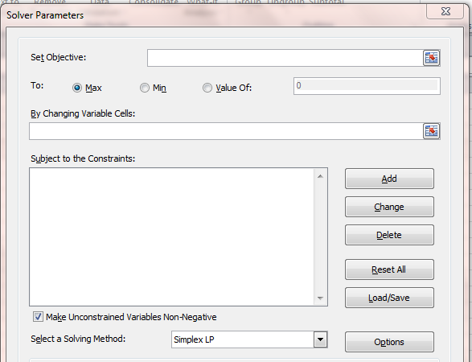
ILP with Solver using B&B: Some comments
In large ILP problems, there may be thousands of branches for exploration.
Solver has to solve thousands of LP problems and this can be very time consuming. We can curtail this by selecting appropriate options.
Enter everything and click on the Options.

Slide 9
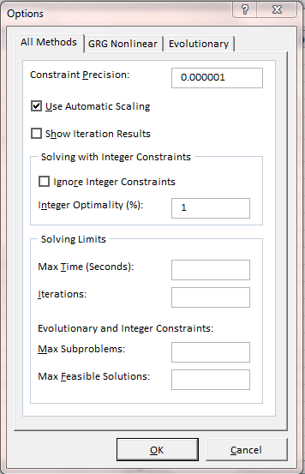
Selecting appropriate values, we can terminate the program earlier and accept the best result obtained up to the termination time. This may or may not be optimal.

Slide 10
Integer Linear Programming models
Models names
Assignment
Facility Location
Knapsack
Machine Scheduling
Set Covering
Shortest Path
Traveling Salesman
Applications
Airline Scheduling
Airline Yield Management
Manpower Scheduling
Network Reliability and Design
Supply Chain Management
We will look at examples.

Slide 11
Knapsack problem
You want to fill your knapsack with different items to maximum value of the goods you are carrying. There are n types of items and there is a weight limit.
Formulation:
Let there be n different item. For item k, let W_{k} to denote weight per unit and V_{k} denote the value per unit. Let B be the maximum weight you can carry. We will use y_{k} to denote number of units of item k included in the knapsack.
Maximize V₁ y₁ + V₂ y₂ + … + V_{n} y_{n}
Subject to: W₁ y₁ + W₂ y₂ + … + W_{n} y_{n} ≤ B
y₁ , y₂ , …, y_{n} ≥ 0 and integer
So many different versions of the problem exist that a book (with over 400 pages) has been published. We will consider two versions.
Version 1: variables y can take only binary values.
Version 2: equality constraint and minimization objective function.

Slide 12
Version 1: Capital Budgeting
Project | P1 | P2 | P3 | P4 | P5
NPV | 10 | 17 | 16 | 8 | 14
Expenditure | 48 | 96 | 80 | 32 | 64
Assume budget (B) = 176 million dollars. Which projects should we select to maximize Net Present Value (NPV)?
Maximize 10 y₁ + 17 y₂ + 16 y₃ + 8 y₄ + 14 y₅
Subject to: 48 y₁ + 96 y₂ + 80 y₃ + 32 y₄ + 64 y₅ ≤ 176
y₁ , y₂ , y₃ , y₄ , y₅ all binary (0 or 1).

Slide 13
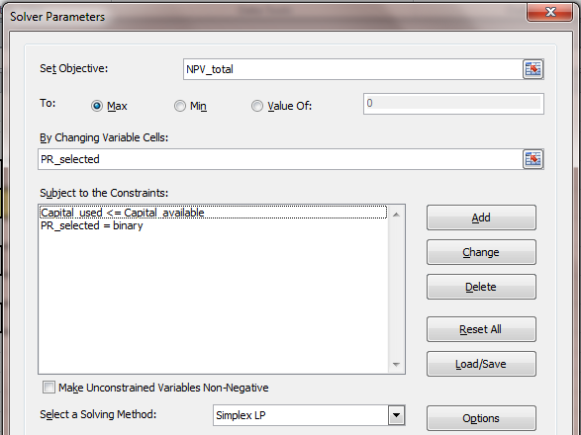
Capital Budgeting Example
Any problems with the model?

Slide 14
Knapsack problem – Version 2
Minimize V₁ y₁ + V₂ y₂ + … + V_{n} y_{n}
Subject to: W₁ y₁ + W₂ y₂ + … + W_{n} y_{n} = B,
y₁ , y₂ , y_{n} all integers ≥ 0n
Minimize with equality constraint
Recognize these examples?
Ex 1: Min. y₁ + y₂ + y₃ + y₄ + y₅ = Z
Subject to: y₁ + 5 y₂ + 10 y₃ + 0 y₄ + 25 y₄ = 42
y₁ , y₂ , y₃ , y₄ , y₅ all integers ≥ 0
Solution: y₁ = 2, y₂ = 1, y₃ = 1, y₄ = 0, y₅ = 1, Z = 5
Ex 2: Min. y₁ + y₂ + y₃ + y₄ + y₅ = Z
Subject to: y₁ + 5 y₂ + 10 y₃ + 20 y₄ + 25 y₄ = 42
y₁ , y₂ , y₃ , y₄ , y₅ all integers ≥ 0
Solution: y₁ = 2, y₂ = 0, y₃ = 0, y₄ = 2, y₅ = 0, Z = 4

Slide 15
Set Covering problem
Nine districts (D1, D2,.., D9) are to be covered within acceptable time limits by emergency vehicles.
D9
*
D1
*
D2
*
Seven potential sites (S1, S2, …, S7) have been identified.
S2
●
D8
*
S1
●
D3
*
S7
●
S3
●
Each site can reach only some districts within the time limit.
S6
●
S4
●
D7
*
D4
*
S5
●
We need to cover all districts with minimum number of sites.
D6
*
D5
*

Slide 16
Set Covering problem
Nine districts (D1, D2, , D9) are to be covered within acceptable time limits by emergency vehicles. Seven sites (S1, S2, …, S7) have been identified. Each site can reach only some districts within the time limit. We need to cover all districts with minimum number of sites.
 | S1 | S2 | S3 | S4 | S5 | S6 | S7
D1 | 0 | 1 | 0 | 1 | 0 | 0 | 1
D2 | 1 | 0 | 0 | 0 | 0 | 1 | 1
D3 | 0 | 1 | 0 | 0 | 0 | 1 | 1
D4 | 0 | 1 | 1 | 0 | 1 | 1 | 0
D5 | 1 | 0 | 1 | 0 | 1 | 0 | 0
D6 | 1 | 0 | 0 | 1 | 0 | 1 | 0
D7 | 1 | 0 | 0 | 0 | 0 | 0 | 1
D8 | 0 | 0 | 1 | 1 | 1 | 0 | 0
D9 | 1 | 0 | 0 | 0 | 1 | 0 | 0
What do 0 and 1 in the table indicate?

Slide 17
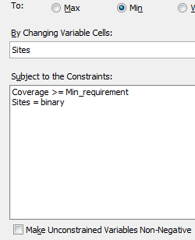
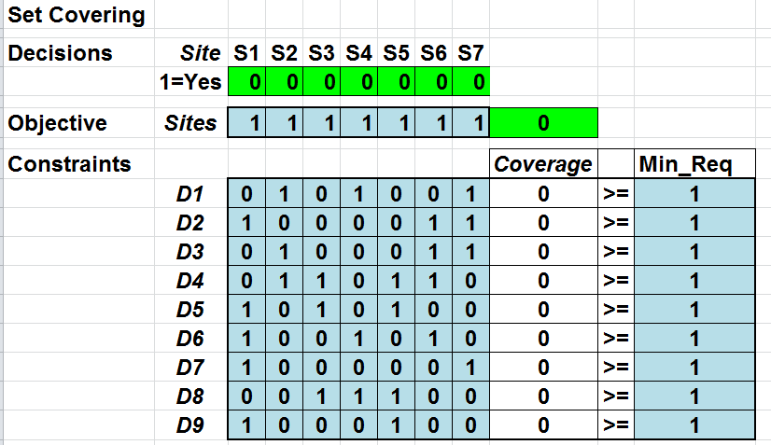
Set Covering Formulation

Slide 18
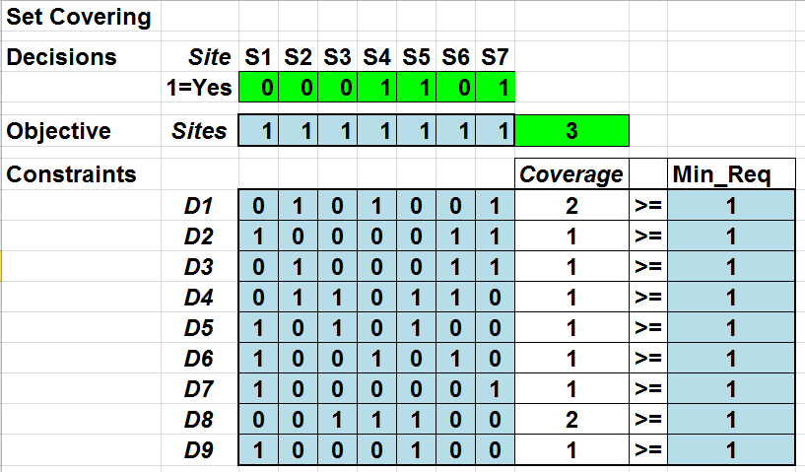
Set Covering Solution
There may be alternate optimum solutions.

Slide 19
Binary Variables & Logical Relationships
In many models, one or more constraints involving binary variables can be added to satisfy desired logical relationship.
Suppose we have several projects P1 , P2, P3, etc. and we define binary variables Y1, Y2, Y3, etc.
Y1 = 0 means project P1 is not selected
Y2 = 1 means project P2 is selected and so on.
We need to add constraint(s) such that when the relationship is satisfied, all constraints must be met and when the relationship is not satisfied, at least one of the constraint must fail.
Suppose the logical relation is: Select P2 or P5 or both.
We need only one constraint. Y2+Y5 ≥ 1.
We will explain this on the next slide.

Slide 20
Relationship/Constraint(s) | Explanation
Select P2 or P5, or both.
Y2 + Y5 ≥ 1
If only P2 is selected, Y2 = 1.
If only P5 is selected, Y5 = 1.
If P2, P5 selected, Y2+Y5 = 2 but when both are not selected, Y2+Y5 = 0 and the constraint is not satisfied.
Select at most one project from P3 , P4 , P5.
Y3 + Y4 + Y5 ≤ 1
If 0 or 1 projects are selected, the constraint is satisfied.
If two are selected, Y3+Y4 +Y5 will be equal to 2 and the constraint is not satisfied. Same if you select all three.
If P5 is selected, then P4 must be as well.
Y4 - Y5 ≥ 0
If P5 is selected, Y5 = 1 then Y4 must also be 1. If Y5=0, Y4 can be 0 or 1.
If Y5 =1 and Y4 = 0, the constraint is not satisfied.

Slide 21
Linking Constraints and Fixed Costs
Suppose we purchase x units of a product at unit cost C. For sending the purchase order, there is a fixed cost F. So the total purchase cost will be (F + Cx).
If this value is included in the objective function, then we will end up with fixed cost F even when x = 0. This should not happen. There should be no fixed cost when we don’t buy.
To correct this, we introduce a binary variable y and add a new constraint as follows.
Minimize Fy + Cx
Subject to: x ≤ My where M is a large number.
y = 0 or 1
Note that when x = 0, y can be 0 or 1 according to the first constraint and minimization will force it to zero.
When x > 0, y will be forced to a value of 1.

Slide 22
Dynamic Lot Sizing Model
The model assumptions / requirements are as follows.
We have a single product with demand D₁, D₂, …, D_{n} for n periods (periods P₁, P₂, … , P_{n}).
Decision variables: X₁, X₂, …, X_{n}. These can be production or purchase quantities, called lot sizes.
No shortages are allowed.
There are no capacity constraints.
There is a fixed setup cost (sometimes called ordering cost) K₁, K₂, …, K_{n}.
For inventory left over at the end of each period, there is a per unit holding cost H₁, H₂, …, H_{n}.
The unit production (or purchase) cost is C₁, C₂, …, C_{n}. .
This is similar to the production planning model except for the fixed setup cost K. This means we need extra binary variables.

Slide 23
Lot sizing formulation (shown for 3 periods)
Period (i) | P1 | P2 | P3
Demand (D_{i}) | D₁ | D₂ | D₃
Ordering cost (K_{i}) | K₁ | K₂ | K₃
Purchase price (C_{i}) | C₁ | C₂ | C₃
Holding cost (H_{i}) | H₁ | H₂ | H₃
Let X₁, X , X₃ be quantities ordered in P1, P2, P3
P_{i} | Inventory
1 | I₁ = X₁ – D₁
2 | I₂ = I₁ + X₂ – D₂ = (X₁ + X₂) – (D₁ + D₂)
3 | I₃ = I₂ + X₃ – D₃ = (X₁ + X₂ + X₃ ) – (D₁ + D₂ + D₃)
X₁ X₂ X₃
I₁ I₂ I₃
D₁ D₂ D₃
Minimize Z = C₁X₁ + C₂X₂ + C₃X₃ + K₁y₁ + K₂y₂ + K₃y₃ + H₁I₁ + H₂I₂ + H₃I₃
Subject to: X₁ , X₂ , X₃ ≥ 0 I₁ , I₂ , I₃ ≥ 0
X₁ – I₁ | = | D₁
X₁ + X₂ – I₂ | = | D₁ + D₂
X₁ + X₂ + X₃ – I₃ | = | D₁ + D₂ + D₃
X₁ - My₁ ≤ 0
X₂ - My₂ ≤ 0 M is a very large number
X₃ - My₃ ≤ 0
y₁ , y₂ and y₃ : 0 or 1

Slide 24
Lot sizing model:
Period (i) | P1 | P2 | P3 | P4 | P5 | Total
Demand (D_{i}) | 87 | 50 | 100 | 60 | 80 | 377
Purchase price (C_{i}) | 10 | 10 | 10 | 10 | 10
Ordering coast (K_{i}) | 120 | 125 | 130 | 135 | 138
Holding cost (H_{i}) | 1.30 | 1.40 | 1.45 | 1.50 | 1.55
Procedure when per unit purchase price does not change.
In period 1, we must buy at least 87 units. Why?
In period 1, we could buy 87, 88, 89, …., 376 or 377 units. Why?
Property: We should not buy units equal to partial period demand.
We should buy 87 or 87+50 or 87+50+100, an so on In P1
Buy 0 or 50 or 50+100 , …., 50+100+60+80 In P2. Why?

Slide 25
Lot sizing model:
Period (i) | P1 | P2 | P3 | P4 | P5 | Total
Demand (D_{i}) | 87 | 50 | 100 | 60 | 80 | 377
Purchase price (C_{i}) | 10 | 10 | 10 | 10 | 10
Ordering coast (K_{i}) | 120 | 125 | 130 | 135 | 138
Holding cost (H_{i}) | 1.30 | 1.40 | 1.45 | 1.50 | 1.55
We will calculate costs of several alternatives.
 | P1 | P2 | P3 | P4 | P5
P1 | 87 | 87+50 | 87+50+100 | 87+50+100+60 | 87+50+100+60+80
P2 |  | 50 | 50+100 | 50+100+60 | 50+100+60+80
P3 |  |  | 100 | 100+60 | 100+60+80
P4 |  |  |  | 60 | 60+80
P5 |  |  |  |  | 80
What does cell P2-P4 indicate?
Buying (50+100+60) units to meet demand for periods P2 to P4.

Slide 26
 |  | Demand: D | 87 | 50 | 100 | 60 | 80
 |  | Holding cost | 1.3 | 1.4 | 1.45 | 1.5 | 1.55
 |  | Period | P1 | P2 | P3 | P4 | P5
P1 |  | BC0 = 0 →
 | K1:120→ | Ordering cost
 |  | Holding cost
 |  | Total cost
P2 |  | BC1 →
 | K2:125→ | Ordering cost
 |  | Holding cost
 |  | Total cost
P3 |  | BC2 →
 | K3:130→ | Ordering cost
 |  | Holding cost
 |  | Total cost
P4 |  | BC3 →
 |  | Not all rows for P4 and P5 are shown
P5
We will do calculations column by column from top to bottom.

Slide 27
 |  | Demand: D | 87 | 50 | 100 | 60 | 80
 |  | Holding cost | 1.3 | 1.4 | 1.45 | 1.5 | 1.55
 |  | Period | P1 | P2 | P3 | P4 | P5
P1 |  | BC0 = 0 →
 | K1:120→ | Ordering cost
 |  | Holding cost
 |  | Total cost
P2 |  | BC1 →
 | K2:125→ | Ordering cost
 |  | Holding cost
 |  | Total cost
P3 |  | BC2 →
 | K3:130→ | Ordering cost
 |  | Holding cost
 |  | Total cost
P4 |  | BC3 →
 |  | Not all rows for P4 and P5 are shown
P5
0
120
0
120
0
120
65
185
0
120
335
455
Best cost for P3 occurs in row P3. We don’t need to calculate numbers here.
120
120
125
0
245
120
125
140
385
185
185
130
0
315
315

Slide 28
 |  | Demand: D | 87 | 50 | 100 | 60 | 80
 |  | Holding cost | 1.3 | 1.4 | 1.45 | 1.5 | 1.55
 |  | Period | P1 | P2 | P3 | P4 | P5
P1
 |  |  | 120 | 185 | 455
P2 |  | BC1 | 120
 |  |  |  | 245 | 385
P3 |  | BC2 |  | 185
 | K3:130 | Ordering cost
 |  | Holding cost
 |  | Total cost |  |  | 315
P4 |  | BC3 |  |  | 315
 | K4:135 | Ordering cost
 |  | Holding cost
 |  | Total cost
P5 |  | BC4
 | K2:138 | Ordering cost
 |  | Holding cost
 |  | Total cost
 |  | BC5
185
130
87
402
185
130
323
638
315
135
0
450
315
135
120
570
How to read the solution?
402
402
138
0
540
540

Slide 29
 |  | Demand: D | 87 | 50 | 100 | 60 | 80
 |  | Holding cost | 1.3 | 1.4 | 1.45 | 1.5 | 1.55
 |  | Period | P1 | P2 | P3 | P4 | P5
P1
 |  |  | 120 | 185 | 455
P2 |  | BC1 | 120
 |  |  |  | 245 | 385
P3 |  | BC2 |  | 185
 |  |  |  |  | 315 | 402 | 638
P4 |  | BC3 |  |  | 315
 |  |  |  |  |  | 450 | 570
P5 |  | BC4 |  |  |  | 402
 |  |  |  |  |  |  | 540
 |  | BC5 |  |  |  |  | 540
Buy in period 5 for period 5 (80 units)
Total cost = $540
Buy in period 3 for periods 3 & 4 (160 units)
Buy in period 1 for periods 1 & 2 (137 units)

Slide 30
What numbers will go in the box for row P3, column P5 (buying in period 3 for P3, P4 and P5)?
 |  | P5
P3 | Best prior cost | BC₂
 | Ordering cost | K₃
 | Holding cost | H₃ * (D₄+ D₅) + H₄ * (D₅)
 | Total cost | Total of above

Slide 31
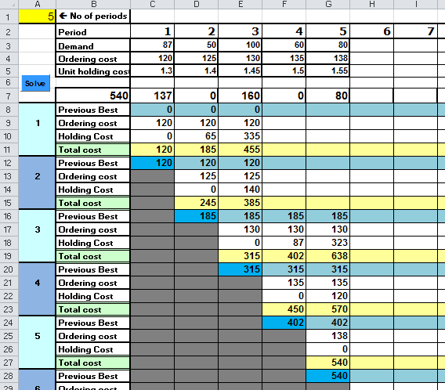
Excel solution
Ordering policy
Total cost

Slide 32
Aggregate Planning
Suppose
1 pickup = 1.6 cars
Objective: to develop a feasible production plan on an aggregate level based on demand, capacities, costs and other factors.
500 pickups and 1600 cars equivalent to:
(500 * 1.6) + 1600 = 2400 cars, or
500 + (1600 / 1.6) = 1500 pickups.
How is equivalence determined?

Slide 33
Calculate aggregate demand in term of the standard product “CC”.
 | Time [Hrs. /unit] | Demand for May [units] | Demand in standard product (CC) units
AA | 1.5 | 2400
BB | 3.0 | 1000
CC | 2.0 | 2000
DD | 1.0 | 1200
Aggregate requirement (demand)
1.5 * 2400 / 2.0 = 1800
3.0 * 1000 / 2.0 = 1500
2.0 * 2000 / 2.0 = 2000
1.0 * 1200 / 2.0 = 600
5900
What to do if capacity in standard units is 5000?
What if demand remains high (or low) month after month?

Slide 34
Developing Aggregate Plan.
For aggregate planning, the planned period is called the planning horizon. For planning, we can use different strategies: Chase, Level or a combination.
Chase Strategy: produce quantity equal to aggregate demand for each period (to keep inventory level zero).
Level Strategy: Produce quantity equal to the average requirement over the planning horizon.
Policies (constraint) examples:
Capacity in each period may be limited.
No shortages may be permitted (customer satisfaction).
No inventory is kept.
Must leave certain inventory at the end of period X.
Overtime limited to 20% of regular time.
Hiring and firing of workers.
Sometime we may have soft constraints. We try to meet these constraints as much as possible. LP does not use soft constraints.

Slide 35
Aggregate Planning Model(for 12 periods)
Periods: P₁, P₂, .., P₁₂
Aggregate demand D₁, D₂, ..,D₁₂
Production: X₁, X₂, ..., X₁₂
End inventory: I₀, I₁, I₂, .., I₁₂.
Regular workers: R₀, R₁, R₂, ..,R₁₂
Overtime O₀, O₁, O₂, ..,O₁₂
R₀, O₀ R₁, O₁ R₂, O₂ R₃, O₃ Workers
X₁ X₂ X₃ Production
I₀ I₁ I₂ I₃
D₁ D₂ D₃ Demand
I_{k} = I_{k-1} + X_{k} – D_{k}
If I_{k} > 0 we have to pay holding cost on inventory.
If I_{k} < 0 we have to pay shortage cost on demand not met.
A worker make β units in a day. The worker makes λ units in overtime (overtime is less than a day).

Slide 36
Chase Strategy
Level Strategy
No inventory.
You can hire or lay off workers (some cost involved). Overtime cannot be given to new workers.
Level production (shortages permitted )
Constant workforce (hire or lay off only in P1)
To find the minimum cost production plan.
Cost = Regular wage & benefit + Overtime wage & benefit
+ Cost of hiring + Cost of lay off
+ Holding cost + Shortage cost
Other costs remain fixed during the year.
What are the decision variables for each strategy?
How to handle holding / shortage cost for the level strategy?

Slide 37
Capital Budgeting Example
Reduce the budget to 175.

