Slide 1
Networks Models
Summer 2013

Slide 2
What’s a network?
node
arc
A network is a diagram using nodes connected with arcs.
Nodes may have different shapes. Arcs can be straight or curved, may or may not have arrows. In different contexts, nodes and arcs represent different things.
For example, in a project, each node may represent a task and each arc indicating precedence (which task goes before or after) relationship.
A 8W
We are going to deal with flow networks.
C 5W
B 4W
A network model describes patterns of flow involving material, people, or funds. Nodes can represent locations, machines or even time elements.
We will consider the following models:
Transportation Assignment Transshipment

Slide 3
Transportation Model
The model can be shown either in a table or by a network. In a table, there are “m” factories (plants) represented by rows and “n” warehouses (stores, destinations) represented by columns.
Available supply (capacity) at each factory is shown in the last column and demand ( requirement) is shown in the last row.
Numbers in the table shows per unit transportation cost from a factory to a store.
Per unit transportation costs
Plant/Warehouse | Atl | Bos | Chi | Den | Capacity
Minn | 0.60 | 0.56 | 0.22 | 0.40 | 9000
Pitt | 0.36 | 0.30 | 0.28 | 0.58 | 12000
Tucs | 0.65 | 0.68 | 0.55 | 0.42 | 13000
Requirement | 7500 | 8500 | 9500 | 8000
m = 3 and n = 4
We need to find the shipping plan at minimum cost.
Shipping quantity from any factory cannot exceed the capacity and demand at each warehouse must be met. More generic names used are: source (for factory) and sink (for warehouse) or destination.

Slide 4
Per unit transportation costs
From/To | Atl | Bos | Chi | Den | Capacity
Minn | 0.60 | 0.56 | 0.22 | 0.40 | 9000
Pitt | 0.36 | 0.30 | 0.28 | 0.58 | 12000
Tucs | 0.65 | 0.68 | 0.55 | 0.42 | 13000
Req. | 7500 | 8500 | 9500 | 8000
Network representation Arrows show direction of shipments.
A
7500
9000
M
This model can be formulated as an LP model. Variables:
MA: shipment from M to A
TD: shipment from T to D.
B
8500
12000
P
C
9500
13000
T
There will be (3 + 4 = ) 7 constraints,
one per row and one per column.
Row 2: PA + PB + PC + PD ≤ 12,000 …. Cannot exceed supply
Column 3: MC + PC + TC ≥ 9,500 …. Must meet demand
D
8000
There will be (3 * 4 = )12 variables and the objective function will be
Min Z = 0.60MA + 0.56MB + … + 0.55TC + 0.42TD
If ∑ supply < ∑ demand, we will have no solution.

Slide 5
Per unit transportation costs
From/To | Atl | Bos | Chi | Den | Capacity
Minn | 0.60 | 0.56 | 0.22 | 0.40 | 9000
Pitt | 0.36 | 0.30 | 0.28 | 0.58 | 12000
Tucs | 0.65 | 0.68 | 0.55 | 0.42 | 13000
Req. | 7500 | 8500 | 9500 | 8000
If ∑ supply < ∑ demand, we will have no solution. To avoid this, we will modify the model slightly.
We can always add a dummy column or a dummy row with zero unit shipping cost and appropriate demand / supply to make ∑ supply = ∑ demand
In our example, total supply = 34000, total demand = 33500.
So we will add a dummy demand column.
Per unit transportation costs
From/To | Atl | Bos | Chi | Den | Extra | Capacity
Minn | 0.60 | 0.56 | 0.22 | 0.40 | 0.00 | 9000
Pitt | 0.36 | 0.30 | 0.28 | 0.58 | 0.00 | 12000
Tucs | 0.65 | 0.68 | 0.55 | 0.42 | 0.00 | 13000
Required | 7500 | 8500 | 9500 | 8000 | 500

Slide 6
LP formulation
Bonner Electronics
 | Per unit transportation costs
 |  | 1 | 2 | 3 | 4 | 5
 | From/To | Atl | Bos | Chi | Den | Extra | Capacity
1 | Minn | 0.60 | 0.56 | 0.22 | 0.40 | 0.00 | 9000
2 | Pitt | 0.36 | 0.30 | 0.28 | 0.58 | 0.00 | 12000
3 | Tucs | 0.65 | 0.68 | 0.55 | 0.42 | 0.00 | 13000
 | Required | 7500 | 8500 | 9500 | 8000 | 500
Decision variables - MA: # of units shipped from M to A, MB:…, TE: ….
There will be 3*5 = 15 variables.
Objective function-
Minimize 0.6MA + 0.56MB+…….+0.42TD+0.0TE
MA, MB, ……. TD, TE ≥ 0
Constraints – all equality, one for each row and column.
Row 1: MA + MB+ MC + MD + ME = 9000
Column 2: MB+ PB+ TB = 8500 Column 5: ME+ PE+ TE = 500

Slide 7
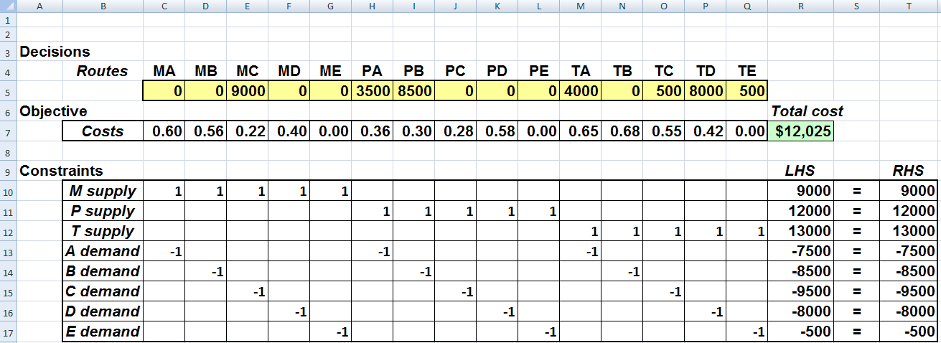
Transportation Model: Solution
We can enter 15 variables in 15 columns as shown above when we use the solver. However, we will use a more compact formulation.
We will create a new template for transportation models.

Slide 8
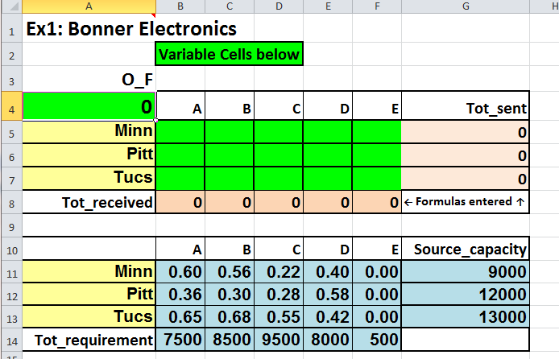
Units_shipped
=SUMPRODUCT(Units_shipped,Unit_shipping_cost)
Constraints: Tot_received = Tot_requirement
Tot_sent = Source_capacity
Units_shipped ≥ 0

Slide 9
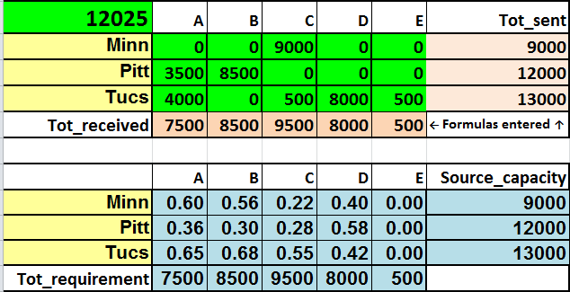
Final solution
A
7500
9000
M
9000
What are the circled entries?
How to verify the total cost?
B
3500
8500
12000
P
8500
4000
C
9500
13000
T
500
8000
D
8000
500
E
500
You are responsible for understanding and explaining the Answer report and the Sensitivity report.

Slide 10
Transportation Model: comments
For this model, we have m*n variables and (m + n) constraints.
When supply and demands are integer numbers, all shipments will be in integers.
While this model has been applied in many cases, a vast number of transportation problems will not fit into this model.
There may be capacity constraints – how much maximum shipment is allowed from a source to a sink.
Capacity constraints (maximum direct shipment allowed between a source and a destination) can result in an infeasible solution.

Slide 11
Transshipment Model
Western Paper company:
Three factories: F1, F2, F3. Five warehouses: W1, W2, W3, W4, W5
Goods are shipped from factories to two depots (D1, D2), repackaged and then shipped to the warehouses. Depots: transshipment points.
Shipping costs, capacities and requirements are shown below.
W1
From factories | D1 | D2 | Capacity
F1 | 1.28 | 1.36 | 2500
F2 | 1.33 | 1.38 | 2500
F3 | 1.68 | 1.55 | 2500
F1
D1
W2
F2
W3
D2
From depots | W1 | W2 | W3 | W4 | W5
D1 | 0.60 | 0.42 | 0.32 | 0.44 | 0.68
D2 | 0.57 | 0.30 | 0.40 | 0.38 | 0.72
Requirement | 1200 | 1300 | 1400 | 1500 | 1600
W4
F3
W5

Slide 12
LP formulation
∑ supply ≥ ∑ demand, no dummy node
 | D1 | D2 | Capacity
F1 | 1.28 | 1.36 | 2500
F2 | 1.33 | 1.38 | 2500
F3 | 1.68 | 1.55 | 2500
From depots | W1 | W2 | W3 | W4 | W5
D1 | 0.60 | 0.42 | 0.32 | 0.44 | 0.68
D2 | 0.57 | 0.30 | 0.40 | 0.38 | 0.72
Requirement | 1200 | 1300 | 1400 | 1500 | 1600
Let X₁₁ be the amount shipped from F1 to D1,
…. Y₁₁ be the amount shipped from D1 to W1.
W1
F1
D1
W2
Minimize
1.28*X₁₁ + …. + 1.55*X₃₂ + 0.60*Y₁₁ + …. + 0.72 *Y₂₅ = Z
F2
W3
D2
F3
W4
Subject to:
Requirement constraints
Y₁₁ + Y₂₁ ≥ 1200 (W1)
Y₁₂ + Y₂₂ ≥ 1300 (W2)
Y₁₃ + Y₂₃ ≥ 1400 (W3)
Y₁₄ + Y₂₄ ≥ 1500 (W4)
Y₁₅ + Y₂₅ ≥ 1600 (W5)
W5
Capacity constraints
X₁₁ + X₁₂ ≤ 2500 (F1)
X₂₁ + X₂₂ ≤ 2500 (F2)
X₃₁ + X₃₂ ≤ 2500 (F3)
Non negativity constraints
Balance equations
- X₁₁ - X₂₁ - X₃₁ + Y₁₁+ Y₁₂ + Y₁₃ + Y₁₄ + Y₁₅ = 0
- X₁₂ - X₂₂ - X₃₂ + Y₂₁+ Y₂₂ + Y₂₃ + Y₂₄ + Y₂₅ = 0

Slide 13
Network diagram
∑ supply = 7500 ∑ demand = 7000
W1
W1
F1
D1
W2
F1
D1
W2
F2
W3
F2
W3
D2
D2
W4
W4
F3
F3
W5
W5
Without dummy
Constraint types:
W6
Supply: ≤
Demand: ≥
Dummy destination W6 gets direct shipments @ 0 cost per unit. All equality constraints.
Balance: =

Slide 14
W1
With the solver, we enter costs along the arrows in the table above.
F1
D1
W2
Where there are no arrows, we use very high unit cost to prevent shipment.
F2
W3
D2
W4
Dummy shipments have unit cost = 0.00
F3
W5
Potentially factories can ship all units to D1 and then to warehouses. Same could happen with D2. Hence capacities and requirements for transshipment points is 7500 (equal to total supply from factories).
W6

Slide 15
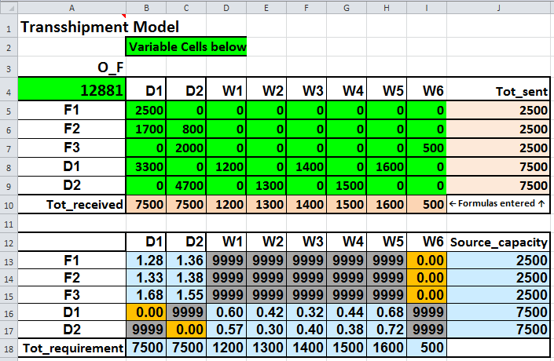

Slide 16
Assignment Model
 | P1 | P2 | P3
C1 | 25 | 36 | 24
C2 | 28 | 32 | 20
C3 | 35 | 30 | 22
Example 1: Three contractors are bidding for three projects. The table shows costs. You cannot assign more than one project to a contractor or more than one contractor to a project. We want to assign contractors to projects to minimize total cost.
Which contractor to which project?
This is a special case of the transportation model with supply = 1 for each row and demand = 1 for each column. Instead of using the solver, we will learn a special method.
Principle: If we add (subtract) a constant value from the cost elements of any row or column, the solution is not affected , i.e. optimal assignments remain the same (only the value of the objective function changes).
 | P1 | P2 | P3
C1 | 25 | 36 | 24
C2 | 28 | 32 | 20
C3 | 35 | 30 | 22
Subtract
25 from column 1,
30 from column 2,
20 from column 3.
 | P1 | P2 | P3
C1 | 0 | 6 | 4
C2 | 3 | 2 | 0
C3 | 10 | 0 | 2

Slide 17
Assignment procedure
 | P1 | P2 | P3
C1 | 26 | 36 | 24
C2 | 28 | 30 | 18
C3 | 35 | 32 | 20
C4 | 40 | 25 | 21
P4
0
0
0
0
Step 0: Start with a balanced n x n problem (Add dummy rows or columns with zero costs, if required).
Step 1*: Subtract the smallest number from each row (then column, if necessary), to create a zero in each row and each column. There should be no negative numbers. *You can start subtractions with columns then rows.
⬇ | ⬇ | ⬇ | ⬇
26 | 25 | 18 | 0
0 | 11 | 6 | 0 | Step 1
2 | 5 | 0 | 0
9 | 7 | 2 | 0
14 | 0 | 3 | 0
Step 2: Make as many assignment in cells with 0 cost as possible. The problem is solved if all assignments are made.
0 | 11 | 6 | 0 | Step 2
2 | 5 | 0 | 0
9 | 7 | 2 | 0
14 | 0 | 3 | 0
Solution: Assign C1 to P1, C2 to P3 and C4 to P2. C3 to ?
Total cost = 69. How did we get the total cost?

Slide 18
How to make maximum number of assignments
0 | 11 | 6 | 0
2 | 5 | 0 | 0
9 | 7 | 2 | 0
15 | 0 | 3 | 0
Choose cell (row 1, column 1) as there is only one zero in column 1. Cross out other elements in row1, column 1. →
0
 | 5 | 0 | 0
 | 7 | 2 | 0
 | 0 | 3 | 0
Choose cell (4,2) as there is only one zero left in column 2 →
0
 |  | 0 | 0
 |  | 2 | 0
 | 0
0
 |  | 0
 |  |  | 0
 | 0
Choose (2, 3) →
What would happen if we had started with cell (4,4)?
0 | 11 | 6 | 0
2 | 5 | 0 | 0
9 | 7 | 2 | 0
15 | 0 | 3 | 0
0 | 11 | 6
2 | 5 | 0
9 | 7 | 2
 |  |  | 0
0
 |  | 0
 |  |  | 0
→
→
We did not make maximum number of assignments.

Slide 19
Assignment: Ex. 2
Step 0: The problem has 3 rows and 5 columns. Add 2 rows.
Step 1: Subtract the smallest number from each row.
 | J1 | J2 | J3 | J4 | J5
I1 | 15 | 27 | 34 | 20 | 26
I2 | 20 | 36 | 31 | 30 | 29
I3 | 24 | 43 | 29 | 22 | 32
I4 | 0 | 0 | 0 | 0 | 0
I5 | 0 | 0 | 0 | 0 | 0
➔ | 15
➔ | 20
➔ | 22
➔ | 0
➔ | 0
0 | 12 | 19 | 5 | 11
0 | 16 | 11 | 10 | 9
2 | 21 | 7 | 0 | 10
0 | 0 | 0 | 0 | 0
0 | 0 | 0 | 0 | 0
Every row and column has a zero
Step 2: Make maximum number of assignment in cells with 0 cost as possible.
0 | 12 | 19 | 5 | 11
0 | 16 | 11 | 10 | 9
2 | 21 | 7 | 0 | 10
0 | 0 | 0 | 0 | 0
0 | 0 | 0 | 0 | 0
Since only 4 assignments are possible right now, we are not done. We need to create more zeros!

Slide 20
Example 2..
Step 3: Draw horizontal and vertical lines to cover all zero elements (number of lines must be equal to the number of assignments).
0 | 12 | 19 | 5 | 11
0 | 16 | 11 | 10 | 9
2 | 21 | 7 | 0 | 10
0 | 0 | 0 | 0 | 0
0 | 0 | 0 | 0 | 0
Step 3A: Find the smallest number not covered by lines and subtract this number from all uncovered cells.
Step 3B: add the same number to the numbers at the intersection of lines.
⬇
3a: Subtract 7.
3b: Add 7
0 | 5 | 12 | 5 | 4
0 | 9 | 4 | 10 | 2
2 | 14 | 0 | 0 | 3
7 | 0 | 0 | 7 | 0
7 | 0 | 0 | 7 | 0
0 | 5 | 12 | 5 | 4
0 | 9 | 4 | 10 | 2
2 | 14 | 0 | 0 | 3
7 | 0 | 0 | 7 | 0
7 | 0 | 0 | 7 | 0
0 | 5 | 12 | 5 | 4
0 | 9 | 4 | 10 | 2
2 | 14 | 0 | 0 | 3
7 | 0 | 0 | 7 | 0
7 | 0 | 0 | 7 | 0
Repeat Step 2 ➔
➔

Slide 21
Example 2 …
Step 3: Draw horizontal as vertical lines to cover all zero elements
0 | 5 | 12 | 5 | 4
0 | 9 | 4 | 10 | 2
2 | 14 | 0 | 0 | 3
7 | 0 | 0 | 7 | 0
7 | 0 | 0 | 7 | 0
Step 3 A and B: Smallest number is 2.
Subtract 2.
Add 2
⬇
Subtract / add 2
Original costs
 | J1 | J2 | J3 | J4 | J5
I1 | 15 | 27 | 34 | 20 | 26
I2 | 20 | 36 | 31 | 30 | 29
I3 | 24 | 43 | 29 | 22 | 32
I4 | 0 | 0 | 0 | 0 | 0
I5 | 0 | 0 | 0 | 0 | 0
0 | 3 | 10 | 3 | 2
0 | 7 | 2 | 8 | 0
4 | 14 | 0 | 0 | 3
9 | 0 | 0 | 7 | 0
9 | 0 | 0 | 7 | 0
0 | 3 | 10 | 3 | 2
0 | 7 | 2 | 8 | 0
4 | 14 | 0 | 0 | 3
9 | 0 | 0 | 7 | 0
9 | 0 | 0 | 7 | 0
Repeat Step 2 ➔
➔
Solution: I1 to J1, I2 to J5 and I3 to J4. Total cost = 66.

Slide 22
How to draw lines to cover all zeros?
Step 3: Draw horizontal and vertical lines to cover all zeros.
Always draw a line over a column / row containing maximum zeros.
If there is a tie, select smallest column # first then smallest row #.
Do not draw line over any row that does not contain an assignment.
0 | 12 | 19 | 5 | 11
0 | 16 | 11 | 10 | 9
2 | 21 | 7 | 0 | 10
0 | 0 | 0 | 0 | 0
0 | 0 | 0 | 0 | 0
Draw line on row 4
Draw line on row 5
Here are two examples.
Draw line on column 1
Draw line on column 4
0 | 3 | 10 | 15 | 10
0 | 0 | 0 | 1 | 9
0 | 22 | 2 | 0 | 7
0 | 2 | 13 | 1 | 4
5 | 0 | 2 | 0 | 0
Draw line on column 1
Draw line on row 5
Draw line on row 2
Draw line on column 4

Slide 23
Assignment procedure
Step 0: Start with a balanced n x n problem (Add dummy rows or columns with zero costs, if required).
Step 1: Subtract the smallest number from each row (then column, if necessary), to create a zero in each row and each column without creating negative numbers. You can start with columns then rows.
Step 2: Make as many assignment in cells with 0 cost as possible. The problem is solved if all assignments are made.
Step 3: Draw horizontal and vertical lines to cover all zeros.
Step 3A: Find the smallest number not covered by lines and subtract this number from all uncovered cells.
Step 3B: add the same number to the numbers at the intersection of lines.
Return to step 2.

Slide 24
Other network models
Shortest Path
- Each arc has a length associated with it
- The length may represent distance, time, cost, etc.
s
t
- The objective is to find the shortest (directed) path from the source to the destination, i.e., the minimum distance, time, cost
Applications: transportation, communication
Maximum Flow
- Arcs represent maximum capacities that limit the quantity
of a product that may be shipped through the arc
- The objective is to maximize the amount of flow from the
starting point (source) to a terminal point (sink)
Applications: traffic control, communication network, production
Traveling Salesman
- Arcs represent “distance” (can be cost, time). Each node is a “city”.
The objective is to minimize distance traveled starting from a city, visiting every other city (along the directed arc) and returning to the starting point.
Application: Scheduling, delivering hot lunch

Slide 25
Minimal Spanning Tree
2
10
6
Consider the undirected network shown.
1
5
4
3
4
Nodes shown here represent cities. Each undirected arc shows a potential (two-way) communications link (no link possible between 1 and 3 or 4 and 7). These links have sufficient capacities.
12
6
11
8
6
7
5
5
6
3
8
6
10
4
8
Numbers on arc represent cost of the link. The objective is to build the communication network connecting all cities at minimum cost, or a minimal spanning tree.
2
6
Obviously there should be no cycles; these represent redundancy and increase the cost.
5
1
4
3
4
6
7
A simple intuitive “greedy” method will always give us an optimal solution!
5
6
3
5
4
8

Slide 26
BASF Network Improvement*
1.6 Billion pounds of finished goods per year
Network of 135 locations (85 were Distribution Centers)
System “evolved” over time, Was never actually designed
Use of LP to Analyze Network
Goal was to define the optimal number and location of warehouses and material flows to satisfy demand at lowest cost.
Gathered data on supplies at node (i) and demand levels at nodes (j) and costs to ship goods along each arc (i, j).
Created and ran model repeatedly to answer many “what-if” questions of management.
Distribution Centers reduced from 86 to 12.
Cut transportation and storage costs by 6%.
Improved cash flows by 9% by closing sites and cutting inventory.
Improved customer service.
Led to similar models for Europe, Asia, etc.
* Paper in Interfaces, May – June 2001. by Sery et. Al.

