Slide 1
Burkley
First edition
Chapter 1
The Science of Motivation
Copyright © 2018 Pearson Education, Inc. All Rights Reserved

Slide 2
Learning Objectives
Who is J. K. Rowling? What habits did she have that helped make her successful?
Theodor Seuss Geisel?
Set goals and
Established habits (on auto pilot!)
Embrased failure
1.1 Analyze the characteristics of motivation
1.1.1 Explain how motivation is future oriented
1.1.2 Define motivation
1.1.3 Describe the relationship between goals and motivation
1.2 Explain how self-control positively affects motivation
1.2.1 Determine the relationship between temptation and self-control
1.2.2 Start to Create your Self-Improvement Project (SIP) goal
Notes:
Slide 2 is list of textbook LO numbers and statements

Slide 3
Introduction: The Science of Motivation
Key questions to be answered
What is motivation?
Why is motivation important?
Notes:
The ability to imagine and prepare for the future is unique to humans, and while the study of motivation is a fairly new field, the concept has strong historical roots.
Motivation is critical because of the wide variety of temptations and their connections to social problems.

Slide 4
1.1: What Is Motivation? (2 of 4)
1.1: Analyze the characteristics of motivation
How are humans different from animals?
Anticipate the future (long term planning)
Free from the “tyranny of bondage to the present”
Develops through childhood
Do other animals have self awareness? (Gilbert, 2006)
1.1.1: Motivation Is Future Oriented (Planning)
1.1.1: Explain how motivation is future oriented
Lobotomies
Neurosurgical procedure
Treatment for severe psychiatric disorders
Impact on planning and goals
Goals
Cognitive representation of the future
Resist temptation
Prefrontal lobe (executive function)
Notes:
1.1: Analyze the characteristics of motivation
Point 1 – How are humans different from animals?
While animals have demonstrated language and self-awareness, the ability to anticipate the future appears to be a human trait.
Humans are able to project their minds into the future.
The ability to think into the future develops as humans grow up.
1.1.1: Motivation Is Future Oriented
1.1.1: Explain how motivation is future oriented
Point 1 – Lobotomies
A lobotomy severs connections to the prefrontal cortex.
The procedure was popular during the 1940s and 1950s.
While lobotomies appeared to have no impact on intelligence and memory, they did impact planning and sticking to goals.
Point 2 – Goals
Goals are cognitive representations of the future that an individual is committed to approach or avoid.
Lobotomized patients could not avoid temptations, reverting to pleasure-seeking animals.
The prefrontal lobe is where the ability to anticipate the future, plan for it, and set goals accordingly is located.

Slide 5
1.1: What Is Motivation? (2 of 4)
1.1.2: Defining Motivation “motive”
1.1.2: Define motivation
What is the definition of motivation?
Motus (what moves us)
Underlying processes that
Initiate behavior
Sustain it
Determine the intensity (energy)
Give if direction (what drink do you go for in he fridge?)
Favorable or unfavorable
The principal components of the energy within motivation
Initiation
Intensity
Persistence
Notes:
1.1.2: Defining Motivation
1.1.2: Define motivation
Point 1 – What is the definition of motivation?
The Latin word motus means to move, and was first used by Cicero when he refers to the motion or stirring of the soul as motus animi.
Schopenhauer first used the word “motivation” in 1813 to describe the underlying processes that provide energy and direction for behavior.
Point 2 – The components of the energy within motivation
Initiation is the starting of a behavior.
Intensity is the amount of resources expended to carry out the behavior.
Persistence is the continuing of the expenditure until the behavior is completed.
How do these components vary by each situation?

Slide 6
1.1: What Is Motivation? (2 of 4)
1.1.3: Goals and Motivation
1.1.3: Describe the relationship between goals and motivation
The Three-Step Process to Achieve a Goal
Choose a particular goal
Develop a plan of action
Initiate and expend resources until completion of goal
Why study motivation?
Determine what drives the behavior of others
Determine what drives your own behavior
Notes:
1.1.3: Goals and Motivation
1.1.3: Describe the relationship between goals and motivation
Point 1 – The Three-Step Process to Achieve a Goal
Refer to Figure 1.1: Using the Three-Step Process to Achieve Your Goal .
Goal-seeking is not always conscious.
What factors, both internal and external, do you think affect the goal-achieving process?
Point 2 – Why study motivation?
Humans are naturally people-watchers and want to understand why people act the way they do.
We also want to know what affects our own goals. This figure is not listed in the template.

Slide 7
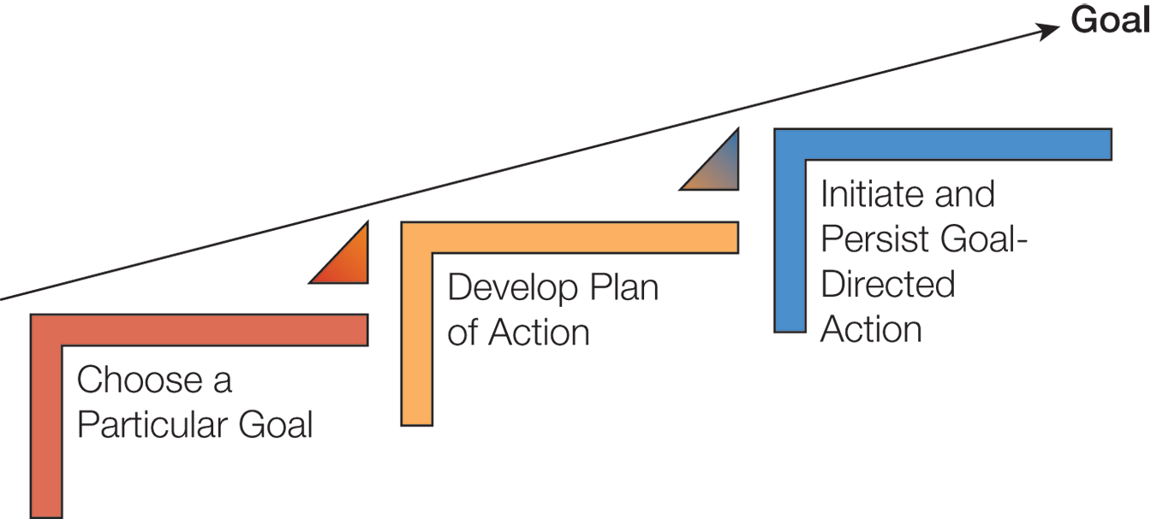
Figure 1.1: Using the Three-Step Process to Achieve Your Goal

Slide 8
1.2: Why Is Motivation Important? (1 of 4)
1.2: Explain how self-control positively affects motivation
What factors affect life success?
Intelligence? (nature / nurture)
Self-esteem? – is there an epidemic of low SE in the U.S?
Narcissistic ?
Self-control
Willpower
Impulses (are you a slave to your impulses?)
Does Serena Williams or Justin Bieber
have a problem with self-control?
Notes:
1.2: Explain how self-control positively affects motivation
Point 1 – What factors affect life success?
How have societal focuses on intelligence and self-esteem affected people, especially the younger generations?
Point 2 – Self-control
Self-control is what allows us to become the person we want to be.
Some people have low self-control and are slaves to their impulses.
How are social problems linked to self-control?

Slide 9
1.2: Why Is Motivation Important? (1 of 4)
1.2.1: Importance of Self-Control
Remember Bandura’s “marshmello” experiment?
1.2.1: Determine the relationship between temptation and self-control
What is the relationship between temptation and self-control?
Never ceasing temptations
Not all temptations are equal
How often do we exert self-control?
3 hours/day
Lower rates for social interaction and alcohol
30 minutes of self-control failure
Prediction of later success
Hoffmann et al, (2012)
How many hours a day did the subjects feel “tempted”?
Sex, sleep, play sports, social interaction –strongest ones
Notes:
1.2.1: Importance of Self-Control
1.2.1: Determine the relationship between temptation and self-control
Point 1 – What is the relationship between temptation and self-control?
Hofmann, Baumeister, Förster, and Vohs (2012) demonstrated that temptation is the norm.
The most common temptations are eating, drinking nonalcoholic beverages, and sleeping.
Leisure, social interactions, and media were also popular.
The highest intensity temptations were sex, sleep, playing sports, and social interaction. Cigarettes and alcohol were the lowest.
Point 2 – How often do we exert self-control?
The Hofmann et al. (2012) study shows temptations are ubiquitous.
Moffitt et al. (2011) found that children who had high self-control at age 3 had better health and wealth at age 32 than children will lower self-control.

Slide 10
1.2: Why Is Motivation Important? (1 of 4)
1.2.2: ProjectMe Goal
1.2.2: Create your ProjectMe goal
The ProjectMe goal
Application of theories and research
Concrete, self-relevant situation
Guidelines
Pick a goal
Weekly monitoring
Length of the class (be realistic)
Public
Legal
Not to perform well in the class
Notes:
1.2.2: ProjectMe Goal
1.2.2: Create your ProjectMe goal
Point 1 – The ProjectMe goal
The purpose of the ProjectMe is to provide a work in progress in which you as a student will apply the theories and research findings from the course to a concrete situation.
This will be an individual, ongoing project in which you identify a goal you want to achieve.
Point 2 – Guidelines
Your goal must be quantifiable and achievable. It might be made public, so choose something you feel comfortable sharing. The goal cannot be to perform well in the course; choose something else instead.

Slide 11
Summary: The Science of Motivation
The definition of motivation
The importance of motivation
Notes:
The ability to plan is located in the prefrontal cortex and is uniquely human. Motivation is the underlying process that provides energy and direction for behavior. Behavior can vary in initiation, intensity, and persistence. Motivation can be affected by biological, environmental, emotional, social, and cognitive forces.
Self-control is the ability to regular and change thoughts, emotions, and behaviors. People with high self-control are not as affected by temptations. Poor self-control is associated with nearly every social problem. Interestingly, a study by Moffitt et al. (2011) showed a link between self-control at 3 and later health, wealth, and criminality at age 32.

Slide 12
Factors that influence motivation:
Kurt Lewin B = f (p*e)
B = Behavior
P = Individual (person) attributes
Biological
Physical
Mental
Emotional
Personality traits
Values
e = Environmental influences
What are some?
* = interaction of p X e

