Slide 1
Burkley
First edition
Chapter 3
Psychological Origins of Motivation
Copyright © 2018 Pearson Education, Inc. All Rights Reserved

Slide 2
Learning Objectives (1 of 1)
3.1 Evaluate will as a psychological origin of motivation
3.1.1 Explain James's contribution to the study of will
3.1.2 Evaluate the contributions of Ludwig Lange and Narziss Ach to the study of will
3.2 Analyze how the concept of instinct played a role in the understanding of motivation
3.2.1 Explain Darwin's contribution to the study of instinct
3.2.2 Explain James' contribution to the study of instinct
3.2.3 Explain McDougall's contribution to the study of instinct
3.2.4 Describe alternate perspectives of instinct
3.2.5 Explain why instincts declined as an underlying concept of motivation
Notes:
Slide 2 is list of textbook LO numbers and statements

Slide 3
Learning Objectives (1 of 2)
3.3 Analyze the aspects of the concept of drive as it relates to motivation
3.3.1 Summarize Freud's contribution to the concept of drive
3.3.2 Describe Hull's contribution to the concept of drive
3.3.3 Contrast instinct and drive as they relate to motivation
3.4 Contrast the psychological theories of personality differences in motivation
3.5 Explain the role incentives play in regard to motivation
3.5.1 Describe Tolman's contribution to the concept of incentives
3.6 Evaluate how thoughts or cognitions play a central role in explaining behavior
3.6.1 Analyze the cognitive revolution in motivation
3.7 Analyze the causes that have popularized motivation science
3.7.1 Describe motivation in the modern era
Notes:
Slide 2 is list of textbook LO numbers and statements

Slide 4
Introduction: Psychological Origins of Motivation
Key questions to be answered
Will (free will vs. determinism)
Can you have it both ways?
Instinct (Pull)
Drive (Push)
Incentives (Pull)
Cognition
The Fall and Rise of Motivation Science
Notes:
Key questions to be answered
Early theories on motivation examined will, which is the ability of an agent to make choices free from constraints. A variety of theorists examined will in a variety of settings.
Determinism states that some predetermined cause determines all things, and that instincts are one form of determinism.
Other theorists argued that people (and animals) are motivated by drive, which is a form of arousal that arises when a need is deprived.
Incentives stemmed from behaviorism, which examined incentives and learning.
In the 1970s, cognition changed the way we understand motivation, removing it from other paradigms.
As with other disciplines, motivation has experienced rises and falls. Currently, there is an increased interest in motivation.

Slide 5
3.1: Will (1 of 2)
3.1: Evaluate will as a psychological origin of motivation
What is “will”? Make choices free from constraint
Plato’s chariot rider
How did will emerge in the field?
Focus on internal control
Focus on resisting temptation
Wilhelm Wundt (Will?))
Founding father of experimental psych)
3.1.1: James's Contributions to the Study of Will
3.1.1: Explain James's contribution to the study of will
What was James’s contribution to the study of will?
Founder of modern psychology in U.S. at Harvard
Brought in Hugo Munsterberger
Deliberate vs. decisive
Will vs. effort
Volition vs. nolition
Notes:
3.1: Evaluate will as a psychological origin of motivation
Point 1 – What is “will”?
Will is sometimes known as willpower or free will.
Point 2 – How did will emerge in the field?
In the late 1800s, the Victorians were searching for secular reasons to retain morality and social order. Samuel Smiles wrote Self-Help in 1859.
Victorians were obsessed with guarding themselves from temptation, especially sexual and hedonistic ones. The temperance movement emerged during this time.
Wundt believed that involuntary actions always start out first as voluntary actions that require a great deal of will.
3.1.1: James's Contributions to the Study of Will
3.1.1: Explain James's contribution to the study of will
Point 1 – What was James’s contribution to the study of will?
James called automatic responses ideo-motor action. However, many times we make a conscious decision to pursue a course of action, and this involves will. Volitional acts begin with a deliberative step, followed by the decisive step.
To keep an effort sustained, we must continually hold our goal in mind and not let it fade.
He argued that there are two types of will: impulsions (volitions) and inhibitions (nolitions). Too much volition is explosive will, and too much nolition is obstructed will. What are some examples of these different behaviors?

Slide 6
3.1: Will (2 of 2)
3.1.2: Contributions of Other Pioneers
3.1.2: Evaluate the contributions of Ludwig Lange and Narziss Ach to the study of will
What was Lange’s contribution to the study of will?
First experimental study of motivation
What was Ach’s contribution to the study of will?
Experimental study of will
Associative equivalent (strength of will over habit)
Hillgruber—difficulty law of motivation (difficult task requires more effort)
The decline of will
Effect of World War I
Progressive Movement
Desire for biological constructs
Notes:
3.1.2: Contributions of Other Pioneers
WWI The Great War 1914 to 1918. Nine million combatants and 7 million civilian deaths.
France, Russian, Britain v. Germany, Austria-Hungary, Italy. Germany lost.
3.1.2: Evaluate the contributions of Ludwig Lange and Narziss Ach to the study of will
Point 1 – What was Lange’s contribution to the study of will?
Lange was the first to officially conduct the first experiment of motivation, using a “control hammer” to measure the time when people responded to a stimulus.
Point 2 – What was Ach’s contribution to the study of will?
Ach required participants to memorize nonsensical pairs of syllables and asked them to override habits with new pairings. To complete the second task successfully, the strength of one’s will had to be stronger than the strength of habit, known as “associative equivalent.”
Hillgruber was a student of Ach who established the difficulty law of motivation, which states that increasing task difficulty automatically increase the amount of effort an individual will devote to the task.
Point 3 – The decline of will
After World War I, the idea of will began to disappear from discourse, except in Germany, where it was strongly associated with the Nazis.
The Progressive Movement involved people focusing more on their external environment and not their inner will.
Scientists also found will difficult to define and measure. They moved to instinct instead.

Slide 7
3.2: Instinct (1 of 3)
3.2: Analyze how the concept of instinct played a role in the understanding of motivation
What is instinct?
Animal urges
Determinism
3.2.1: Darwin’s Contribution to the Study of Instinct
3.2.1: Explain Darwin's contribution to the study of instinct
Charles Darwin and instinct
Natural selection (can there be unnatural selection?)
Power of external environment to shape species
3.2.2: James’s Contribution to the Study of Instinct
3.2.2: Explain James' contribution to the study of instinct
William James’s contribution to the study of instinct
“The faculty of acting in such a way as to produce certain ends, without foresight of the ends, and without previous education in the performance.”
List of instincts
Notes:
3.2: Analyze how the concept of instinct played a role in the understanding of motivation
Point 1 – What is instinct?
Early philosophers were intrigued by the idea of instinct and its influence on behavior.
Instincts represent one form of determinism in the sense that they represent an innate predisposition to approach or avoid a particular outcome.
3.2.1: Darwin’s Contribution to the Study of Instinct
3.2.1: Explain Darwin's contribution to the study of instinct
Point 1 – Charles Darwin and instinct
The criterion necessary for the existence of extinction of a species is whether it promotes survival.
Darwin’s ideas caused motivation researcher to focus on the power of external environments in shaping behavior, instead of internal factors such as intelligence and will. His ideas placed motivation out of philosophy and into biology.
3.2.2: James’s Contribution to the Study of Instinct
3.2.2: Explain James' contribution to the study of instinct
Point 1 – William James’s contribution to the study of instinct
James included instincts for rivalry, hunting, fear, and play.
James argued that instinct was among many other motivational forces.

Slide 8
3.2: Instinct (2 of 3)
3.2.3: McDougall’s Contribution to the Study of Instinct
3.2.3: Explain McDougall's contribution to the study of instinct
William McDougall’s contribution to the study of instinct
18 instinct “propensities”
Cognitions
Behavior
Emotions
3.2.4: Alternative Perspectives of Instinct
3.2.4: Describe alternate perspectives of instinct
What are the alternative perspectives of instinct?
Reflexes
Emotional, purposive (teleological)
Notes:
3.2.3: McDougall’s Contribution to the Study of Instinct
3.2.3: Explain McDougall's contribution to the study of instinct
Point 1 – William McDougall’s contribution to the study of instinct
McDougall believed instinct was the only motivational force responsible for human behavior.
He argued that instincts affect cognitions by selectively focusing our attention toward particular objects.
He believed that instincts influence our behavior by providing energy and direction for our actions.
He also believed that instincts are intricately tied to emotions, and that the emotional component was the core of instinct.
3.2.4: Alternative Perspectives of Instinct
3.2.4: Describe alternate perspectives of instinct
Point 1 – What are the alternative perspectives of instinct?
Some theorists argued that instincts were almost identical to reflexes, especially when referring to animal reflexes.
Other theorists (including McDougall) thought that certain cues in the environment elicit an instinct, and this elicits an emotion that turns to action.

Slide 9
3.2: Instinct (3 of 3)
3.2.5: The Decline of Instincts
3.2.5: Explain why instincts declined as an underlying concept of motivation
The decline of instincts
Lack of clear criteria
Contradictions between instincts
Circular logic used to identify instincts
Just limitless!
Notes:
3.2.5: The Decline of Instincts
3.2.5: Explain why instincts declined as an underlying concept of motivation
Point 1 – The decline of instincts
Why did the popularity of instincts lead to their downfall? What other factors contributed to it?

Slide 10
3.3: Drive (1 of 3)
3.3: Analyze the aspects of the concept of drive as it relates to motivation
What is drive?
A form of arousal or energy when a biological need is deprived
Assumed to be aversive
Primary reinforcers
Qualities of drive
Initiated by need
Organisms try to reduce drive.
Every behavior is to reduce drive.
Necessary for learning
Notes:
3.3: Analyze the aspects of the concept of drive as it relates to motivation
Point 1 – What is drive?
When we are deprived of a need, then we experience drive.
Objects or events that reduce drive are primary reinforcers.
Point 2 – Qualities of drive
A mouse who is deprived of food will learn to run a maze for food faster than a mouse who is not deprived.

Slide 11
3.3: Drive (2 of 3)
3.3.1: Freud’s Contribution to Drive
3.3.1: Summarize Freud's contribution to the concept of drive
What is Freud’s contribution to drive?
Behavior is motivated to satisfy basic biological needs
Libido
Needs are never fully satisfied
Freud’s three types of drives
Sex (self-evident)
Death (unconscious- you don’t even know you have it!)
Self-preservation (run from the bear!)
Notes:
3.3.1: Freud’s Contribution to Drive
3.3.1: Summarize Freud's contribution to the concept of drive
Point 1 – What is Freud’s contribution to drive?
Libido is the internal energy generated by basic needs.
Needs never go away and will only settle down briefly before resurfacing.
Point 2 – Freud’s three types of drives
Freud believed that the key to mental and physical health is to satisfy the three drives on a regular basis.
How can humor help satisfy a drive?

Slide 12
3.3: Drive (3 of 3)
3.3.2: Hull’s Contribution to Drive (S-R)
3.3.2: Describe Hull's contribution to the concept of drive
What is Hull’s contribution to drive?
The intensity of an organism’s behavior is determined by drive multiplied by habit.
Nonspecific arousal
Habits
3.3.3: Instinct Versus Drive
3.3.3: Contrast instinct and drive as they relate to motivation
What is the difference between instinct and drive?
Instinct is innate. (Reflexive)
Drive has no restrictions.(whatever satisfies)
Criticisms related to drive
Not all behaviors seem to derive from biological needs.
Learning occurs without drive.
Notes:
3.3.2: Hull’s Contribution to Drive
3.3.2: Describe Hull's contribution to the concept of drive
Point 1 – What is Hull’s contribution to drive?
Hull believed drive was a form of nonspecific arousal, while habits are well-learned responses that become automatically activated by situational cues.
Why did Hull’s theory appeal to a wide range of motivational theorists?
3.3.3: Instinct Versus Drive
3.3.3: Contrast instinct and drive as they relate to motivation
Point 1 – What is the difference between instinct and drive?
Why was drive considered to be better at explaining motivation than instinct?
Point 2 – Criticisms related to drive
How did incentive motives, secondary reinforcers, and functional autonomy attempt to counteract the argument that many behaviors do not stem from biological needs?

Slide 13
3.4: Personality
3.4: Contrast the psychological theories of personality differences in motivation
Theories of needs
Henry Murray—Thematic Apperception Test
- (list of all major needs)
Abraham Maslow—hierarchy of needs
Notes:
3.4: Contrast the psychological theories of personality differences in motivation
Point 1 – Theories of needs
Murray identified 24 psychogenic needs and developed a measure to assess how strong a particular need was within an individual.
Refer to Figure 3.1: Maslow’s Hierarchy of Needs This figure is not listed in the template.

Slide 14
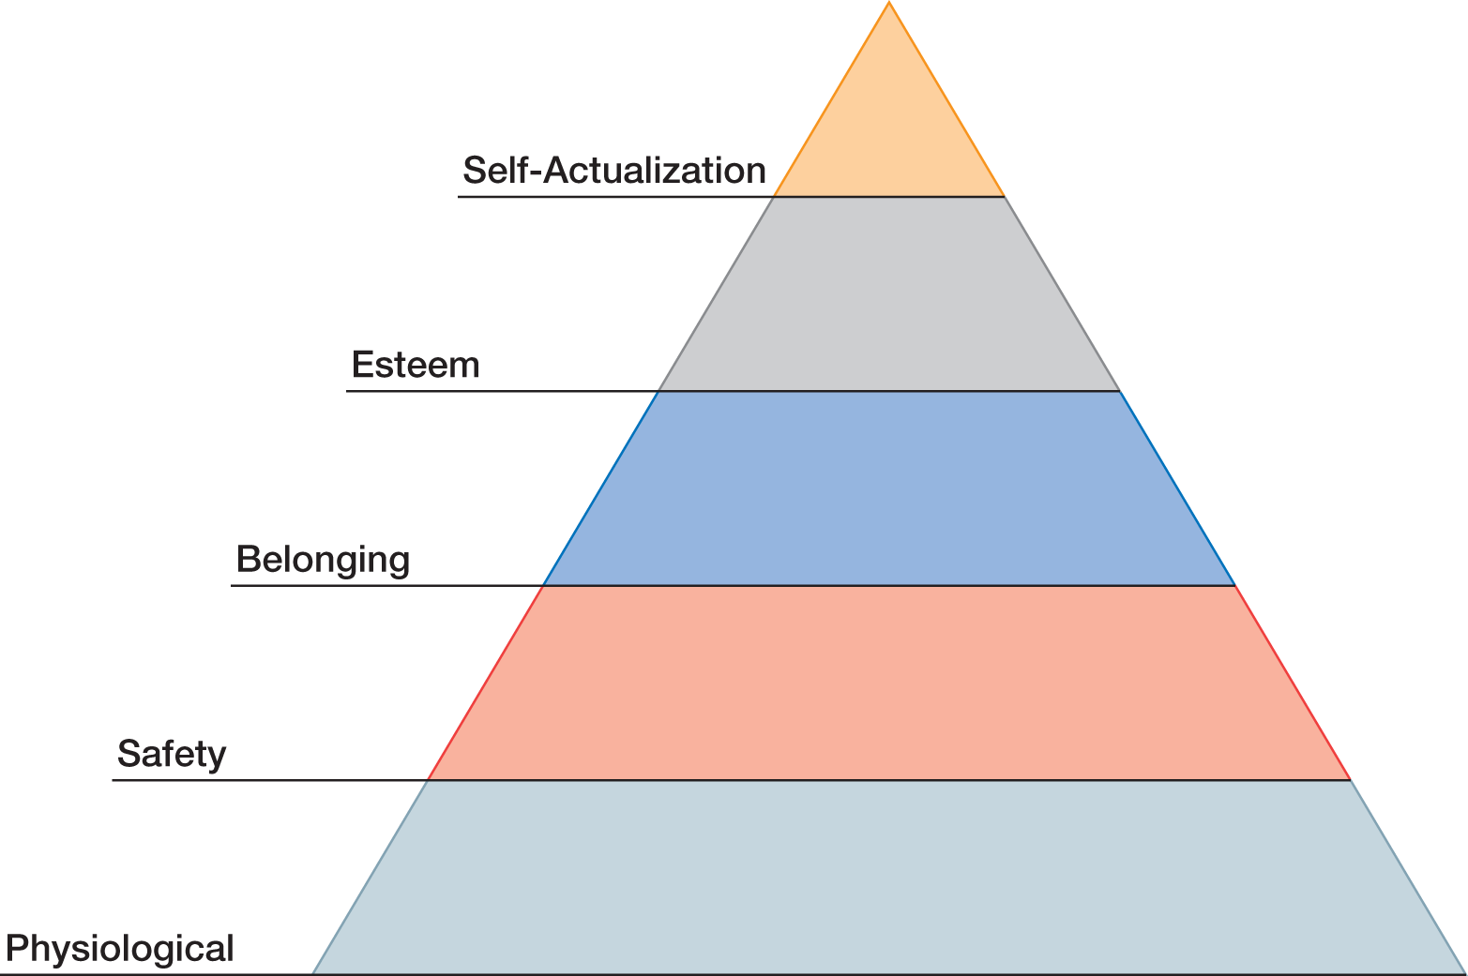
Figure 3.1: Maslow's Hierarchy of Needs

Slide 15
3.5: Incentives
3.5: Explain the role incentives play in regard to motivation
What role do incentives play in regard to motivation?
Behaviorism
Incentives
The importance of incentives
Thorndike’s Law of Effect
Tolman and Honzik (1930)—maze learning
3.5.1: Tolman’s Contribution to Incentives
3.5.1: Describe Tolman's contribution to the concept of incentives
What was Tolman’s contribution to the concept of incentives?
Focus on mental processes
Latent learning
Expectancy
Expectancy-value theory
Notes:
3.5: Explain the role incentives play in regard to motivation
Point 1 – What role do incentives play in regard to motivation?
One of the core motivational components of the behaviorist approach is that an incentive (external stimuli) can motivate an organism to perform a particular behavior.
Point 2 – The importance of incentives
The responses that are closely followed by an incentive will be more associated with that situation than other responses with be.
Discuss the 1930 study of incentives and mazes. Refer to Figure 3.2: Effect of Incentives on Maze Performance.
3.5.1: Tolman’s Contribution to Incentives
3.5.1: Describe Tolman's contribution to the concept of incentives
Point 1 – What was Tolman’s contribution to the concept of incentives?
Tolman argued that learning occurs, so he went beyond basic behaviorism.
Latent learning occurs without obvious incentive, while expectancy is the perceived likelihood that the behavior will be successful.
Expectancy-value theory states that behavior results from the joint function of one’s expectancy and value.

Slide 16
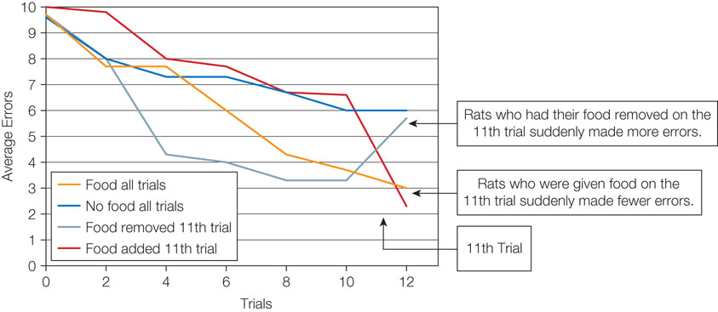
Figure 3.2: Effect of Incentives on Maze Performance

Slide 17
3.6: Cognition
3.6: Evaluate how thoughts or cognitions play a central role in explaining behavior
How does cognition play a central role in behavior?
Cognitive maps
Cognition, not behaviorism
3.6.1: The Cognitive Revolution in Motivation
3.6.1: Analyze the cognitive revolution in motivation
The cognitive revolution
Mentalistic explanations of motivation
Human qualities
How did the cognitive revolution affect the study of motivation?
Set the stage
Lost sight of motivational, volitional, and emotional explanations for human behavior
Notes:
3.6: Evaluate how thoughts or cognitions play a central role in explaining behavior
Point 1 – How does cognition play a central role in behavior?
Refer to Figures 3.3—A-C: Rat Maze Used to Study Cognitive Mapping.
How did Tolman and his students demonstrate that the rats had created cognitive maps?
3.6.1: The Cognitive Revolution in Motivation
3.6.1: Analyze the cognitive revolution in motivation
Point 1 – The cognitive revolution
New theorists in the 1970s focused on ideas such as goals, attributions, expectations, plans, self-beliefs, and self-concept.
There was a greater focus on how humans are different from animals by using humans and goal-setting versus animals in mazes.
Point 2 – How did the cognitive revolution affect the study of motivation?
Many theories, such as expectancy-value theory, still influence the field today.
Motivation was broken into pieces and landed in different psychological subfields.

Slide 18
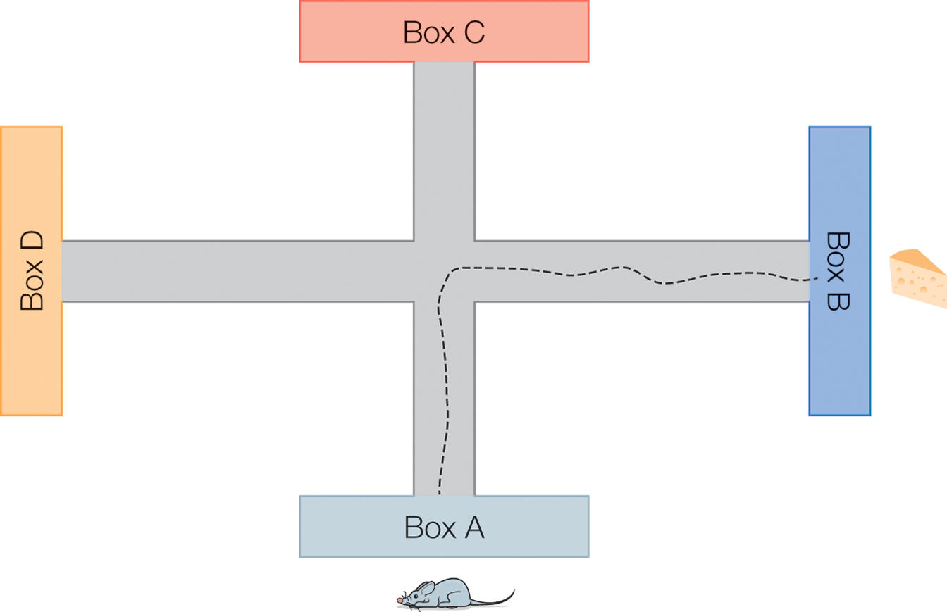
Figure 3.3: Rat Maze Used to Study Cognitive Mapping

Slide 19
3.7: The Fall and Rise of Motivation Science (1 of 2)
3.7: Analyze the causes that have popularized motivation science
The rise of motivation science
Dynamic psychology
Purposive psychology
The fall of motivation science
Behaviorism
Cognition
3.7.1: Motivation in the Modern Era
3.7.1: Describe motivation in the modern era
Motivation in the modern era
Rapidly increasing in popularity
Motivation and Emotion
1990 Nebraska Symposium on Motivation
Notes:
3.7: Analyze the causes that have popularized motivation science
Point 1 – The rise of motivation science
Discuss the major milestones in motivational psychology during the 20th century.
Point 2 – The fall of motivation science
In the 1950s and 1960s, behaviorism and cognition scattered motivation throughout subfields, but in the 1980s, motivation began to grow in popularity again.
3.7.1: Motivation in the Modern Era
3.7.1: Describe motivation in the modern era
Point 1 – Motivation in the modern era
A recent survey conducted by the Society for the Study of Motivation found that 43% of articles in a top journal used motivation-related keywords.
Motivation is growing again among scientists, scholars, and society.

Slide 20
3.7: The Fall and Rise of Motivation Science (2 of 2)
3.7.2: Reasons for Motivation’s Resurgence
3.7.2: Explain the reason motivation science has returned to the forefront
Why is motivation growing in popularity?
Popularity of evolutionary and cross-cultural psychology
Technological advances in neuropsychology and psychophysiology
Recognition of motivation’s practical applications
3.7.3: The New Look of Motivation
3.7.3: Describe the New Look of motivation
What characteristics are associated with modern motivation?
Interdisciplinary
Complex
Relies on midrange theories
Goal-focused
Driven by willpower
Notes:
3.7.2: Reasons for Motivation’s Resurgence
3.7.2: Explain the reason motivation science has returned to the forefront
Point 1 – Why is motivation growing in popularity?
Both evolutionary and cross-cultural psychology highlight the importance of motives, values, and emotions in guiding behavior.
New technology, like fMRIs, can determine brain activities when experiencing an emotion.
Science has become more translational and application to everyday people.
3.7.3: The New Look of Motivation
3.7.3: Describe the New Look of motivation
Point 1 – What characteristics are associated with modern motivation?
Modern motivation depends on its alliance with other subfields in psychology, and even fields beyond psychology.
Modern approaches to motivation embrace its complexity.
Human and animal behaviors are complex and influenced by many different factors.
A goal is a cognitive representation of a future outcome that the organism is committed to approach or avoid. Why do modern researchers prefer the concept of goals over instinct or drive?
Motivation researchers are focused on the ways that human behavior is driven by conscious, volitional attempts to exert self-control.

Slide 21
Summary: Psychological Origins of Motivation
Will as a psychological origin of motivation
How the concept of instinct played a role in the understanding of motivation
The aspects of the concept of drive as it relates to motivation
The psychological theories of personality and the differences in motivation
The role incentives play in regard to motivation
How thoughts or cognitions play a central role in explaining behavior
The causes that have popularized motivation science
Notes:
Early psychological approaches to motivation concerned will. Wundt believed involuntary actions that do not require will evolved from voluntary actions. James thought behavior is sometimes a function of ideo-motor action. He distinguished two types of will: volition and nolition. Lange conducted the first experiment in the study of motivation with a stimulus (bell) and anticipated response. Ach conducted the first experiment on will, discovering it must be stronger than a habit. Hillgruber established the difficulty law of motivation.
Instincts were one form of determinism. James created a list of instincts, while McDougall argued that all human behavior is a result of basic animal urges. He also argued that instincts influence cognition by focusing attention toward particular objects.
Drive is initiated by need deprivation and aversion. Every behavior is interpreted as an attempt to reduce drive and behaviors that are accompanied by a drive reduction are strengthened. Freud proposed three drives: sex, death, and self-preservation. Hall argued that drive was nonspecific arousal and that the intensity of an organism’s behavior is determined by drive multiplied by habit.
Murray developed a list of 24 needs and then developed the Thematic Apperception Test to measure individual differences in need strength. Maslow developed a need hierarchy and argued that an individual could not move up to a higher level without fulfilling the level below it.
Behavioral psychologists examine the role of incentives. Thorndike developed the Law of Effect, while Tolman proposed the concepts of latent learning and expectancy-value theory.
The cognitive revolution changed the study of motivation by focusing on cognition and ignoring other explanations for behavior.
Motivation is now more popular than ever, but has experienced rises and falls over time. The “New Look” is characterized by its interdisciplinary approach, recognition of its complexity, its focus on midrange theories, and its emphasis on goals.

