Slide 1
Burkley
First edition
Chapter 4
Core Human Motives
Copyright © 2018 Pearson Education, Inc. All Rights Reserved

Slide 2
Learning Objectives
4.1 Classify the core motives that drive human behavior
4.1.1 Describe the concept of physiological needs
4.1.2 Describe the concept of psychological needs
4.2 Identify the criteria for a motive to be a core human motive
4.3 Evaluate the self-determination theory of core human motives
4.3.1 Describe the relationship between SDT and goals
4.3.2 Explain the need for all three motives
4.3.3 Analyze the criticisms of self-determination theory
4.4 Distinguish between intrinsic and extrinsic motivation
4.4.1 Describe intrinsic motivation
4.4.2 Describe extrinsic motivation
Notes:
Slide 2 is list of textbook LO numbers and statements

Slide 3
Introduction: Core Human Motives
Key questions to be answered
Core motives drive human behavior
Criteria for core motives
Self-determination theory
Intrinsic and extrinsic motivation
Notes:
Much of what humans want are actually needs that are physiological or psychological.
Core motives guide our behaviors; these motives are goal-oriented, beneficial, and universal.
Self-determination theory suggests that the three core human motives are autonomy, competence, and belonging, although there are critiques against this theory.
People can be motivated intrinsically or extrinsically; intrinsic motivation appears to mediate our core motives and our behaviors.

Slide 4
4.1: Core Motives Drive Human Behavior(1 of 2)
4.1: Classify the core motives that drive human behavior
What are the core motives?
Needs vs. wants
What’s the difference? Name some.
4.1.1: Physiological Needs
Failure to fulfill leads to: ?
4.1.1: Describe the concept of physiological needs
What are physiological needs?
Basic biological requirements
State of deficiency
Homeostasis
not the only need that guides behavior
Notes:
4.1: Classify the core motives that drive human behavior
Point 1 – What are the core motives?
Psychologists have identified that motives are tied to needs, not wants, and that they are internal sources of pressure that push an individual to achieve a goal.
Failure to fulfill needs can result in illness or even death.
4.1.1: Physiological Needs
4.1.1: Describe the concept of physiological needs
Point 1 – What are physiological needs?
Physiological needs are driven by a state of deficiency.
Bodies’ systems need to regulate and maintain a stable internal environment.

Slide 5
4.1: Core Motives Drive Human Behavior (2 of 2)
4.1.2: Psychological Needs
Why are they like fertilizer?
Promote P, H, H
4.1.2: Describe the concept of psychological needs
Why focus so much on psychological ones?
What are psychological needs?
Maslow’s Hierarchy of Needs (5)
Affection (think Harry Harlow)
Accomplishment
Love
Notes:
4.1.2: Psychological Needs
4.1.2: Describe the concept of psychological needs
Point 1 – What are psychological needs?
Maslow argued that there is a hierarchy of needs that drive human behavior. The bottommost needs are physiological.
Psychological needs act as “fertilizer” to promote optimal performance, happiness, and health.

Slide 6
4.2: Criteria for Core Motives
4.2: Identify the criteria for a motive to be a core human motive
What are the criteria for core motives?
Goal-oriented behaviors
motivational
Adaptive and beneficial
Benefit the individual
Universal
Everyone has them
Similar to the instinct assumption
Notes:
4.2: Identify the criteria for a motive to be a core human motive
Point 1 – What are the criteria for core motives?
A core human motive should elicit goal-oriented behaviors that satisfy a motive. For example, Heather Abbott sought out a support group for amputees. Core motives should motivate a wide range of behaviors within a large range of settings.
A core motive should result in benefits that facilitate health and survival. Furthermore, if this motive is not fulfilled, then it should result in physical or psychological pathology.
Core motives are evident across different countries, languages, and cultures.
Do you think all of these criteria must be met for a motive to be core?

Slide 7
4.3: Self-Determination Theory(1 of 3)
4.3: Evaluate the self-determination theory of core human motives (well established ones)
Self-determination theory (SDT)
SDT focuses on the Quality of why you pursue the goal/
What were the Heather Abbott’s motives for each?
Autonomy is…?
Competence is…?
Belonging is…?
Notes:
4.3: Evaluate the self-determination theory of core human motives
Point 1 – Self-determination theory (SDT) for Heather Abbott:
Autonomy – to go shopping
Competence – to run fast and far
Belonging – to give back to her community of those with disabilities
SDT focuses on the quality of motivation. In other words, people who achieve their goals for the right reasons will achieve better outcomes than others.

Slide 8
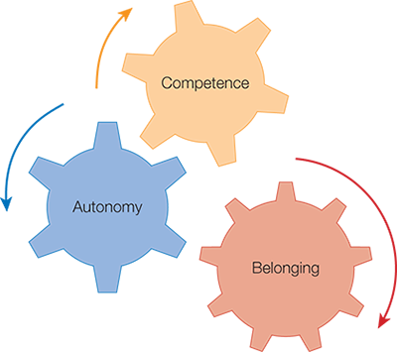
Figure 4.1: Applying Self-Determination Theory

Slide 9
General Causality Scale Description (Deci & Ryan)
Individual Styles Questionnaire
Individual Styles (GCOS) scoring temlate (Excel)

Slide 10
4.3: Self-Determination Theory (2 of 3)
4.3.1: SDT and Goals
4.3.1: Describe the relationship between SDT and goals
What is the relationship between SDT and goals?
Not all goals are created equal.
SDT goals lead to happiness
Sheldon et al. (2001) tested the relative importance of SDT goals::
autonomy,
competence,
belonging,
self-esteem (which some consider to be a component of competence), and
pleasure (i.e., hedonism).
Notes:
4.3.1: SDT and Goals
4.3.1: Describe the relationship between SDT and goals
Point 1 – What is the relationship between SDT and goals?
Goals that fulfilled autonomy, competence, and belonging were ranked the highest according to a study by Sheldon, Elliot, Kim, and Kasser (2001). Self-esteem and pleasure followed.
Sheldon et al. (2001) instructed groups of people to adapt different goals, and happiness was linked to autonomy, competence, and belonging.
Refer to Figure 4.2: Comparing Core Human Motives to Goal Progress.

Slide 11
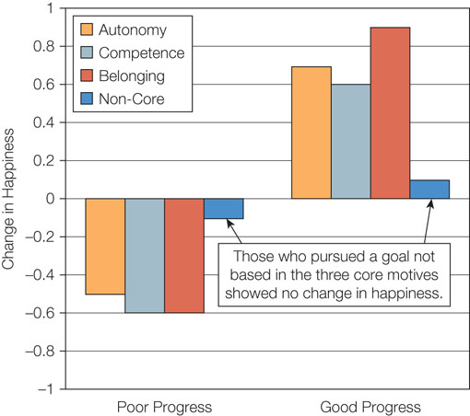
Figure 4.2: Comparing Core Human Motives to Goal Progress

Slide 12
4.3: Self-Determination Theory (3 of 3)
4.3.2: Do We Need All Three Motives?
4.3.2: Explain the need for all three motives
Do we need all three motives for Well-being and Fulfillment?
Do we need a balance (Sheldon and Niemiec (2006)
Notes:
4.3.2: Do We Need All Three Motives?
4.3.2: Explain the need for all three motives
Point 1 – Do we need all three motives?
Sheldon and Niemiec (2006) found that having balanced fulfillment across all three needs was a determinant for well-being.
Higher levels of self-esteem are linked to having all three needs fulfilled.
4.3.3: Criticisms of Self-Determination Theory
4.3.3: Analyze the criticisms of self-determination theory
Point 1 – What are the criticisms of SDT?
Kenrick et al. (2010) argued that the top needs are mate acquisition, mate retention, and parenting. What are the criticisms of this argument?
Some theorists argue that the need for security and self-esteem should be added to the list.

Slide 13
4.3.3: Criticisms of Self-Determination Theory
4.3.3: Analyze the criticisms of self-determination theory
What are the criticisms of SDT?
Human behavior and animal behavior
Kenrick et al (2010 say evolutionary needs
to pass on genes are primary.
But why, then do they forgo child bearing?
Limited number of core motives for SDT but there may b more….

Slide 14
4.4: Intrinsic and Extrinsic Motivation
4.4: Distinguish between intrinsic and extrinsic motivation
What affects goals and positive outcomes?
Mediators (things that affect the process connecting two variables)
Need fulfillment -> ? -> positive outcomes
4.4.1: Intrinsic Motivation
4.4.1: Describe intrinsic motivation
What is intrinsic motivation?
Inherently interesting or enjoyable (what are some of yours?
Work no longer feels like work. (Leonard Cohen says….)
Intrinsic motivation as a mediator
Need fulfillment leads to intrinsic motivation.
Vallerand’s model of motivation
Positive outcomes
Name three ways teachers have encouraged IM in you as a student
Notes:
4.4: Distinguish between intrinsic and extrinsic motivation
Point 1 – What affects goals and positive outcomes?
Mediators are variables or processes that occur between two other variables of interest.
Intrinsic motivation may be the “?” in the relationship.
4.4.1: Intrinsic Motivation
4.4.1: Describe intrinsic motivation
Point 1 – What is intrinsic motivation?
Sometimes, we engage in behaviors simply because we enjoy them.
We engage in an activity of our own accord (self-determined).
Point 2 – Intrinsic motivation as a mediator
According to SDT, any behavior that facilitates autonomy, competence, or belonging ignites intrinsic motivation.
According to Vallerand’s model, factors in the environment that increase autonomy, competence, and belonging lead to intrinsic motivation.
Intrinsic motivation leads to positive outcomes, like task persistence, creativity, and well-being.
Discuss experiment by Grouzet, Vallerand, Thill, and Provencher (2004).
What are some practical ways to encourage intrinsic motivation in school and work?

Slide 15
4.4: Intrinsic and Extrinsic Motivation
4.4.2: Extrinsic Motivation
4.4.2: Describe extrinsic motivation
What is extrinsic motivation?
Behavior for an external reason
Goals beyond autonomy, competence, and belonging
The intrinsic–extrinsic continuum
Internalization
Functional autonomy of motives (G. Allport)
Perceived Locus of Causality (PLOC) internalization continuum
No motivation
External regulation
Introjected regulation
Identified regulation
Integrated regulation
Intrinsic regulation
Notes:
4.4.2: Extrinsic Motivation
4.4.2: Describe extrinsic motivation
Point 1 – What is extrinsic motivation?
We participate in many behaviors, such as going to work, to receive a reward or avoid a punishment.
Extrinsic goals may be financial success, improving our image, or conforming to others.
Point 2 – The intrinsic–extrinsic continuum
Internalization is the process whereby individuals transform external social rules and requests into internal, personally endorsed values.
Allport (1937) suggested that the initial motivation for a behavior may become separated from the actual behavior over time.
Point 3 – Perceived Locus of Causality (PLOC) internalization continuum
Ryan and Connell (1989) plotted motivation on a continuum. Refer to Figures 4.3A–4.3F.
How can you tell which category an action falls within?

Slide 16
Figure 4.3: PLOC Internalization Continuum

Slide 17
Summary: Core Human Motives
The core motives that drive human behavior
The criteria for a motive to be a core human motive
The self-determination theory of core human motives
The difference between intrinsic and extrinsic motivation
Notes:
Most of our wants are actually needs that are either physiological or psychological. Psychological needs are not necessary for survival, but are needed for mental health and well-being.
Core motives lead to goal-oriented behaviors that satisfy the motive, are adaptive and beneficial, and are found universally across cultures.
Self-determination theory posits that the core human motives are autonomy, competence, and belonging. People are more likely to choose a goal that fulfills one of these motives and report higher levels of well-being when all three motives are met. SDT has two key criticisms: motivations may not be different between humans and animals, and humans may need more than just three motives.
Intrinsic motivation leads to behaviors that are done for enjoyment, while extrinsic motivation leads to behaviors that are done for rewards or to avoid punishment. There is a continuum of extrinsic and intrinsic motivation, and we learn to be intrinsically motivated. Ryan and Connell (1989) suggested four types of extrinsic motivation: external regulation, introjected regulation, identified regulation, and integrated regulation.

