Slide 1
Burkley
First edition
Chapter 5
Autonomy
Copyright © 2018 Pearson Education, Inc. All Rights Reserved

Slide 2
Learning Objectives (1 of 2)
5.1 Analyze the concept of autonomy as a core motive
5.1.1 Describe the panic button effect
5.1.2 Explain the relationship between control and money
5.1.3 Analyze how autonomy elicits behaviors
5.1.4 Explain how autonomy produces positive outcomes
5.1.5 Describe the universality of autonomy
5.2 Analyze the attribution theory
5.2.1 Describe the types of attributions
5.2.2 Analyze the factors that influence attributions
5.3 Evaluate the overjustification effect in relation to motivation
5.3.1 Describe examples of the overjustification effect
Notes:
Slide 2 is list of textbook LO numbers and statements

Slide 3
Learning Objectives (2 of 2)
5.3.2 Analyze the causes of the overjustification effect
5.4 Analyze the positive effects of the illusion of control
5.4.1 Explain how choice influences the illusion of control
5.4.2 Explain how outcome sequence influences the illusion of control
5.5 Contrast the different types of magical thinking
5.5.1 Explain the concept of tempting fate
5.5.2 Explain the concept of mind control
5.6 Analyze how the loss of autonomy can affect motivation
5.6.1 Describe the concept of reactance
5.6.2 Explain the concept of learned helplessness
5.7 Contrast the potential reasons people may desire a lack of control
5.7.1 Explain how choice can affect motivation
Notes:
Slide 2 is list of textbook LO numbers and statements

Slide 4
Introduction: Autonomy
Key questions to be answered
The need for autonomy
Taylor Swift?
Attribution theory
Overjustification effect
Illusion of control
Magical thinking
Reaction to loss of autonomy
Desire for no control
Notes:
The need for autonomy represents a basic desire for personal control.
Attributions refer to people’s beliefs about the cause of a particular outcome and can be in a variety of forms.
The overjustification effect tells us that motivation decreases when people are given an extrinsic reward for a task that is already intrinsically rewarding.
Most people overestimate the amount of control they have in their lives.
The illusion of control leads to magical thinking, such as tempting fate.
When people feel their freedom is being taken away, they can be reactive and then possibly show learned helplessness.
Having too many options decreases motivation to do well.

Slide 5
5.1: The Need for Autonomy (2 of 4)
5.1: Analyze the concept of autonomy as a core motive
Autonomy as a core motive
Control Basic need for autonomy
what did T. Jefferson say ? About without choice?
5.1.1: Panic Button Effect
Glass, Singer, and Friedman (1969).
5.1.1: Describe the panic button effect
What is the panic button effect?
Perception of control
Provides comfort
How do you feel abut being in an elevator w/o a panic button?
5.1.2: Is Control More Desirable Than Money?
5.1.2: Explain the relationship between control and money
Is control more desirable than money?
Ex.: College professors
Well-being and autonomy meta-analysis (Fischer & Boer, 2011 63 studies
Notes:
5.1: Analyze the concept of autonomy as a core motive
Point 1 – Autonomy as a core motive
Given a choice, people will choose a more painful option just to retain control.
Autonomy is defined as a desire for freedom, personal control, and free choice.
5.1.1: Panic Button Effect
5.1.1: Describe the panic button effect
Point 1 – What is the panic button effect?
Describe the experiment with the buzzer by Glass, Singer, and Friedman (1969).
5.1.2: Is Control More Desirable Than Money?
5.1.2: Explain the relationship between control and money
Point 1 – Is control more desirable than money?
Psychology PhDs earn less than many other fields, but they have more autonomy.
A greater sense of autonomy is associated with greater well-being. Wealth was not directly associated with well-being.
Refer to Figure 5.1: Motivation: Money Versus Control.

Slide 6
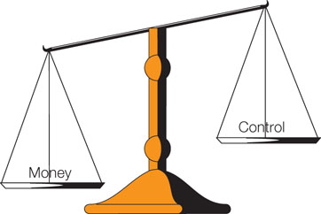
Figure 5.1: Motivation: Money Versus Control

Slide 7
5.1: The Need for Autonomy (2 of 4)
5.1.3: Autonomy Elicits Behaviors
5.1.3: Analyze how autonomy elicits behaviors
How does autonomy elicit behavior?
Self-determination theory a deficit
deficit in autonomy produce autonomy-seeking behaviors
Autonomy as a deficit-oriented need
, Sheldon and Gunz (2009) students who felt they lacked autonomy were more interested in pursuing activities that would restore their autonomy
5.1.4: Autonomy Produces Positive Outcomes
5.1.4: Explain how autonomy produces positive outcomes
How does autonomy produce positive outcomes?
Link with survival, higher self-esteem, Less depression
Better goal performance (in school performance!)
Pursuing the “right” goals
Self-concordance – goal fit
Careers
Notes:
5.1.3: Autonomy Elicits Behaviors
5.1.3: Analyze how autonomy elicits behaviors
Point 1 – How does autonomy elicit behavior?
Autonomy is one of the three core human motives that drive behavior.
People who lack autonomy seek activities to restore it.
5.1.4: Autonomy Produces Positive Outcomes
5.1.4: Explain how autonomy produces positive outcomes
Point 1 – How does autonomy produce positive outcomes?
People who pursue goals that fulfill autonomy have higher levels of well-being.
Autonomous motivation has been linked to greater conceptual understanding and goal achievement.
Autonomy increases brain-based sensitivity to failure.
Given your understanding of autonomy, how is it used as a punishment? Why?
Point 2 – Pursuing the “right” goals
Self-concordance means that the goal fits with the individual’s sense of self.
How does self-concordance translate to your career goals?

Slide 8
5.1: The Need for Autonomy (2 of 4)
5.1.5: Autonomy Is Universal
5.1.5: Describe the universality of autonomy
How is autonomy universal?
Cross-cultural
occurs in less independence-oriented cultures like Russia and Japan (Deci et al., 2001
Eastern/Western cultures
Chirkov, Ryan, Kim, & Kaplan, 2003, Chirkov, Ryan, & Willness, 2005).
Notes:
5.1.5: Autonomy Is Universal
5.1.5: Describe the universality of autonomy
Point 1 – How is autonomy universal?
Studies show that throughout the world, greater autonomy is associated with higher levels of well-being.

Slide 9
5.2: Attribution Theory (1 of 4)
5.2: Analyze the attribution theory
Heider (1958), we seek out information in this way so that we can predict what is going to happen
Attribution theory
Why do people do what they do?
Predict the future
Control a situation
When do we search for causal attributions? (Weiner, 1972b; 2006).
Unexpected outcomes
Important outcomes
Negative outcomes
Notes:
5.2: Analyze the attribution theory
Point 1 – Attribution theory
Determining the causes of behavior helps lead to autonomy.
Point 2 – When do we search for causal attributions?
We engage in attributional thinking as a way of regaining some control.

Slide 10
5.2: Attribution Theory (1 of 4)
5.2.1: Types of Attributions
5.2.1: Describe the types of attributions
Two dimensions of attributes
Locus
Stability
The four possibilities of attributions
Ability
Effort
Difficulty
Luck
Notes:
5.2.1: Types of Attributions
5.2.1: Describe the types of attributions
Point 1 – Two dimensions of attributes
Refer to Figure 5.2: Two Dimensions of Attributions: Locus and Stability.
Internal attribution resides within the person, and external attribution resides within the situation.
Stable attribution happens regularly, and unstable attribution happens irregularly.
Point 2 – The four possibilities of attributions
Refer to Figure 5.3: The Four Possibilities of Attributions.
What are some additional dimensions that could also play a role?

Slide 11
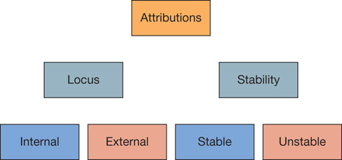
Figure 5.2: Two Dimensions of Attributions: Locus and Stability

Slide 12
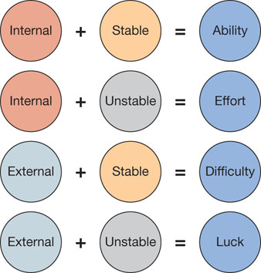
Figure 5.3: The Four Possibilities of Attributions

Slide 13
5.2: Attribution Theory (1 of 4)
5.2.2: Factors That Influence Attributions
5.2.2: Analyze the factors that influence attributions
Factors that influence attributions
Internal locus of control (perceived control)
External locus of control (perceived lack of control)
Situational differences
Notes:
5.2.1: Types of Attributions
5.2.1: Describe the types of attributions
Point 1 – Factors that influence attributions
People high in external locus of control are more likely to make external attributions and feel less in control.
How does teaching styles impact autonomy and success? How could this translate to a manager?

Slide 14
5.3: Overjustification Effect (1 of 4)
5.3: Evaluate the overjustification effect in relation to motivation
What is the overjustification effect?
Combining intrinsic and extrinsic motivation
Reduction in motivation when people are given an extrinsic reward for something they intrinsically enjoyed
Notes:
5.3: Evaluate the overjustification effect in relation to motivation
Point 1 – What is the overjustification effect?
Discuss Deci (1971) and the incentives with puzzles.
Refer to Figure 5.4: Overjustification Effect.

Slide 15
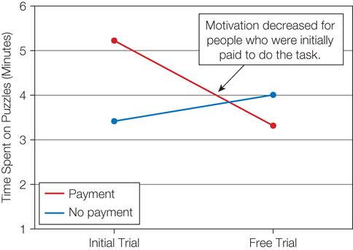
Figure 5.4: Overjustification Effect

Slide 16
5.3: Overjustification Effect (2 of 4)
5.3.1: Examples of the Overjustification Effect
5.3.1: Describe examples of the overjustification effect
Examples of the overjustification effect
David Chappelle
Rewarding college students
5.3.2: Why the Overjustification Effect Occurs
5.3.2: Analyze the causes of the overjustification effect
Why does the overjustification effect occur?
Autonomy
Certain conditions—interesting, expected reward, and material reward
Notes:
5.3.1: Examples of the Overjustification Effect
5.3.1: Describe examples of the overjustification effect
Point 1 – Examples of the overjustification effect
Why did Chappelle walk away from his Comedy Central show?
Why do college students whose parents pay for college have lower grades?
5.3.2: Why the Overjustification Effect Occurs
5.3.2: Analyze the causes of the overjustification effect
Point 1 – Why does the overjustification effect occur?
When we work on a project because it’s fun, we feel a sense of autonomy. Receiving a reward removes the control.
When the task is interesting, the reward is expected, and the reward is material, the overjustification effect is more likely.

Slide 17
Overjustification Rememdies
How to get kids to eat healthy food
Don’t use the Premack Principle – what is that?
Give them choices (autonomy)
Get them to help prepare the food (ocompetence)
Tastewize Kids Program
What does it take to make it work?
Task must be interesting (potential for IM)
For boring tasks
Use unexpected rewards don’t undermine M)
Use material rewards

Slide 18
Conditions for Overjustification to Occur
1. Task must be interesting (potential to undermine IM )
2. A reward is expected
3. The reward is a tangible one

Slide 19
5.4: Illusion of Control (1 of 4)
5.4: Analyze the positive effects of the illusion of control
The illusion of control
Positive illusions (mentally healthy people have them!)
Taylor and Brown (1988)
Does this happen with cocaine use?
We’re all above average (Lake Wobegon effect)
More likely to try new experiences /strive harder
Depressive realism (Dobson & Franche, 1989)
5.4.1: Choice Influences the Illusion of Control
5.4.1: Explain how choice influences the illusion of control
How choice influences the illusion of control
More choices
Overestimate control
Notes:
5.4: Analyze the positive effects of the illusion of control
Point 1 – The illusion of control
Mentally healthy people are more likely to view themselves in unrealistically positive terms and think they have more control over their environment.
People who suffer from depression hold a more accurate perception of their abilities and their control.
5.4.1: Choice Influences the Illusion of Control
5.4.1: Explain how choice influences the illusion of control
Point 1 – How choice influences the illusion of control
Discuss Dunn and Wilson (1990) and die game.

Slide 20
5.4: Illusion of Control (2 of 4) Perceived Choice & Sequence influence Illusion of Control
5.4.2 Illusion of control –driven by need for autonomy
- would you bet more on a number you chose or one assigned to you?
(Dunn & Wilson, 1990)
Who plays the lottery? Do you choose a number < 31?
5.4.2: Outcome Sequence Influences the Illusion of Control
Winning streak (I’m not!) v. losing streak (I’m not)
Does winning early or later in increase illusion of control?
5.4.2: Explain how outcome sequence influences the illusion of control
How does outcome sequence influence the illusion of control?
Positive outcomes
Timing
Notes:
5.4.2: Outcome Sequence Influences the Illusion of Control
5.4.2: Explain how outcome sequence influences the illusion of control
Point 1 – How does outcome sequence influence the illusion of control?
People who experience a winning streak are more likely to assume they have control over a task.
Discuss Figure 5.5: Timing of Winning Streaks on Perceptions of Control.

Slide 21
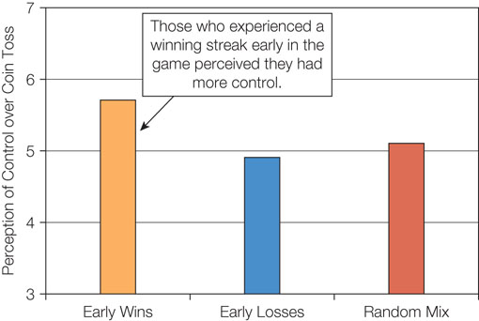
Figure 5.5: Timing of Winning Streaks on Perceptions of Control

Slide 22
5.5: Magical Thinking (1 of 4)
5.5: Contrast the different types of magical thinking
What is magical thinking?
Superstitions
Supernatural
5.5.1: Tempting Fate
5.5.1: Explain the concept of tempting fate
Tempting fate (should you change your answer on multiple choice?)
Gut feeling not to tempt it
Inconsequential behaviors
5.5.2: Mind Control (for helping and hurting people)
5.5.2: Explain the concept of mind control
Mind control (who do voodo? You do?)
(Pronin, Wegner, McCarthy, & Rodriguez, 2006)
Impact others’ behavior by thinking of it
Notes:
5.5: Contrast the different types of magical thinking
Point 1 – What is magical thinking?
Magical thinking makes us feel as if we have more control over an event than we really do.
How do superstitions act as secondary control methods?
5.5.1: Tempting Fate
5.5.1: Explain the concept of tempting fate
Point 1 – Tempting fate
We irrationally assume that inconsequential behaviors control our future destiny.
5.5.2: Mind Control
5.5.2: Explain the concept of mind control
Point 1 – Mind control
Discuss Pronin et al. (2006) study on voodoo dolls.

Slide 23
5.6: Reactions to Loss of Autonomy (1 of 4)
5.6: Analyze how the loss of autonomy can affect motivation
How do people respond to a lack of control?
Psychological reactance)
Learned helplessness
5.6.1: Reactance (resist losing autonomy
5.6.1: Describe the concept of reactance
Reactance
Teenagers
College students
Forbidden fruit
Notes:
5.6: Analyze how the loss of autonomy can affect motivation
Point 1 – How do people respond to a lack of control?
Psychological reactance is when people feel they are losing their freedom, they reassert their autonomy by doing the opposite of what was asked.
Learned helplessness is when we try to take back control and fail.
5.6.1: Reactance
5.6.1: Describe the concept of reactance
Point 1 – Reactance
Refer to Figure 5.6: Warning Labels on Interest in Violent Television.

Slide 24
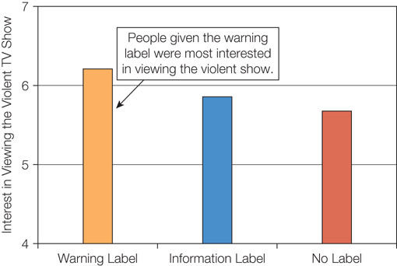
Figure 5.6: Warning Labels on Interest in Violent Television

Slide 25
5.6: Reactions to Loss of Autonomy (1 of 4)
5.6.2: Learned Helplessness
5.6.2: Explain the concept of learned helplessness
Learned helplessness
Response after reactance
May be adaptive -
useful to avoid Perseveration
Helplessness in one situation applies to all situations
(it may generalize to other situations where you can exert control)
Notes:
5.6.2: Learned Helplessness
5.6.2: Explain the concept of learned helplessness
Point 1 – Learned helplessness
Discuss Seligman and Maier (1967) and dogs.
How can this situation apply to human behavior?

Slide 26
5.7: Desire for No Control (1 of 4)
5.7: Contrast the potential reasons people may desire a lack of control
Why do people sometimes desire a lack of control?
Others more knowledgeable
Others more skilled
5.7.1: Too Much or Too Little Choice
5.7.1: Explain how choice can affect motivation
Too much or too little choice?
Restaurants
Too many topics
The golden mean
Satisficer
Maximiser
Notes:
5.7: Contrast the potential reasons people may desire a lack of control
Point 1 – Why do people sometimes desire a lack of control?
In game shows and when we visit professionals, we are more likely to give up control.
5.7.1: Too Much or Too Little Choice
5.7.1: Explain how choice can affect motivation
Point 1 – Too much or too little choice?
When we have too many choices, it often decreases our motivation.
The more choices we have, the more information we have to gather on each choice.
A satisficer accepts a good-enough choice.
A maximiser is someone who always wants to make the best possible decision.

Slide 27
5.7.1: Choice Affects Motivation
5.7: When overwhelmed
What’s in your coffee? Too many choices? Do you get overwhelmed when you go a Greek diner?
Every been to Portland OR to get a waffle?
Can having more options to choose lead to less likely to engage and lower quality? Iyengar and Lepper (2000) –students choosing from many or few options to write an essay on “Twelve Angry Men”
Be a satisfier rather than a maximiser?
Notes:
5.7: Contrast the potential reasons people may desire a lack of control
Point 1 – Why do people sometimes desire a lack of control?
In game shows and when we visit professionals, we are more likely to give up control.
5.7.1: Too Much or Too Little Choice
5.7.1: Explain how choice can affect motivation
Point 1 – Too much or too little choice?
When we have too many choices, it often decreases our motivation.
The more choices we have, the more information we have to gather on each choice.
A satisficer accepts a good-enough choice.
A maximiser is someone who always wants to make the best possible decision.

Slide 28
Summary: Autonomy
The concept of autonomy as a core motive
Attribution theory
The overjustification effect in relation to motivation
The positive effects of the illusion of control
The different types of magical thinking
How the loss of autonomy can affect motivation
The potential reasons people may desire a lack of control
Notes:
As shown by the panic button effect, just believing you have control can be beneficial. Autonomy is a strong predictor of well-being, and people who pursue goals that fit them well are more satisfied.
Attributions can be 1) internal or external; and 2) stable or unstable. Internal attributions are more beneficial than external attributions.
The overjustification effect occurs because it decreases autonomy and is most likely to occur when the task is interesting, the extrinsic reward is expected, and the reward is material.
The illusion of control is good for mental health and causes people to assume they can control or predict chance events.
Tempting fate and mind control are two forms of magical thinking, which stems from the illusion of control.
When people lose autonomy, they may become reactive by doing the opposite of what they were told to do. When a loss of control persists, then people often experience learned helplessness.
For the most part, a high level of control is best, but when there are too many choices, then people’s motivation decreases.

