Slide 1
Burkley
First edition
Chapter 6
Competence
Copyright © 2018 Pearson Education, Inc. All Rights Reserved

Slide 2
Learning Objectives
6.1 Analyze the concept of competence as a core motive
6.1.1 Analyze how competence elicits behaviors
6.1.2 Explain how competence produces positive outcomes
6.1.3 Describe the universality of competence
6.2 Analyze the ways in which people express competence
6.2.1 Contrast learning and performance goals (Dweck)
6.2.2 Contrast entity and incremental beliefs
6.2.3 Explain the concept of self-efficacy
6.2.4 Explain the concept of flow
6.3 Evaluate how the self impacts our motivation
6.3.1 Analyze how goal fusion can impact motivation
6.3.2 Analyze how self-esteem can impact motivation
Notes:
Slide 2 is list of textbook LO numbers and statements

Slide 3
Learning Objectives
6.4.1 Describe social comparison theory (Festinger)
6.4.2 Explain the concept of self-assessment
6.4.3 Explain the concept of self-verification
6.4.4 Explain the concept of self-enhancement
6.4.5 Explain the concept of self-improvement
6.4.6 Describe how self-evaluation motives may be used
6.5 Analyze how the loss of competence can affect motivation
6.5.1 Explain the concept of self-serving attributional bias
6.5.2 Explain the concept of self-handicapping
6.5.3 Explain the concept of excuse making
Notes:
Slide 2 is list of textbook LO numbers and statements

Slide 4
Introduction: Competence
Key questions to be answered
The need for competence
Variability in the expression of competence
The role of the self
Self-evaluation motives
Reactions to a loss of competence
Notes:
The need for competence is a core motive that refers to people’s basic desire for effectiveness, ability, or success.
People vary in the ways they express and fulfill their competence.
The self-concept refers to an individual’s collection of self-knowledge.
Self-evaluation refers to people’s attempts to judge aspects of their self-concepts, including their competencies and abilities.
Self-serving attributions involve making internal attributions for successes and external attributions for failures.

Slide 5
6.1: The Need for Competence (1 of 3)
6.1: Analyze the concept of competence as a core motive
What is the need for competence?
Desire for effectiveness, ability, or success
Doing one’s best
Learning new skills
Notes:
6.1: Analyze the concept of competence as a core motive
Point 1 –What is the need for competence?
Refer to Figure 6.1: Competence Involves the Desire for Ability, Success, and a Sense of Effectiveness

Slide 6
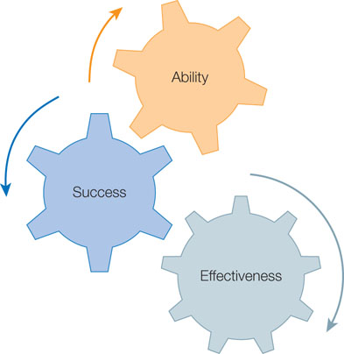
Figure 6.1: Competence Involves the Desire for Ability, Success, and a Sense of Effectiveness

Slide 7
6.1: The Need for Competence (2 of 3)
6.1.1: Competence Elicits Behaviors
6.1.1: Analyze how competence elicits behaviors
How does competence elicit behaviors?
Natural curiosity
Seek new information
Fear of incompetence
6.1.2: Competence Produces Positive Outcomes
(Fisher ,78). When word puzzle task was autonomous – competence cause increase in motivation
6.1.2: Explain how competence produces positive outcomes
How does competence produce positive outcomes?
Physical health
Mental health
6.1.3: Competence Is Universal
6.1.3: Describe the universality of competence
Notes:
6.1.1: Competence Elicits Behaviors
6.1.1: Analyze how competence elicits behaviors
Point 1 – How does competence elicit behaviors?
From birth, we seek out new information, set and strive for abstract goals, and avoid situations in which we feel incompetent.
Discuss Sheldon and Gunz (2009) and college students and a personality test.
6.1.2: Competence Produces Positive Outcomes
6.1.2: Explain how competence produces positive outcomes
Point 1 – How does competence produce positive outcomes?
Feeling competent is linked to many positive benefits.
Benefits from competence often only occur if the individual also feels autonomy.
Why would autonomy be linked to competence?
Discuss Fisher (1978) and word-find puzzles.
6.1.3: Competence Is Universal
6.1.3: Describe the universality of competence
Point 1 – Competence is universal.
Competence is universal in all cultures.
However, Eastern cultures are more likely than Western cultures to value competence within group-based domains.

Slide 8
6.1: The Need for Competence (3 of 3)
Competence is universal.
Western – individual competence more important
Eastern cultures – within group competence is more important
Different definitions for each type of country

Slide 9
6.2: Variability in the Expression of Competence (1 of 5)
6.2: Analyze the ways in which people express competence
How do people differ in their approach to competence?
Achievement motivation
Types of goals
Beliefs about where competencies come from
Perception of competency level
6.2.1: Learning Versus Performance Goals
6.2.1: Contrast learning and performance goals
Learning goals vs. performance goals
Learning goals—learn and improve competence
Performance goals—prove their competence
Independent goal types
High learning/high performance
High learning/low performance
Low learning/high performance
Low learning/low performance
Notes:
6.2: Analyze the ways in which people express competence
Point 1 – How do people differ in their approach to competence?
Some people are more driven to fulfill their competence need than others.
Some people adopt the goal to improve their competence, while others adopt to goal to prove their competence.
People who think competencies are something they are born with respond differently from people who think their competencies are something they had to work hard to achieve.
People who perceive themselves to be competent respond differently from people who see themselves as incompetent.
6.2.1: Learning Versus Performance Goals
6.2.1: Contrast learning and performance goals
Point 1 – Learning goals vs. performance goals
People who prefer learning goals are not concerned about making mistakes and want to learn new things.
People who prefer performance goals are concerned with looking competent.
Point 2 – Independent goal types
Goals may not be on the same continuum, and people can fall into different categories.
Point 3 – Approach vs. avoidance
Refer to the 2 x 2 goal taxonomy.
Learning-approach goals are the most beneficial, while performance-avoidance goals are the least.

Slide 10
6.2: Variability in the Expression of Competence (2 of 5)
Approach vs. avoidance
Desire to approach success
Desire to avoid failure

Slide 11
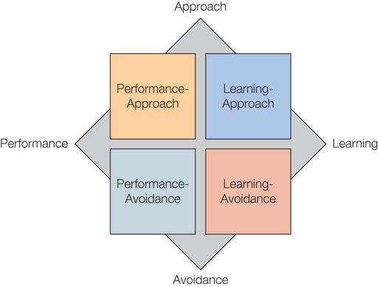
Figure 6.2: The 2 × 2 Goal Taxonomy

Slide 12
6.2: Variability in the Expression of Competence (3 of 5)
6.2.2: Entity Versus Incremental Beliefs
6.2.2: Contrast entity and incremental beliefs abut competencies
Dweck’s theory of implicit beliefs
Entity theorists (believe IQ is fixed)
Incremental theorists (believe it’s incremental)
Differing outcomes for entity and incremental beliefs
Differences in the definition of competence
Differences in goal adaptation
Differences in effort after failure
How praise influences entity and incremental beliefs
Effort
Intelligence
Notes:
6.2.2: Entity Versus Incremental Beliefs
6.2.2: Contrast entity and incremental beliefs
Point 1 – Dweck’s theory of implicit beliefs
Entity theorists believe traits and abilities are fixed.
Incremental theorists believe traits and abilities are malleable.
Point 2 – Differing outcomes for entity and incremental beliefs
Entity theorists means being competent is doing something well right away without effort. Incremental theorists believe you work hard and improve over time.
Entity people adopt performance goals while incremental people adopt learning goals.
Incremental people increase efforts after failure, while entity people are more likely to walk away.
Point 3 – How praise influences entity and incremental beliefs
Refer to Mueller and Dweck (1998) study of task persistence. Refer to Figure 6.3: Praise on Task Persistence.

Slide 13
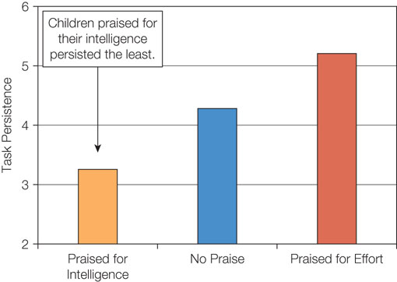
Figure 6.3: Praise on Task Persistence

Slide 14
6.2: Variability in the Expression of Competence (4 of 5)
6.2.3: Self-Efficacy
6.2.3: Explain the concept of self-efficacy
What is self-efficacy?
Belief about ability to accomplish a task
Task-specific
Not actual ability
Self-efficacy and motivational outcomes
Exert effort
Less emotional stress
Goal achievement
Attributions and self-efficacy
Early experiences
Attributions: internal, external, stable, unstable
Notes:
6.2.3: Self-Efficacy
6.2.3: Explain the concept of self-efficacy
Point 1 – What is self-efficacy?
Self-efficacy is demonstrated in the children’s book The Little Engine That Could.
Self-efficacy beliefs are not global beliefs.
Refer to Figure 6.4: Our Level of Competence is Determined by Both Our Abilities and Our Perceived Capabilities (Self-Efficacy).
Point 2 – Self-efficacy and motivational outcomes
Students achieve more when their self-efficacy beliefs are increased.
Point 3 – Attributions and self-efficacy
Early experiences partially contribute to self-efficacy beliefs.
Attributions play a high role: Internal attributions increase feelings of pride and accomplishment, and stable attributions increase hope that good performances will occur in the future.

Slide 15
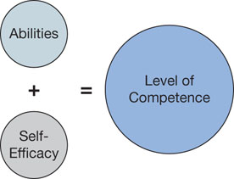
Figure 6.4: Our Level of Competence Is Determined by Both Our Abilities and Our Perceived Capabilities (Self-Efficacy)

Slide 16
6.2: Variability in the Expression of Competence (5 of 5)
6.2.4: Flow
6.2.4: Explain the concept of flow
What is flow?
A subjective state in which people feel completely absorbed and focused on an activity
Concerns, anxieties, commitments, time melt away
What causes flow?
Self-efficacy matches task competency
Benefits of flow
Task performance
Task continuation
Notes:
6.2.4: Flow
6.2.4: Explain the concept of flow
Point 1 – What is flow?
Csikszentmihalyi (1982) was interested in why people perform time-consuming activities for no extrinsic reward.
Point 2 – What causes flow?
Refer to Figure 6.5: Factors That Determine Flow.
Point 3 – Benefits of flow
Discuss Keller and Bless (2008) and the study of college students and Tetris.
Flow is both a mental and a physical experience.

Slide 17
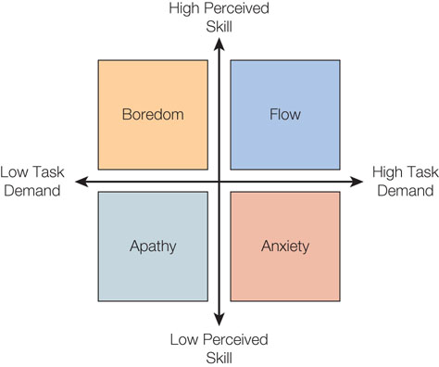
Figure 6.5: Factors That Determine Flow

Slide 18
6.3: The Role of Self (1 of 2)
6.3: Evaluate how the self impacts our motivation
What is the self-concept?
Individual’s collection of self-knowledge
Competencies as a foundation
6.3.1: Goal Fusion
6.3.1: Analyze how goal fusion can impact motivation
What is goal fusion?
The extent a goal is perceived to be integrated into a person’s self-concept
Measuring goal fusion
Notes:
6.3: Evaluate how the self impacts our motivation
Point 1 – What is the self-concept?
The self-concept is who you think you are.
Discuss the reflection list of “I am.” Competencies form the basis for the sense of self.
6.3.1: Goal Fusion
6.3.1: Analyze how goal fusion can impact motivation
Point 1 –What is goal fusion?
When fusion is high, people feel one with their goal. (People who jog vs. people who are joggers.)
Refer to Figure 6.6: Measure of Goal Fusion.
When we do not feel fused with a goal, successes and failures with that goal have little impact.

Slide 19
Figure 6.6: Measure of Goal Fusion

Slide 20
6.3: The Role of Self (2 of 2)
6.3.2: Self-Esteem
6.3.2: Analyze how self-esteem can impact motivation
What is self-esteem?
How favorably or unfavorably people evaluate themselves
What determines self-esteem?
Contingencies of self-worth
Notes:
6.3.2: Self-Esteem
6.3.2: Analyze how self-esteem can impact motivation
Point 1 – What is self-esteem?
Self-esteem is considered to be a major motivator of human behavior.
Point 2 – What determines self-esteem?
Crocker at al. (2003; 2012; 2001) discuss that the impact an event has on one’s self-esteem depends on the relevance of that event to one’s contingencies of self-worth.
Discuss Crocker, Sommers, and Luhtanen (2002) study of college seniors applying to graduate school.

Slide 21
6.4: Self-Evaluation Motives (1 of 4)
6.4: Differentiate self-evaluation motives
What is self-evaluation?
Judging aspects of self-concept
6.4.1: Social Comparison Theory
6.4.1: Describe social comparison theory
Social comparison theory
Festinger (1954)—We only know who we are and what we are capable of by comparing ourselves to others
Need to accurate assess abilities
Four self-evaluation motives - we are motivated to -
Self-assessment
Self-verification
Self-enhancement
Self-improvement
Notes:
6.4: Differentiate self-evaluation motives
Point 1 – What is self-evaluation?
People tend to compare their skills to those around them.
6.4.1: Social Comparison Theory
6.4.1: Describe social comparison theory
Point 1 – Social comparison theory
We make decisions of athletic ability or intelligence by comparing ourselves to others.
When no definitive test is available, we look to others.
Is it important to know how others score?
Point 2 – Four self-evaluation motives
Refer to Figure 6.7: Motives to Evaluate Own Competencies.

Slide 22
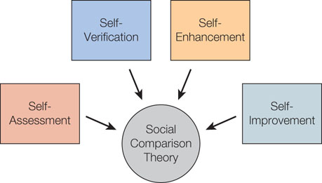
Figure 6.7: Motives to Evaluate Own Competencies

Slide 23
6.4: Self-Evaluation Motives (2 of 4)
6.4.2: Self-Assessment: To Thine Own Self Be True
6.4.2: Explain the concept of self-assessment
What is self-assessment?
The motivation to obtain an accurate evaluation of one’s abilities and competencies
Diagnostic tests
6.4.3: Self-Verification: To Thine Own Self Be Sure
6.4.3: Explain the concept of self-verification
What is self-verification?
The motivation to maintain consistency between self-conceptions and new information
Company of others
Negative self-views
Symbolic completion theory
Clothing or symbols that represent to those around us who we are
Notes:
6.4.2: Self-Assessment: To Thine Own Self Be True
6.4.2: Explain the concept of self-assessment
Point 1 – What is self-assessment?
Polonius suggested that the most important thing in life is to be true to yourself and not to pretend to be something you are not.
Diagnostic tests like personality tests or horoscopes are one way to fulfill self-assessment.
6.4.3: Self-Verification: To Thine Own Self Be Sure
6.4.3: Explain the concept of self-verification
Point 1 – What is self-verification?
Sometimes, we engage in a behavior to prove that we are good at it.
We like having consistent information.
Discuss Giesler, Josephs, and Swann’s (1996) study on positive self-views and negative self-views.
Refer to Figure 6.8: Which Profile Would You Pick ?
We tend to seek out the company of others who verify their self-views.
People are more likely to divorce a spouse when they think that their spouse perceives them too favorably.
This figure is not included in the template.
Point 2 – Symbolic completion theory
From clothing to symbols (like ribbons), we choose items that send a message about ourselves.

Slide 24
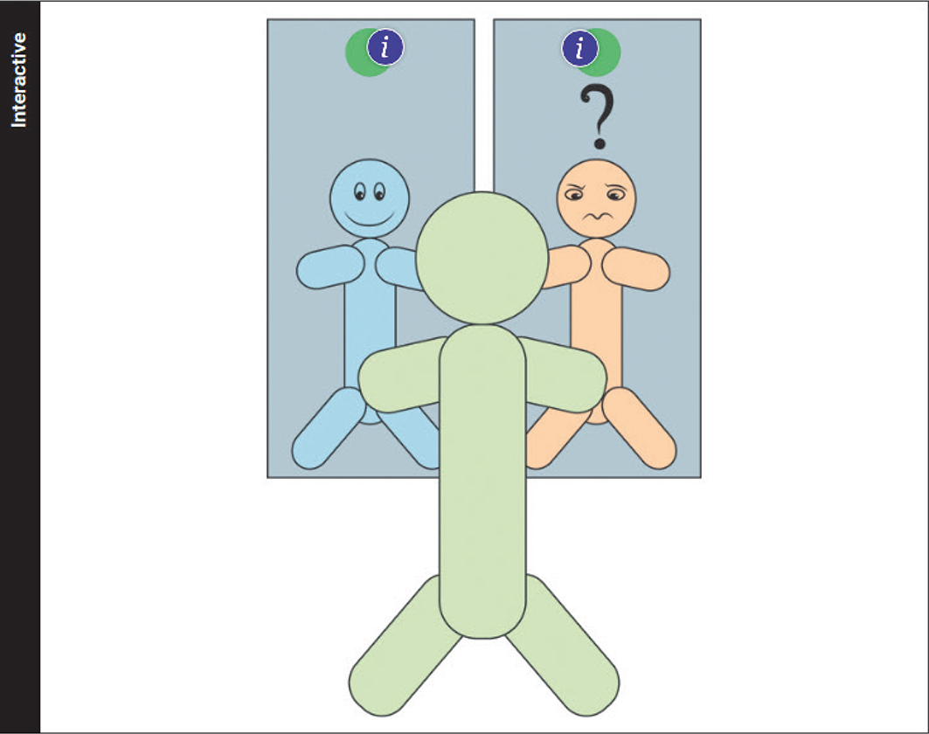
Figure 6.8: A hotspot with a stick diagram shows the two profiles of an individual, the positive profile has a happy face, while the negative profile has a sad face.

Slide 25
6.4: Self-Evaluation Motives (3 of 4)
6.4.4: Self-Enhancement: To Thine Own Self Be Good
6.4.4: Explain the concept of self-enhancement
What is self-enhancement?
The motivation to enhance the positive aspects and decrease the negative aspects of our self-concept
Positive feedback
Positive illusions
The better-than-average effect (“Lake Wobegon effect” – very robust!
Also note the Dunning –Kruger effect
Downward social comparison
Self-affirmation theory
If one part of our self-concept is threatened, we can restore our sense of self by affirming another values part of the self-concept.
6.4.5: Self-Improvement: To Thine Own Self Be Better
6.4.5: Explain the concept of self-improvement
Notes:
6.4.4: Self-Enhancement: To Thine Own Self Be Good
6.4.4: Explain the concept of self-enhancement
Point 1 – What is self-enhancement?
Sometimes, we just want to feel good about ourselves.
We engage in behaviors that help us feel good about ourselves.
The better-than-average effect is the pattern of thinking that we are better than the average.
Point 2 – Self-affirmation theory
Facebook and our profiles enable users to reaffirm competence.
6.4.5: Self-Improvement: To Thine Own Self Be Better
6.4.5: Explain the concept of self-improvement
Point 1 – What is self-improvement?
We constantly seek self-improvement in jobs, school, and relationships.
Point 2 – How does self-improvement motivate people?
When we compare our skills to people who are more skilled, we are more inspired to become competent.
What dangers are associated with upward social comparisons?
We are more likely to feel threatened when someone outdoes us on a domain that is dear to our heart.

Slide 26
6.4: Self-Evaluation Motives (4 of 4)
What is self-improvement?
The motivation to improve one’s traits, abilities, and well-being
How does self-improvement motivate people?
Upward social comparisons
Domain-specific

Slide 27
6.5: Reactions to Loss of Competence (1 of 3)
6.5: Analyze how the loss of competence can affect motivation
Self-defensive strategies
Self-serving attributional bias
Self-handicapping
Excuse making
Notes:
6.5: Analyze how the loss of competence can affect motivation
Point 2 – Self-defensive strategies
Self-defensive strategies allow us to externalize information when it threatens our sense of competency.
Refer to Figure 6.9: Self-Defensive Strategies.

Slide 28
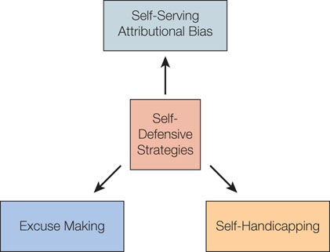
Figure 6.9: Self-Defensive Strategies

Slide 29
6.5: Reactions to Loss of Competence (2 of 3)
6.5.1: Self-Serving Attributional Bias
6.5.1: Explain the concept of self-serving attributional bias
What is self-serving attributional bias?
People take credit for their successes and deny blame for their failures.
Beneficial
6.5.2: Self-Handicapping (a behavioral strategy)
6.5.2: Explain the concept of self-handicapping
What is self-handicapping?
The tendency to create an external obstacle that blocks one’s own performance
Anticipating a potential failure
Harmful
Notes:
6.5.1: Self-Serving Attributional Bias
6.5.1: Explain the concept of self-serving attributional bias
Point 2 – What is self-serving attributional bias?
We strategically use internal and external attributions to maintain overly positive self-evaluations.
While it seems delusionary, it helps people put more effort to positive solutions.
6.5.2: Self-Handicapping
6.5.2: Explain the concept of self-handicapping
Point 2 – What is self-handicapping?
By creating an obstacle that guarantees failure, people can blame the poor outcome on the external cause and not blame themselves.
People are more likely to use this strategy when they expect failure.
Discuss Berglas and Jones (1978) study of IQ tests.
Refer to Figure 6.10: Self-Handicapping as Expressed Through Drug Choice.
Self-handicapping seems to do more harm than good.

Slide 30
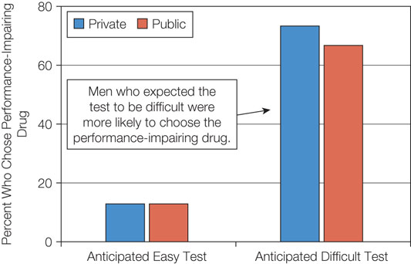
Figure 6.10: Self-Handicapping as Expressed Through Drug Choice

Slide 31
6.5: Reactions to Loss of Competence (3 of 3)
6.5.3: Excuse Making (a cognitive strategy)
6.5.3: Explain the concept of excuse making
What is excuse making?
An attempt to shift attributions for a negative outcome from internal causes to external causes
Notes:
6.5.3: Excuse Making
6.5.3: Explain the concept of excuse making
Point 2 – What is excuse making?
How is excuse making different from self-handicapping?

Slide 32
Summary: Competence
The concept of competence as a core motive
The ways in which people express competence
How the self impacts our motivation
The different self-evaluation motives
How the loss of competence can affect motivation
Notes:
People whose sense of competencies is threatened show a higher desire for competence. People who pursue competence-relevant goals are happier and healthier than those who pursue other types of goals.
Learning goals frame the task as an opportunity to improve competencies; performance goals frame it an opportunity to prove their competencies. Entity theorists believe traits and abilities are fixed while incremental theorists believe they can and do change over time. Praising for effort is better than praising for ability. Flow occurs when a person is in a state of concentration and becomes completely absorbed within an activity.
Goal fusion refers to the extent that a goal is perceived to be integrated into one’s self-concept. People highly fused with their goal are more likely to achieve their goal and are more impacted by goal feedback.
Social comparison theory posits that people evaluate their abilities by comparing to the abilities of similar others. Self-assessment states people are motivated to obtain an accurate evaluation of their abilities. Self-verification states people are motivated to maintain consistency between their self-concepts and new information. Self-enhancement states people are motivated to enhance positive aspects and decrease negative aspects of their self-concept. Positive illusions are overly positive self-perceptions. Downward social comparisons involve comparing our skills to those worse off; self-affirmation theory states that if one aspect of the self-concept is threatened, we can reflect on another valued aspect. Self-improvement states people are motivated to improve their abilities. We compare ourselves to others better than ourselves, but self-enhancement appears to be the dominant motive.
Self-handicapping occurs when someone who is anticipating failure purposely creates an obstacle that will prevent his or her own success. Excuses try to shift the cause of a negative outcome from internal to external causes. It protects self-esteem and makes others less likely to blame us for our failures.

