Slide 1
Burkley
First edition
Chapter 7
Belonging
Copyright © 2018 Pearson Education, Inc. All Rights Reserved

Slide 2
Learning Objectives (1 of 2)
7.1 Analyze the concept of belonging as a core motive
7.1.1 Analyze how belonging elicits behaviors
7.1.2 Explain how belonging produces positive outcomes
7.1.3 Describe the universality of belonging
7.2 Describe how the sociometer theory is related to motivation
7.2.1 Explain the concepts that influence self-esteem
7.3 Analyze the ways people gain and maintain belonging
7.3.1 Explain the relationship between likeability and belonging
7.3.2 Explain the relationship between competence and belonging
7.4 Analyze theories that examine how groups help fulfill the need to belong
7.4.1 Describe social identity theory
Notes:
Slide 2 is list of textbook LO numbers and statements

Slide 3
Learning Objectives (2 of 2)
7.4.2 Explain terror management theory
7.4.3 Describe optimal distinctiveness theory
7.5 Compare the psychological outcomes of belonging in cyberspace versus real-world interactions
7.5.1 Explain how cyberspace affects belonging
7.5.2 Explain the relationship between cyberspace and face-to-face contact
7.6 Analyze how the loss of belonging can affect motivation
7.6.1 Describe how researchers study ostracism
7.6.2 Explain how internal reactions to rejection can affect motivation
7.6.3 Explain how behavioral reactions to rejection can affect motivation
7.6.4 Explain how long-term reactions to rejection can affect motivation
Notes:
Slide 2 is list of textbook LO numbers and statements

Slide 4
Introduction: Belonging
Key questions to be answered
The need to belong
Sociometer theory
How we gain and maintain belonging
Fulfilling our need to belong within groups
Fulfilling our need to belong within cyberspace
Reactions to loss of belonging
Notes:
Humans have a fundamental need to belong and to form and maintain lasting, positive relationships.
A person’s relational value reflects the degree to which other people value a relationship with them.
Self-presentation refers to our attempts to project a positive social impression.
Our group memberships are ones that fulfill our need to belong.
People often fulfill their need to belong through the use of the Internet and social media.
Ostracism occurs frequently, and it can result in many reactions, short term and long term.

Slide 5
7.1: The Need to Belong (1 of 3)
7.1: Analyze the concept of belonging as a core motive
Belonging as a core motive
Rejection
Pervasive drive to form and maintain lasting, positive interpersonal relationships
How do we know belonging is a core motive?
Babies
Pair bonding
Loners/hermits
Notes:
7.1: Analyze the concept of belonging as a core motive
Point 1 – Belonging as a core motive
71% of students report bullying as a problem; 42% report being bullied online/cell phones.
Belonging is also sometimes referred to as a need for affiliation or need for relatedness.
Point 2 – How do we know belonging is a core motive?
Within 36 hours of birth, babies prefer human faces.
Only 3% of mammals practice pair bonding.
Even loners have ongoing contact with others. When people truly live alone or do not have social connectedness, it is not usually done out of choice.

Slide 6
7.1: The Need to Belong (2 of 3)
7.1.1: Belonging Elicits Behaviors
7.1.1: Analyze how belonging elicits behaviors
Tom Hanks in Castaway …and his friend Wilson
How does belonging elicit behaviors?
Quickly and easily form bonds with caregivers, group members, and acquaintances
“Rebound” relationships
Social snacking
7.1.2: Belonging Produces Positive Outcomes
7.1.2: Explain how belonging produces positive outcomes
How does belonging produce positive outcomes?
Adaptive
Mental health and well-being
Physical health
Notes:
7.1.1: Belonging Elicits Behaviors
7.1.1: Analyze how belonging elicits behaviors
Point 1 – How does belonging elicit behaviors?
Consider Tom Hanks’ character in Castaway and how he created human contact with the volleyball he called Wilson.
Physical proximity is a major determinant of friendship development and interpersonal attraction.
How does this relate to dating and friendships in college?
After a relationship ends, we often try to fill that hole.
Discuss Sheldon and Gunz (2009) and the personality test challenging belonging.
Social snacking involves seeking out symbolic reminders of our current or past social connections.
7.1.2: Belonging Produces Positive Outcomes
7.1.2: Explain how belonging produces positive outcomes
Point 1 – How does belonging produce positive outcomes?
Social connections compensated for a lack of speed, ferocity, and strength in our ancestors.
How does that social connectedness translate to survival in our modern world?
Studies show that people who report being lonely have increased rates of depression, personality disorders, and suicidal thoughts and behaviors.
Belonging is associated with more exercise, better diets, and better dental hygiene.
Being lonely is associated with higher death rates. Discuss Luo et al. (2012) and research with the National Death Index.

Slide 7
7.1: The Need to Belong (3 of 3)
7.1.3: Belonging Is Universal
7.1.3: Describe the universality of belonging
Belonging is universal
Found in every culture/country
Cultural differences in relationships
Western –> Loose / Eastern ->tight/secure
Individual differences
need for affiliation varies
Women (partner) v. Men (group)
Belonging in the brain
Structure responsible for processing pain and pleasure
Anterior cingulate cortex
Oxytocin (“love hormone” “cuddle chemical”
Neurochemical
Treating social disorders
Increase socialness (a nose-spray to stimulate trust?)
Notes:
7.1.3: Belonging Is Universal
7.1.3: Describe the universality of belonging
Point 1 – Belonging is universal.
People in every society belong to small groups.
Western cultures tend to seek loose relationships, while Eastern cultures seek secure, tight relationships.
Some people have a stronger “affiliation motive” than others and have high fears of rejection. Men focus on loose bonds with large groups, while women prefer tight, intimate relationships.
Point 2 – Belonging in the brain
Social connections are inherently pleasurable.
Raises the idea that social rejection produces the same effects as physical pain.
Point 3 – Oxytocin
Oxytocin plays a role in social affiliation and pair bonding.
Oxytocin has been influential in treating autism spectrum disorder.
Oxytocin can help typical people become more social. Refer to Kosfeld et al. (2005) and game of trust.

Slide 8
7.2: Sociometer Theory
7.2: Describe how the sociometer theory is related to motivation
What is sociometer theory?
The degree to which other people value interacting with and having a relationship with us
Relational value
Self-esteem
Gauge
7.2.1: Does Acceptance Boost Self-Esteem and Rejection Reduce It?
7.2.1: Explain the concepts that influence self-esteem
Does acceptance boost self-esteem?
Exclusion lowers self-esteem when it reflects disapproval from others.
Just about any other(s)
Even by strangers
Notes:
7.2: Describe how the sociometer theory is related to motivation
Point 1 – What is sociometer theory?
Our attempts to maximize acceptance and reduce rejection is an effort to enhance relational value.
Both positive and negative behaviors are linked to increasing our relational value.
Self-esteem is influenced heavily by our sense of belonging.
The sociometer monitors social relationships and gives a warning when one is in danger of being rejected.
7.2.1: Does Acceptance Boost Self-Esteem and Rejection Reduce It?
7.2.1: Explain the concepts that influence self-esteem
Point 1 – Does acceptance boost self-esteem?
Refer to Figure 7.1: Effect of Group Exclusion on Self-Esteem.
Discuss Leary et al. (1995) and group exclusion study.
Self-esteem decreases with rejection from strangers, people we desire, and even by non-sentient beings.

Slide 9
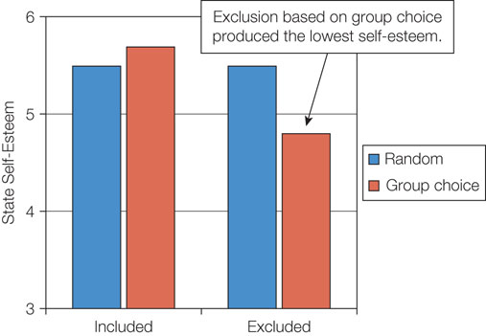
Figure 7.1: Effect of Group Exclusion on Self-Esteem

Slide 10
7.3: How We Gain and Maintain Belonging (1 of 2)
7.3: Analyze the ways people gain and maintain belonging
How do we gain and maintain belonging?
Self-presentation
Likeability
Competence
7.3.1: Likeability
7.3.1: Explain the relationship between likeability and belonging
The relationship between likeability and belonging
Pleasant, friendly, agreeable
Emphasize similarity
Primary factor in being liked
Matching hypothesis
Utilize ingratiation
Flattery, praise
Notes:
7.3: Analyze the ways people gain and maintain belonging
Point 1 – How do we gain and maintain belonging?
Impression management is important because making a good impression is one of the most important tasks in initiating a social relationship.
We try to present traits to gain and maintain relationships.
7.3.1: Likeability
7.3.1: Explain the relationship between likeability and belonging
Point 1 – The relationship between competence and belonging
People who are more competent have a higher relational value.
Why do we want to share our accomplishments with others?

Slide 11
7.3: How We Gain and Maintain Belonging (2 of 2)
7.3.2: Competence
7.3.2: Explain the relationship between competence and belonging
The relationship between competence and belonging
Strive for success
Others like you if you’re competent!
Reciprocal self-disclosure (Sidney Jourard)
Developing in trust (the glue for friendships
:Friendship is
“when people know all about you but like you anyway”
Notes:
7.3.2: Competence
7.3.2: Explain the relationship between competence and belonging
Point 1 – The relationship between competence and belonging
People who are more competent have a higher relational value.
Why do we want to share our accomplishments with others?

Slide 12
7.4: Fulfilling Our Need to Belong Within Groups (1 of 3)
7.4: Analyze theories that examine how groups help fulfill the need to belong
Why do we want to belong to groups?
Minimal group paradigm
In-group favoritism
7.4.1: Social Identity Theory (Tajfel)
7.4.1: Describe social identity theory
What is social identity theory?
We form groups quickly because our groups represent a major source of self-esteem.
Self-esteem from group memberships
Favor in-group members
(are you more likely to throw an out-group under the bus?
Especially after sniffing oxytocin?
Notes:
7.4: Analyze theories that examine how groups help fulfill the need to belong
Point 1 – Why do we want to belong to groups?
Groups are created from the most minimal of conditions.
Once minimal groups are created, people start to show preferential treatment toward their in-group and hostility to the out-group.
7.4.1: Social Identity Theory
7.4.1: Describe social identity theory
Point 1 – What is social identity theory?
We categorize others into in-groups and out-groups to arouse feelings of competition and a desire to win.
When our group does well, we experience a rise in self-esteem.
Discuss De Dreu et al. (2011) and Dutch participants with a moral dilemma.

Slide 13
7.4: Fulfilling Our Need to Belong Within Groups (2 of 3)
7.4.2: Terror Management Theory
7.4.2: Explain terror management theory
What is terror management theory?
Recognize mortality
Coping mechanisms—perceived immortality
People cope with the inherent fear of their own death by promoting and defending the groups to which they belong.
Evidence for terror management theory
Mortality salience
Conformity to group norms
Identification with one’s gender and race
Criticisms
Inconsistent with evolutionary theory
Cannot account for behaviors like suicide
Uncertainty or meaning can create the same responses
Do people actually experience “terror” when thinking about their own death?
Notes:
7.4.2: Terror Management Theory
7.4.2: Explain terror management theory
Point 1 – What is terror management theory?
Humans can imagine the future, both good and bad.
Coping mechanisms include the group and culture, which provides a sense of immortality, from an afterlife or culture.
Point 2 – Evidence for terror management theory
Watching videos or writing an essay predicting death is the most common way to examine terror management theory.
Refer to Figure 7.2: Terror Management Theory
We seek out groups to which we can belong, and reminders of death increase people’s commitment to others.
Point 3 – Criticisms
Which criticisms do you think are valid? Why?

Slide 14
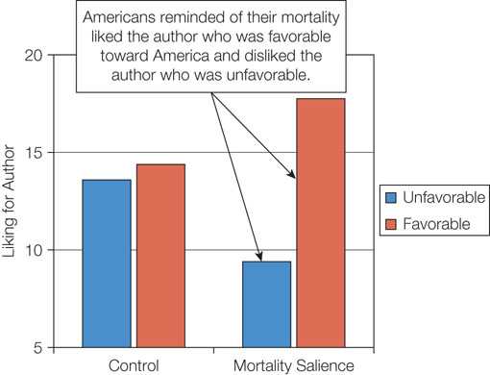
Figure 7.2: Terror Management Theory

Slide 15
7.4: Fulfilling Our Need to Belong Within Groups (3 of 3)
7.4.3: Optimal Distinctiveness Theory
7.4.3: Describe optimal distinctiveness theory
What is optimal distinctiveness theory?
Tension between assimilation and differentiation
Define identity in an accepting but selective group.
Notes:
7.4.3: Optimal Distinctiveness Theory
7.4.3: Describe optimal distinctiveness theory
Point 1 – What is optimal distinctiveness theory?
Within a group setting, these two desires are opposites, and we work to resolve the tension.
Refer to Figure 7.3: Humans Constantly Experience a Tension Between Desires for Assimilation and Differentiation.

Slide 16
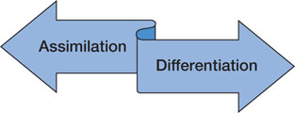
Figure 7.3: Humans Constantly Experience a Tension Between Desires for Assimilation and Differentiation

Slide 17
7.5: Fulfilling Our Need to Belong Within Cyberspace (1 of 2)
7.5: Compare the psychological outcomes of belonging in cyberspace versus real-world interactions
How do we fulfill our need to belong in cyberspace?
Communication options
Social media
7.5.1: Is Cyberspace Good or Bad for Belonging?
7.5.1: Explain how cyberspace affects belonging
Is cyberspace good or bad for belonging?
Mixed studies
Facebook
Disconnection
Increased connection
Temporary fix
Notes:
7.5: Compare the psychological outcomes of belonging in cyberspace versus real-world interactions
Point 1 – How do we fulfill our need to belong in cyberspace?
The Internet has dramatically changed how we communicate and interact with one another.
7.5.1: Is Cyberspace Good or Bad for Belonging?
7.5.1: Explain how cyberspace affects belonging
Point 1 – Is cyberspace good or bad for belonging?
Some studies show negative impacts, such as a reduced sense of belonging. Others show that cyberspace is a good way to fulfill the need to belong.
Point 2 – Facebook
People who feel disconnected are more likely to use Facebook. They then feel more connected.
But, Facebook does not help people resolve their sense of loneliness and isolation.

Slide 18
7.5: Fulfilling Our Need to Belong Within Cyberspace (2 of 2)
7.5.2: Does Cyberspace Reduce Face-to-Face Contact?
7.5.2: Explain the relationship between cyberspace and face-to-face contact
Does cyberspace reduce face-to-face contact?
Unwarranted concern
Facilitate relationships
Retain connections over long distances
Notes:
7.5.2: Does Cyberspace Reduce Face-to-Face Contact?
7.5.2: Explain the relationship between cyberspace and face-to-face contact
Point 1 – Does cyberspace reduce face-to-face contact?
People must eventually bring their online relationships into the real world of face-to-face interactions.
Why do some studies suggest that relationships that start online can be better than those that start the traditional way?

Slide 19
7.6: Reactions to Loss of Belonging (1 of 5)
7.6: Analyze how the loss of belonging can affect motivation
What are the reactions to loss of belonging?
Ostracism
Bullying
Cyberbullying
School violence
Notes:
7.6: Analyze how the loss of belonging can affect motivation
Point 1 – What are the reactions to loss of belonging?
There are many forms of ostracism, some more severe than another.
Increased incidences of violence, especially among children, has led to a greater awareness of ostracism.

Slide 20
7.6: Reactions to Loss of Belonging (2 of 5)
7.6.1: How Researchers Study Ostracism
7.6.1: Describe how researchers study ostracism
Studying ostracism From diary entries:
Over 1/3 from a friend, relative, or romantic partner
“Life Alone” technique
Personality inventory and feedback
Made the Ps aggressive
“Get Acquainted” technique
One P is left out of group membership
Cyberball
Kip Williams invention
Consequences of rejection
Internal (brain level – structures same as ones for pain/pleare)
anterior cingulate cortex (ACC)
Behavioral – borrow a pet
Long term
Notes:
7.6.1: How Researchers Study Ostracism
7.6.1: Describe how researchers study ostracism
Point 1 – Studying ostracism
What are the various ways researchers can study ostracism?
Why are these ways effective?
Point 2 – Consequences of rejection
Refer to Figure 7.4: Consequences of Rejection This figure is not listed in the template.

Slide 21
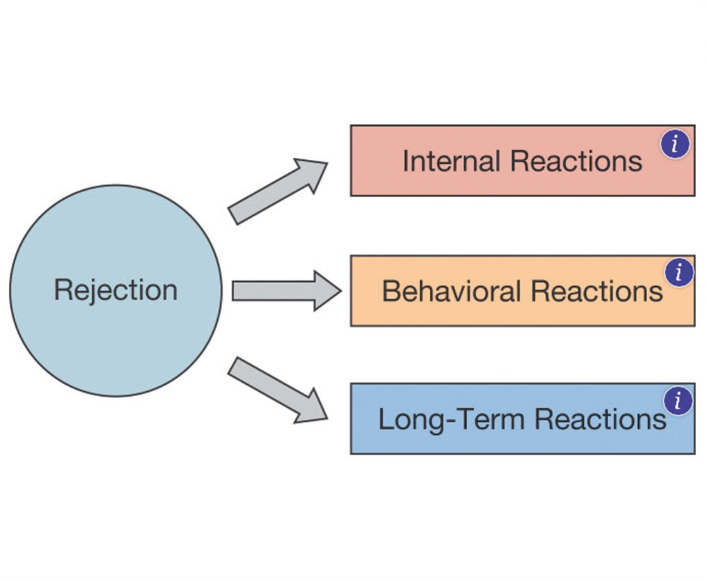
Figure 7.4: Consequences of Rejection

Slide 22
7.6: Reactions to Loss of Belonging (3 of 5)
7.6.2: Internal Reactions to Rejection
7.6.2: Explain how internal reactions to rejection can affect motivation
The hurt feelings of rejection
Hurt feelings
Anterior cingulate cortex
Treating hurt feelings
Emotional numbness
Shock
“Life alone” technique
Twenge, Baumiester, DeWall, Ciarocco, & Bartels, 2007
Those rejected were less altruistic
Impaired cognitive functioning
Poorer cognitive functioning (makes you dumb as well as numb!)
Poorer memory
“Life alone” technique
Notes:
7.6.2: Internal Reactions to Rejection
7.6.2: Explain how internal reactions to rejection can affect motivation
Point 1 – The hurt feelings of rejection
Refer to Figure 7.5: Six Experiences That Cause Hurt Feelings
All of the experiences that cause hurt feelings involve low relational value in some form or another.
Why does social reject hurt in ways that other negative events do not?
Discuss the Eisenberger, Leiberman, and Williams (2003) study with Cyberball.
Does acetaminophen help treat hurt feelings? Discuss DeWall et al. (2010).
Point 2 – Emotional numbness
Studies show that rejection causes people to become emotionally numb and less likely to help others in need.
Point 1 – Impaired cognitive functioning
Refer to Figure 7.6: Effect of Rejection on Test Performance
Considering a lonely future negatively impacts cognitive functioning.

Slide 23
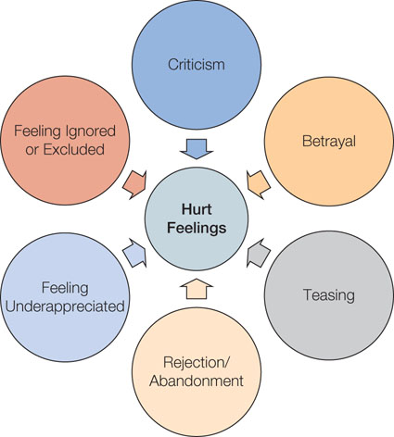
Figure 7.5: Six Experiences That Cause Hurt Feelings

Slide 24
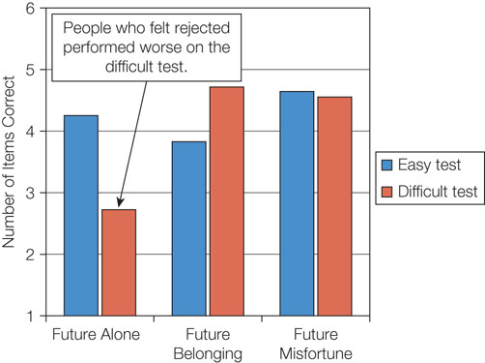
Figure 7.6: Effect of Rejection on Test Performance

Slide 25
7.6: Reactions to Loss of Belonging (4 of 5)
7.6.3: Behavioral Reactions to Rejection
7.6.3: Explain how behavioral reactions to rejection can affect motivation
Aggression (what does this say about participation in gang activity?)
Experiences of ostracism
School shootings
Desensitization
Impaired self-regulation
Self-defeating behaviors
Drinking, eating?
Can overweight be self-perpuating?
Notes:
7.6.3: Behavioral Reactions to Rejection
7.6.3: Explain how behavioral reactions to rejection can affect motivation
Point 1 – Aggression
Many school shooters have the experience of ostracism in common.
Two-thirds of school shootings in the United States involved bullying and ostracism.
Discuss Twenge et al. (2001) and aggression responses.
Rejection makes people more sensitive to rejection information.
What can help offset the aggression response to rejection?
Point 2 – Impaired self-regulation
Discuss Tice et al. (2001) and self-defeating behaviors.
Neuroimaging reveals that rejection decreases activity in the brain that controls regulation.

Slide 26
7.6: Reactions to Loss of Belonging (5 of 5)
7.6.4: Long-Term Reactions to Rejection
7.6.4: Explain how long-term reactions to rejection can affect motivation
What are the long-term reactions to rejection?
Shame
Humiliation
Low self-esteem
Depression
Self-destruction
Notes:
7.6.4: Long-Term Reactions to Rejection
7.6.4: Explain how long-term reactions to rejection can affect motivation
Point 1 – What are the long-term reactions to rejection?
Chronic teasing, bullying, and ostracism can lead to many negative psychological indicators.
Long-term rejection can lead to self-destructive behaviors, such as eating disorders or suicide.
What do we need to do to reduce suicide risks?

Slide 27
Summary: Belonging
The concept of belonging as a core motive
The concepts that influence self-esteem
The ways people gain and maintain belonging
The theories that examine how groups help fulfill the need to belong
The psychological outcomes of belonging in cyberspace versus real-world interactions
How the loss of belonging can affect motivation
Notes:
Humans seek out social connections, form bonds easily, and be reluctant to break bonds once they are formed.
According to sociometer theory, self-esteem acts like a gauge. When self-esteem is high, we are accepted by others, and vice versa.
People try to present themselves as likeable by emphasizing their similarities or engaging in ingratiation techniques.
Research using the minimal group paradigm indicates that people form group bonds quickly and easily, and that once a group is formed, people demonstrate in-group favoritism. According to social identity theory, we automatically categorize people into in-groups and out-groups. According to terror management theory, our groups protect us against the fear of death by promising immortality. According to optimal distinctiveness theory, people strive to strike a balance between assimilation and differentiation.
People who feel disconnected from others are more likely to use social media, which helps them feel more connected.
Researchers study ostracism in a variety of methods. Ostracism results in a number of inner reactions, including hurt feelings, numbness, and impaired cognitive functioning. Long-term ostracism is associated with self-destructive behaviors and suicide.

