Slide 1
Burkley
First edition
Chapter 8
Goal Setting
Copyright © 2018 Pearson Education, Inc. All Rights Reserved

Slide 2
Learning Objectives (1 of 3)
8.1 Analyze the components of a goal
8.1.1 Define the term goal
8.1.2 Explain why goals are important
8.1.3 Explain the causes of goals
8.1.4 Explain how goals are structured
8.2 Analyze the features of a goal
8.2.1 Explain the concepts of expectancy and value with regard to goals
8.2.2 Explain the concept of difficulty with regard to goals
Notes:
Slide 2 is list of textbook LO numbers and statements

Slide 3
Mount Everest -

Slide 4
Learning Objectives (2 of 3)
8.2.3 Explain the concept of specificity with regard to goals
8.2.4 Describe the joint effect of difficulty and specificity
8.2.5 Explain the concept of proximity with regards to goals
8.2.6 Contrast approach goals and avoidance goals
8.2.7 Explain how factors other than motivation affect performance
8.3 Explain the importance of goal commitment in motivation
8.3.1 Analyze the causes and consequences of goal commitment
8.3.2 Explain the mental strategies used to boost goal commitment
Notes:
Slide 2 is list of textbook LO numbers and statements

Slide 5
Learning Objectives (3 of 3)
8.3.3 Describe the factors that make up a commitment to an ongoing goal
8.4 Analyze the phases of the motivation process
8.4.1 Describe the four motivational phases
8.4.2 Describe the two types of goal mindsets
8.5 Analyze the concept of goal conflict
8.5.1 Identify the four types of goal conflict
8.5.2 Explain the concept of goal shielding
Notes:
Slide 2 is list of textbook LO numbers and statements

Slide 6
Introduction: Goal Setting
Key questions to be answered
Goals
Goal features
Goal commitment
The motivation process
Goal conflict
Notes:
A goal is a cognitive representation of a future outcome. We all have them, but rarely consider what they entail.
People tend to select goals that are high in expected likelihood of success and high perceived value.
Goal commitment refers to the process whereby a person forms an intention to strive for a goal.
The motivation process can be divided into defined steps.
Goal conflict occurs whenever we have two competing goals.

Slide 7
8.1: Goals (1 of 2)
8.1: Analyze the components of a goal
What is special about goals?
Separate from fantasy
Motivational
8.1.1: What Is a Goal?
8.1.1: Define the term goal
Four aspects of goal construct
Cognitive representations
Future-focused
Commitment
Approach or avoidance-based
Notes:
8.1: Analyze the components of a goal
Point 1 – What is special about goals?
We all have a general sense of goals and how they are motivating, but there are more specific details of how to define them and use them.
8.1.1: What Is a Goal?
8.1.1: Define the term goal
Point 1 – Four aspects of goal construct
A goal is defined as a cognitive representation of a future outcome that an individual is committed to approach or avoid.
What are some goals you have for this course? In your personal life? How do those goals fulfill the four aspects of goal construct?

Slide 8
8.1: Goals (2 of 2)
8.1.2: Why Are Goals Important?
8.1.2: Explain why goals are important
Why are goals important?
Enhance performance
Focus
Positive psychological functioning
Greater life satisfaction
8.1.3: Where Do Goals Come From?
8.1.3: Explain the causes of goals
Reasons for adopting a goal
Needs (autonomy, competence, belonging)
Demands
Culture
Notes:
8.1.2: Why Are Goals Important?
8.1.2: Explain why goals are important
Point 1 – Why are goals important?
People who set goals paid more attention to the goal-relevant sections (refer to Rothkopf and Billington, 1979).
The psychological benefits of having goals occurs regardless of whether or not the goal is achieved.
8.1.3: Where Do Goals Come From?
8.1.3: Explain the causes of goals
Point 1 – Reasons for adopting a goal
Henry Murray believed that people adopt goals to fulfill physiological or psychological needs.
Murray also believed that people receive external sources of pressure to fulfill a goal. Self-set goals are ones we choose for ourselves, while assigned goals are given to us by others.
The environment and culture where we are raised influences the types of goals we set.

Slide 9
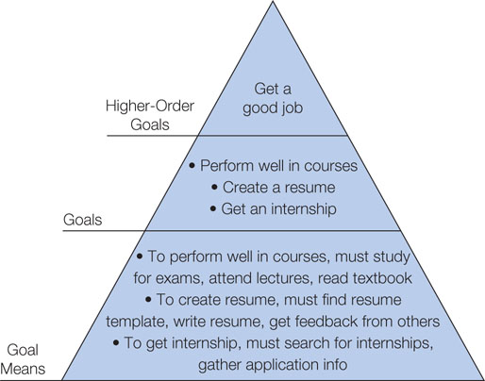
Figure 8.1: Goal Hierarchy

Slide 10
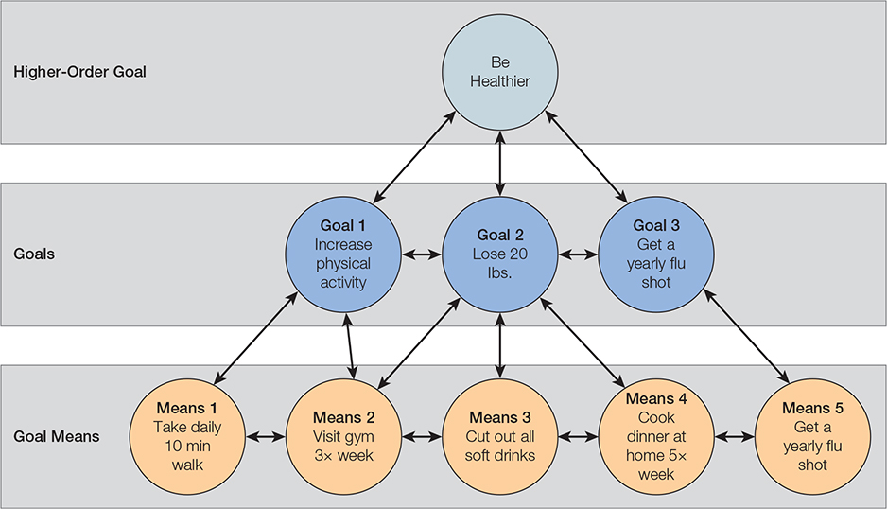
Figure 8.2: Goal Systems Theory

Slide 11
8.2: Goal Features (1 of 6)
8.2: Analyze the features of a goal
Types of goals
Not all goals are created equal.
Possibility of achievement
8.2.1: Expectancy and Value
8.2.1: Explain the concepts of expectancy and value with regard to goals
Expectancy-Value Theory
Expectancy x Value = Behavior
Motivation
Subjective
Influential sources
Perceived capability
Belief in outcome
Notes:
8.2: Analyze the features of a goal
Point 1 – Types of goals
The types of goals are set will help determine whether or not they can be met.
8.2.1: Expectancy and Value
8.2.1: Explain the concepts of expectancy and value with regard to goals
Point 1 – Expectancy-Value Theory
Behavior results from the joint function of expectancy and value.
If either expectancy or value is 0, then the person will not carry out the action.
Motivation is highest when both expectancy and value are high.
Expectancy and value are both subjective assessments.
Point 2 – Influential sources
A person’s perceived capability and a belief in goal achievement both influence expectancy estimates.

Slide 12
8.2: Goal Features (2 of 6)
8.2.2: Difficulty
8.2.2: Explain the concept of difficulty with regard to goals
What is goal difficulty?
Knowledge
Skill
Understanding the role of goal difficulty in goal achievement
Levels of aspiration
Goal conflict
8.2.3: Specificity
8.2.3: Explain the concept of specificity with regard to goals
What is specificity?
How precisely one defines a goal
Notes:
8.2.2: Difficulty
8.2.2: Explain the concept of difficulty with regard to goals
Point 1 – What is goal difficulty?
Difficulty relates to the knowledge and skill required to achieve a goal.
Point 2 – Understanding the role of goal difficulty in goal achievement
Lewin et al. (1944) observed the paradox of aspiration.
Goal conflict occurs whenever we have two competing or mutually exclusive goals.
The more difficult the goal, the more energy and effort people will invest in their goal pursuit.
What can you do to ensure your goal is difficult enough to ensure success?
8.2.3: Specificity
8.2.3: Explain the concept of specificity with regard to goals
Point 1 – What is specificity?
Discuss Earley, Wojnaroski, and Prest (1987) and student goals.
Point 2 – Why do specific goals facilitate goal achievement?
How can you transform a vague goal into a specific one?

Slide 13
Table 8.1: Vague Versus Specific Goals
Vague Goals | Specific Goals
Write a novel
Perform better in school
Be healthier
Save more money

Slide 14
8.2: Goal Features (3 of 6)
Why do specific goals facilitate goal achievement?
Attention
Reduce ambiguity
Measure progress
Definitive end point
8.2.4: Joint Effect of Difficulty and Specificity
8.2.4: Describe the joint effect of difficulty and specificity
The joint effect of difficulty and specificity
Significant impact
Strong effect on performance
Notes:
8.2.4: Joint Effect of Difficulty and Specificity
8.2.4: Describe the joint effect of difficulty and specificity
Point 1 – The joint effect of difficulty and specificity
Refer to Figure 8.3: Goal Difficulty and Specificity.

Slide 15
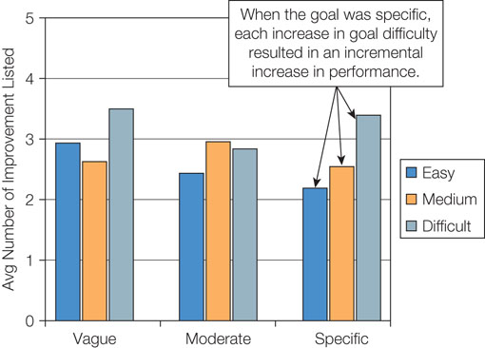
Figure 8.3: Goal Difficulty and Specificity

Slide 16
8.2: Goal Features (4 of 6)
8.2.5: Proximity
8.2.5: Explain the concept of proximity with regards to goals
What is proximity?
Distal goals
Proximal goals
Goal-gradient hypothesis
Construal level theory
Distal—abstract
Proximal—concrete
Notes:
8.2.5: Proximity
8.2.5: Explain the concept of proximity with regards to goals
Point 1 – What is proximity?
Refer to Figure 8.4: Distal and Proximal Goals.
The more proximal the goal, the more motivated we are to achieve it.
Organisms increase effort as the goal becomes more proximal.
Refer to Figure 8.5: Proximal Versus Distal Goals.
Point 2 – Construal level theory
Discuss Liberman and Trope (1998).

Slide 17
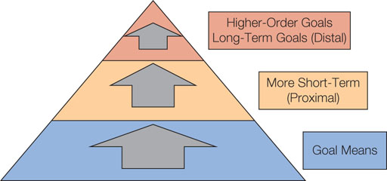
Figure 8.4: Distal and Proximal Goals

Slide 18
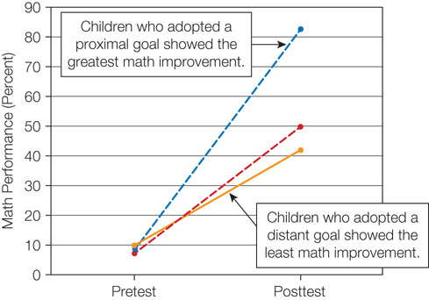
Figure 8.5: Proximal Versus Distal Goals

Slide 19
8.2: Goal Features (5 of 6)
8.2.6: Approach Versus Avoidance Goals narrows focus on:
Approach
goal means directly leading to desirable outcomes)
Avoidance
any behavior that helps avoid the bad outcome
8.2.6: Contrast approach goals and avoidance goals
Approach goals
Goal means
Behavioral activation system (BAS)
Sensitive to reward
Avoidance goals
Chaotic, unpredictable behaviors
Behavioral inhibition system (BIS)
Sensitive to punishment
Notes:
8.2.6: Approach Versus Avoidance Goals
8.2.6: Contrast approach goals and avoidance goals
Point 1 – Approach goals
Approach goals narrow focus on the goal means that directly lead to the desired outcome.
The BAS is generally perceived as a system sensitive to positive stimuli.
Point 2 – Avoidance goals
Avoidance goals tend to direct people’s focus to any behavior that moves the individual away from the undesired end state.
The BIS is generally sensitive to negative stimuli.
People vary in which system is stronger.

Slide 20
8.2: Goal Features (6 of 6)
8.2.7: Non-Motivational Factors (Will do)
8.2.7: Explain how factors other than motivation affect performance
Non-motivational factors (Can do)
Skill level
Training
Coaching
Access to resources
Notes:
8.2.7: Non-Motivational Factors
8.2.7: Explain how factors other than motivation affect performance
Point 1 – Non-motivational factors
If two individuals have comparable skills, training, and resources, then the person who sets difficult, specific, proximal approach goals will likely outperform the other individual.

Slide 21
8.3: Goal Commitment (1 of 3)
8.3: Explain the importance of goal commitment in motivation
Goal commitment
Process whereby a person forms an intention to strive for a goal
Varies per individual and the importance of the goal
8.3.1: Causes and Consequences of Goal Commitment
8.3.1: Analyze the causes and consequences of goal commitment
What factors increase goal commitment?
Equifinality Kruglanski and colleagues (2011)
(one vs many means to the goal)
Which brings more commitment?
Expectancy is higher in which one?
Value
Notes:
8.3: Explain the importance of goal commitment in motivation
Point 1 – Goal commitment
A high level of commitment implies the individual is willing to exert resources into the pursuit of the goal and will not give up until the goal is achieved.
People vary greatly in terms of their goal commitment.
8.3.1: Causes and Consequences of Goal Commitment
8.3.1: Analyze the causes and consequences of goal commitment
Point 1 – What factors increase goal commitment?
If there are multiple ways to achieve a goal, expectancy is high.
Point 2 – What consequences does goal commitment have on the goal process?
Being committed to a goal has many positive influences on whether or not the goal will be achieved.

Slide 22
8.3: Goal Commitment (2 of 3)
What consequences does goal commitment have on the goal process?
Goal performance
Higher effort
Persistence
Goal-consistent actions
Resist temptations
Reach goal completion
8.3.2: Mental Strategies to Boost Goal Commitment
8.3.2: Explain the mental strategies used to boost goal commitment
Mental strategies to increase goal commitment
Indulging (focus on a positive outcome fantasy)
Dwelling (focus on a present negative situation)
Mental contrasting (focus on present negative and positive future)
Notes:
8.3.2: Mental Strategies to Boost Goal Commitment
8.3.2: Explain the mental strategies used to boost goal commitment
Point 1 – Mental strategies to increase goal commitment
Mental fantasies can lower goal commitment.
Dwelling on obstacles is also associated with lower goal commitment.
Mental contrasting involves first imagining the desired positive future and then imagining the present negative future. Mental contrasting gets people excited and energized about a goal.

Slide 23
8.3: Goal Commitment (3 of 3)
8.3.3: Commitment to an Ongoing Goal (dynamic process)
8.3.3: Describe the factors that make up a commitment to an ongoing goal
Factors that influence goal commitment
(Burkley et al. modeled on relationship committment)
Goal satisfaction (high commitment:
when making progress to reach it
Goal investments (high commitment:
when devoting many resources to it
Goal alternatives (low commitment:
When resources are diverted to other things
Reflect on your SIP regarding these commitment factors….
Notes:
8.3.3: Commitment to an Ongoing Goal
8.3.3: Describe the factors that make up a commitment to an ongoing goal
Point 1 – Factors that influence goal commitment
Burkley et al. (2013) proposed a model of goal commitment that shows goal commitment is highest when satisfaction and investments are high and alternatives are low.

Slide 24
8.4: The Motivation Process (1 of 2)
8.4: Analyze the phases of the motivation process
The motivation process
Process that occurs between goal selection and goal performance
8.4.1: The Four Motivational Phases
8.4.1: Describe the four motivational phases
The Rubicon Model
Predecisional phase
Rubicon
Postdecisional phase
Actional phase
Postactional phase
Notes:
8.4: Analyze the phases of the motivation process
Point 1 – The motivation process
Researchers have identified a handful of processes to break down the motivation process.
8.4.1: The Four Motivational Phases
8.4.1: Describe the four motivational phases
Point 1 – The Rubicon Model
Refer to Figure 8.6–A-D: Rubicon Model.
The first phase consists of choosing a goal from an array of possible goals.
The Rubicon is the point of no return.
The postdecisional phase is deciding how to pursue the goal.
The actional phase is engaging in goal-directed behaviors.
The postactional phase evaluates the results of the goal striving.

Slide 25
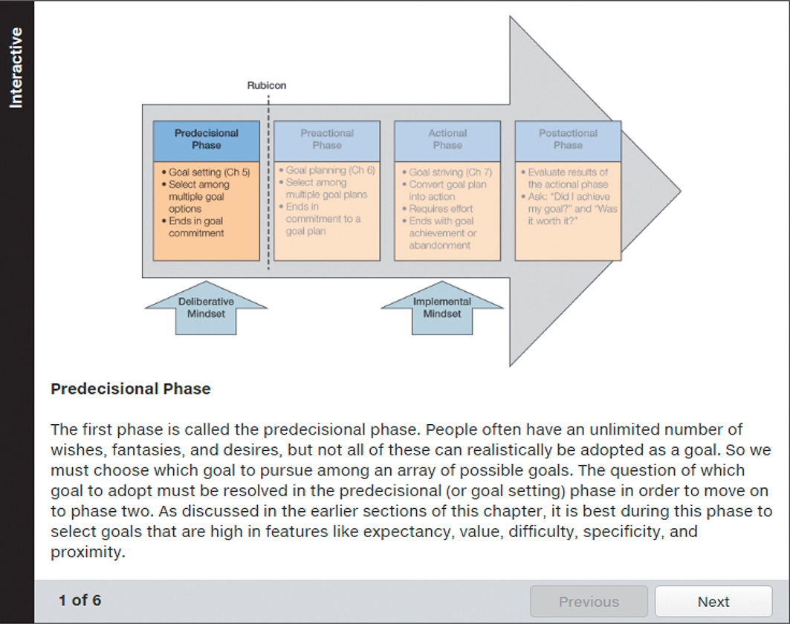
Figure 8.6: Rubicon Model

Slide 26
8.4: The Motivation Process (2 of 2)
8.4.2: Goal Mindsets
8.4.2: Describe the two types of goal mindsets
Deliberative mindset
Precisional phase
Open-mindedness
Implemental mindset
Actional phase
Closed-mindedness – now goal directed…
Notes:
8.4.2: Goal Mindsets
8.4.2: Describe the two types of goal mindsets
Point 1 – Deliberate mindset
It is important to have an objective view of oneself, but it is difficult to do so.
Point 2 – Implemental mindset
A closed-minded approach can help keep people motivated by promoting the initiation of goal-directed behaviors.

Slide 27
8.5: Goal Conflict (1 of 2)
8.5: Analyze the concept of goal conflict
Goal conflict
Two competing or mutually exclusive goals
Stress, depression, anxiety
8.5.1: Types of Goal Conflict
Types of goal conflict
Approach-approach
Nice to have
Avoidance-avoidance
Between the devil and the deep blue sea”
Approach-avoidance
Attractive and unattractive aspects to same goal
Double approach-avoidance
Options have both favorable and unfavorable attributes
What are some you have had???...
Notes:
8.5: Analyze the concept of goal conflict
Point 1 – Goal conflict
Goal conflict occurs whenever we have goal alternatives that interfere with our focal goal.
People who experience goal conflict are more likely to experience depression than others, as well as be less likely to achieve their goals.
8.5.1: Types of Goal Conflict
8.5.1: Identify the four types of goal conflict
Point 1 – Types of goal conflict
Two equally attractive goals make choosing them difficult and stressful.
Choosing between two unattractive goals may cause people to drop out or try other avoidance techniques.
Approach-avoidance involves attractive and unattractive features within a single goal. It is the most common conflict.
Double approach-avoidance involves choosing between two goals that each have both good and bad aspects.
Refer to Figures 8.8 to 8.11.

Slide 28
8.5: Goal Conflict (2 of 2)
8.5.2: Goal Shielding
8.5.2: Explain the concept of goal shielding
Goal shielding (inhibiting alternative goals that conflict/compete)
Prioritization
Highlighting
(consistently choosing the high priority goal)
Balancing
(alternating back and forth when goals conflict)
Harmonious passion
(easily switch from one goal to another)
Obsessive passion
(uncontrollable urge to pursue a goal and unable to disengage from it)
Notes:
8.5.2: Goal Shielding
8.5.2: Explain the concept of goal shielding
Point 1 – Goal shielding
We can protect focal goals by engaging in different strategies.
Prioritization involves giving one goal priority over the other.
Consistently choosing the goal highest in priority is highlighting.
The tendency to alternate back and forth between multiple goals is balancing.
People experience harmonious passion when they can easily switch to another goal.
Obsessive passion involves an uncontrollable urge to pursue a goal and an inability to turn it off.

Slide 29
Summary: Goal Setting
The components of a goal
The features of a goal
The importance of goal commitment in motivation
The phases of the motivation process
The concept of goal conflict
Notes:
Goals are similar to other thoughts in that they are organized hierarchically and can be automatically activated. They represent an image of something in the future and enhance performance. Goals are associated with positive psychological benefits. They are organized in a three-level hierarchy: higher-order goals, short-term goals, and goal means.
People are more likely to set difficult goals than easy goals since we are more likely to earn praise when we attain a difficult goal. People are more successful when they select specific goals and when they choose goals high in difficulty. Proximal goals are short-term goals, while distal goals are long-term. Proximal goals are more concrete, and distal goals are more abstract.
High commitment is associated with better goal performance and persistence. Commitment is higher when expectancy and value levels are high and equifinality is high. Mentally elaborating on a positive future is called indulging and do so on the negative future is dwelling. Mental contrasting increases goal commitment.
The four phases in the Rubicon model are predecisional, postdecisional, action, and postactional. A deliberative mindset is characterized by open-mindedness and objectivity, and is most beneficial during the predecisional process. An implemental mindset is characterized by closed-mindedness and positive bias, and is most beneficial during the actional phase.
Goal conflict can take the form of approach-approach, avoidance-avoidance, approach-avoidance, or double-approach avoidance. Goal shielding occurs when people protect their focal goal by inhibiting alternative goals. When goals conflict, people may highlight a higher priority goal or strive to achieve balance.

