Slide 1
Burkley
First edition
Chapter 12
Emotions

Slide 2
Chapter 12 Emotions
emotion, affect, and mood
relationships: thoughts, emotions, and behavior
biological theories (James-Lange, Cannon Bard)
cognitive theories (Schachter’s cognitive labeling)
cognition or emotion – which comes first?
Lazarus – Cognitive appraisal theory
Zajonc – automatically prefer things (mere exposure)
Plutchik – both occur in a Circular sequence
neuroscience (ACC and amygdala)
the physiological sources of emotions and cognitions
the types of emotions
purpose for emotions
Feedback, belongingness, guide thinking
emotion regulation
Situation selection / modification
Attentional deployment
Reappraise
Notes:
Emotions are conscious evaluative reactions to a specific event, while affect is an unconscious evaluative reaction. Mood is a generalized state that does not link to a specific event.
The commonsense perspective suggests that thoughts cause emotions and that emotions cause behaviors.
The James-Lange theory posits that emotions result from physiological changes in the autonomic nervous system that occur automatically in response to a stimulus.
The Cannon-Bard theory states that physical changes in the body accompany but do not cause emotions. When a visual stimulus activates the thalamus, it splits the electrical signal and send it to the cerebral cortex and the hypothalamus.
According to Schachter-Singer’s cognitive labeling theory, emotions are caused by the combination of unexplained physiological arousal and a cognitive label. People high in arousal sometimes misattribute the arousal to an incorrect source. According to Lazarus’ appraisal theory, when people encounter a stimulus, they engage in a primary appraisal, asking whether the stimulus is good or bad. The secondary appraisal asks whether they have the ability to cope with the stimulus.
Lazarus argues cognitions precede emotions; Zajonc disagrees. Zajonc’s research on the mere-exposure effect shows that people automatically prefer things that they have seen before. Plutchik argues cognitions and emotions occur within a circular sequence of events.
The amygdala is considered to be the emotional computer, directing attention toward emotionally salient stimuli.
Biological theorists believe in a limited number of core emotions, while cognitive theorists believe there may be an unlimited number. Core emotions are primary emotions that are innate, expressed in a distinct way, and universal. The Facial Action Coding System (FACS) is a comprehensive dictionary of human expressions that define each of the six core emotions (anger, disgust, fear, happiness, sadness, and surprise). Negative emotions produce specific action responses, while positive emotions produce nonspecific thought responses.
Emotions provide feedback, provide goal progress, promote belonging, and are contagious. Emotions guide thinking and impact motivation.
Gross identified five ways that people can regulate emotions: situation selection, situation modification, attentional deployment, cognitive change, and response modulation.

Slide 3
Lisa Nowak & Colleen Shipman
What were her emotions over a life time?

Slide 4
12.1: What Is an Emotion?
Emotion (slow)
conscious evaluative reaction to an event.
strong, singular feelings.
Affect (quick) + or (-) feeling
Unconscious evaluation reaction to an event
Mood vs. emotion
Mood—generalized affective state
Emotion—toward a particular target
Think of one for each
Notes:
12.1: Distinguish between emotion, affect, and mood
Point 1 – What is an emotion?
Emotions propel us to action.
Point 2 – Reasons associated with disagreements on emotions
Emotions have been described as passions (raw, violent emotions) or sentiments (calm, reflective emotions).
There is a lack of a widely accepted definition. For this class, we will use the term “emotion” to refer to a conscious evaluative reaction to an event. Emotions are strong, singular feelings.
Point 3 – Affect vs. emotion
The second you are introduced to something, you spend the first few milliseconds categorizing it into something you like or dislike.
Point 4 – Mood vs. emotion
Mood is considered a separate construct from emotion.

Slide 5
12.2: What Causes Emotions?
common sense theory?
Thoughts cause emotions
Emotions cause behavior
Notes:
12.2: Explain the relationship between thoughts, emotions, and behavior
Point 1 – What is the common sense theory?
Refer to Figure 12.1: The Common Sense Theory

Slide 6
Figure 12.1: The Common Sense Theory Give an example you have experienced?

Slide 7
Biological Perspective
James-Lange Theory
Stimulus -> Behavior -> Emotion
Emotions is a:
direct result of physiological changes that occur
automatically in response to a stimulus.
Emotions are the mind’s interpretation to the body’s response.
The autonomic nervous system needs to:
Maintains homeostasis
Sympathetic nervous system (flight or fight)
Parasympathetic nervous system (calms the Sympathetic down)
Notes:
12.3.1: James-Lange Theory
12.3.1: Explain the James-Lange theory of emotion causality
Point 1 – The James-Lang theory
Refer to Figure 12.2: The James-Lange Theory.
It is opposite to the commonsense approach.
Point 2 – The autonomic nervous system
Refer to Figure 12.3: Sympathetic Nervous System Versus Parasympathetic Nervous System.
Point 3 – The connection between physiological responses and emotions
Different physiological responses in the ANS produce different emotions.
Where is each emotion experienced?

Slide 8
Figure 12.2: The James-Lange Theory

Slide 9
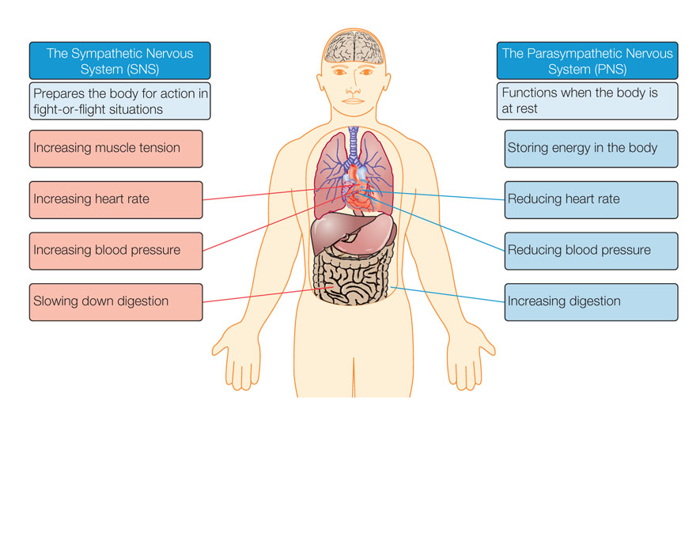
Arousal Calming down (Sympathetic) (parasympathetic)

Slide 10
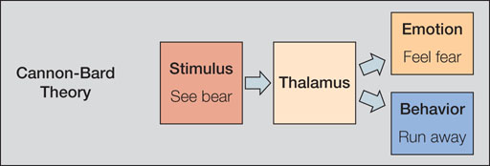
Biological Perspective
Cannon-Bard Theory
At times, certain physiological responses co-occur with emotions
Thalamus
Notes:
12.3.2: Cannon-Bard Theory
12.3.2: Explain the Cannon-Bard theory of emotion causality
Point 1 – The Cannon-Bard theory
Refer to Figure 12.5: The Cannon-Bard theory.
When a visual stimulus activates the thalamus, it splits an electric signal and sends one to the cerebral cortex (to trigger emotion) and the other to the hypothalamus and ANS (to produce physiological response).

Slide 11
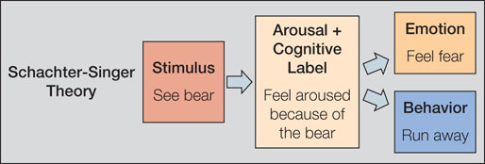
Cognitive Theory: Schachter-Singer Cognitive Labeling Theory

Slide 12
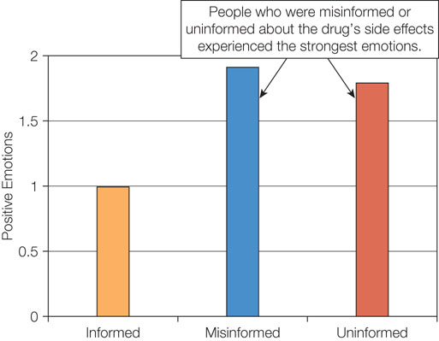
Figure 12.7: Misattribution of Arousal

Slide 13
Cognitive Perspective
Schachter-Singer cognitive labeling theory
Misattribution?
What happened in the Dutton and Lake “bridge study?
Did Cindy throw Colleen off the bridge?
Can you think of a situation where you misattributed an emotion?
How can you help to make sure your first date will not be the last one?
Notes:
12.4: Analyze the cognitive theories put forth to explain emotion causality
Point 1 – The cognitive perspective
Nietzsche once wrote, “every passion…contains in itself its own quantum of reason.”
Emotions can be caused by people’s thoughts and appraisals.

Slide 14
Cognitive Perspective: Appraisal theory (Lazarus)
Primary appraisal –
Is the arousal
Negative? Threat or fear?
Positive ? Beneficial?
Neither? – no emotion
Secondary appraisal
Do I have the resources to deal to cope with the harm or benefit?
E.g. Negative appraisal
“difficult exam! But I can do it!
(related to one’s level of autonomy and self-efficacy
Can you think of a situation you have had?
Cognitions precede arousal (Lazarus)
If able to cope (Secondary arousal) then the arousal decreases
Notes:
12.4.2: Appraisal Theories
12.4.2: Explain appraisal theories
Point 1 – Lazarus’s appraisal theory
The first question is whether a stimulus is good, bad, or irrelevant to well-being.
The second question is whether one has the ability to cope with the consequences of the event.
Point 2 – Misattribution of arousal
Discuss Schachter and Singer (1962) and injection.
Refer to Figure 12.7: Misattribution of Arousal.
Point 3 – Can misattribution of arousal facilitate romantic attraction?
Discuss Dutton and Aron (1974).
High arousal did lead to misattribution.
How people experience arousal impacts the chance of misattribution.

Slide 15
12.7: What Types of Emotions Are There?
12.7: Differentiate between the types of emotions
What types of emotions are there?
Core emotions (biological theory) 3-10?
disgust, fear, happiness, sadness, and surprise (Ekman)
Each has a corresponding facial expression
And brain correlates!
Secondary emotions (cognitive theory) Infinite
as many ways as we can perceive a stimulus)
- “Families” of emotions
….of colours (Plutchikn’s wheel)
Notes:
12.7: Differentiate between the types of emotions
Point 1 – What types of emotions are there?
Biological theorists estimate the number of emotions between 3 and 10.
Cognitive theorists believe there are an almost infinite number of emotions.
Emotions represent a vaguely defined continuum that involves many secondary emotions.

Slide 16
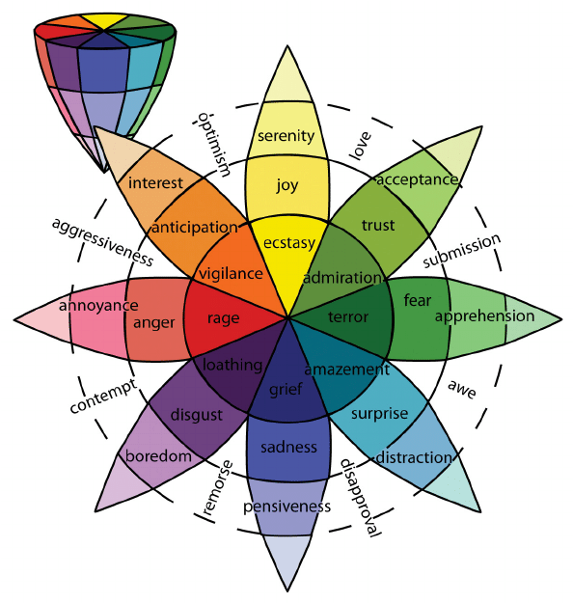

Slide 17
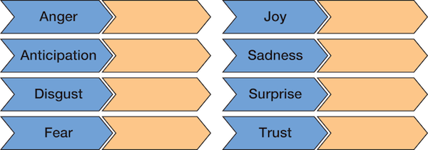
Figure 12.8: Plutchik’s Emotions and Their Corresponding Evolutionary Motives …and they have neural correlates

Slide 18
12.8: What Is the Purpose of Emotions?
12.8: What is the purpose of emotions?
Feedback
Belongingness
Thinking
Behaviour
12.8.1: How do emotions provide feedback?
How well we are doing at our goals
Meta-monitoring loop (feedback in TOTE)
Implications of the meta-monitoring loop
Feeling good even when the goal hasn’t been achieved An immediate reduction in effort following good goal progress
Notes:
12.8: Evaluate the purpose served by emotions
Point 1 – What is the purpose of emotions?
While emotions can sometimes cause us to make poor decisions or engage in harmful behaviors, they also serve important functions.
12.8.1: Emotions Provide Feedback
12.8.1: Analyze how emotions provide feedback
Point 1 – How do emotions provide feedback?
Emotions help us make adjustments to achieve our goals.
The meta-monitoring loop was added to the TOTE model to assess the rate of goal progress.
Point 2 – Implications of the meta-monitoring loop
The meta-monitoring loop helps us sustain a goal, but it also may hinder us.

Slide 19
12.7: What Types of Emotions Are There?
12.7.2: Positive Emotions v. Negative Emotions
Negative emotions - >
Specific responses
Physical responses
Positive emotions ->
Non-specific responses
Cognitive responses
How do positive emotions motivate us?
Fredrickson’s broaden-and-build theory
Positive emotions help to:
broaden our attention and thoughts
build resources.
Notes:
12.7.2: Positive Emotions
12.7.2: Describe the theories underlying positive emotions
Point 1 – How do positive emotions differ from negative emotions?
Negative emotions produce specific reactions, while positive emotions produce nonspecific emotions.
Negative emotions produce physical responses, while positive emotions produce a cognitive response.
Point 2 – How do positive emotions motivate us?
Positive emotions expand our attention, improve cognition, and boost creativity.
Positive emotions expand the way we think and encourage us to try new things.

Slide 20
12.8: What Is the Purpose of Emotions?
12.8.2: Emotions Promote Belongingness
12.8.2: Analyze how emotions promote belongingness
How do emotions promote belongingness?
Communicate feelings to others
Creating and maintaining relationships
Emotion contagion (give an example you experienced)
12.8.3: Emotions Guide Thinking
Positive emotions—“dumbing down”
Negative emotions—”attend to details more)
Can this partly explain why we become increasingly more politically polarized?
Feelings-as-information theory
We make judgments by asking how we feel about something.
Life satisfaction (how has COVID 19 affected your Life Satisfaction?
Notes:
12.8.2: Emotions Promote Belongingness
12.8.2: Analyze how emotions promote belongingness
Point 1 – How do emotions promote belongingness?
Emotions can be communicated verbally or nonverbally.
When people form strong social bonds, they experience positive emotions. Negative emotions play a role in breaking social bonds.
Seeing someone express an emotion leads us to mimic their facial expression, and once we form that expression, we feel the emotion ourselves.
12.8.3: Emotions Guide Thinking
12.8.3: Analyze how emotions guide thinking
Point 1 – How do emotions guide thinking?
Why do positive emotions cause people to “dumb down?”
Why do negative emotions increase thinking?
Point 2 – Feelings-as-information theory
We use the feelings-as-information process to make many of our life decisions. How about your life satisfaction?
Discuss Schwarz and Clore (1983).

Slide 21
12.8: What Is the Purpose of Emotions?
12.8.4: How do emotions guide behavior? Indirect influence
Mood-as-input theory (when to stop working on a task) –stop rules
The subjective stop rule – “am I enjoying it?)
(positive -> continue)
(negative -> quit)
The objective stop rule – “have I reached my goal?”
(positive -> quit)
(negative -> continue)
Affective forecasting – how you will feel (not very good at it)
Predicting emotional feelings in the future
Cognitive biases
Focalism (focus too much on the single event)
Immune neglect (we have more resources than we think)
Notes:
12.8.4: Emotions Guide Behavior
12.8.4: Analyze how emotions guide behavior
Point 1 – How do emotions guide behavior?
Emotions occur after behavior, operating as an inner feedback system that causes people to reflect on their preceding behavior and evaluate the consequences.
Refer to Figure 12.9: Model of How Emotions Indirectly Guide Behavior.
Point 2 – Mood-as-input theory
What is the difference between the subjective and objective stop rules?
Point 3 – Affective forecasting
Research shows that humans do a pretty poor job of affective forecasting. Discuss the studies on lottery, etc.
Focalism occurs when we imagine how an event will make us feel, and we focus too much on the single event.
Immune neglect occurs when we fail to take into account all of the coping resources that we have.

Slide 22
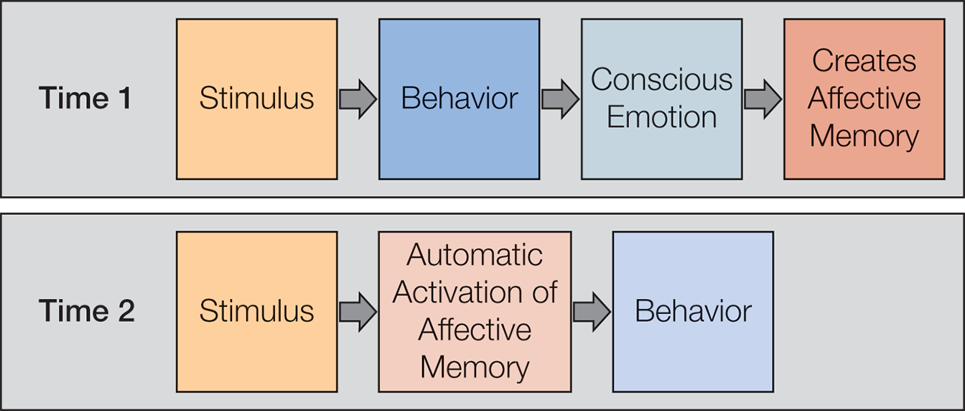
Figure 12.9: Model of How Emotions Indirectly Guide Behavior

Slide 23
12.9: Emotion Regulation
12.9: Describe the importance of emotion regulation
Emotion regulation
How people try to influence which emotions they experience
The modal model of emotion regulation (Gross and Thompson, 2007)
Situation selection – choose one you will like
Situation modification -
Attentional deployment – focus attention elsewhere (headphones at dentist)
Cognitive change – reappraise the situation (rationalize it?)
Response modulation – don’t be angry, meditate
Notes:
12.9: Describe the importance of emotion regulation
Point 1 – Emotion regulation
Humans learn to regulate their emotions for many reasons.
Point 2 – The modal model of emotion regulation (Gross and Thompson, 2007)
How does each strategy work to keep our emotions in check? Which one(s) are easiest for you?

Slide 24
Summary: Emotions
The difference between emotion, affect, and mood
The relationship between thoughts, emotions, and behavior
The biological theories put forth to explain emotion causality
The cognitive theories put forth to explain emotion causality
The debate on the question of whether cognition or emotion comes first
The research work done in neuroscience to understand the sources of emotions and cognitions
The difference between the types of emotions
The purpose served by emotions
The importance of emotion regulation
Notes:
Emotions are conscious evaluative reactions to a specific event, while affect is an unconscious evaluative reaction. Mood is a generalized state that does not link to a specific event.
The commonsense perspective suggests that thoughts cause emotions and that emotions cause behaviors.
The James-Lange theory posits that emotions result from physiological changes in the autonomic nervous system that occur automatically in response to a stimulus.
The Cannon-Bard theory states that physical changes in the body accompany but do not cause emotions. When a visual stimulus activates the thalamus, it splits the electrical signal and send it to the cerebral cortex and the hypothalamus.
According to Schachter-Singer’s cognitive labeling theory, emotions are caused by the combination of unexplained physiological arousal and a cognitive label. People high in arousal sometimes misattribute the arousal to an incorrect source. According to Lazarus’ appraisal theory, when people encounter a stimulus, they engage in a primary appraisal, asking whether the stimulus is good or bad. The secondary appraisal asks whether they have the ability to cope with the stimulus.
Lazarus argues cognitions precede emotions; Zajonc disagrees. Zajonc’s research on the mere-exposure effect shows that people automatically prefer things that they have seen before. Plutchik argues cognitions and emotions occur within a circular sequence of events.
The amygdala is considered to be the emotional computer, directing attention toward emotionally salient stimuli.
Biological theorists believe in a limited number of core emotions, while cognitive theorists believe there may be an unlimited number. Core emotions are primary emotions that are innate, expressed in a distinct way, and universal. The Facial Action Coding System (FACS) is a comprehensive dictionary of human expressions that define each of the six core emotions (anger, disgust, fear, happiness, sadness, and surprise). Negative emotions produce specific action responses, while positive emotions produce nonspecific thought responses.
Emotions provide feedback, provide goal progress, promote belonging, and are contagious. Emotions guide thinking and impact motivation.
Gross identified five ways that people can regulate emotions: situation selection, situation modification, attentional deployment, cognitive change, and response modulation.

