Slide 1
Burkley
First edition
Chapter 14
Situational Influences
Copyright © 2018 Pearson Education, Inc. All Rights Reserved

Slide 2
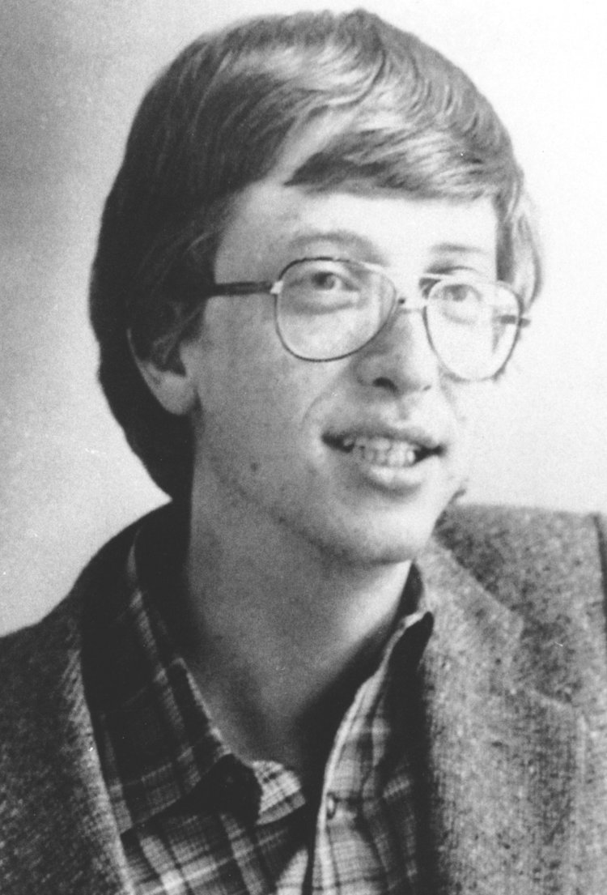
Who is this nerd?
Was he privileged?

Slide 3
Summary: Situational Influences
How the
Environment impacts behavior
behaviorist approach
Drive theory
Drive theory v. arousal theory
How social situations affect motivation
How variables interact to influence behavior
Notes:
Situational factors influence behavior and must be taken into consideration.
Inspired by Darwin, behaviorists recognized that the situation is the dominant force in learning and behavior modification. Thorndike’s Law of Effect states responses that are closely followed by a desirable outcome will be more associated with that situation than other responses. Conditioning can be either classical or operant. Reinforcement is defined as any event that follows the behaviors and strengthens that behavior.
Drive is defined as a state of tension or arousal caused by a deprived biological need. Hull considered drive to be nonspecific arousal. High drive facilitates performance on easy tasks and impairs performance on difficult tasks
Arousal theory assumes that all behaviors can be placed on a continuum of relaxation vs. excitement and that a moderate level of arousal is best for performance.
Zajonc’s theory states that the presence of others increases arousal, and this arousal will facilitate behavior when the task is easy, but inhibit behavior when the task is difficult. Deindividuation refers to the loss of self-awareness and individual accountability that occurs when people are in a group. Social loafing refers to the tendency for people to exert less effort when working in a group. Social power refers to the ability to control others.
Person-by-situation explanations assert that person variables and situation variables interact with each other in a multiplicative way to influence behavior. Lewin’s field theory states that behavior (B) is a function (f) of person factors (P) and environment factors (E).

Slide 4
14.1: The Power of the Situation
14.1: How the environment impacts behavior
Fundamental attribution error
What is it?
Over attributing internal causes for other’s behavior
Has anyone ever done that to you?
Examples?
Have you ever made the error?
Examples?
Notes:
14.1: Explain how the environment impacts behavior
Point 1 – The connection between environment and behavior
We tend to focus on internal factors instead of external ones.
How can we control our diets using situational factors?

Slide 5
14.2: Behaviorism (1 of 2)
Systematic study of behavior
without the consideration of inner mental states.
Why not mental states?
14.2.1: Principles of Behaviorism -Emphasis on the situation
Thorndike’s Law of Effect
What is it? Cats in a box?
Stimulus-response bond (C. Hull)
Conditioning (two types)
Classical conditioning (did you try the whistle and blow experiment?)
Operant conditioning
Notes:
14.2: Explain human behavior using the behaviorist approach
Point 1 – What is behaviorism?
Anything an organism does can be considered a behavior.
We cannot accurately describe one’s internal state.
14.2.1: Principles of Behaviorism
14.2.1: Analyze the principles of behaviorism
Point 1 – Emphasis on the situation
Behaviorists wondered if the environment could shape the evolution of an organism’s behavior.
Thorndike suggested that an organism’s response can be affected by a desirable outcome: the S-R bond.
Point 2 – Conditioning
The classical conditioning occurs when an environmental stimulus becomes associated with a naturally occurring stimulus.
Operant conditioning occurs when a behavior operates on the environment to generate a consequence for that behavior.
Which conditioning explains human learning and motivation better?
Point 3 – Reinforcement
Positive reinforcers refer to the presence of a pleasant outcome, while negative reinforcers refer to the removal of an unpleasant outcome.
Timing of reinforcement also affects reinforcement. Which schedule of reinforcement do you think is best?

Slide 6
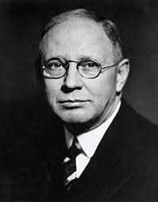
Guess what DWM this is? Hint: S->R
Clark Hull

Slide 7
Reinforcement Procedures
How does reinforcement affect the behavior?
- Always Increases the behavior…in…
Frequency
Duration or
Intensity
Notes:
14.2.1: Principles of Behaviorism
14.2.1: Analyze the principles of behaviorism
Point 1 – Emphasis on the situation
Behaviorists wondered if the environment could shape the evolution of an organism’s behavior.
Thorndike suggested that an organism’s response can be affected by a desirable outcome: the S-R bond.
Point 2 – Conditioning
The classical conditioning occurs when an environmental stimulus becomes associated with a naturally occurring stimulus.
Operant conditioning occurs when a behavior operates on the environment to generate a consequence for that behavior.
Which conditioning explains human learning and motivation better?
Point 3 – Reinforcement
Positive reinforcers refer to the presence of a pleasant outcome, while negative reinforcers refer to the removal of an unpleasant outcome.
Timing of reinforcement also affects reinforcement. Which schedule of reinforcement do you think is best?
14.2.2: Applying Behaviorism Principles
14.2.2: Apply behaviorism principles to your own life
Point 1 – Applying behaviorism principles
What are some environmental changes you can make to achieve your goals?

Slide 8
Reinforcement (Two Steps)
1. Define the Behavior
you want to change
2. Identify the Consequence
Positive (+) add a consequence to the situation
Negative (-) remove a consequence to the situation
Schedules of reinforcement
Continuous
Partial (fixed, variable, ratio, interval)
Which one is used at the Horseshoe Casino..
To fleece customers with the slots machines…?
Notes:
14.2.1: Principles of Behaviorism
14.2.1: Analyze the principles of behaviorism
Point 1 – Emphasis on the situation
Behaviorists wondered if the environment could shape the evolution of an organism’s behavior.
Thorndike suggested that an organism’s response can be affected by a desirable outcome: the S-R bond.
Point 2 – Conditioning
The classical conditioning occurs when an environmental stimulus becomes associated with a naturally occurring stimulus.
Operant conditioning occurs when a behavior operates on the environment to generate a consequence for that behavior.
Which conditioning explains human learning and motivation better?
Point 3 – Reinforcement
Positive reinforcers refer to the presence of a pleasant outcome, while negative reinforcers refer to the removal of an unpleasant outcome.
Timing of reinforcement also affects reinforcement. Which schedule of reinforcement do you think is best?
14.2.2: Applying Behaviorism Principles
14.2.2: Apply behaviorism principles to your own life
Point 1 – Applying behaviorism principles
What are some environmental changes you can make to achieve your goals?

Slide 9
Schedules of reinforcement
Continuous reinforcement
…follows the behavior every time
Partial reinforcement:
fixed or variable – ratio
fixed or variable -interval
Which one is used at the Horseshoe Casino..
To fleece customers with the slots machines…?
Notes:
14.2.1: Principles of Behaviorism
14.2.1: Analyze the principles of behaviorism
Point 1 – Emphasis on the situation
Behaviorists wondered if the environment could shape the evolution of an organism’s behavior.
Thorndike suggested that an organism’s response can be affected by a desirable outcome: the S-R bond.
Point 2 – Conditioning
The classical conditioning occurs when an environmental stimulus becomes associated with a naturally occurring stimulus.
Operant conditioning occurs when a behavior operates on the environment to generate a consequence for that behavior.
Which conditioning explains human learning and motivation better?
Point 3 – Reinforcement
Positive reinforcers refer to the presence of a pleasant outcome, while negative reinforcers refer to the removal of an unpleasant outcome.
Timing of reinforcement also affects reinforcement. Which schedule of reinforcement do you think is best?
14.2.2: Applying Behaviorism Principles
14.2.2: Apply behaviorism principles to your own life
Point 1 – Applying behaviorism principles
What are some environmental changes you can make to achieve your goals?

Slide 10
Schedules of reinforcement in casinos…
Partial reinforcement:
fixed or variable – ratio
fixed or variable –interval
Which one is used at the Horseshoe Casino..
To fleece customers with the slots machines…?
Notes:
14.2.1: Principles of Behaviorism
14.2.1: Analyze the principles of behaviorism
Point 1 – Emphasis on the situation
Behaviorists wondered if the environment could shape the evolution of an organism’s behavior.
Thorndike suggested that an organism’s response can be affected by a desirable outcome: the S-R bond.
Point 2 – Conditioning
The classical conditioning occurs when an environmental stimulus becomes associated with a naturally occurring stimulus.
Operant conditioning occurs when a behavior operates on the environment to generate a consequence for that behavior.
Which conditioning explains human learning and motivation better?
Point 3 – Reinforcement
Positive reinforcers refer to the presence of a pleasant outcome, while negative reinforcers refer to the removal of an unpleasant outcome.
Timing of reinforcement also affects reinforcement. Which schedule of reinforcement do you think is best?
14.2.2: Applying Behaviorism Principles
14.2.2: Apply behaviorism principles to your own life
Point 1 – Applying behaviorism principles
What are some environmental changes you can make to achieve your goals?

Slide 11
Variable Ratio!

Slide 12
Operant Conditioning
Two more types
(who has taken Dr. Gaspariai’s class on Behavior Mod?)
Punishment (stops / suppresses the behavior)
Positive (+) add aversive Consequence)
Negative (-) remove a pleasant Consequence)
Who has read “why We Do What We Do?”
Extinction
Remove altogether, the Consequence that reinforce the behavior

Slide 13
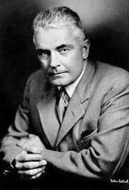
Yet another one…. …taught at a nearby college, had to leave because he dated Rosalie Raynor, his graduate student who helped with Little Albert
JB Watson at JHU

Slide 14
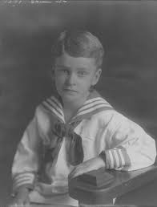
Who is THIS DWM?
Hint:
Beyond freedom and Dignity
Walden Two

Slide 15
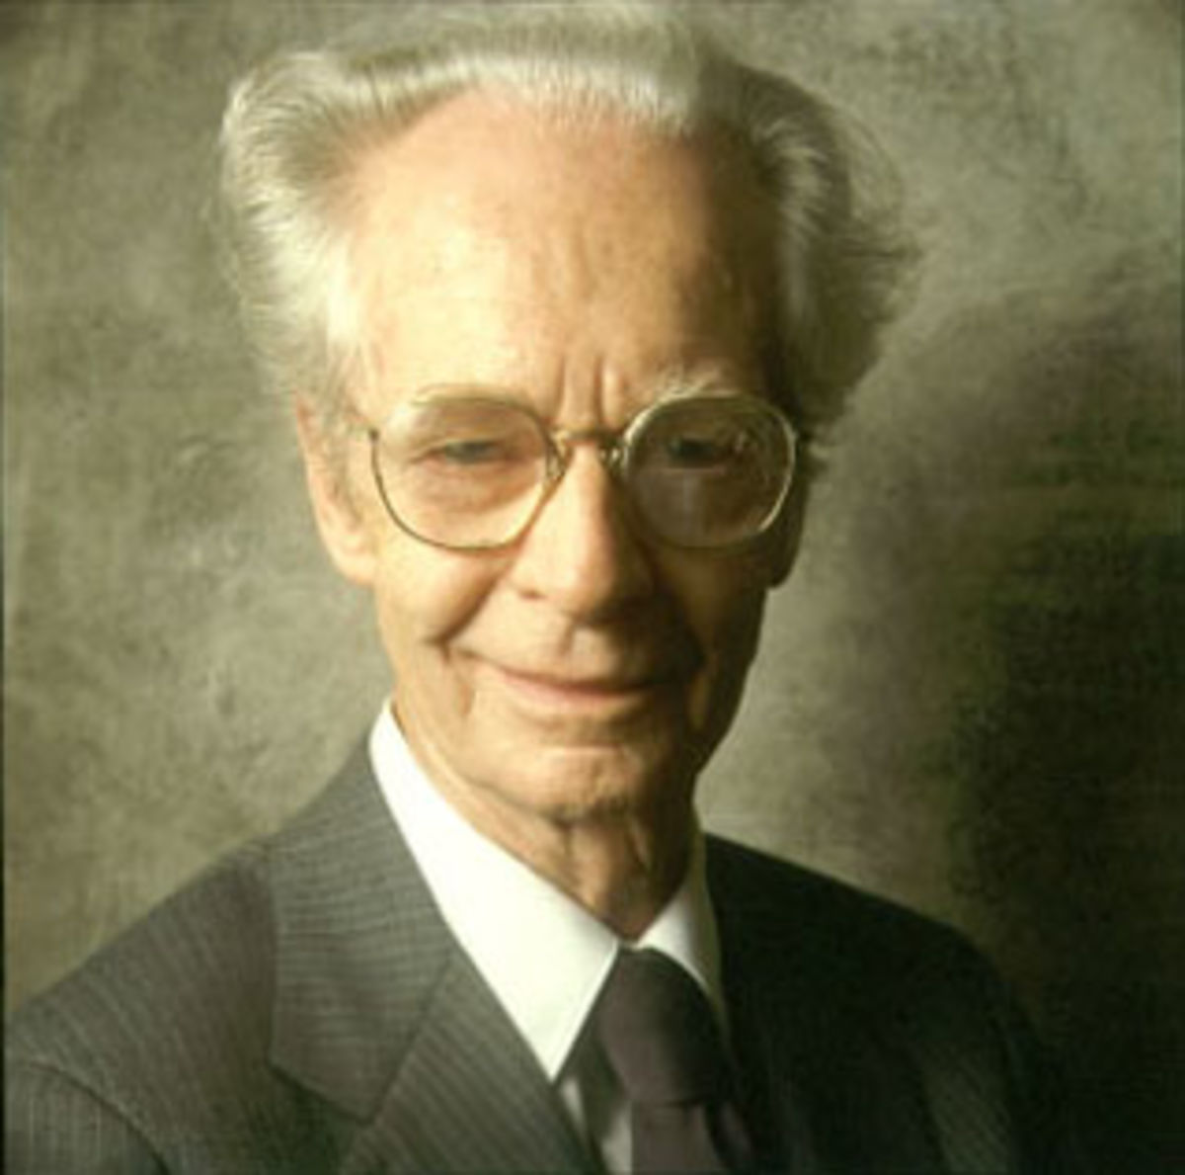
Later in life….few years older…
BF Skinner

Slide 16
14.3: Drive theory
Aversive or uncomfortable state
Energy that fuels learning
Must satisfy those Needs..
For homeostasis, please!
Hull’s drive theory
Drive (deficit/deprivation)-> prompts action)
Habit is established between Stimulus and Response
Behavior = Drive x Habit
Implications for easy versus difficult tasks
Easy tasks = habitual
Drive and performance
Notes:
14.3: Explain the concept of drive
Point 1 – Drive theory
When drive is high, the organism is motivated to engage in behaviors that reduce it.
Behaviorists argued that drive occurred when biological needs are unmet.
14.3.1: Principles of Drive Theory
14.3.1: Explain the principles of Hull’s drive theory
Point 1 – Hull’s drive theory
Biological needs ignite drive.
Habits emerge because they were rewarded in the past.
The equation indicates that the excitatory level of a behavior is a function of drive multiplied by habit.
Why is the theory multiplicative?
Point 2 – Implications for easy versus difficult tasks
When we are experts and have done something for years, the task becomes easy and habitual.
High levels of drive will facilitate performance on easy tasks, but impair it on difficult ones.

Slide 17
Arousal Theory (1 of 3)
14.4.1: Mentally and physically alertness
Consciousness, attention, intensity of behavior
Arousal is based in physiology.
Directly measured – what are some ways?
Specific regions of the brain—
reticular activation system (RAS)
Curvilinear relationship between arousal and performance
Yerkes-Dodson law
An upside-down U-shaped curve
Task difficulty dependent
Anderson (1994) —caffeine and test performance
How much should you drink?
Just enough!
Notes:
14.4: Contrast between drive theory and arousal theory
Point 1 – Development of arousal theory
Arousal theory developed as drive theory fell out of favor in the 1950s.
14.4.1: Principles of Arousal Theory
14.4.1: Explain the principles of arousal theory
Point 1 – What is arousal?
Refer to Figure 14.1: Principles of Arousal Theory
Point 2 – Arousal is based on physiology.
Because arousal could be directly measured, it was considered to be a more objective scientific concept than drive.
Point 3 – Curvilinear relationship between arousal and performance
Refer to Figure 14.2: Yerkes-Dodson Law.
Easy tasks do not require a great deal of thought and, instead, rely on stamina and persistence.
Refer to Figure 14.3: Effect of Caffeine on Easy and Difficult Tasks.
Point 4 – Low arousal is aversive.
Too much arousal and too little arousal are both aversive.
Studies using sensory deprivation show that a lack of stimulation produces a host of negative effects.

Slide 18
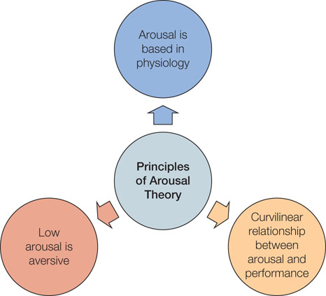
Figure 14.1: Principles of Arousal Theory

Slide 19
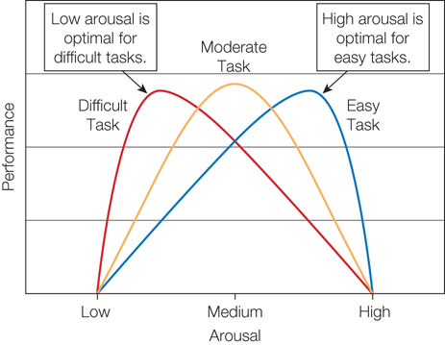
Figure 14.2: Yerkes-Dodson Law Lagom (Swedish)

Slide 20
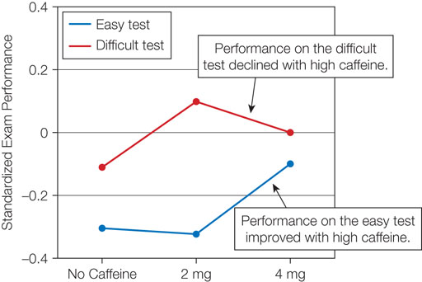
Figure 14.3: Effect of Caffeine on Easy and Difficult Tasks (Anderson, -94)

Slide 21
14.5: Social Situations (1 of 5)
14.5.1: Social Facilitation and Inhibition (Triplett and Zajonc)
Social facilitation
Ex.: Triplett (1897)—bicycle races; fishing
Social inhibition
Zajonc’s theory
Presence of others increases arousal
Physiological response
Easy tasks vs. difficult tasks
Notes:
14.5: Analyze the way social situations impact motivation
Point 1 – Social situations
Humans are social creatures who are impacted by social situations.
14.5.1: Social Facilitation and Inhibition
14.5.1: Explain the concepts of social facilitation and inhibition in terms of motivation
Point 1 – Social facilitation
The tendency for the presence of others to improve task performance is known as social facilitation.
Does the situation have to be one of competition? Why or why not?
The tendency for the presence of others to impair task performance is known as social inhibition.
Point 2 – Zajonc’s theory
Zajonc’s theory reflects Hull’s drive theory.
The presence of others is thought to result in social facilitation when the task is easy, and result in social inhibition when the task is difficult.
Discuss example of skateboarder/snowboarder.
Point 3 – Evidence for Zajonc’s theory
Refer to Figure 14.5–A-C: Zajonc’s Cockroach Study on Social Facilitation and Inhibition.
What implications does Zanjoc’s theory have for work, school, and sporting events?

Slide 22
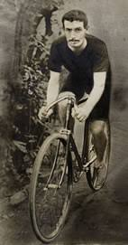
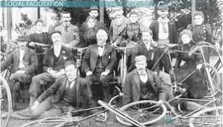
Norman Triplett –Social Faciliation

Slide 23
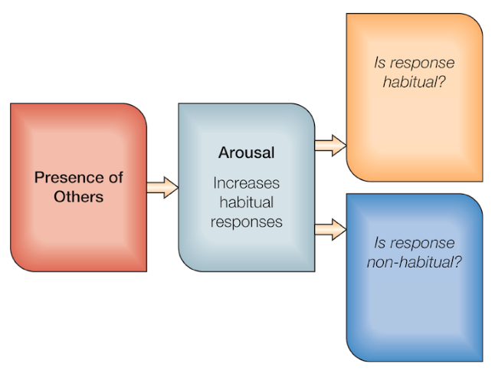
Figure 14.4: Social Facilitation and Inhibition

Slide 24
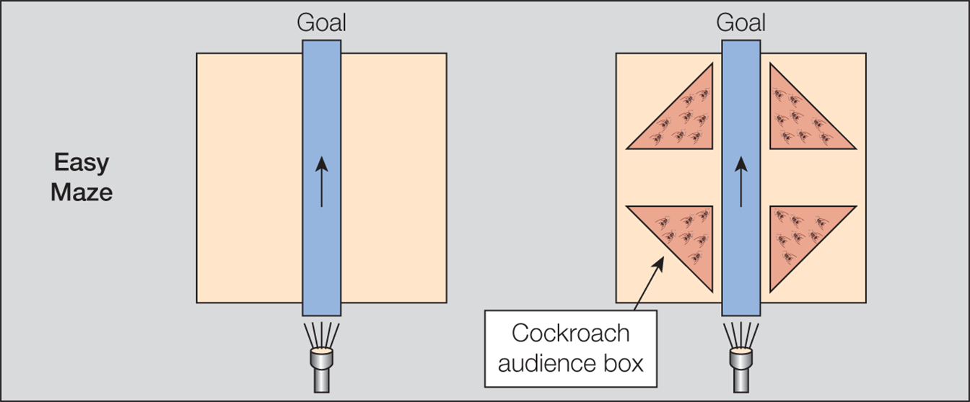
Figure 14.5-A: Easy Maze

Slide 25
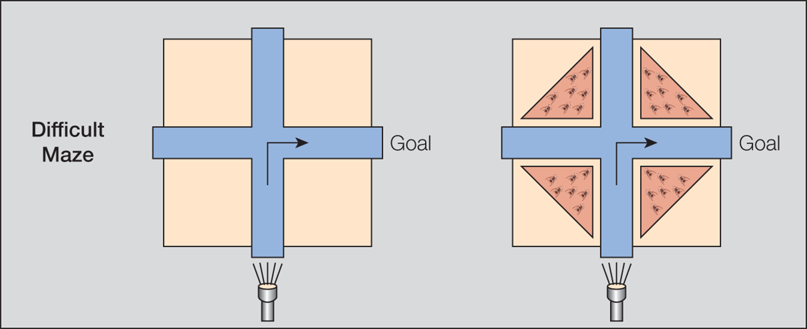
Figure 14.5-B: Difficult Maze

Slide 26
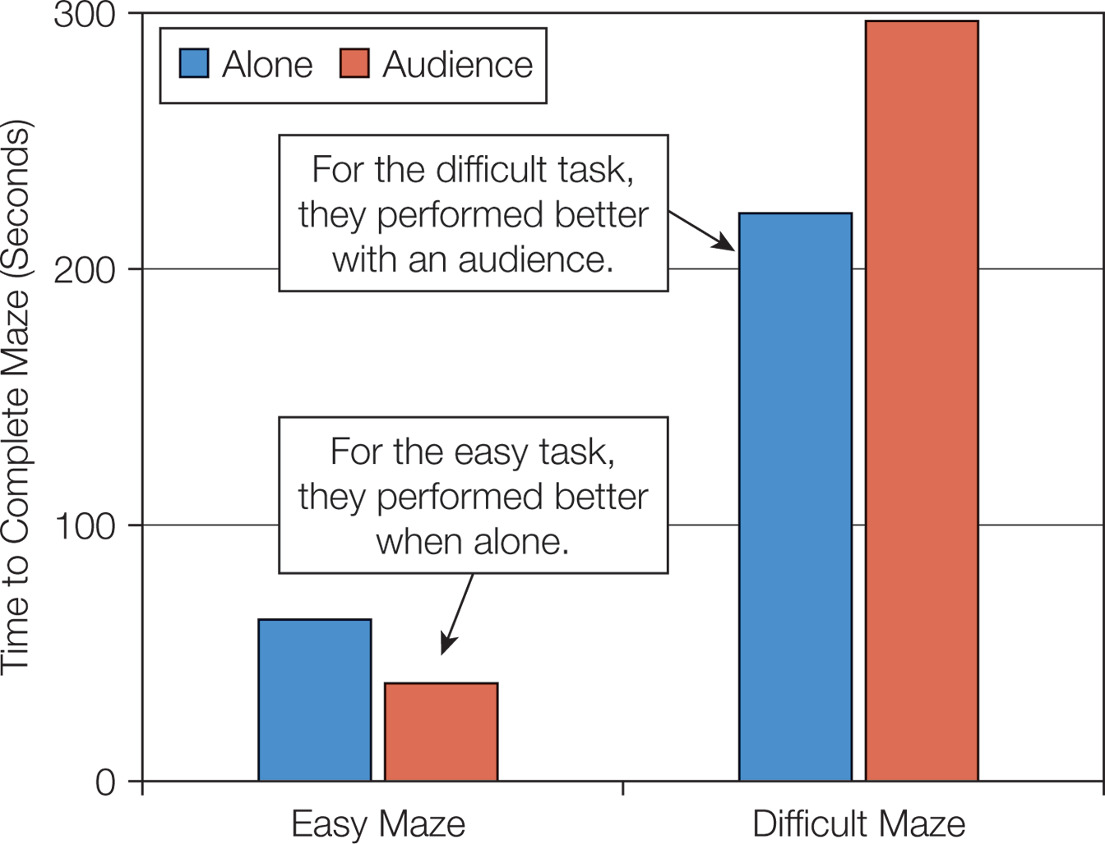
Figure 14.5-C: Results of Zajonc’s Cockroach Study (How does this happen in sports?)

Slide 27
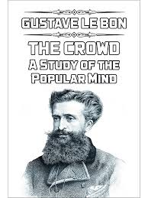
14.5: Social Situations
Deindividuation (Halloween, Mardi Gras)
Any present day examples? Good ones? Bad ones?
Task with a group Gustave Le Bon (1841- 1931) polymath
Mob mentality, herd mentality, crowd psychology
Cultural rules and norms no longer apply
Situational features
Are groups always bad?
Altruistic behaviors
Group cohesiveness
Examples of some..?
What is one you belong to?
Group norms
(the best way to control behavior!)
Notes:
14.5.2: Deindividuation
14.5.2: Explain the concept of deindividuation in terms of motivation
Point 1 – Deindividuation
Groups foster a sense of anonymity and a loss of individuality.
Deindividuation refers to the loss of self-focus and individual accountability that occurs when people are in a group.
People in a state of deindividuation no longer feel accountable for their actions and are more likely to act against their own standards and values.
Situational factors like drugs, alcohol, masks, or foreign places can produce deindividuation.
Discuss deindividuation during Halloween (Diener et al., 1979)—Figure M.
How does deindividuation explain online behaviors?
Point 2 – Are groups always bad?
Any situational feature that decreases individuality and increases group cohesion is likely to encourage conformity among group members.

Slide 28
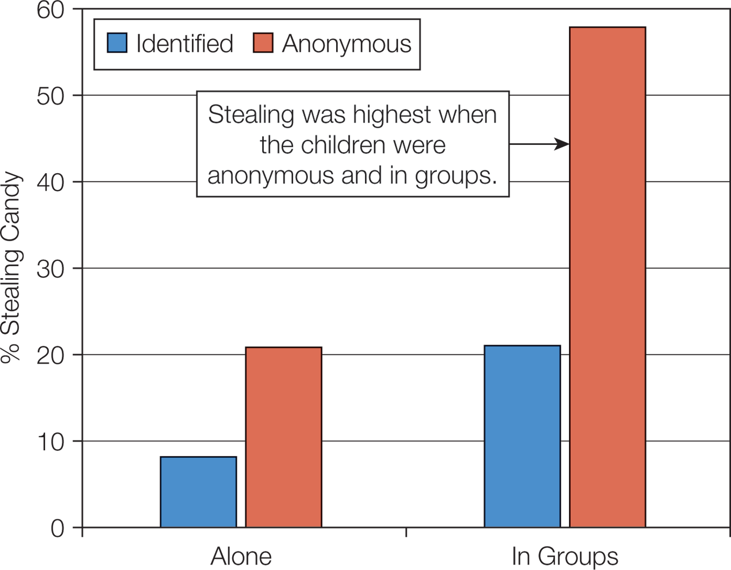
Figure: Result of Deindividuation During Halloween

Slide 29
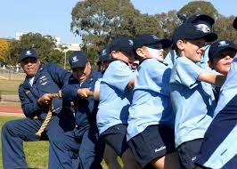
Max Ringelmann What’s happening here?

Slide 30
14.5: Social Situations (5 of 5)
14.5.4: Social Power
Enables one to control …..for either good or bad.
Bill Gates? How did he use his $$ for power?
14.6: Explain how variables interact to influence behavior
Is motivation primarily driven by person factors or situation factors?
Person-by-situation explanations
Kurt Lewin (1942)—Field theory
Behavior = f(P,E)
Notes:
14.5.4: Social Power
14.5.4: Explain the concept of social power in terms of motivation
Point 1 – Social power
People high in the need for power perceive that the best way to fulfill their goals is to focus on influencing those around them.
People high in the need for power are more likely to use aggression or sexual permissiveness.
Point 2 – The pursuit of power
Morgenthau argued that power and love both stem from the same basic root of loneliness.
When power fails to cure loneliness, leaders often seek even more power.
Power can fulfill the need for autonomy.
Point 3 – Positives and negatives of power
What are the positives and negatives of power? Why do so many powerful men make headlines for negative actions?
Discuss Ent et al. (2012) with regard to self-control and power. Studies suggest that powerful people are strategic about where they exert their limited self-control resources.
Point 4 – Can power backfire?
People in high-power roles are more likely to engage in risky behavior and to cheat on a spouse.

Slide 31
How variables interact to influence behavior
Is motivation primarily driven by person factors or situation factors?
Person-by-situation explanations
Kurt Lewin (1942)—Field theory
Behavior = f(P,E)
What are the person * situation factors that explain Bill Gates’ success?
Notes:
14.6: Explain how variables interact to influence behavior
Point 1 – Is motivation primarily driven by person factors or situation factors?
Person variables and situation variables interact with each other in a multiplicative way to influence people’s responses.
Discuss stimulation and introverts vs. extraverts.
Lewin argued that forces in this field drive people toward their goals or away from them.
Behavior is a function of both person factors and environment factors.

Slide 32
Summary: Situational Influences
How the environment impacts behavior
behaviorist approach
drive
drive theory v. arousal theory
social situations affect motivation
variables interact to influence behavior
Notes:
Situational factors influence behavior and must be taken into consideration.
Inspired by Darwin, behaviorists recognized that the situation is the dominant force in learning and behavior modification. Thorndike’s Law of Effect states responses that are closely followed by a desirable outcome will be more associated with that situation than other responses. Conditioning can be either classical or operant. Reinforcement is defined as any event that follows the behaviors and strengthens that behavior.
Drive is defined as a state of tension or arousal caused by a deprived biological need. Hull considered drive to be nonspecific arousal. High drive facilitates performance on easy tasks and impairs performance on difficult tasks
Arousal theory assumes that all behaviors can be placed on a continuum of relaxation vs. excitement and that a moderate level of arousal is best for performance.
Zajonc’s theory states that the presence of others increases arousal, and this arousal will facilitate behavior when the task is easy, but inhibit behavior when the task is difficult. Deindividuation refers to the loss of self-awareness and individual accountability that occurs when people are in a group. Social loafing refers to the tendency for people to exert less effort when working in a group. Social power refers to the ability to control others.
Person-by-situation explanations assert that person variables and situation variables interact with each other in a multiplicative way to influence behavior. Lewin’s field theory states that behavior (B) is a function (f) of person factors (P) and environment factors (E).

