Slide 1

BOOZ ALLEN:
EMPOWER CHANGE WITH US
Fall 2019

Slide 2


WHAT ARE YOU DOING TO SEPARATE YOURSELF FROM THE
3.8M GRADUATES?

Slide 3

EMPOWER PEOPLE TO CHANGE THE WORLD
AND THAT STARTS
  WITH YOU

Slide 4

OUR WORK HAS TRANSFORMED THE WAY ORGANIZATIONS SERVE CUSTOMERS AND CITIZENS, KEPT SOLDIERS SAFER ON BATTLEFIELDS, FURTHERED SPACE EXPLORATION, DISRUPTED HUMAN TRAFFICKING NETWORKS, AND PROTECTED CONNECTED CARS FROM CYBER ATTACKS.

Slide 5

BOOZ ALLEN
AT A GLANCE
We bring bold thinking and a desire to be the best in our work in consulting, analytics, digital solutions, engineering, and cyber with industries ranging from defense to health, energy, and international development.
FOUNDED HEADQUARTERS
1914 McLean, VA
OUR CLIENTS
We work with a diverse base of public- and
private-sector clients across a wide swath of industries, in the U.S. and internationally.
EMPLOYEES
REVENUE
26,100
$6.7 Billion
as of March 31, 2019
In the 2019 fiscal year
OUR PEOPLE
29% 55%
Are either veterans or active service members
of our leadership team is comprised of women
Defense 46%
Civil 27%
10.5% 20%
of employees speak two or more languages
of employees are under 30
Intel 24%
34% 41%
Commercial 3%
Hold one or more professional certifications
Have advanced degrees (masters or higher)
BOOZ ALLEN HAMILTON
5

Slide 6






CAPABILITIES
OUR
CONSULTING
ANALYTICS
DIGITAL
SOLUTIONS
ENGINEERING
CYBER
Built on more than a century of management consulting heritage and drawing on the knowledge of thousands of technical experts, our capabilities blend the best technology with an unrivaled grasp of people and process.
Booz Allen supports both large-scale transformation and specialized problem-solving.
Our team of data scientists thinks bigger, pushes further, and asks the questions others don’t as we dare to transform business and society.
We’re solving today’s most complex digital problems with ideas and expertise that take technologies and software products to another level.
Pioneering next-gen tools
& products with world-class engineering expertise centered in 27 labs across the U.S.
We protect our clients against the attacks of today, and prepare them for the threats of tomorrow.
BOOZ ALLEN HAMILTON
6

Slide 7
PROJECTS
OUR
CONSULTING
ANALYTICS
DIGITAL
SOLUTIONS
ENGINEERING
CYBER
Within our five core capabilities, we serve a wide range of clients and missions.
Partner with a pediatric hospital to fight childhood diseases.
Work with the IRS to save billions in tax fraud.
Connect a global community to our national parks.
Work with the
Air Force to protect our airspace.
Study the minds of cyber enemies so organizations can fight back.
Help reduce auto theft and preserve law enforcement resources.
Help veterans get their benefits.
Help build battlefield sensors.
Work with the FDA to get drugs to patients faster.
Defend our nation’s infrastructure.
Ensure overseas military members can vote.
Apply digital forensics to automotive systems to track criminals.
Protect the mobile workforce.
Help the Army support wounded warriors.
Adapt mathematical and predictive models to deliver healthcare insights.
BOOZ ALLEN HAMILTON
7

Slide 8

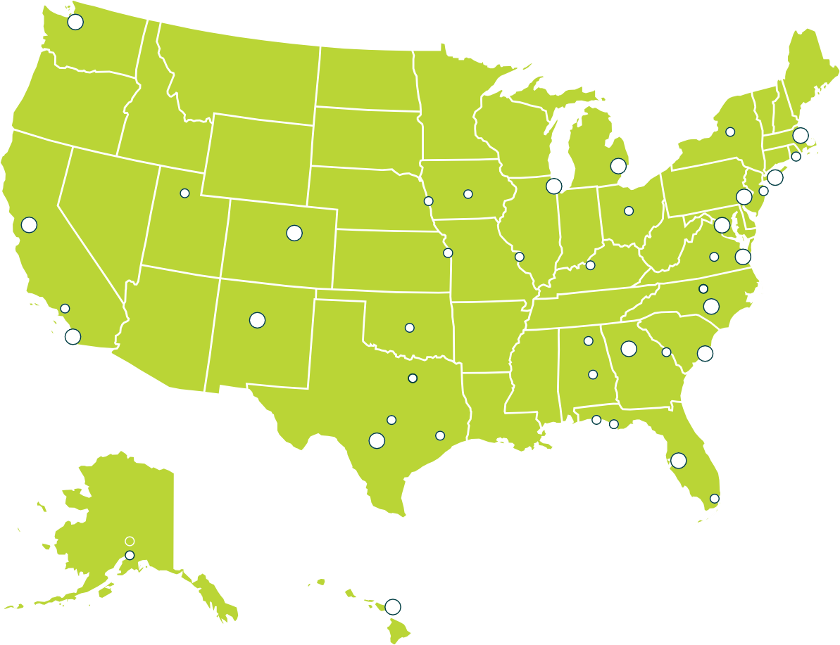

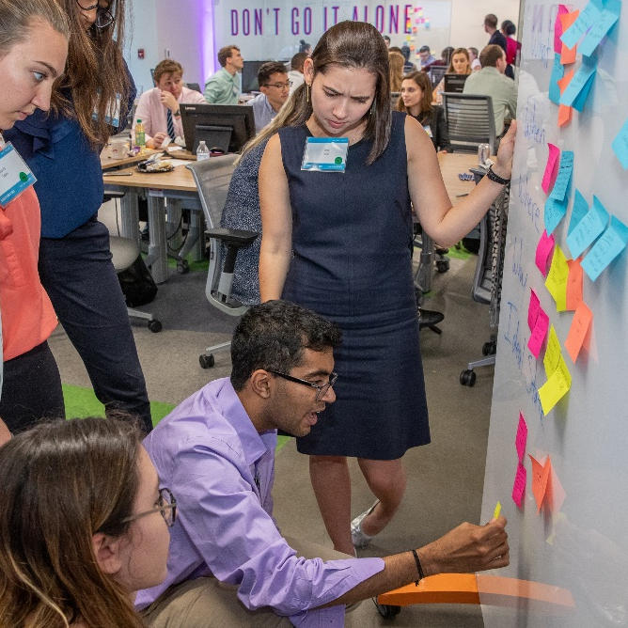
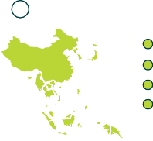





PRESENCE
OUR
Seattle
INTERNATIONAL
Asia-Pacif ic
Our global presence extends to
Singapore
400 locations and 20 countries.
Boston
Okinawa, Japan Seoul, South Korea Guam
Rome
Established in communities far and
Troy
Newport New York City
Redbank Philadelphia
DC METRO
wide, we offer hands-on support wherever our clients need it.
We also have five innovation labs throughout the country, which partner with startups, incubators, and investors to help solve our country’s most complex problems.
Salt Lake City
Omaha
Chicago
Urbandale
Beavercreek
San Francisco
Denver
Kansas City
St. Louis
Radcliff
Charlottesville
Norfolk
Europe
Durham Fayetteville
Venice, Italy Baumholder, Griesheim,
Stuttgart, and Wiesbaden, Germany
Cambridge, and Huntingdon, United Kingdom
Mons, Belgium
El Segundo
Albuquerque
Oklahoma City
San Diego
Huntsville
Atlanta
Augusta
Charleston
Dallas
Montgomery
Austin
Pensacola
Panama City
San Antonio
Houston
Middle East & North Africa (MENA)
Tampa
Abu Dhabi,
United Arab Emirates
Cairo, Egypt
Riyadh, Saudi Arabia
Miami
Anchorage
Honolulu
BOOZ ALLEN HAMILTON
8

Slide 9
ORGANIZATION
OUR
LEADERSHIP
GLOBAL DEFENSE GROUP
encompasses our work in support of Aerospace, Army, Commercial, Joint
Combatant Commands (JCC), and Navy Marine Corps (NMC) clients
NATIONAL SECURITY
GROUP
encompasses our talent and client delivery in Cyber, Defense/Military Intel, National Agencies and International
CIVILIAN SERVICES GROUP
encompasses our talent and client delivery in Health; Finance, Energy and Economic Development (FED); and Justice, Homeland Security, and Transportation (JHT)
We’re always evolving—building value and opportunity by investing in technology sectors such as
data science and analytics, digital solutions, engineering, and cybersecurity. We’re supporting those skills with investments in innovation—empowering our employees to be creative thinkers.
STRATEGIC INNOVATION GROUP
responsible for scaling our functional differentiation, as well as developing and monetizing breakthrough solutions in the areas of digital transformation, artificial intelligence, advanced cyber, and augmented and virtual reality that will accelerate the Firm’s growth and performance
ENTERPRISE SERVICES GROUP
encompasses our internal functions, including business development and services, contracting, procurement, and pricing (CPP), corporate affairs, knowledge management, ethics, legal, and compliance, human resources, information and security services, and real estate and facilities operations
BOOZ ALLEN HAMILTON
9

Slide 10
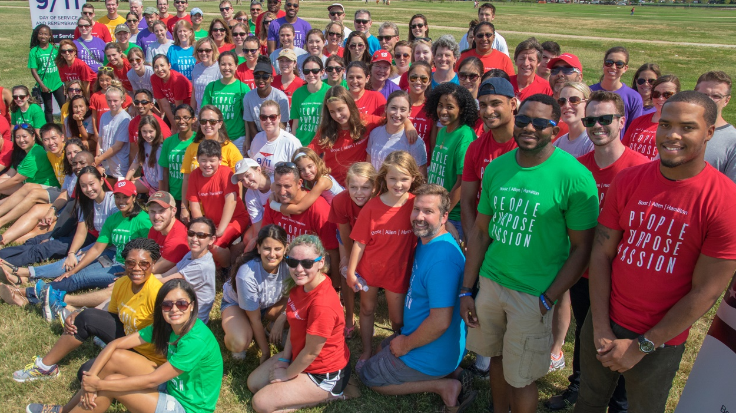
COMMUNITY IMPACT
“
OUR
"Volunteering ultimately comes down to three things: promoting positive energy, investing in our communities, and empowering people. If my time, wo`rds, or interactions can create an environment that encourages someone else to feel like they have the power to grow or to positively impact someone else's life then I am doing my part.”–-- Brittany Hart
Through corporate contributions, pro bono consulting, and a culture of volunteerism, we proudly support programs related to health, military families and veterans, STEM careers, education, and community resilience.
How to contribute? That’s up to you!
Through our Booz Allen Cares program, employees can find and share volunteer opportunities, apply for grants, record service hours, and more.
Guided by strong values and a spirit of service, we reach beyond office walls to strengthen and enrich the communities where we live and work.
BOOZ ALLEN HAMILTON
10

Slide 11

AWARDS AND RECOGNITION
INDEED.COM
#23 of 50 Top-rated Workplaces;
#13 Best Work/Life Balance, 2019
VAULT MAGAZINE
#1 in Public Sector Consulting
FORBES
#21 Best Employers for Women;
#1 in DC Area
Industry peers, analysts, and media have recognized us for client service, innovation,
company culture, social impact, and commitment to diversity and inclusion. Accolades include:
CONSULTING.COM
#15 Best Consulting Firm
in 2019
MILITARY TIMES
#8 Best Company for Vets
WORKING MOTHER
Two Decades on the 100
Best Companies List
DISABILITY EQUALITY
HUMAN RIGHTS
CAMPAIGN
100% score on the Corporate Equality Index on policies and practices related to LGBTQ workplace equality
CAREERS AND
INDEX
100% Score
DISABLED
#10 Top 50 Employers
BOOZ ALLEN HAMILTON
11

Slide 12

How many
garden
hoses are there in the
US?
BOOZ ALLEN HAMILTON
12

Slide 13
BE YOU.
BE BOOZ ALLEN.
BE EMPOWERED.
When you commit to doing great work,
driving business forward,
and dreaming about what’s next,
you can forge your
own path at Booz Allen.
That’s our promise.
BOOZ ALLEN HAMILTON
13

Slide 14

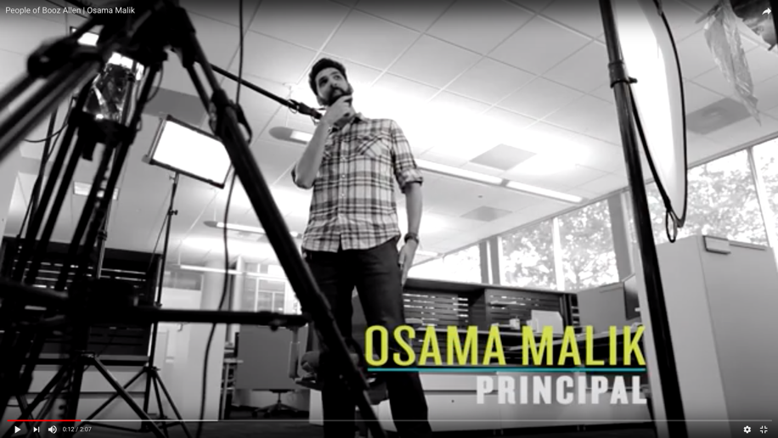

BE YOU
MEANS BRINGING YOUR BEST
We want to ensure that you have an inclusive work environment where you can thrive. Booz Allen is enriched when we are able
to harness the power of our employees’ collective ingenuity.
BE CURIOUS & CONTRIBUTE
Proactively challenge yourself and your teammates to leave an imprint on the missions and clients you serve.
SELF IMPROVE & CONTINUALLY LEARN
Relentlessly seek out experiences that sharpen your skills and expose you to new ideas.
BE AN INDUSTRY LEADER
Maintain a brand of excellence in your field, both outside and inside the firm.
PEOPLE OF BOOZ ALLEN SPOTLIGHT
SERVE WITH VALUES-BASED CHARACTER
Act both as a compassionate competitor, and in the selfless service of the collective.
ADVOCATE FOR THE FUTURE
Promote and advance the capabilities and contributions of your team.
BOOZ ALLEN HAMILTON
14

Slide 15

BE BOOZ ALLEN
MEANS EMBRACING OUR CULTURE
Our firm’s purpose, values, and leadership philosophy provide transparency and consistency around what is expected of everyone at the firm, from consultant to partner. As a result, the firm culture highly values ethics, collaboration, and strong leadership.
PURPOSE-DRIVEN & VALUES-BASED
A common purpose and set of values that are the bedrock of our actions and decisions.
CONSULTATIVE TEAM ENVIRONMENT
A diverse collective of mission-focused peers to solve the world’s toughest problems.
CONSISTENT LEADERSHIP PHILOSOPHY
Leaders who exemplify our values and steward our people and the firm through a set of shared beliefs.
COMPETITIVE COMPENSATION & TOTAL REWARDS
Competitive compensation and benefits packages include leading appreciation, development, and opportunity models.
STRONG BRAND & 100-YEAR LEGACY
An original management consultancy, with a diverse portfolio and reputation that has stood the test of time.
BOOZ ALLEN HAMILTON
15

Slide 16

BE EMPOWERED
MEANS HARNESSING OUR EMPLOYEE VALUE PROPOSITION
OWN YOUR EXPERIENCE
At Booz Allen, the most fulfilling careers go to those who take their chance and raise their hand, who learn along the way, who prepare for their next challenge, and who know their relationships make all the difference.
The EVP is an agreement between the firm and our employees—if our employees commit to bring their best selves to work and to live by the firm’s purpose and values, Booz Allen promises to help them own their experience, to learn without limits, and to enjoy the pursuit of a career and life that is meaningful to them.
LEARN WITHOUT LIMITS
We provide our people clear access to the latest thinking, the latitude to learn how they prefer, and the pathways to apply their knowledge and unlock new doors. Our employees know their decision to jump between missions, to stay their current course, to enroll in certifications, or to develop new skills will be valued equally.
ENJOY THE PURSUIT
It’s our responsibility to ensure our people can own, take pleasure in, and benefit from the pursuit. This responsibility extends beyond an established culture that demands integrity, inspires courage, incentivizes ingenuity, promotes feedback, and rewards heart. It also includes flexible, personalized, and respected benefits they trust will support their life goals, too.
BOOZ ALLEN HAMILTON
16

Slide 17

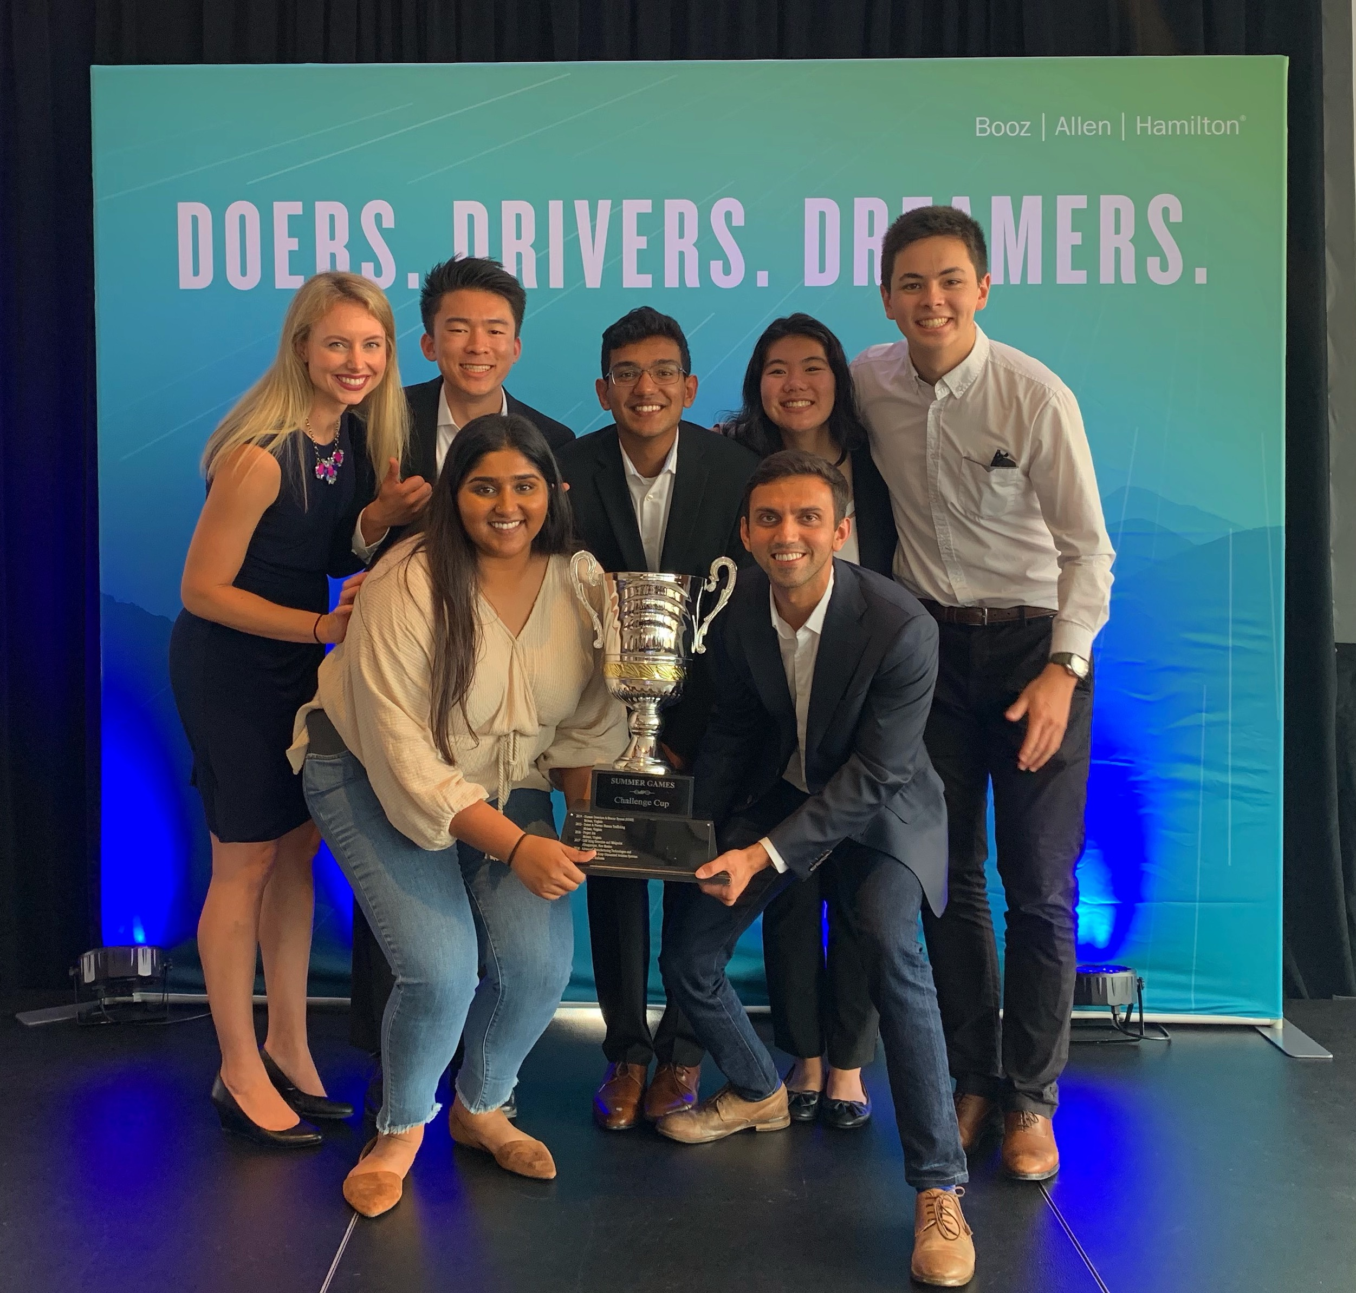
SUMMER GAMES
INTERNSHIP PROGRAM
Booz Allen’s Enterprise-Wide Internship Program is a
10 week project-based internship program.
In 2020, we plan to have approximately 350 interns in 23 cities.
SUMMER GAMES PROJECTS
Real-world problems faced by our business
Capability development, process improvement or social good
Selected by Booz Allen leadership
Intern-driven solutions vs. directed tasking
SUMMER GAMES TEAMS
4-5 interns per team
2 challenge leaders – full time client facing staff
Intern driven-solutions vs. directed tasking
THE CHALLENGE CUP
All interns travel to DC for the final week of the internship
Teams present their work to Booz Allen leadership
Finalists present to executive leadership
The winning team – Challenge Cup Champions!
2019 Summer Games Challenge Cup Champions – El Segundo, CA – UberKuber
Visualization Tool for Application Management
BOOZ ALLEN HAMILTON
17

Slide 18
SUMMER GAMES FAQ
Who are we looking for?
  2021 and 2022 graduates in the following majors
    Data science and analytics, math and statistics
    Computer Science and Computer Engineering
    Information Systems with Cybersecurity
    Security and risk analysis
    Engineers with a strong interest in analytics
What’s a typical day like?
  Data gathering and analysis
  Brainstorming solutions
  Meeting with subject matter experts
  Creating prototypes
  Building a business case
Is this a paid internship?
  Yes, pay rate is based on projected graduation year
When will interviews be held?
  DC Metro -Starting in mid-October
  Conducted virtually through HireVue platform
  Regional offices - Separate application for each office (Varying timelines by office)
How do we assign interns to projects in DC Metro?
  Skills needed for projects
  Intern interests
  Cross-section of intern skills on projects
BOOZ ALLEN HAMILTON
Booz Allen Hamilton Internal
18
18

Slide 19
Garden Hose
Thought Process
300M = people in US
100M = Average 3 people per household
50M = Estimate half are suburban/rural
40M = Estimate 20% are homes/apartments
80M = Garden hoses are inexpensive 2 per house
90M = 10M random others (zoos, businesses, etc..)
30M = Garden hoses per year (replaced every 3 years)
BOOZ ALLEN HAMILTON
19

Slide 20
Garden Hose
Thought Process
What about if you had
2 weeks to figure out how many garden hoses
are in the US?
BOOZ ALLEN HAMILTON
20
Notes:
Who would you talk to?

Slide 21
Qualities in Consultant
Passion
Not just solve a problem, but find the problem
Communication skills
Self-starter / Entrepreneurial
Time management skills
Personality
BOOZ ALLEN HAMILTON
21

Slide 22
      A Multi-Step ProcesS
All students must apply through HandShake and submit resume – Resume drop deadline is October 15th for all positions!
Follow links through HandShake postings to apply through our internal jobs system, Workday, to the matching position requisition:
  Cyber Security Consultant—Booz Allen Hamilton (Full-Time)
  Data Analyst Consultant—Booz Allen Hamilton (Full-Time)
  Digital Solutions Developer—Booz Allen Hamilton (Full-Time)
  General Management Consultant—Booz Allen Hamilton (Full-Time)
  Systems Engineer—Booz Allen Hamilton (Full-Time)
  2020 Summer Games Internship–Booz Allen Hamilton (Summer Internship)
If you are selected for an interview, a brief phone screen will be completed by our recruiting team to confirm eligibility requirements
Upon completion of the phone screen, the campus recruiting team will contact candidates to schedule in-person interviews if there is interest
      NEED ADDITIONAL INFORMATION? EMAIL
UFRecruiting@bah.com
BOOZ ALLEN HAMILTON
22

Slide 23

QUESTIONS?

Slide 24


FOLLOW US
@BoozAllen
@LifeAtBooz
@BoozAllen
Booz Allen
Booz Allen Hamilton

