Slide 1
Intro to Consulting &
Booz Allen Hamilton
University of Baltimore
Notes:
0:30
Dr. Noorie kicks off
Welcome class and thanks for joining me today
Before we jump right in, let me go ahead and introduce myself…

Slide 2
Agenda
What is Consulting?
Overview of Booz Allen
TI & Consulting Experience
Internships
Q&A
Notes:
1 minute
What is Consulting?
Overview of consulting industry
Different types of consulting
Characteristics of successful consultants
Overview of Booz Allen
Booz Allen service offerings and position in the consulting world
Identify types of clients we serve
Highlight our organizational structure
TI & Consulting Experience
Define TI’s core human capital capabilities
Discuss projects I’ve been supporting
Client Project Best Practices
Observed in academic and professional setting; important to apply to your own projects this semester
Q&A
We will have some time for Q&A at the end. If you have questions throughout the presentation, type them in the chat box and I’ll be sure to answer then at the end or if it regards applying/recruiting, Jessica Koers can attempt to answer it for you.

Slide 3
What Is Consulting?

Slide 4
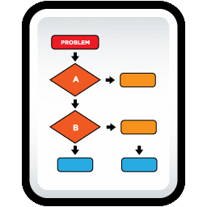
Booz Allen’s definition of the consulting industry
We take complex client problems
Assemble capabilities, insights, and understandings from experts in a variety of fields
We are Problem Solvers
Shape thinking about the issue
Help define and implement lasting solutions
Notes:
2-3 minutes
Think of Consulting has complex problem-solving. Organizations hire us, the subject-matter experts, to come and apply our expertise to solve their most challenging problems. Our clients reach to us for help in the areas of:
Management Consulting – Change Management, Strategic Communications, Operational Efficiency, & IT Strategy
Engineering
Technology – Cloud Computing, Cybersecurity
Strategic Innovation – Digital, NextGen Analytics & Data Science, & Predictive Intelligence

Slide 5
Within the industry there are two main “types” of consulting – Management & Technical
Management
Technical
Management consultants advise on almost every aspect of corporate and government operations. This includes marketing, finance, corporate strategy and organization, manufacturing processes, electronic commerce (e-commerce) or business, and human resources.
Strategic Thinking
Problem Solving
Team Oriented
Quantitative Proficiency
Scientific and technical consultants provide technical advice across a wide spectrum of areas, some specializing in Information Technology, others providing Systems Engineering, and Prototyping support. Technical consultants work hand in hand with technical and non-technical clients.
Sectors
Government
Commercial
Notes:
2-3 minutes
Management Consulting – Equips organizations with strategies on how to maximize efficiency while cutting costs. This is the “people and process” side of consulting.
Typically, existing problems are identified and a performance improvement plan is created.
Areas: Change Management, Strategic Communications, Simulation Planning, Operational Efficiency, IT Strategy
Technical Consulting – Focuses on teaching organizations how to select and use Information Technology to achieve their organizational objectives
Areas: Cloud Computing, Cyber Security, Systems Delivery
The skills in the middle are needed in both Management and Technical consulting, as they can be applied across a variety of different project scopes
Two Sectors in Consulting:
Government –
Provides solutions to private sector government agencies, such as Department of Homeland Security, the CIA, U.S. Department of Veteran’s Affairs
Projects typically last longer, sometimes up to 5-7 years
Common to work on client site
Limited travel; main client base in DC
Commercial –
Public sector; Commercial Banks, NFL, Johnson & Johnson
Typically switch projects every 3-6 months
More travel; clients are spread all over

Slide 6
Consulting is a balance between subject matter expertise, business knowledge, and communication
Characteristics of a Successful Consultant
Strategic thinker | Proactive
Reliable | Entrepreneurial
Flexible | Good listener
Analytical | Excellent writer
Leadership | Service orientation
Ethical | Team oriented
Problem solver | Strong Networker
Notes:
3 minutes
All consultants need to possess these characteristics to be successful. For example:
You need to be reliable – not only for the client, but for the team you work with.
Consulting firms continue to grow their business by delivering results that endure while maximizing the client experience. If you exceed client expectations in previous engagements, the client is likely to award the organization with more work when competing with other firms in the future, thus increasing revenue.
It’s important to be perceived as reliable by the team you work with so when you are rolling off other projects, you have built your “brand” and other teams want to bring you on the project. Your reputation in the firm dictates the work you are placed on.
You need to be a good listener – often times with Consulting the client will tell you what they believe to be the problem they are experiencing. However, this is not always the case. It is critical that you listen to their experiences before jumping to the next phase – the real problem should be identified and agreed upon.
You need to be a strategic thinker and problem solver – this is the basis of consulting. Your contributions should be innovative and directly address client challenges. Remember – if the problem was easy, they wouldn’t need to outsource to come up with a solution.

Slide 7
Overview of Booz Allen

Slide 8
The Firm At-a-Glance
Booz Allen Hamilton has been at the forefront of strategy and technology consulting for 100 years. Today, Booz Allen is a leading provider of management consulting, technology, and engineering services.
Founded: 1914 Headquarters: McLean, VA
Locations: 104 locations in 7 countries
Employees: 23,000 people
Revenue: $5.76 billion
NYSE: BAH
For Whom
US government in defense, intelligence, and civil markets
Major corporations in the financial services, healthcare, and energy markets
Institutions and not-for-profit organizations
International clients—primarily in the Middle East
What We Do
Consulting
Analytics
Mission Operations
Technology
Engineering
Strategic Innovation
Honors & Awards
#1 “Best Consulting Firms for Public Sector Consulting”, Vault 2016
#3 “The Most Prestigious Consulting Firms”, Vault 2016
#5 “Best Consulting Firms for Aerospace & Defense Consulting”, Vault 2016
Notes:
1 minute
BAH just recently celebrated 100th year anniversary
Primarily have been involved in providing management and people solutions – that is what we sell our clients. Starting to make a shift into developing tools and products that can be coupled with our consulting services (this is how the SIG came about)
*Read types of clients we serve*
*Read Awards*

Slide 9
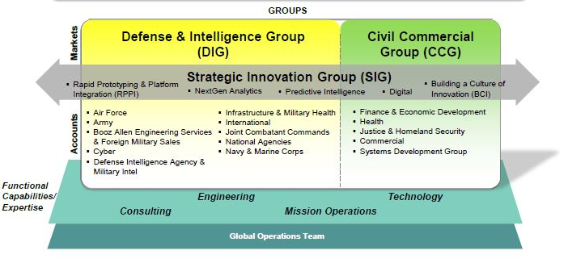
So what is consulting within the government space?
At Booz Allen, consulting expertise covers a lot of ground and is organized across our Market Groups
These Market Groups cover the range of career options that are available at Booz Allen
Notes:
1 minute
Booz Allen is comprised of three major market groups: DIG, CCG, and SIG
DIG Example Clients: Army, Air Force, Navy, Marine Corps, DoD, NASA
CCG Example Clients:
Environment – US Environmental Protection Agency (EPA), Department of Energy (DoE)
Financial – US Dept of Treasury, IRS, FDIC (Federal Department Insurance Corporation), Federal Reserve Board (FRS), SEC
Health – VA, HHS, FDA, NIH, CDC
SIG: Acts as more of a cross-cut, providing innovative tools and solutions to all types of clients across the firm in the areas of NextGen Analytics, PI, Digital, etc.
Ex. CyberSim – cyber threat training and assessment tool that uses capture-the-flag gaming scenarios. Organizations can use it to test potential candidates’ abilities, in addition to continuously developing their skills.
Can be sold to Intelligence agencies, commercial, anything that contains sensitive/secure information that needs to be protected

Slide 10
TalentInsight (TI) & Consulting Experience

Slide 11
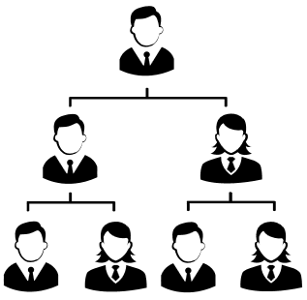
TalentInsight (TI) – People Solutions
Human Capital professionals leveraging predictive analytics to provide strategic innovative people solutions, tools, and capabilities to government and commercial clients. These service offerings span across all stages of the Talent Management Lifecycle, with a focus on the cybersecurity and data science fields.
Workforce Planning & Analytics
Leadership Development & Coaching
Talent
Management
Training & Facilitation
Cybersecurity
Data Science
Notes:
4-5 minutes
TalentInsight is the admin functional team that I am on. We are a Human Capital team that provides the “people solutions” to our client’s technical problems, specifically in the areas of cybersecurity and data science.
Ex. NTA Talent Management Model –
What: Threat Analysts are used by organizations to identify, monitor, track, and report unauthorized access of information or system attacks
Problem: Clients needed to attract and hire new types of candidates that possess KSAs that reflect industry trends and technological changes in order to continue achieving their org mission/goals
TI Solution: Leveraged competency modeling skills, in addition to conducting thorough market research and data collection, to create job and position descriptions, competencies, and behavioral indicators that clients can use when sourcing and recruiting qualified candidates
Workforce Planning & Analytics – Determining what an organization is going to need in terms of the size, type, and quality of workforce to achieve its mission/goals. Identifies the mix of experience levels, knowledge and skills required and the steps to acquire the right number of the right kind of people at the right time
Ex. VA Workforce Planning – Appointment Scheduling problems – not enough schedulers + lack adequate interpersonal skills, technical skills, and subject knowledge = poor customer service
Leadership Development & Coaching– Design curriculum for emerging, frontline, middle, and senior level leaders
Offerings: Assessment and identification, Leadership Challenge Simulations (games that force leaders to make decisions while experiencing consequences – develop skills in controlled settings), Workshops, Ongoing learning activities, Evaluation – Certification programs (ex. VA Workforce Planning Certification Program)
Coaching = subsect of LD. Assist in resolving team issues by providing one-on-one coaching to the leader and real-time coaching to the team. Work with individual leaders to create career development or performance improvement plans, formalize goals, and establish action plans through one-on-one coaching.
Talent Management – Acquiring, engaging, developing, leading, and retaining talent in an organization
Recruitment & Staffing Strategy – Establishing and promoting an “employee brand;” using technology to identify and group candidates, while using metrics to measure results; and retention – monitoring employee satisfaction, creating employee development plans
Training & Facilitation – Utilize adult learning theories and instructional frameworks to design, develop, and deliver educational courses, workshops and seminars, or simulations intended to engage leaders in real-world scenarios and reinforce critical skills while offering opportunities for continuous performance feedback. Offerings: FTF, virtual IL; Platforms: Adobe Connect, WebEx
Cybersecurity – Methods taken to protect a system from unauthorized access or attacks
Ex. Commercial Banking Cyber Intel Foundations Training
Data Science – Extracting knowledge or insights from data; fields of predictive intelligence, data mining, predictive analytics

Slide 12
Internships at Booz Allen

Slide 13
Opportunities
Overview
These internships – held over the summer – are split into capability-specific and project-specific types. Both internships offer students the chance to learn about Booz Allen, network with future colleagues, and do work that matters. Our firmwide internship program has been nationally recognized for excellence by the National Association of Colleges and Employers.
If selected for this program, you will:
Work on a challenging and rewarding project in a field related to your studies and interests
Engage in social, networking, and community service activities with leadership, staff, and other interns
1
Firmwide Internships
Interns work in fields such as:
Organization and Strategy
Cyber
Economic and Business Analysis
Intelligence and Operations Analysis
Modeling and Simulation
Systems Engineering and Integration
Interested in applying?
Visit BoozAllen.com/Careers to create your online candidate profile
Click “VIEW ALL AVAILABLE POSITIONS” under the “Internships: Expanding your College Experience” tab
Apply for positions that interest you

Slide 14
Opportunities
Overview
Students collaborate in cross-disciplinary teams to develop a breakthrough idea or solution for one of our clients’ most pressing, complex, and multi-dimensional challenges. Over the course of 10 weeks, students learn new technical skills, network with innovative business and thought leaders, and participate in exclusive events. In addition, students explore new areas and problems through the Student Incubator where senior leaders and clients select the most promising ideas. Finalists return during the academic year to develop their idea into a proof of concept.
2
Summer Games Internship Program
To be considered, students should:
Be enrolled in a full-time degree program
Have demonstrated interest in technical and non-technical disciplines
Be graduating from their degree program no later than December 2018
Previous challenges include:
Saving lives by building a prototype of an autonomous hexacopter to locate victims trapped in accessible areas, and notify authorities of their location
Utilizing big data and analytics to maximize revenue for the sports industry
Interested in applying?
Email your cover letter and resume to Summer_Games@bah.com

Slide 15
Hear it from the interns
https://www.youtube.com/watch?v=we-logs7cuc

Slide 16
Previous Internships at Booz Allen
Phase 1: LD database & catalog
Internal audit of BAH’s LD programs, courses, workshops
Provided employees with IC to use for future + Marketing tool to promote BAH capabilities
The Big Idea Event: I.C.E
Individually led initiative to improve searchability, accessibility, & org of BAH’s IC
Summer
2014
Summer
2013
Spring
2015
VA Workforce Planning Certification Program
SIG Games: VA Appt Scheduling System
The Big Idea Event Phase 2:
CrowdStarter
Developed IT & Management solutions to address inefficient apt scheduling practices
Created Org Staffing Charts, Labor Pyramids, Process Maps, Infographics, Cost Analysis Chart
Internal idea-generation site designed to bring ideas to fruition
Worked with 3rd party vendor to create clickable prototype
ILT course materials
Analytical reports
Focus Groups

Slide 17
Q & A

Slide 18
Prior Questions
How many internship positions are open?
Are internships full-time or part-time?
Where are internships located? Mostly in the D.C. area?
What kind of work will be completed? Will it be a majority of individual work or will teamwork and collaboration be emphasized?
Will the work completed by interns be meaningful to Booz Allen?
What kind of mentoring will interns be receiving?
Will interns be partnered with higher level Consultants throughout the program?
What has your career path been like and what opportunities has Booz Allen provided you?

Slide 19
Helpful Links
Summer Games Internship Program: http://www.boozallen.com/careers/find-your-job/graduating-students/strategic-innovation-games
Firmwide Internships: http://www.boozallen.com/careers/find-your-job/graduating-students/internships
Graduating Students & Internship Job Postings: http://www.jobs.net/jobs/booz-allen-hamilton/en-us/search/Graduating-Students-and-Internships/STKF81M6SDZSL4ZQ1135/
Booz Allen LinkedIn Student Hub: https://www.linkedin.com/groups/812409
Connect with us on social media to follow all of our latest news and updates! #BoozAllenHamilton

Slide 20
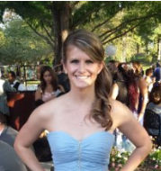
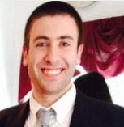
Contact Information
Kathy Ford
Senior Consultant
Ford_Kathleen@bah.com
Katie Wrenn
Senior Consultant
Wrenn_Kathryn@bah.com
Dennis DuLaney
Consultant
Dulaney_Dennis@bah.com

