Slide 1
HR Analytics –
Using Survey Results to Assess Employee Engagement
Thomas A. Olenchock, MS Chief, Future Force Project US Coast Guard

Slide 2
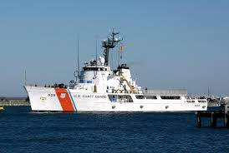
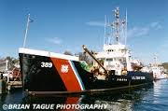
About me…

Slide 3
Agenda
What is Employee Engagement
Research
OPM definition for Federal Agencies
Why Should we care about Engagement?
Benefits
Associations
How Do you measure it?
An Example

Slide 4
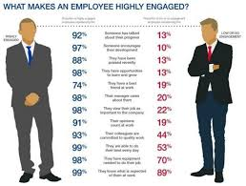
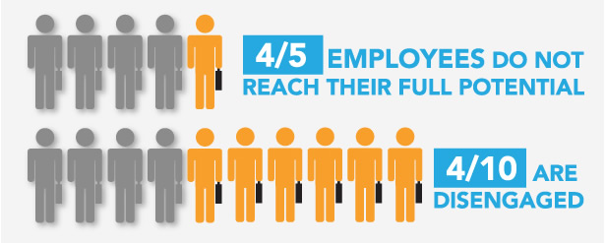
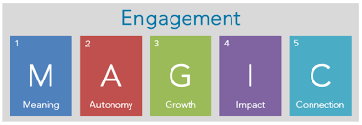
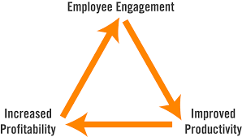
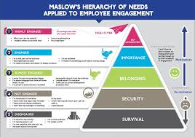

Slide 5
What is Employee Engagement
OPM conducted a review of employee engagement to ascertain:
How to define it
What outcomes leaders can expect if they improve engagement
What strategies leaders can use to drive improvements in engagement
Established a working group of stakeholders and OPM Research Psychologists to research these issues and develop a common definition

Slide 6
What Does the Research Say?
There is no commonly accepted single definition of employee engagement
There is some agreement that employee engagement has three components – Do, Think, and Feel
Behavioral – discretionary effort
Cognitive – understand job’s demands and work group’s strategy
Attitudinal – energy, vigor, and passion
Engagement is closely related to several other familiar organizational variables

Slide 7
OPM Definition of Engagement
“The employee’s sense of purpose that is evident in their display of dedication, persistence, and effort in their work or overall attachment to their organization and its mission.”

Slide 8
A Model of Engagement
Productivity
Retention
Job Satisfaction
Innovation
Discretionary Effort
Enhance Customer Service
Job characteristics (e.g., autonomy)
Organizational Climate (e.g., support, diversity)
Personal Characteristics
(e.g., conscientiousness)
Organizational Commitment
Organizational Citizenship
Engagement
Motivation
Contextual Factors

Slide 9
What are the Outcomes of Improved Engagement?
Improved Productivity
Improved Retention
Improved Job Satisfaction
Increased Innovation
Improved Customer Service
Increased Perceptions of Well-being

Slide 10
What Drives Engagement?
Job Characteristics
Autonomy
Task Variety
Feedback (consistent, ongoing)
Task Significance
Job Complexity
Support (supervisor and co-workers)
Fit (values)

Slide 11
What Drives Engagement?
Organizational Climate
Working Conditions (social support and physical conditions)
Leadership
Inclusive environment (fair and impartial)
Personal Characteristics
Conscientiousness
Positive Affect (enthusiasm, energy)
Proactive personality
Contextual Factors
Public Service
Job Security and Benefits
Fiscal Environment
Advancement Opportunities
Mission of the Agency

Slide 12
Leadership and Engagement
“Leaders” include individuals who have authority, commonly assigned through a formal position, to influence group members and move them toward a common organizational goal
Leaders can strongly influence levels of employee engagement and discretionary effort
Leadership is impactful at all levels

Slide 13
Leadership and Engagement
Leaders play a key role in shaping employees’ actual and perceived work environments by:
Clarifying employee expectations
Allocating resources and rewards
Driving the pace and volume of work
Transformational Leadership – focuses on relationship-building and relationship-maintaining behaviors
Transaction Leadership has its place
Focus should be on goal-setting, contingent rewards, and efficiency

Slide 14
Best Practices to Improve Engagement
Leadership Behaviors:
Start with onboarding
Design meaningful and motivating work (when possible)
Support and coach employees
Enhance employee personal resources
Facilitate the development of co-worker professional relationships
Set performance and development goals

Slide 15
Best Practices to Improve Engagement
Formal Activities:
Leadership Training
Performance Management
Job Design
Selection
Measurement

Slide 16
Best Practices to Improve Engagement
Informal Activities:
Social Events
Ongoing Performance Feedback
Career Development Discussions
Individualized Consideration – Ask

Slide 17
How WE Measure
A case study

Slide 18
A Model of Engagement
Productivity
Retention
Job Satisfaction
Innovation
Discretionary Effort
Enhance Customer Service
Job characteristics (e.g., autonomy)
Organizational Climate (e.g., support, diversity)
Personal Characteristics
(e.g., conscientiousness)
Organizational Commitment
Organizational Citizenship
Engagement
Motivation
Contextual Factors

Slide 19
Organizational Assessment Survey

Slide 20
Organizational Commitment
Organizational Commitment
Engagement
Affective Commitment: Affection for job
“I like the kind of work that I do.”
Continuance Commitment: Fear of loss
“How do you rate the Coast Guard in providing job security for people like yourself?”
Normative Commitment: Sense of obligation
Not surveyed: obligated service measurable.

Slide 21
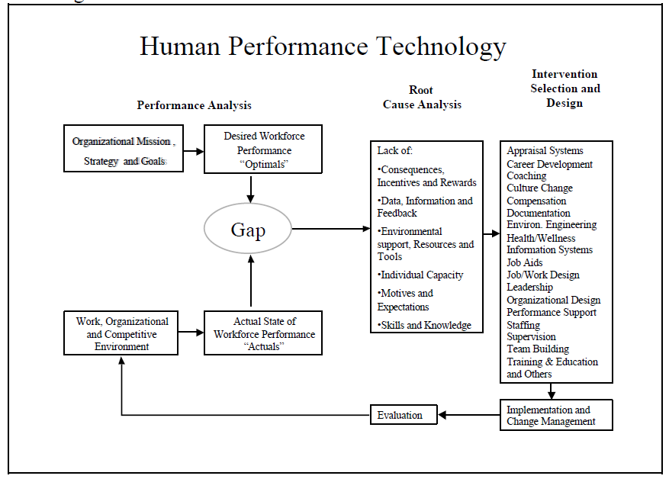
Organizational Commitment
Senior Enlisted Needs Assessment
Culture of Respect
OAS
Occupational Analyses
DEOCS
FEVS

Slide 22
Organizational Citizenship
Organizational Citizenship
Engagement
Gender Differences:
Demographics – subgroup analysis
Altruism:
“A spirit of cooperation and teamwork exists in my immediate work unit”
Counter Productive Work Behaviors:
“In my work unit, steps are taken to deal with poor performers.”

Slide 23
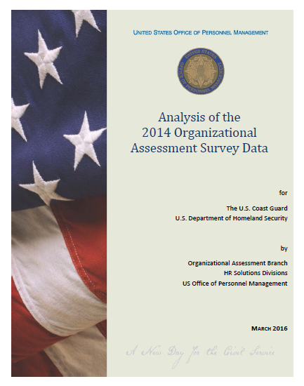
Organizational Citizenship
To what extent do members of different demographic groups view the Coast Guard’s critical work environment areas differently in 2014? Do these results continue the patterns found in the 2002-2012 data?
Table 15. Favorability scores for Critical Areas by Gender
Critical Area | Men (N=19,483) | Women (N=4,326)
Leadership and Quality | 77% | 74%
Training/Career Development | 65% | 61%
Innovation | 50% | 47%
Customer Orientation | 64% | 63%
Table 17. Favorability Scores for Critical Areas by Summarized Race/Ethnicity
Critical Area | White (N=17,279) | Non-Whites (N=6,076)
Leadership and Quality | 77% | 75%
Training/Career Development | 65% | 63%
Innovation | 50% | 49%
Customer Orientation | 64% | 63%
Fairness and Treatment of Others | 66% | 61%
Communication | 71% | 69%

Slide 24
Organizational Citizenship
How does gender influence the work environment perceptions of those Coast Guard members who said they were considering leaving the Coast Guard versus those who are not considering leaving the Coast Guard? To what extent does active duty service length and military rank interact with gender and intent to leave the Coast Guard to influence work environment perceptions?
Table 28. Perceptions of the Coast Guard by Gender, Stayers vs. Leavers, and Enlisted vs. Officers for Members Whose Active Duty Service Length is 2-3 Years
Tenure 2-3 years
Critical Area | Enlisted |  |  |  | Officers
 | Males |  | Females |  | Males |  | Females
 | Leavers N=658 | Stayers N=492 | Leavers N=262 | Stayers N=165 | Leavers N=60 | Stayers N=75 | Leavers N-57 | Stayers N=58
Leadership | 70.6% | 83.0% | 68.0% | 85.7% | 70.8% | 90.0% | 67.0% | 91.0%
Training | 65.6% | 75.6% | 60.7% | 78.1% | 59.2% | 87.1% | 69.3% | 78.3%
Innovation | 41.5% | 53.5% | 33.5% | 57.1% | 38.1% | 64.8% | 37.0% | 60.0%
Customer | 55.1% | 66.2% | 53.2% | 87.0% | 54.9% | 81.3% | 65.2% | 78.2%
Fairness | 54.1% | 65.3% | 42.2% | 64.8% | 60.1% | 87.8% | 61.1% | 83.1%

Slide 25
Motivation
Skill Variety
“I receive training and guidance to develop the knowledge and skills necessary to perform other jobs or to pursue new careers.”
Skill Mastery
“I receive the training I need to perform my job.”
Autonomy
“I have a feeling of personal empowerment and ownership of work processes.”

Slide 26
Motivation
Engagement
Dr. Kanter’s 3M’s of Motivation
Mastery: Help People develop deep skills
“I am provided with training that enhances my career advancement opportunities.”
Meaningfulness: Create community
“My manager provides an environment that supports member/employee involvement, contributions, and teamwork.”
Membership: Reinforce larger purpose
‘I understand how my work contributes to my unit/command’s mission and goals.”
Motivation

Slide 27
Motivation
71% Federal Employees agree: “I feel highly Motivated at work.” – MSPB November 2012

Slide 28
Engagement
Organizational Commitment
Organizational Citizenship
Engagement
No one-stop answer
The OAS provides many ways to investigate the component elements of Engagement.
The OAS provides trends back to 2002 which adapt to evolving definitions/research.
Measurement will require survey data.
Employee engagement has three components – Do, Think, and Feel
Behavioral – discretionary effort
Cognitive – understand job’s demands and work group’s strategy
Attitudinal – energy, vigor, and passion
Motivation

