Slide 2
Followership
Chapter 12

Slide 3
Overview
Followership Description
Followership Defined
Role-Based and Relational-Based Perspectives
Typologies of Followership
Theoretical Approaches
Followership and Destructive Leaders
How Does Followership Work?

Slide 4
Followership Description
Followers play a central role in the leadership process.
Historically, leaders have captured most of our attention.
Leaders have been viewed as the causal agents for organizational change.
Today, researchers view leadership as a shared process. Leaders and followers are interdependent.
The world needs more followers, and less glorified leaders.

Slide 5
Followership Defined
Followership--is a process whereby an individual or individuals accept the influence of others to accomplish a common goal.
Followership has an ethical dimension; it is not morally neutral.
There are ethical consequences to followership; the character and behavior of followers have an impact on organizational outcomes.

Slide 6
Role-Based Perspective
Focus is on the typical roles followers enact while occupying a formal or informal position within a hierarchical system.
Followers’ behaviors affect the leader and organizational outcomes.

Slide 7
Relational-Based Perspective
Based on social constructivism: People create meaning about their reality as they interact with each other.
Followership is co-created by the leader and follower in a given situation through communication.
Leadership occurs as people exert influence on each other and respond to those influence attempts.

Slide 8
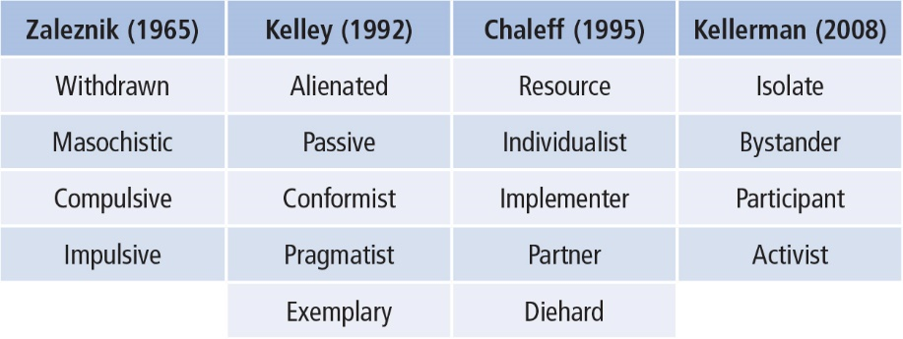
Four Typologies of Followership

Slide 9
Zaleznik Typology (1965)
Psychological view of follower behaviors
Two axes of follower behaviors:
-dominance/submission
-passivity/activity
Four types of followers
- withdrawn (submissive/passive)
- masochistic (submissive/active)
- compulsive (dominance/passive)
- impulsive (dominance/active)

Slide 10
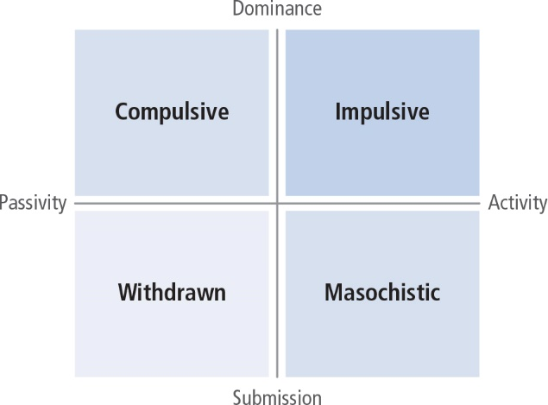
Types represent followers’ responses to inner tensions regarding authority. Tensions may be unconscious but often come to the surface when interacting with the leader.

Slide 11
Kelly Typology (1992)
Most recognized followership typology
Followers are enormously valuable to organizations
Emphasizes the motivations of followers
What accounts for exemplary followership?
Two axes of follower behavior:
- independent critical thinking/dependent uncritical thinking
- active/passive

Slide 12
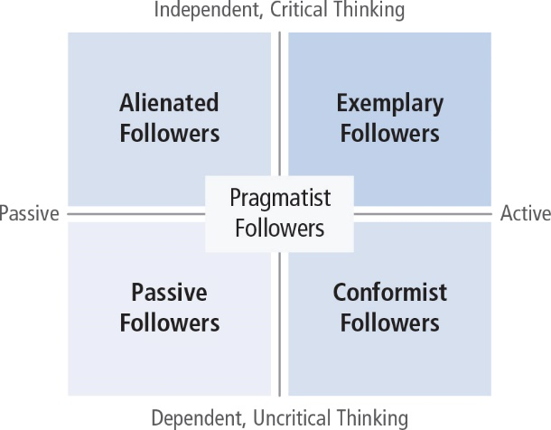

Slide 13
Passive followers: Look to leader for direction and motivation
Conformist followers: On the leader’s side but still look for direction and guidance
Alienated followers: Think for themselves and exhibit negative energy
Exemplary followers: Active, positive, and offer independent constructive criticism

Slide 14
Effective followers share same qualities:
They self-manage and think for themselves; exercise control, work without supervision.
They show strong commitment to organizational goals and well as personal goals.
They build their competence and master job skills.
They are credible, ethical, and courageous.

Slide 15
Chaleff Typology (1995, 2003, 2008)
Developed from WWI experience. Why do people follow toxic leaders like Hitler? What can be done to prevent this from recurring?
Followers serve a common purpose along with leaders.
Followers need to take a more proactive role.
Followers need to take more responsibility, feel more agency, and confidence in ability to influence others.

Slide 16
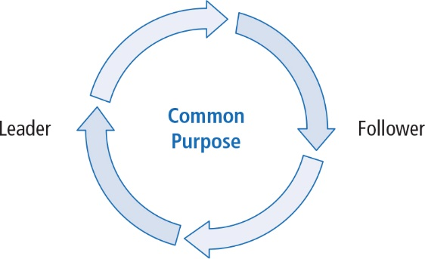

Slide 17
Prescriptive approach to making courageous followers:
Assume responsibility for the common purpose
Support the leader and organization
Constructively challenge the leader if the common purpose or integrity of the group is being threatened
Champion the need for change when necessary
Take a moral stand that is different from the leader’s to prevent ethical abuses

Slide 18
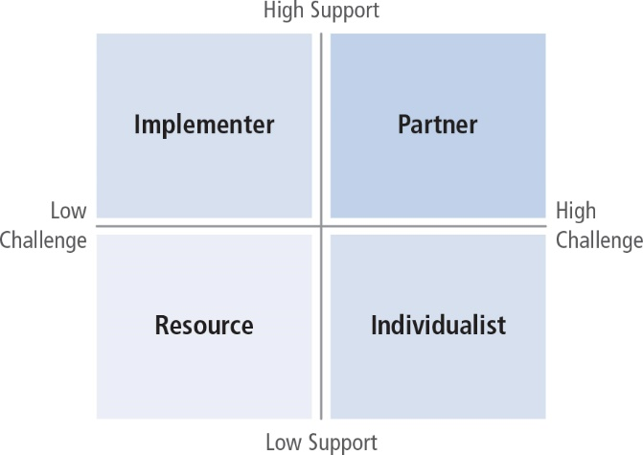

Slide 19
Two axes of courageous followership:
- courage to support (low–high)
- courage to challenge (low–high)
Four styles of followership
- Resource (low support, low challenge)
- Individualist (low support, high challenge)
- Implementer (high support, low challenge)
- Partner (high support, high challenge)

Slide 20
Kellerman Typology (2008)
Developed from perspective of political science
Leaders’ importance overestimated because they have more power, authority and influence; importance of followers is underestimated.
Followers are “unleaders” with less rank and who defer to leaders.

Slide 21
Followers differentiated on one attribute: Level of engagement (low–high)

Slide 22
Five levels of followers:
Isolates are completely unengaged.
Bystanders are observers who do not participate.
Participants are partially engaged and willing to take a stand on issues.
Activists feel strongly about the leader and the leader’s policies and act on their own beliefs.
Diehards are totally dedicated to their cause; deeply committed to supporting the leader or opposing the leader.

Slide 23
The Value of Typologies
Provide a starting point for research
Highlight many ways followers have been conceptualized
Share some commonalities among them
Provide labels for follower types which can assist leaders in effectively communicating with them

Slide 24
Theoretical Approaches to Followership
Uhl-Bien (2014)--Followership is comprised of “characteristics, behaviors and processes of individuals acting in relation to leaders.”
Followership is a relationally-based process that includes how followers and leaders interact to construct leadership and its outcomes.

Slide 25
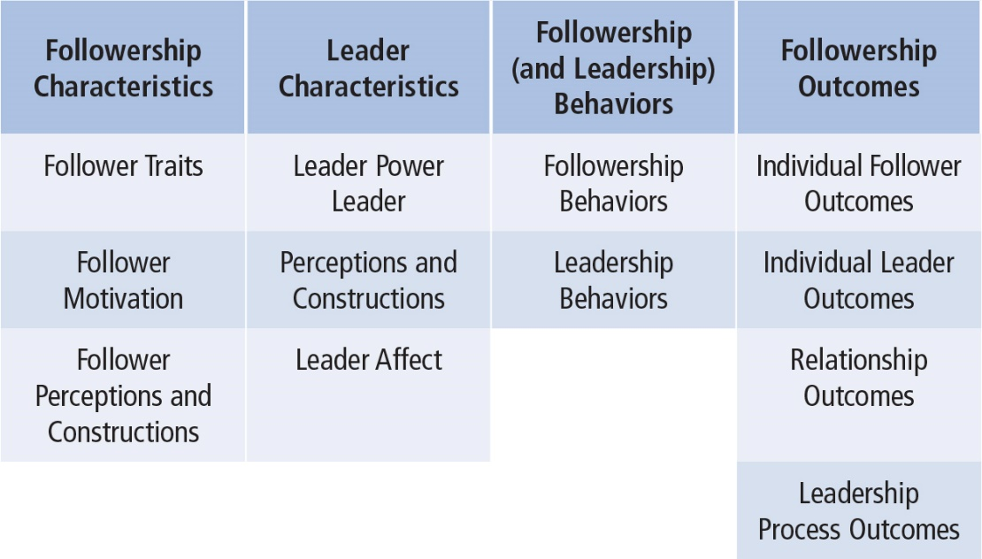

Slide 26
Follower characteristics
- attributes, traits, motivations, and perceptions
Leader characteristics
- attributes, power, perceptions, and affect
Followership and leadership behaviors
- Extent to which followers obey, defer to, or resist the leader
- How leader influences followers to respond
Followership outcomes
-Results that influence the follower, leader, their relationship, and the leadership process.

Slide 27
Two Theoretical Frameworks
Reversing the Lens
Focus on how followers affect leaders and organizational outcomes
Followers can be change agents
-Impact of follower characteristics on follower behavior
- Impact of follower behavior on leader perceptions and behaviors and vice versa
- Impact of both followers and leaders on followership outcomes

Slide 28
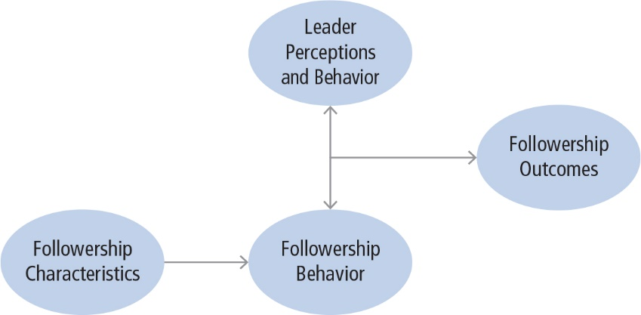

Slide 29
The Leadership Co-Created Process
One person’s leadership behaviors interact with another person’s followership behaviors to create leadership and its outcomes.
Leader behaviors are influence attempts.
Follower behaviors grant power to another, comply, or challenge.

Slide 30
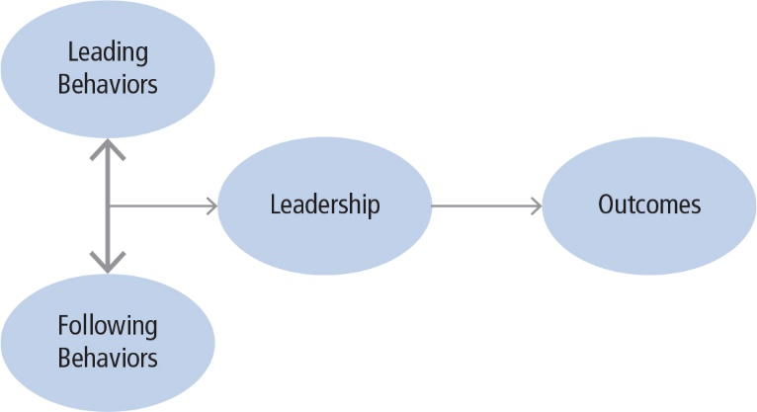

Slide 31
New Perspectives on Followership Carsten, Harms, and Uhl-Bien, 2014
Followers get the job done
Followers work in the best interest of the organization’s mission
Followers challenge leaders
Followers support the leader
Followers learn from leaders

Slide 32
Followership and Destructive Leaders Lipman-Blumen: The Allure of Toxic Leaders (2005)

Slide 33
How Followership Works
Discussing followership elevates its importance and the value of followers
Followership is about how individuals accept influence of others to reach a common goal
Research helps us understand why harmful leadership occurs and sometimes goes unrestrained

Slide 34
Strengths
Recognizes followership as an integral part of the leadership equation
Forces a whole new way for people to think about leadership, and to focus on followers
Views leadership as co-constructed
Provides a set of basic prescriptions for what a follower should or shouldn’t’ do to be effective

Slide 35
Criticisms
Little methodical research ahs been done so far
Current followership literature primarily based on observation and anecdote
Leader-centric view of leadership may be too ingrained for followership to gain importance

Slide 36
Application
Followership is as important as leadership.
Learning about leadership can be useful for organizational training and development.
Leaders can learn how to understand followers and how to most effectively work with them.

