Slide 1
Exelon Overview
Tyler Salley, M.S.
Talent Management & Organizational Development

Slide 2
Professional Background
Staffing & HR Consulting 2014 – 2017
Recruiter
Account Manager
Talent Solutions Engineer
Program Manager, Organizational Development 2018 - 2019
B.S., Psychology, 2010 - 2014
M.S., Applied Behavioral Sciences 2017 - 2019
Notes:
Your facilitators for today’s session will be Tyler & Deanna – intros

Slide 3
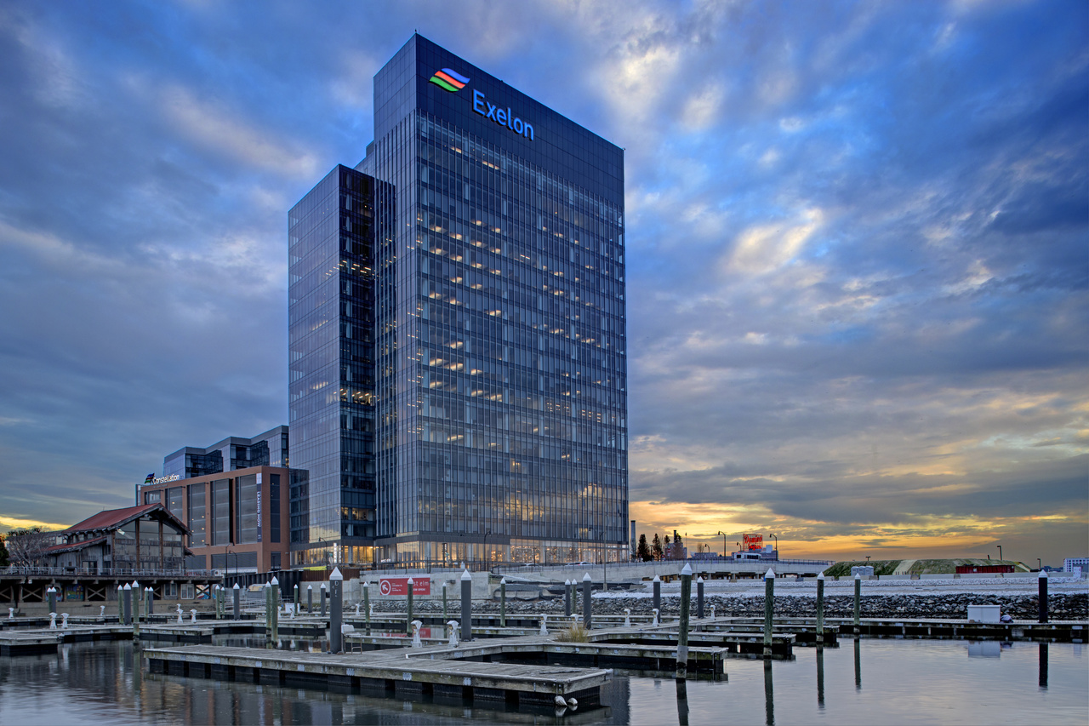
What is Exelon
FORTUNE 100
Does business in 48 states, D.C., and Canada
2018 revenues of $35.9 billion
35,000 employees nationwide
12 million customers, including two-thirds of the Fortune 100​​​​
UB Exelon Presentation
Notes:
We are a FORTUNE 100 company that work​s in every stage of the energ​​​​y business: power generation, competitive energy sales, transmission and delivery.
As the nation's leading competitive energy provider, Exelo​n does business in 48 states, D.C., and Canada and had 2017 revenues of $33.5 billion​​. We employ approximately 34,000 people nationwide.​​​​
Exelon is one of the largest competitive U.S. power generators, with more than 32,700 megawatts of nuclear, gas, wind, solar and hydroelectric generating capacity comprising one of the nation’s cleanest and lowest-cost power generation fleets.

Slide 4
What is Exelon
Notes:
We are a FORTUNE 100 company that work​s in every stage of the energ​​​​y business: power generation, competitive energy sales, transmission and delivery.
As the nation's leading competitive energy provider, Exelo​n does business in 48 states, D.C., and Canada and had 2017 revenues of $33.5 billion​​. We employ approximately 34,000 people nationwide.​​​​

Slide 5
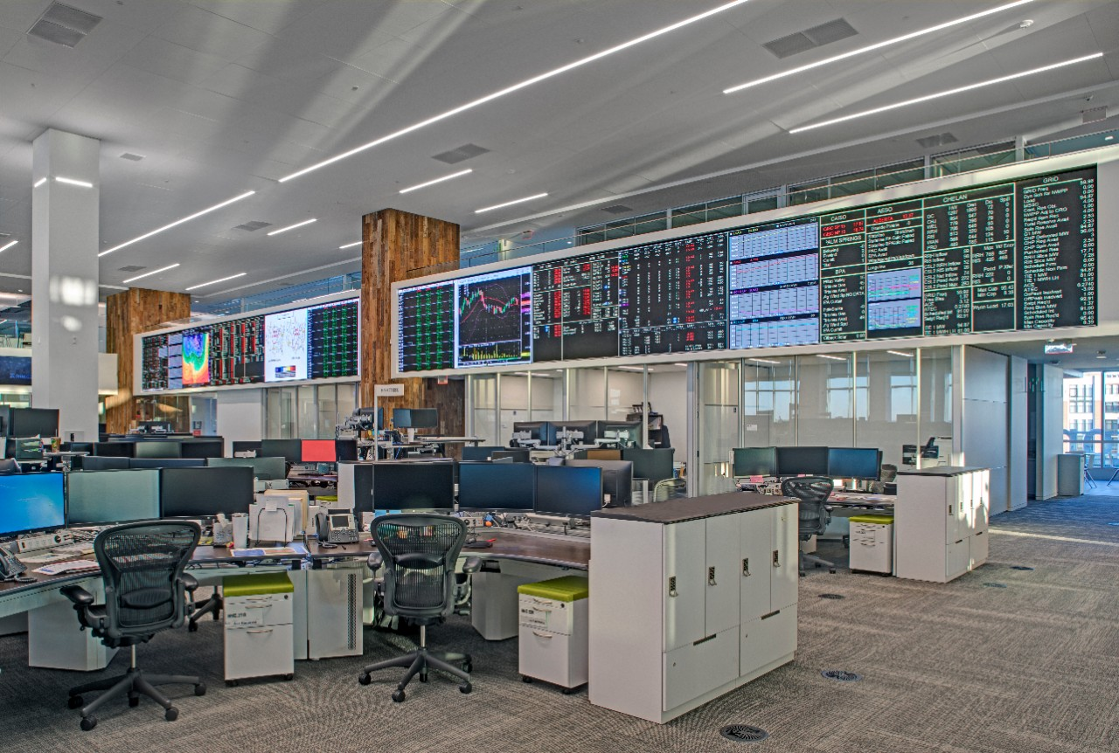
Constellation
In 2018, procured 8 million RECs for customers, enabling them to avoid 3.6 million metric tons of GHG emissions and support the development of renewables power generation
381 MW of solar projects developed since 2007
123,561
113,325
Commercial & Industrial Power Customers
Commercial & Industrial Natural Gas Customers
Notes:
Dedicated Team of Regulatory, Market & Wholesale Experts

Slide 6
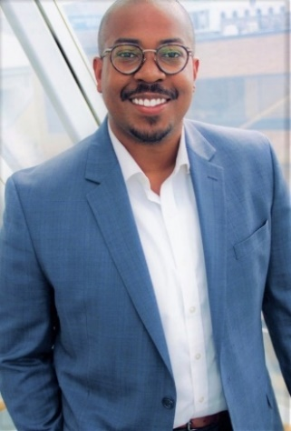
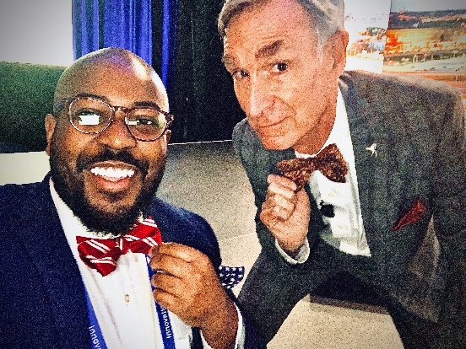
My Role
Most Impactful Classes
Motivation, Satisfaction, and Leadership
Personnel Assessment/Psychology
Occupational Health & Stress
Multivariate Statistics
Employment Law
Tyler Salley
Strategist, Talent Management & Org. Development
What I do?
Culture Agenda
Leadership Development
Employee Development
Survey Development
Onboarding
Employee Engagement
Talent Insights & Analytics
Notes:
Example of 180 Analysis

Slide 7
Ty’s Tips
Always network!
Professional Portfolio
Save EVERYTHING
Know your strengths
Notes:
Linkedin + Resume need to be 100% all the time
Highlight your I/O experience in every job you’ve had. Be able to tell a story
Start early
Make corrections on your graded papers, be able to describe what/how you did and why
Use notes as a reference point (google drive), books, articles, feedback, papers

Slide 8
Questions
Notes:
Linkedin + Resume need to be 100% all the time
Highlight your I/O experience in every job you’ve had. Be able to tell a story
Start early
Make corrections on your graded papers, be able to describe what/how you did and why
Use notes as a reference point (google drive), books, articles, feedback, papers

