Slide 1
Employee Discretion: When, Where, & How Rebecca Thompson, PhD Purdue University Krannert School of Management
Some of the research in this presentation was conducted in collaboration with the Dean of Faculties Office and the ADVANCE Center at Texas A&M University. ADVANCE-IT is an NSF funded grant to facilitate the advancement and retention of women faculty in science, technology, engineering, and math disciplines. This material is based upon work supported by the National Science Foundation under NSF Cooperative Agreement No. HRD-1008385

Slide 2
Research Areas
Personality & Individual Differences
Mentoring
Work-Life
Facilitation of roles
Maladaptive personality traits & workplace behaviors
Thompson, Payne, Horner, & Morey, 2012
Predictive validity of personality tests
Berry, Kim, Wang, Thompson, & Mobley, 2013
Individual differences across contexts
Barratt, Bergman, & Thompson, R&R, Sex Roles
Need for mentoring
Payne, & Thompson, in preparation
Unique Contexts
Thompson, Bergman, & Barratt, in preparation
Workplace Flexibility
Kossek, Hammer, Thompson, & Burke, 2014, SHRM; Thompson, Cook, Payne, Henning & Jean, in preparation; Thompson, Payne & Taylor, R&R, JOOP; Thompson & Payne, in preparation
Occupational Health & Well-being
Kossek, Thompson, Davis, DePasquale, Sabbath, Kelly, & Burke, in progress

Slide 3
Overview
Introduction and Outline
Workplace Flexibility
Study 1:
Flextime, Flexplace, or Both?
Study 2:
Discretion: When, Where, and How
Conclusions

Slide 4
Control
Where
How
When

Slide 5
Flexible Work Arrangements (FWAs)
Mutually beneficial arrangement between employees and employers
Both parties agree on when, where and how
Can be formal or informal
Kossek, Hammer, Thompson, & Burke, 2014

Slide 6
Types & Examples of Workplace Flexibility
Type | Example
Time Schedule (When) | Flextime
 | Compressed workweeks
 | Flex shift work/ workday schedules
 | Self-scheduled breaks
Location/Place of Work (Where) | Telework; home based
 | Remote work
 | Hoteling
Amount of Work (How Much) | Job-sharing
 | Reduced load or customized work/part-time work
Work Continuity (Leaves/Breaks) | Long-term breaks/sabbaticals, career flexibility
 | FMLA
 | Comp time
Abbreviated from Kossek, Hammer, Thompson, & Burke, 2014; based on Kossek & Michel, 2010

Slide 7
Benefits of Workplace Flexibility
Organization
Job/
Co-workers
Increase Productivity.
Decrease Accidents.
Employees
Greater control over where, when and how they work.
Community
Employees can be involved in community, school and family events taking place during traditional work and commuting hours.
Less likely to miss work (due to illness, nonwork demands).
Improved well-being.
Address challenges of the globalization of business.
Potential cost savings and reduced turnover.
Attract and retain quality employees.
Abbreviated from Kossek, Hammer, Thompson, & Burke, 2014

Slide 8
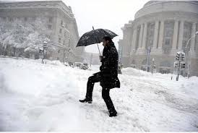
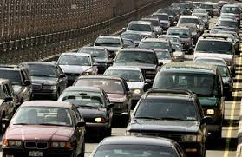
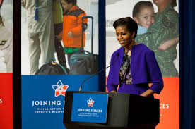
Increase in Workplace Flexibility Use
Natural events
Hurricanes, Winter storms
Economic Need
Fuel Costs
Federal Government Trends
Public Laws 108-199 & 108-447
White House Flexibility Forums (2010)
Telework Enhancement Act (2010)
NSF announced new workplace flexibility policies (2011)
Lister & Harnish, 2011; Matos & Galinsky, 2012; U.S. Office of Personnel Management, 2011

Slide 9
Workplace Flexibility in the News
Companies reversing flex policies
Question if workplace flex is for everyone
Researchers argue poorly implemented policies
New Research Directions
Perceptions of Policies
Who benefits from FWAs?
Redefining Workplace Flexibility
Allen, 2001; Eaton, 2003; Kossek, 2013

Slide 10
Study 1: When, Where, or Both?
Alter time and/or place of work
Flextime and Flexplace
Confounded in literature & practice
Perceptions of flexibility
Recruitment & Applicants
Where
When
Thompson, Payne, & Taylor (R&R, JOOP)

Slide 11
Study 1: Method
Participants, Design, and Procedure
190 undergraduates recruited from upper level classes
A 3 x 3 within-subjects experimental design
policy-capturing approach
Participants rated hypothetical organizations
Dependent Variables:
Anticipated Organizational Support
Organizational Attraction
Thompson, Payne, & Taylor (R&R, JOOP)

Slide 12
Organization 1 offers the following recruitment package:
A. A competitive salary, with opportunities for promotion and bonuses based on performance
B. Generous benefits package including a choice of medical programs, company-matched 401(k), stock options, maternity and paternity leave
C1. Traditional Work Schedule - 8am-5pm work schedule
C2. Flextime with Core Hours - Employees may work any preferred 8 hour shift but must be present for core work hours of 10am-3pm.
C3. Flextime – Employees are free to work at any time they want as long as they get their work done.
D1. Traditional Work Environment - Employees must work at the main work site and are not permitted to work at home.
D2. Partial Flexplace – Employees may work from home via technology such as a computer up to 3 days a week.
D3. Complete Flexplace - Employees may work from home via technology such as a computer.
 | No Flextime | Flextime with Core Hours | Flextime no Core Hours
Complete Flexplace | A, B, C3, D1 | A, B, C3, D2 | A, B, C3, D3
Some Flexplace | A, B, C2, D1 | A, B, C2, D2 | A, B, C2, D3
No Flexplace | A, B, C1, D1 | A, B, C1, D2 | A, B, C1, D3

Slide 13
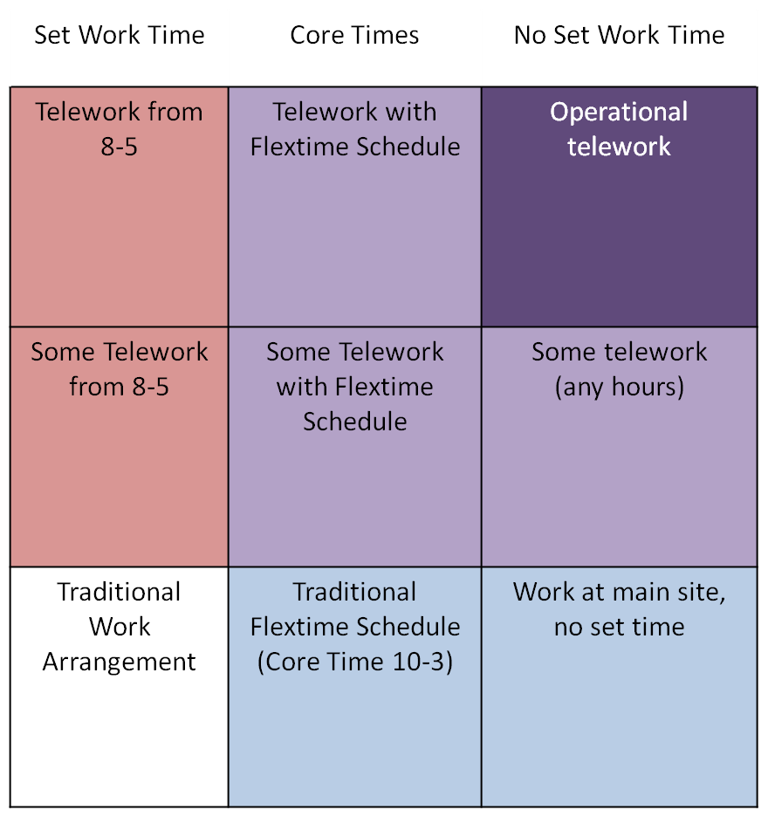
less
Flextime
more
 | Completely flexible in time and place
 | Flexible in time and place
 | Flexible in time
 | Flexible in place
 | No Flexibility
less
Flexplace
more
Thompson, Payne, & Taylor (R&R, JOOP)

Slide 14
Study 1: Results
 | No Flextime M (SD) | Low Flextime M (SD) | High Flextime M (SD) | Flexplace Collapsing Flextime M (SD)
High Flexplace | 3.62 (0.80) 3.70 (0.82) | 3.71 (0.79) 3.99 (0.75) | 3.87 (0.91) 4.13 (0.88) | 3.73 (0.84) ª 3.94 (0.84) ª
Low Flexplace | 3.61 (0.76) 3.66 (0.80) | 3.74 (0.76) 3.96 (0.78) | 3.85 (0.75) 4.12 (0.77) | 3.73 (0.76) ª 3.91 (0.80) ª
No Flexplace | 3.43 (0.82) 3.40 (0.89) | 3.59 (0.77) 3.71 (0.77) | 3.62 (0.76) 3.81 (0.80) | 3.55 (0.79) 3.63 (0.84)
Flextime Collapsing Flexplace | 3.55 (0.80) 3.59 (0.85) | 3.68 (0.77) 3.88 (0.79) | 3.78 (0.82) 4.02 (0.83)
Means of Anticipated Organizational Support and Organizational Attraction by Condition, N = 190. ª = conditions of flexplace that were not significantly different from one another. All marginal means for flextime were significantly different from one another.
Thompson, Payne, & Taylor (R&R, JOOP)

Slide 15
Study 1: Results
.46*
Perceived Flexibility in time (when)
Flextime
.16*
.14*
.27*
.34*
Anticipated Org Support
.54*
Org Attraction
.11*
.17*
Perceived Flexibility in place (where)
.13*
Flexplace
.63*
Note. χ²(4) = 22.32, p < .01, CFI = .99, RMSEA = .05, SRMR = .02
Thompson, Payne, & Taylor (R&R, JOOP)

Slide 16
Study 1:Discussion
Individuals attracted to both
Having both is additive but not synergistic
Organizations benefit from offering flextime or flexplace
Theoretical and Applied Implications
Consistent patterns across structural & perceived
Offering flexibility sends message to potential applicants
Limitations
Student sample
Thompson, Payne, & Taylor (R&R, JOOP)

Slide 17
Study 2: When, Where, and How
Multidimensional Construct
Where
How
When
Various terms used to describe employee discretion
job autonomy, flexibility, control
Where
How
When
Thompson & Payne (in preparation)

Slide 18
Study 2: When, Where, and How
Roles: sets of expectations about the amount/type of behavior expected of a person holding a particular role
Multiple roles
Job: a set of task elements grouped together under one job title and designed to be performed by a single individual
Design/characteristics of the job within work role
Tasks: discrete work activities conducted for a unique purpose
associated with multiple jobs
Cascio & Aguinis, 2011; Ilgen & Hollenbeck, 1991

Slide 19
Study 2: When, Where, and How
WHEN
The extent to which employees are permitted to manipulate the temporal boundaries of tasks in their work role
Flextime →Core times
Continuous variable
WHERE
The extent to which employees are permitted to manipulate the physical boundaries of their work role and how frequently they can do so
Measured by the frequency of work away from main work site
Telework & Flexplace
Cohen & Gadon, 1978; Galinsky et al., 2004; Matos & Galinsky, 2012

Slide 20
Study 2: Defining Discretion
HOW
The extent to which employees are permitted to make decisions about the methods used within their work role
Means of conducting work
Control job-related tasks vs. role boundaries
JOB AUTONOMY
Work method (how)
Work Scheduling (when)
Breaugh, 1985; Hackman & Oldham, 1975; Morgeson & Humphrey, 2006

Slide 21
Study 2: Defining Discretion
(Control)
(Autonomy)
(Flexibility)
How
When
Where
*Note: overlap in domains not intended to reflect actual amount of theoretical overlap. Thus shapes are not necessarily to scale.

Slide 22
Study 2: Defining Discretion
Hypotheses
Distinct Dimensions of Discretion
Between Role Discretion
Discretion in when → nonwork outcomes related outcomes
Discretion in where one works → nonwork outcomes related outcomes
Within Role Discretion
Discretion in how (method) one conducts work → work related outcomes
Discretion over when (task scheduling) one conducts work→ work related outcomes
Interaction between dimensions of discretion
Thompson & Payne (in preparation)

Slide 23
Study 2: When, Where, and How Method: Participants, Design, & Procedure
All faculty (N = 2728) invited to participate
Response rate of 1475 (54%)
N = 1223 usable responses (44%)
Men (n = 789, 65%); Women (n = 413, 34%)*
Age (M = 50.69 , SD = 11.79)
White (n = 707), Asian (n = 55), Latino/a or Hispanic (n = 50)
Tenure Status
Non-tenure track (n = 274)
Tenure-track assistant (n = 189)
Tenured associate (n = 289)
Tenured (n = 422)
Org Tenure (M = 15.20, SD = 11.47)
*Some percentages do not total 100 due to small number of responses in other categories as well as missing responses.
Thompson & Payne (in preparation)

Slide 24
Study 2: When, Where, and How Method: Measures
Demographics
Employee Discretion
Instructions: “For the next set of items, please think ONLY about your research related tasks and responsibilities (as opposed to your teaching, service and/or administrative responsibilities) during your typical work day. Recognizing that all faculty members must follow ethical and legal guidelines, please rate the following items.”
When
Micro Breaugh (1985)
Macro Kossek et al (2006)
Where Kossek et al (2006)
How Breaugh (1985)
Role Ambiguity Rizzo et al. (1970)
Work Role Outcomes
Job satisfaction, turnover intentions, & burnout
Nonwork Role Outcomes
Work-nonwork conflict, life satisfaction, physical health, psychological distress symptoms
Thompson & Payne (in preparation)

Slide 25
Study 2: When, Where, and How Results: Factor Structure of Employee Discretion
Structure | χ² | Δ χ² | df | Δ df | CFI | SRMR | RMSEA | RMSEA CI
One factor | 5995.87* |  | 90 |  | 0.54 | 0.12 | 0.27 | (.26, .27)
Two factors | 5608.55* | 387.32 | 89 | 1 | 0.57 | 0.11 | 0.26 | (.26, .27)
Four factors | 1643.79* | 4352.08 | 84 | 6 | 0.88 | 0.08 | 0.14 | (.14, .15)
Five factors | 421.94* | 5573.93 | 80 | 10 | 0.97 | 0.04 | 0.07 | (.06, .08)
Note. Five factor model = (1) where, (2) micro when, (3) macro when, (4) how, (5) criteria; Four factor model = (1) where, (2) when (micro and macro), (3) how (4) criteria; Two factor model = (1) where, when (micro and macro), how, (2) criteria; One factor = (1) where, when (micro and macro), how, criteria.
Thompson & Payne (in preparation)

Slide 26
Study 2: When, Where, and How Results: Relative Influence of Dimensions
 | Outcomes | How | When (Micro) | When (Macro) | Where
Work | Job Satisfaction (work) | .08* | .13* | .12* | .08*
 | Burnout (work) | -.14* | -.17* | -.19* | -.16*
 | Turnover Intentions (work) | -.03 | -.07* | -.10* | -.08*
Nonwork | Life Satisfaction (nonwork) | .14* | .16* | .15* | .16*
 | Physical Health (nonwork) | -.05 | -.11* | -.07* | -.09*
 | Psychological Distress Symptoms (nonwork) | -.04 | -.07* | -.05 | -0.01
 | Work-Nonwork Conflict (nonwork) | -.01 | -.08* | -.14* | -.07*
+The interactions between when & where, how & when, as well as the three-way interactions among all 3 types of discretion were all unsupported.
Note. All results were computed controlling for Negative Affectivity, Sex, Organizational Tenure, Tenure Status, Marital Status, Number of Dependents, and College. In this figure, blue cells refer to discretion in the work/task domain whereas red cells refer to discretion in the nonwork/between roles domain Lighter cells reflect nonsignifcant results.

Slide 27
Study 2: When, Where, and How Results: Role Ambiguity
H13F: Interaction between When and Role Ambiguity on Turnover Intentions.
H14A: Interaction between Where and Role Ambiguity on Job Satisfaction.
H14B: Interaction between Where and Role Ambiguity on Life Satisfaction.
Note. All results were computed controlling for Negative Affectivity, Sex, Organizational Tenure, Tenure Status, Marital Status, Number of Dependents, and College.

Slide 28
Study 2: When, Where, and How Results: Role Ambiguity
H14F: Interaction between Where and Role Ambiguity on Turnover Intentions.
H14G: Interaction between Where and Role Ambiguity on Work-Nonwork Conflict.
Note. All results were computed controlling for Negative Affectivity, Sex, Organizational Tenure, Tenure Status, Marital Status, Number of Dependents, and College.

Slide 29
Study 2: When, Where, and How Discussion
Multiple conceptualizations of discretion
Uncontaminated measures
3 primary dimensions
How
Work domain
Where & When
Work & Nonwork domain
Allen et al., 2013 ; Averill, 1973; Ganster & Fusilier, 1989; Spector, 1986

Slide 30
Conclusions
Conceptual Distinctions
Multidimensional nature of Discretion
Micro & Macro When
Effects of employee discretion
Beneficial for employee and employer outcomes
Policies should be tied to perceptions and intended outcomes
Organizations may be limited in what they can offer, but can still benefit from flex
No “one-size-fits-all” policy

Slide 31
Future Directions
How is discretion currently being used?
What does/can employee discretion look like across job domains?
Who can use employee discretion?
What is the process of employee discretion?

Slide 32
Thank You

