Slide 2
Introduction
Chapter 1

Slide 3
Overview
Importance of Leadership
Leadership Defined
- Ways of conceptualizing leadership
- Definition and components
Leadership Described
- Trait versus process
- Assigned versus emergent
- Leadership and power
- Leadership and coercion
- Leadership and management

Slide 4
The Evolution of Leadership Definitions
1900–1929--Control and centralization of power
1930s--Trait approach
1940s--Group approach
1950s--Group theory, shared goals, and effectiveness
1960s--Leadership as behavior
1970s--Organizational behavior

Slide 5
The Evolution of Leadership Definitions
1980s--Explosion of research
- Leader’s will
- Influence
- Traits
- Transformation

Slide 6
21st century--The process of leadership
- Authentic leadership
- Spiritual leadership
- Servant leadership
- Adaptive leadership
- Followership
- Discursive leadership

Slide 7
Conceptualizing Leadership
Some definitions view leadership as:
The focus of group processes
A personality perspective
An act or behavior
The power relationship between leaders and followers
A transformational process
A skills perspective
Notes:
Leader at center of group change & activity – represents the “will” of the group
combo of special traits/characteristics - allows them to affect others to accomplish tasks.
3. Things leaders do that bring about change
4. Leaders have power and use it to cause change
5. In helping group members achieve their goals/meet needs

Slide 8
Leadership Defined
Leadership
is a process whereby an individual influences a group of individuals to achieve a common goal.

Slide 9
Components Central to the Phenomenon of Leadership
Leadership
Leaders
Is a process
Involves influence
Occurs within a group context
Attends to common goals
And followers are involved together
And followers need each other
Often initiate and maintain the relationship
Are not above or better than followers

Slide 10
Leadership Described
Trait Versus Process Leadership
Assigned Versus Emergent Leadership
Leadership and Power
Leadership and Coercion
Leadership and Management

Slide 11
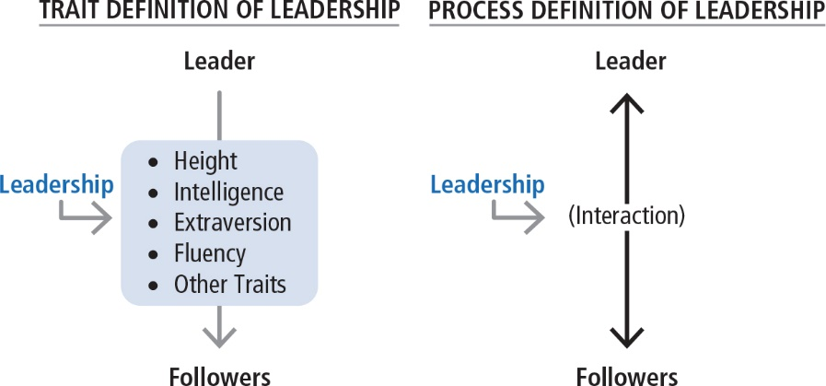

Slide 12
Trait Versus Process Leadership
Leadership is a property or set of properties possessed in varying degrees by different people (Jago, 1982).
  Observed in leadership behaviors
  Can be learned

Slide 13
Assigned Versus Emergent Leadership
Assigned
Emergent
Leadership based on occupying a position within an organization
  Team leaders
  Plant managers
  Department heads
  Directors
An individual perceived by others as the most influential member of a group or organization regardless of the individual’s title
  Emerges over time through communication behaviors
    Verbal involvement
    Being informed
    Seeking others’ opinions
    Being firm but not rigid
  Affected by personality and gender

Slide 14
Leadership and Power
Power
Bases of Social Power
French and Raven (1959); Raven (1965)
The capacity or potential to influence
Ability to affect others’ beliefs, attitudes, and actions
Referent
Expert
Legitimate
Reward
Coercive
Information
Power is a relational concern for both leaders and followers.

Slide 15
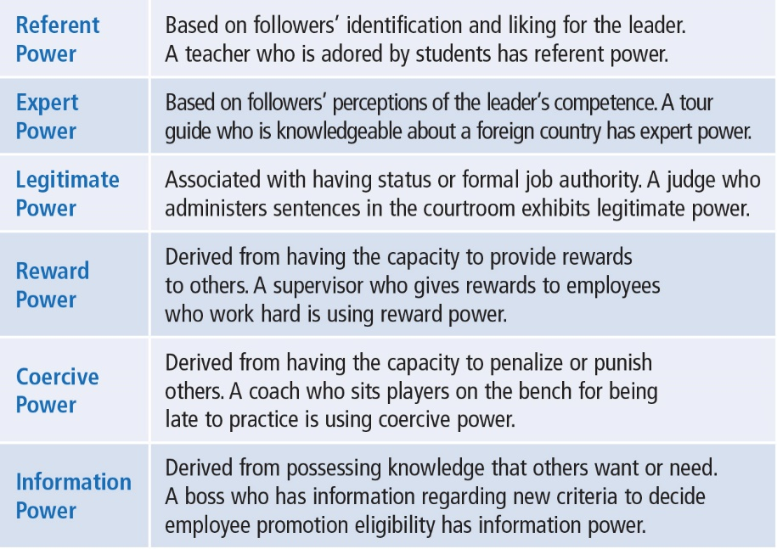
Leadership and Power

Slide 16
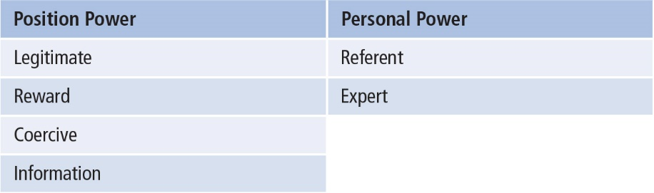
Leadership and Power
Position Power derived from office or rank in an organization
Personal Power is influence derived from being seen as likable and knowledgeable

Slide 17
Shift in Leadership Power, Kellerman (2012)
Power no longer the domain of leaders
Followers demand more from leaders
Access to technology has empowered followers
Leaders more transparent
Decline in respect for leaders
Leadership as social contract between leaders and followers

Slide 18
Leadership and Coercion
Coercion Involves
Examples of Coercive Leaders
Use of force to effect change
Influencing others to do something by manipulating rewards and penalties in the work environment
Use of threats, punishments, and negative rewards
Adolf Hitler
Jim Jones
Taliban leaders
Power and restraint used to force followers to
engage in extreme
behavior

Slide 19
Leadership and Management, Kotter (1990)
Management Activities
Leadership Activities
“Produces order
and consistency”
“Produces change
and movement”
Planning and Budgeting
Organizing and Staffing
Controlling and Problem Solving
Establishing direction
Aligning people
Motivating/inspiring
Major activities of management and leadership
are played out differently; BUT, both are essential
for an organization to prosper.

Slide 20
Leadership and Management, Zaleznik (1977)
Managers
Unidirectional Authority
Leaders
Multidirectional Influence
Are reactive
Prefer to work with people solving
Low emotional involvement
Are emotionally active and involved
Shape ideas over responding to them
Act to expand available options
Change the way people think about what is possible

