Slide 2
Skills Approach
Chapter 3

Slide 3
Overview
Skills Approach Perspective
Three-Skill Approach (Katz, 1955)
Skills-Based Model (Mumford et al., 2000)
How Does the Skills Approach Work?

Slide 4
Skills Approach Description
Perspective
Definition
Leader-centered perspective
Emphasis on skills and abilities that can be learned and developed
Leadership skills: The ability to use one’s knowledge and competencies to accomplish a set of goals and objectives

Slide 5
Three-Skill Approach (Katz, 1955)
Technical Skill
Human Skill
Conceptual Skill

Slide 6
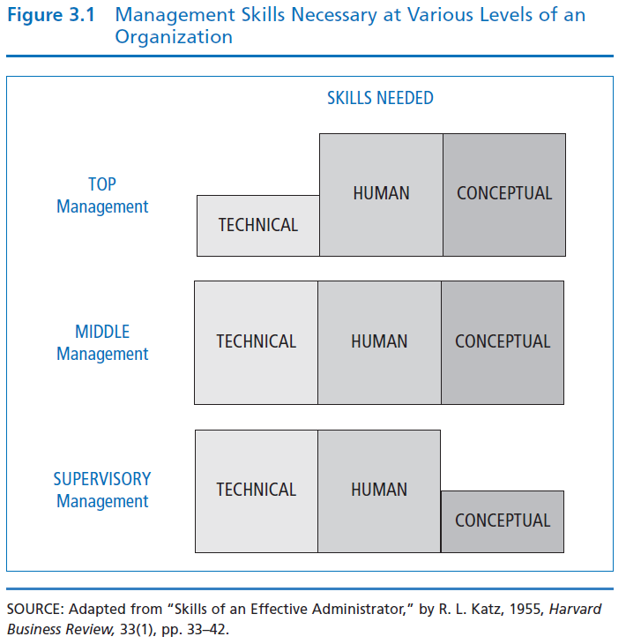
Basic Administrative Skills--Katz (1955)
Leaders need all three skills-- but relative importance changes based on level of management

Slide 7
Technical Skill
Having knowledge about and being proficient in a specific type of work or activity.
  Specialized competencies
  Analytical ability
  Use of appropriate tools and techniques
Technical skills involve hands-on ability with a product or process
Most important at lower levels of management

Slide 8
Human Skill
Having knowledge about and being able to work with people.
  Being aware of one’s own perspective and others’ perspectives at the same time
  Assisting group members in working cooperatively to achieve common goals
  Creating an atmosphere of trust and empowerment of members
  Important at all levels of the organization

Slide 9
Conceptual Skill
the ability to do the mental work of shaping meaning of organizational policy or issues (what company stands for and where it’s going)
  Works easily with abstraction and hypothetical notions
  Central to creating and articulating a vision and strategic plan for an organization
  Most important at top management levels

Slide 10
Skills-Based Model
Skills Model Perspective
Competencies
  Individual Attributes
  Leadership Outcomes
  Career Experiences
  Environmental Influences

Slide 11
Skills Model Description
(Mumford, Zaccaro, Harding, Jacobs, & Fleishman, 2000)
Perspective
Skills-Based Model of Leadership
Research studies (1990s) goal: to identify the leadership factors that create exemplary job performance in an organization
Emphasizes the capabilities that make effective leadership possible rather than what leaders do
Capability model-- Examines relationship between a leader’s knowledge & skills & the leader’s performance.
Suggests many people have the potential for leadership

Slide 12
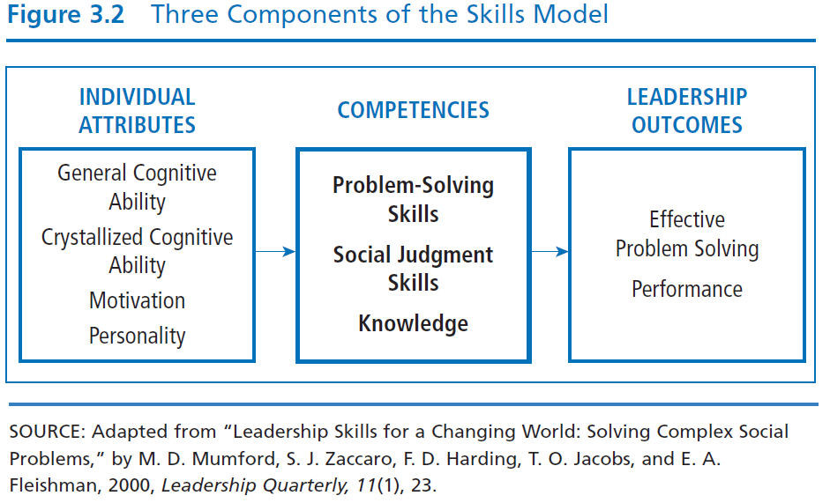

Slide 13
Competencies Skills
Problem Solving
Social Judgment
Knowledge
Creative ability to solve new/unusual, ill-defined organizational problems
Capacity to understand people and social systems
- Perspective taking
- Social perceptiveness
- Behavioral flexibility
- Social performance
The accumulation of information and the mental structures to organize the information

Slide 14
Nine Key Problem Solving Skills
- Mumford, Todd, Higgs, and McIntosh, 2017
1. Problem definition
2. Cause/goal analysis
3. Constraint analysis
4. Planning
5. Forecasting
6. Creative thinking
7. Idea evaluation
8. Wisdom
9. Sense making/visioning

Slide 15
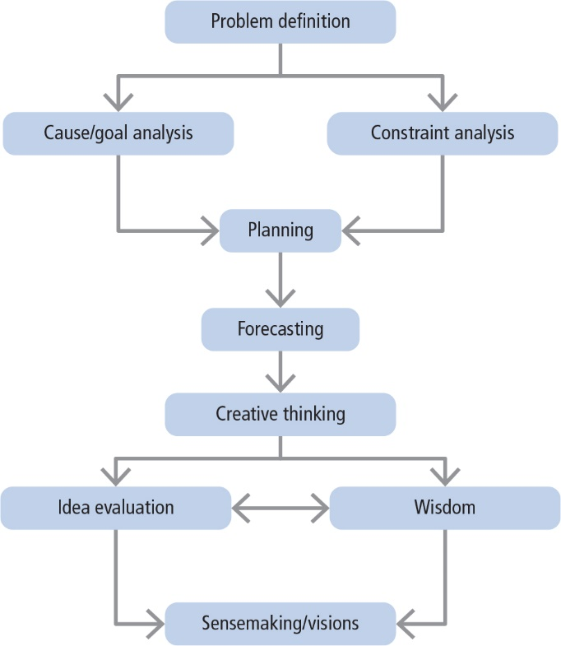
Hypothetical Relationships of Problem-Solving Skills

Slide 16
Individual Attributes
General Cognitive
Ability
Crystallized
Cognitive Ability
Motivation
Personality
Person’s intelligence
Perceptual processing
Information processing
General reasoning
Creative & divergent thinking
Memory
Intellectual ability learned or acquired over time
Three aspects of motivation
Willingness
Dominance
Social good
Any characteristic
that helps people
cope with complex
organizational
situations is
probably related to leader performance

Slide 17
Leadership Outcomes
Problem Solving
Performance
Criteria = originality and quality of solutions to problem situations--good problem-solving involves creating solutions that are:
Logical
Effective
Unique
Go beyond given information
Degree to which a leader has successfully performed his/her assigned duties

Slide 18
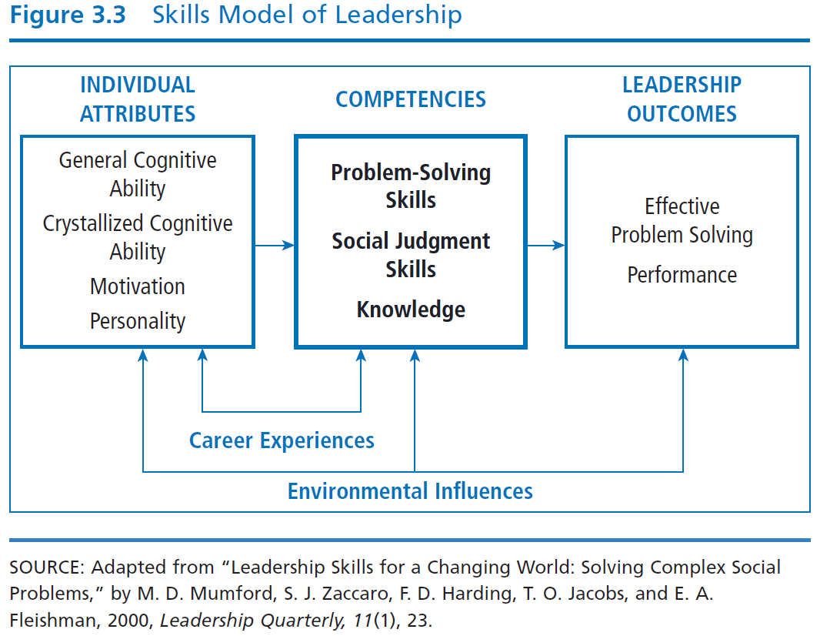

Slide 19
Career Experiences
Challenging
Assignments
Mentoring
Appropriate
Training
Hands-on
Experience with
Novelty
Experience gained during career influences leader’s knowledge and skills to solve complex problems
Leaders learn and develop higher levels of conceptual capacity if they progressively confront more complex and long-term problems as they ascend the organizational hierarchy

Slide 20
Environmental Influences
Factors in a leader’s situation that lie outside of his or her competencies, characteristics, and experiences
  Internal environmental influences--For example, Outdated technology, skill level of employees
  External environmental influences--For example, Economic, political, or social issues; natural disasters

Slide 21
How Does the Skills Approach Work?
Focus of skills approach
Strengths
Criticisms
Application

Slide 22
Skills Approach
Focus
Principal Research Perspectives
Focus is primarily descriptive--it describes leadership from skills perspective
Provides structure for understanding the nature of effective leadership
Katz (1955) suggests importance of particular leadership skills varies depending where leaders reside in management hierarchy
Mumford, Campion, and Morgeson (2007) suggest higher levels of all skills needed at higher levels of hierarchy
Mumford, Zaccaro, and Harding et al. (2000) suggest leadership outcomes are direct result of leader’s skilled competency in problem-solving, social judgment, and knowledge

Slide 23
Strengths
First approach to conceptualize and create a structure of the process of leadership around skills
Describing leadership in terms of skills makes leadership available to everyone
Provides an expansive view of leadership that incorporates wide variety of components (i.e., problem-solving skills, social judgment skills)
Provides a structure consistent with leadership education programs

Slide 24
Criticisms
Breadth of the skills approach appears to extend beyond the boundaries of leadership, making it more general, less precise
Weak in predictive value; does not explain how skills lead to effective leadership performance
Skills model includes individual attributes that are trait-like

Slide 25
Application
The Skills Approach provides a way to delineate the skills of a leader.
It is applicable to leaders at all levels within the organization.
The skills inventory can provide insights into the individual’s leadership competencies.
Test scores allow leaders to learn about areas in which they may wish to seek further training.

