Slide 2
Leader–Member Exchange Theory
Chapter 7

Slide 3
Overview
LMX Theory Description
LMX Theory Perspective
Early Studies
Later Studies
Leadership Making
How Does the LMX Approach Work?

Slide 4
Definition
Leader–member exchange (LMX) theory:
  conceptualizes leadership as a process
    that is centered on the interactions between a leader and followers
Some theories focus on leaders:
  trait approach, skills approach, and behavior approach
Other theories focus on the follower and the context:
  situational leadership, path–goal theory.

Slide 5
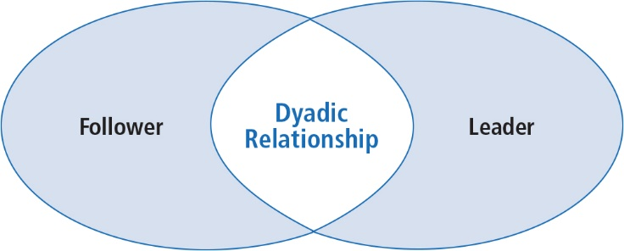
Dimensions of Leadership
LMX theory makes the dyadic relationship between leaders and followers the focal point of the leadership process
Notes:
Figure 7.1: Dimensions of Leadership

Slide 6
LMX Theory Description
Perspective
Development--LMX theory first described by Dansereau, Graen, and Haga (1975); Graen and Cashman (1975); and Graen (1976)
Revisions--Theory has undergone a number of revisions since its inception and continues to be of interest to researchers
Assumption--LMX theory challenges the assumption that leaders treat followers in a collective way, as a group.
  LMX--Directed attention to the differences that might exist between the leader and each of his/her followers

Slide 7
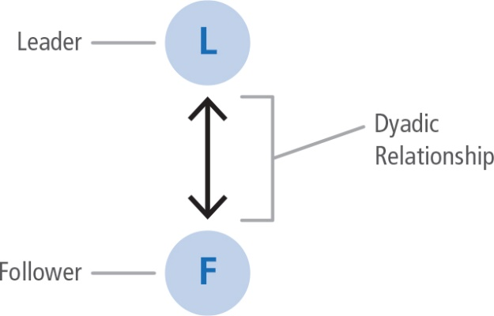
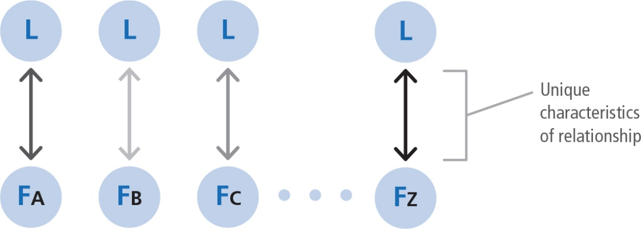
Early Studies
First studies of LMX called--Vertical Dyad Linkage (VDL)
  Focus on the vertical linkages leaders formed with each of their followers
  Leader’s relationship to a work unit viewed as a series of vertical dyads
Notes:
Figure 7.2: The Vertical Dyad
Figure 7.3: Vertical Dyads

Slide 8
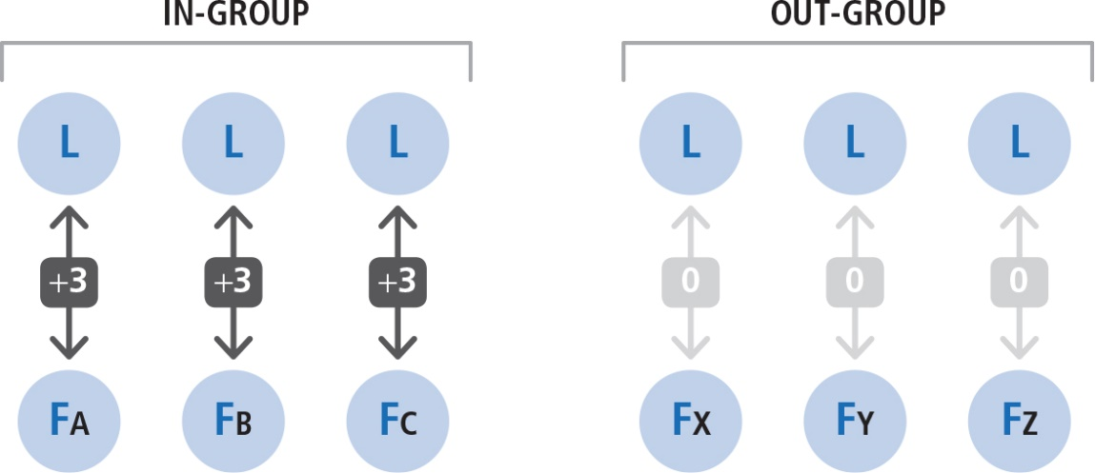
Early Studies
Leader’s work unit as a whole was viewed as a series of vertical dyads; leader forms unique relationship with each follower
Notes:
Figure 7.4: In-Groups and Out-Groups

Slide 9
Early Studies
Researchers found two general types of linkages (or relationships)--those based on
  Expanded/negotiated role responsibilities
  (extra-roles) = in-group
    Relationships marked by mutual trust, respect, liking, and reciprocal influence
    Receive more information, influence, confidence, and concern than out-group members
  Formal employment contract (defined-roles) =
  out-group
    Relationships marked by formal communication based on job descriptions

Slide 10
Early Studies
In-group/out-group status based on how well follower works with the leader and how well the leader works with the follower
How followers involve themselves in expanding their role responsibilities with the leader determines whether they become in-group or out-group participants
Becoming part of the in-group involves follower negotiations in performing activities beyond the formal job description

Slide 11
In-Group and Out-Group Followers
F
In-Group
  more information, influence, confidence, and concern from leader
  more dependable, highly involved, and communicative than out-group
F
F
In-Group
Out-Group
Leader
F
F
F
F
F
F
    Out-Group
    less compatible with leader
    usually just come to work, do the job, and go home
F
F
F
F
F
F
Follower

Slide 12
Later Studies (Graen & Uhl-Bien, 1995)
Initial research primarily addressed differences between in-groups and out-groups; later research addressed how LMX theory was related to organizational effectiveness
Later research focus on the quality of leader–member exchanges resulting in positive outcomes for
  Leaders
  Followers
  Groups
  Organizations in general

Slide 13
Later Studies (Graen & Uhl-Bien, 1995)
Researchers found that high-quality leader–member exchanges resulted in
  Less employee turnover
  More positive performance evaluations
  Higher frequency of promotions
  Greater organizational commitment
  More desirable work assignments
  Better job attitudes
  More attention and support from the leader
  Greater participation
  Faster career progress

Slide 14
Later Studies
Gerstner and Day (1997)
LMX consistently related to member job performance, overall satisfaction, supervisor satisfaction, commitment, role conflict and clarity, turnover intentions.
Support for psychometric properties of LMX Questionnaire
Ilies, Nahrang, and Morgeson (2007)
Meta-analysis of 51 research studies
Positive relationship between LMX quality and citizenship behaviors (discretionary employee behaviors that go beyond the prescribed role, job description, or reward system.

Slide 15
Later Studies
Hill, Kang, and Seo (2014)
Work relationships co-constructed through communication
Greater amount of electronic communication between leaders and followers leads to higher LMX

Slide 16
Leadership Making (Graen & Uhl-Bien, 1995)
A prescriptive approach to leadership that emphasizes that a leader should develop high-quality exchanges with all of her or his followers, rather than just a few.
  Three phases of leadership making which develop over time:
(a) stranger phase
(b) acquaintance phase
(c) mature partnership phase

Slide 17
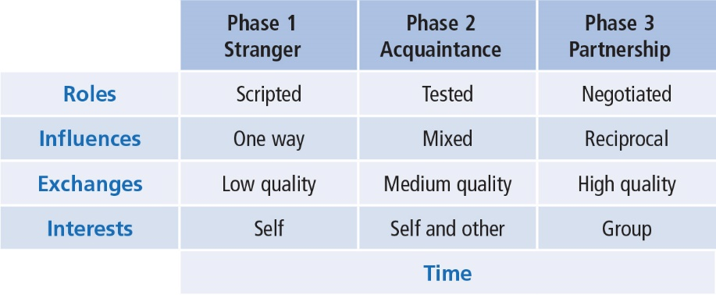
Leadership Making
(Graen & Uhl-Bien, 1995)
Notes:
Table 7.1: Phases in Leadership Making

Slide 18
Leadership Making (Graen & Uhl-Bien, 1995)
Phase 1 Stranger
Interactions within the leader–follower dyad are generally rule bound
Rely on contractual relationships
Relate to each other within prescribed organizational roles
Experience lower quality exchanges
Motives of follower directed toward self-interest rather than good of the group

Slide 19
Leadership Making (Graen & Uhl-Bien, 1995)
Phase 1 continued
How do leaders and followers determine relationship quality?
By leaders using narrative storylines to determine how trustworthy followers are (Kelley, 2014)
By looking at the social interaction between leaders and followers (Sheer, 2014)
By using traditional relationship-building techniques such as conflict management and shared tasks (Madlock & Booth-Butterfield, 2012)

Slide 20
Leadership Making (Graen & Uhl-Bien, 1995)
Phase 2
Acquaintance
Begins with an “offer” by leader/follower for improved career-oriented social exchanges
Testing period for both, assessing whether
  the follower is interested in taking on new roles
  leader is willing to provide new challenges
Shift in dyad from formalized interactions to new ways of relating
Quality of exchanges improves along with greater trust and respect
Less focus on self-interest, more on goals of the group

Slide 21
Leadership Making (Graen & Uhl-Bien, 1995)
Phase 3
Mature Partnership
Marked by high-quality leader–member exchanges
Experience high degree of mutual trust, respect, and obligation toward each other
Tested relationship and found it dependable
High degree of reciprocity between leaders and subordinates
May depend on each other for favors and special assistance
Highly developed patterns of relating that produce positive
Outcomes for both themselves and the organization
Partnerships are transformational--moving beyond self-interest to accomplish greater good of the team and organization

Slide 22
How Does the LMX Theory Approach Work?
Focus of LMX theory
Strengths
Criticisms
Application

Slide 23
How Does LMX Theory Work?
LMX theory works in two ways: It describes leadership and it prescribes leadership
  In both, the central concept is the dyadic relationship
Descriptively:
It suggests that it is important to recognize the existence of in-groups and out-groups within an organization
Significant differences in how goals are accomplished using in-groups versus out-groups
Relevant differences in in-group versus out-group behaviors

Slide 24
How Does LMX Theory Work?
Prescriptively:
Best understood within the Leadership–Making Model
(Graen & Uhl-Bien, 1995)
  Leader forms special relationships with all followers
  Leader should offer each follower an opportunity for new roles/responsibilities
  Leader should nurture high-quality exchanges with all followers
  Rather than concentrating on differences, leader focuses on ways to build trust and respect with all followers, resulting in entire work group becoming an in-group

Slide 25
Strengths
LMX theory validates our experience of how people within organizations relate to one another and the leader.
LMX theory is the only leadership approach that makes the dyadic relationship the centerpiece of the leadership process.
LMX theory directs our attention to the importance of communication in leadership.
Solid research foundation on how the practice of LMX theory is related to positive organizational outcomes.

Slide 26
Criticisms
Inadvertently supports the development of privileged groups in the workplace; appears unfair and discriminatory.
The basic theoretical ideas of LMX are not fully developed.
  How are high-quality leader–member exchanges created?
  What are the means to achieve building trust, respect, and obligation? What are the guidelines?
Because of various scales and levels of analysis, measurement of leader–member exchanges is being questioned.

Slide 27
Application
Applicable to all levels of management and different types of organizations
Directs managers to assess their leadership from a relationship perspective
Sensitizes managers to how in-groups and out-groups develop within their work units
Can be used to explain how CEOs strategically develop special relationships with select individuals in upper management
Can be used to explain how individuals create leadership networks at various levels throughout an organization
Can be applied in different types of organizations--volunteer, business, education, and government settings

