Slide 2
Transformational Leadership
Chapter 8

Slide 3
Overview
Transformational Leadership (TL) Perspective
A Model of Transformational Leadership
Transformational Leadership Factors
Full Range of Leadership Model
The Additive Effects of TL
Other Transformational Leadership Perspectives
How Does the Transformational Approach Work?

Slide 4
Transformational Leadership
Description
Process--TL is a process that changes and transforms individuals, both leaders and followers.
Influence--TL involves an exceptional form of influence that moves followers to accomplish more than what is usually expected.
Core elements--TL is concerned with emotions, values, ethics, standards, and long-term goals.
Encompassing approach--TL describes a wide range of leadership influence where followers and leaders are bound together in the transformation process.

Slide 5
Types of Leadership Defined (Burns, 1978)
TRANSACTIONAL
PSEUDO-TRANSFORMATIONAL
Focuses on the
exchanges
that occur
between leaders
and their followers
Focuses on the
leader’s
own interests rather than the interests of his or her followers
TRANSFORMATIONAL
Process of
engaging with others
to create a connection that increases
motivation and morality in both the leader and the follower

Slide 6
Types of Leadership Defined
(Burns, 1978)
No new taxes = votes
Turn in assignments = grade
Surpass goals = promotion
The exchange dimension is so common that you can observe it at all walks of life.
Focuses on the
exchanges
that occur
between leaders
and their followers
TRANSACTIONAL

Slide 7
Types of Leadership Defined
(Burns, 1978)
Leaders who are
  transforming but in a negative way
  self-consumed, exploitive; power- oriented, with warped moral values
Includes leaders like
  Adolph Hitler
  Saddam Hussein
Focuses on the
leader’s
own interests rather than the interests of his or her followers
PSEUDOTRANSFORMATIONAL

Slide 8
Pseudotransformational
(Christie, Barling, & Turner, 2011)
Four experimental studies => model of pseudotransformational leadership
  Self-serving
  Unwilling to encourage independent thought in followers
  Exhibits little general caring for others
  Uses inspiration and appeal to manipulate followers for his or her own ends

Slide 9
Types of Leadership Defined Burns (1978)
Leader is attentive to the needs and motives of followers and tries to help followers reach their fullest potential.
Mohandas Gandhi raised the hopes and demands of millions of his people and in the process was changed himself.
Ryan White raised people’s awareness about AIDS.
Process of
engaging with others
to create a connection
that increases
motivation
and morality in both the
leader and the follower
TRANSFORMATIONAL

Slide 10
Transformational Leadership and Charisma
Definition
Charisma--A special personality characteristic that gives a person superhuman or exceptional powers and is reserved for a few, is of divine origin, and results in the person being treated as a leader (Weber, 1947).
Charismatic Leadership Theory (House, 1976)
  Charismatic leaders act in unique ways that have specific charismatic effects on their followers.

Slide 11
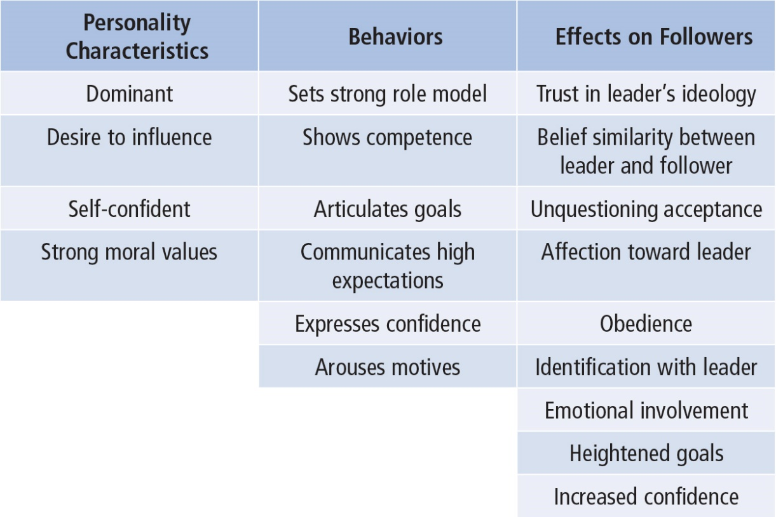
Theory of Charismatic Leadership
(House, 1976)
Notes:
Table 8.1: Personality Characteristics, Behaviors, and Effects on Followers of Charismatic Leadership

Slide 12
Theory of Charismatic Leadership
(Shamir, House, & Arthur, 1993)
Later Studies
Charismatic Leadership:
  Transforms follower’s self-concepts; tries to link identity of followers to collective identity of the organization
    Forge this link by emphasizing intrinsic rewards and de-emphasizing extrinsic rewards
    Throughout process, leaders
      express high expectations for followers
      help followers gain sense of self-confidence and self-efficacy

Slide 13
Model of Transformational Leadership (Bass, 1985)
  Expanded and refined version of work done by Burns and House. It included
    More attention to followers’ rather than leader’s needs
    Suggested TL could apply to outcomes that were not positive
    Described transactional and transformational leadership as a continuum
  Extended House’s work by
    Giving more attention to emotional elements and origins of charisma
    Suggested charisma is a necessary but not sufficient condition for TL

Slide 14

Model of Transformational Leadership
TL motivates followers beyond the expected by
raising consciousness about the value and importance of specific and idealized goals
transcending self-interest for the good of the team or organization
addressing higher level needs
Notes:
Figure 8.1: Leadership Continuum From Transformational to Laissez-Faire Leadership

Slide 15
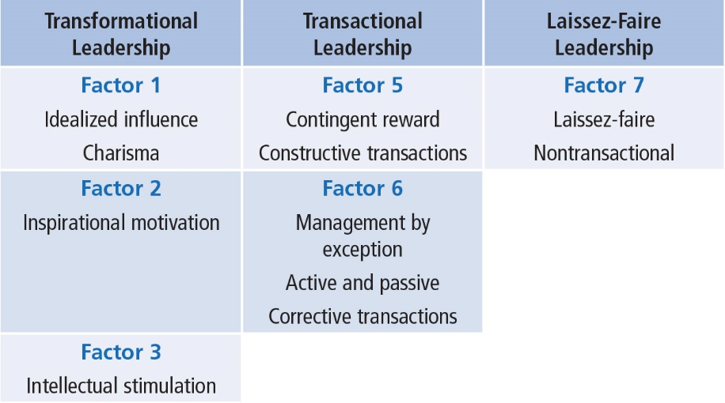
Transformational Leadership Factors
Notes:
Table 8.2: Leadership Factors

Slide 16
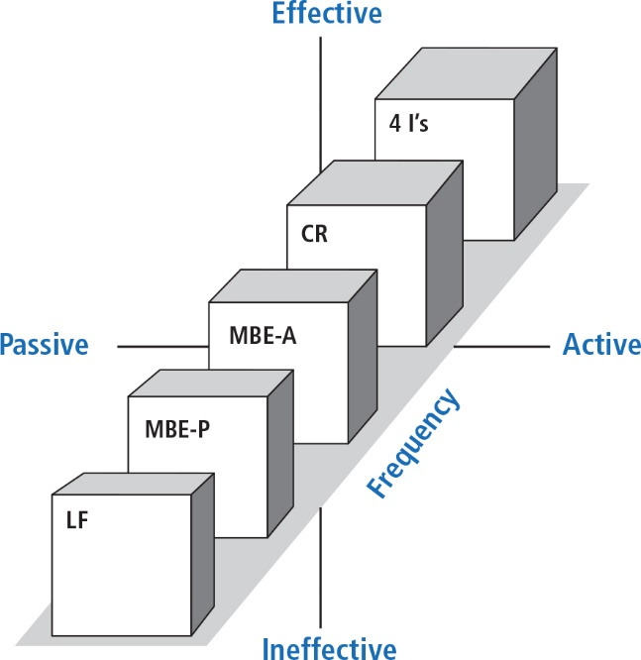
Full Range of Leadership Model
Notes:
Figure 8.2: Full Range of Leadership Model with Legend

Slide 17
Transformational Leadership Factors: The 4 Is
Idealized Influence
  Acting as strong role models
  High standards of moral and ethical conduct
  Making others want to follow the leader’s vision
Inspirational Motivation
  Communicating high expectations
  Inspiring followers to commitment and engagement in shared vision
  Using symbols and emotional appeals to focus group members to achieve more than self-interest

Slide 18
Transformational Leadership Factors: The 4 Is
Intellectual Stimulation
  Stimulating followers to be creative and innovative
  Challenging their own beliefs and valuing those of leader and organization
  Supporting followers to
  Try new approaches
  Develop innovative ways of dealing with organization issues
Individualized Consideration
  Listening carefully to the needs of followers
  Acting as coaches to assist followers in becoming fully actualized
  Helping followers grow through personal challenges
  For example, showing optimism helps employees become more engaged in their work (Tims et al., 2011)

Slide 19
The Additive Effect of Transformational Leadership
Augments impact on employee’s performance and company profit (Rowald & Heinitz, 2007)
Positively related to job satisfaction and performance (Nemanich & Keller, 2007)
Boosts employee engagement and optimism (Tims, et. al., 2011)
TL leaders more likely to promote employee’s achieving their mastery goals (Hamstra, et.al.,2014)

Slide 20
Transactional Leadership Factors
Contingent Reward
The exchange process between leaders and followers in which effort by followers is exchanged for specified rewards
For example, how much TV a child can watch after practicing piano.
Management-by-Exception
Leadership that involves corrective criticism, negative feedback, and negative reinforcement
  Two forms
    Active--Watches follower closely to identify mistakes/rule violations
    Passive--Intervenes only after standards have not been met or problems have arisen

Slide 21
Nonleadership Factor
Laissez-Faire
The Absence of Leadership
A hands-off, let-things-ride approach
Refers to a leader who
  abdicates responsibility,
  delays decisions,
  gives no feedback, and
  makes little effort to help followers satisfy their needs.
May also be a strategic choice by leader to acknowledge subordinates’ abilities

Slide 22
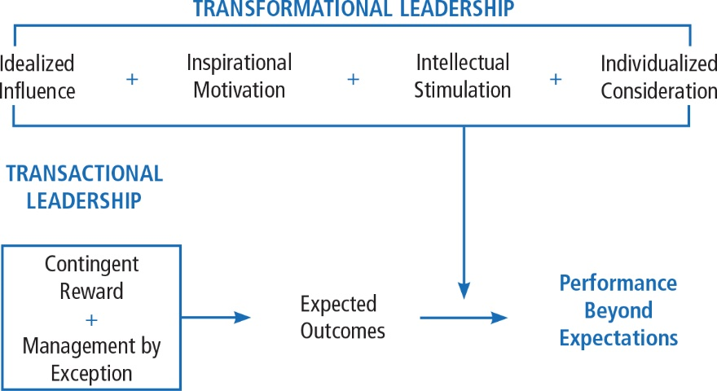
Individualized Consideration
Notes:
Figure 8.3: The Additive Effect of Transformational Leadership

Slide 23
Bennis and Nanus (1985)
Four Leader Strategies in Transforming Organizations
Clear vision of organization’s future state
TL’s social architect of organization
Create trust by making their position known and standing by it
Creatively deploy themselves through positive self-regard

Slide 24
Kouzes and Pozner (1987, 2002)
Model consists of five fundamental practices
Model the Way
Inspire a Shared Vision
Challenge the Process
Enable Others to Act
Encourage the Heart

Slide 25
How Does the Transformational Leadership Approach Work?
Focus of Transformational Leadership
Strengths
Criticisms
Application

Slide 26
Transformational Leadership
Overall Scope
Describes how leaders can initiate, develop, and carry out significant changes in organizations
Focus of Transformational
Leaders
TLs empower and nurture followers
TLs stimulate change by becoming strong role models for followers
TLs commonly create a vision
TLs require leaders to become social architects
TLs build trust and foster collaboration

Slide 27
Strengths
Broadly researched. TL has been widely researched, including a large body of qualitative research centering on prominent leaders and CEOs in major firms.
Intuitive appeal. People are attracted to TL because it makes sense to them.
Process focused. TL treats leadership as a process occurring between followers and leaders.
Expansive leadership view. TL provides a broader view of leadership that augments other leadership models. Contributes to leader’s growth.
Emphasizes followers. TL emphasizes followers’ needs, values, and morals.
Effectiveness. Evidence supports that TL is an effective form of leadership.

Slide 28
Criticisms
Lacks conceptual clarity
  Dimensions are not clearly delimited
  Parameters of TL overlap with similar conceptualizations of leadership
  Unclear whether dimensions are simply descriptions of TL
Measurement questioned
  Validity of MLQ not fully established
  Some transformational factors are not unique solely to the transformational model
TL treats leadership more as a personality trait or predisposition than a behavior that can be taught
No causal link shown between transformational leaders and changes in followers or organizations
TL is elitist and antidemocratic
Suffers from heroic leadership bias
Has the potential to be abused
May not be well-received by millennials

Slide 29
Application
Provides a general way of thinking about leadership that stresses ideals, inspiration, innovations, and individual concerns
Can be taught to individuals at all levels of the organization
Able to positively impact a firm’s performance
May be used as a tool in recruitment, selection, promotion, and training development
Can be used to improve team development, decision-making groups, quality initiatives, and reorganizations
The MLQ and Sosik and Jung (2010) guide help leaders to target areas of leadership improvement

