Slide 2
Servant Leadership
Chapter 10

Slide 3
Overview
Servant Leadership Description
Servant Leadership Defined
Historical Basis of Servant Leadership
Ten Characteristics of Servant Leadership
Building a Theory About Servant Leadership

Slide 4
Overview
Building a Model of Servant Leadership
How Does Servant Leadership Work?
Strengths and Criticisms
Application

Slide 5
Servant Leadership Description
Servant Leadership--is a paradox: both service and influence
Interest in Servant Leadership
  Most scholarship has been prescriptive, until recently
  Past 10 years have clarified the concept and its assumptions
  Focuses on leadership from the point of view of the leader and his/her behaviors
  Servant leaders put followers first

Slide 6
Servant Leadership Defined
Greenleaf Definition:
  “Servant leadership begins with the natural feeling that one wants to serve, to serve first. Then conscious choice brings one to aspire to lead. . . . The difference manifests itself in the care taken by the servant--first to make sure that other people’s highest priority needs are being served. The best test . . . is: do those served grow as persons; do they, while being served, become healthier, wiser, freer, more autonomous, more likely themselves to become a servant? And, what is the effect on the least privileged in society; will they benefit, or, at least, will they not be further deprived?”
  Sometimes treated as a trait, but viewed as a behavior in this chapter

Slide 7
Historical Basis of Servant Leadership
Greenleaf Center for Servant Leadership
  Advocating for building consensus in groups rather than using coercive leadership
  Inspired by Hesse’s novel, Journey to the East, where the travelers discovered the true leader of their group was the servant
  Leaders have a social responsibility for the “have-nots”
  Leaders shift authority to those who are being led

Slide 8
10 Characteristics of a Servant Leader (Spears, 2002)
Listening--acknowledging the viewpoint of followers and validating these perspectives.
Empathy--“standing in the shoes” of another person and attempting to see the world from that person’s point of view.
Healing--in helping followers become whole, servant leaders are themselves healed.
Awareness--understanding oneself and the impact one has on others.

Slide 9
10 Characteristics of a Servant Leader (Spears, 2002)
5. Persuasion--creates change through gentle, nonjudgmental argument.
6. Conceptualization--the ability to be a visionary for an organization.
7. Foresight--the ability to predict what is coming based on what is occurring in the present and what has happened in the past.

Slide 10
10 Characteristics of a Servant Leader (Spears, 2002)
8. Stewardship--carefully managing the people and organization one has been given to lead. Holding the organization in trust for the greater good of society.
9. Commitment to the Growth of People--treating each follower as a unique person with intrinsic value beyond what he/she contributes to the organization.
10. Building Community--allowing followers to identify with something greater than themselves that they value.

Slide 11
Building a Theory about Servant Leadership
Greenleaf’s leadership approach--loosely defined characteristics and normative principles
Servant leadership adopted as guiding philosophy in many organizations
Recent models of SL developed using multiple variables
  Russell and Stone (2002)
  Patterson (2003)
  Coetzer et al. (2017)

Slide 12
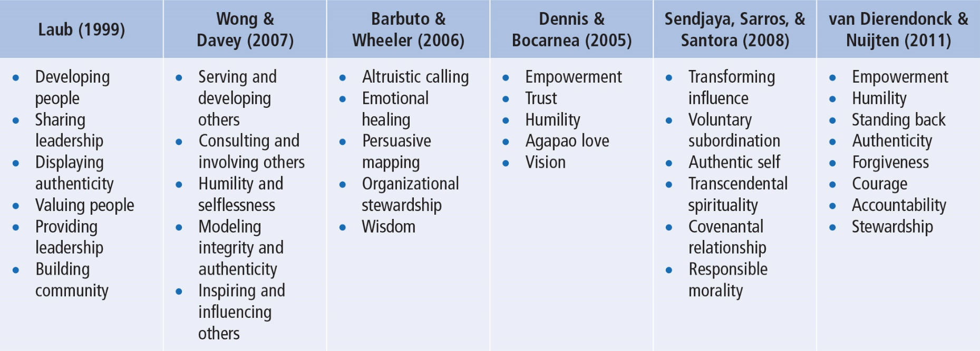
Building a Theory About Servant Leadership
Notes:
Table 10.1: Key Characteristics of Servant Leadership

Slide 13
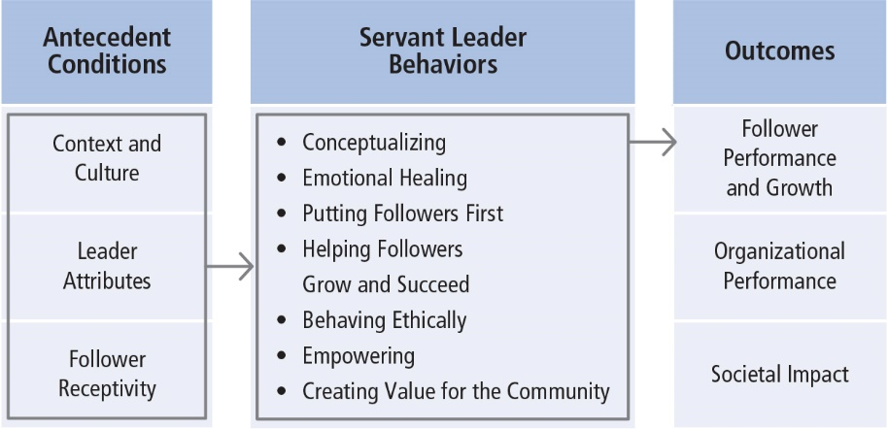
Building a Theory About Servant Leadership
Notes:
Figure 10.1: Model of Servant Leadership

Slide 14
Model of Servant Leadership
(Liden et al., 2008)
Antecedent Conditions (3)
  Context and culture
    Organizational context
    Dimensions of culture (e.g., power distance)
  Leader attributes
    Traits interact with ability to engage in servant leadership (moral development, emotional intelligence, agreeableness, humility)
  Follower receptivity
    Some subordinates do not want to work with servant leaders
    When matched with followers who desire it, servant leadership has a positive impact on performance and organizational citizenship behavior

Slide 15
Model of Servant Leadership
(Liden et al., 2008)
Servant Leader Behaviors (7)
  Conceptualizing
    Thorough understanding of the organization
    For example, senior nursing supervisor in emergency room
  Emotional healing
    Recognizing others’ problems and taking the time to address them
    For example, Hospice priest on Chicago’s south side
  Putting followers first
    For example, widely published health education professor

Slide 16
Model of Servant Leadership
(Liden et al., 2008)
  Helping followers grow and succeed
    Knowing followers’ professional or personal goals
    For example, high school music teacher
  Behaving ethically
    Doing the right thing in the right way
    For example, CEO and leaked document from rival company
  Empowering
    Allowing followers the freedom to be independent, make decisions on their own, and be self-sufficient
    For example, college professor with TAs

Slide 17
Model of Servant Leadership
(Liden et al., 2008)
  Creating value for the community
    Intentionally giving back to the community
    Encouraging followers to volunteer for community service
    For example, principal of alternative high school

Slide 18
Model of Servant Leadership
(Liden et al., 2008)
Outcomes (3)
  Follower performance and growth
    Recognizing followers’ contributions and helping them realize their human potential
    Favorable impact on subordinate in-role performance (identification with organization, adaptability, proactivity, service climate, reduced turnover, organizational citizenship)
    Followers themselves may become servant leaders
  Organizational performance
    Positive relationship between servant leadership and OCB
    Team effectiveness enhanced by increasing members’ shared confidence that they could be effective
  Societal impact
    For example, Mother Teresa and Sisters of Charity
    For example, Southwest Airlines

Slide 19
How Does SL Work?
SL is different from many other leadership theories.
It is concerned with putting followers first and the outcomes that are likely to emerge.
SL works best when leaders are altruistic and have a strong motivation to help others.
It is important for followers to be receptive to this style of leadership.
SL results in community and societal change.

Slide 20
Strengths
Makes altruism the central component of the leadership process.
Provides a counterintuitive approach to the use of influence. Leaders should share control.
SL is not a panacea. It may not be effective when subordinates are not open to being guided, supported, and empowered.
Research has resulted in a sound measure of SL--the SLQ.

Slide 21
Criticisms
Because the name appears contradictory, SL may be seen as whimsical, or not really “leadership.”
Researchers are unable to reach consensus on a common definition or theoretical framework for SL.
The prescriptive overtone suggests that good leaders “put others first,” which conflicts with other principles of leadership such as directing, concern for production, and so on. It can also sound moralistic, which may deter some researchers.
Conceptualizing is not unique to servant leaders. It is unclear why it is included in this model.

Slide 22
Application
SL can be applied at all levels of management and in all types of organizations.
SL has been used extensively in a variety of organizations for more than 30 years.
Organizations should be careful to select employees who (a) are interested in building long-term relationships with followers and (b) have strong ethics.
SL is taught at many colleges and universities and is used by numerous independent coaches, trainers, and consultants.

