Slide 2
Team Leadership
Chapter 14

Slide 3
Overview
Team Leadership Perspective
Team Leadership Model
Team Effectiveness
Leadership Decisions
Leadership Actions
How Does the Team Leadership Model Work?

Slide 4
Descriptions and Perspectives
Team = Group of organizational members who are interdependent, share common goals, and coordinate activities to accomplish those goals
  Can meet face-to-face or be virtual
  Team-based and technology-enabled can use best talent, facilitate collaboration, and reduce travel costs
  But virtual teams are also challenged by separations of time, distance, and culture
  Decisions and scheduling may take more time

Slide 5
Outcomes of Effective Teams
  Greater productivity
  More effective use of resources
  Better decisions and problem-solving
  Better-quality products and services
  Greater innovation and creativity (Parker, 1990)

Slide 6
Descriptions and Perspectives
Organizational culture needs to support employee involvement
  Heterarchy: fluid power shifting in teams
Team leadership is process oriented
  How do teams develop critical capabilities?
  How do team leaders adjust to contingencies as they arise?
  How do leader actions promote task and interpersonal development?
Shared or Distributed Leadership
  When members of the team take on leadership behaviors to influence the team and maximize team effectiveness
  Shared team leadership improves effectiveness of virtual teams

Slide 7
Team Leadership Model
Model provides leader or designated team member with a mental model to help
  Diagnose team problems, and
  Take appropriate action to correct team problems
Effective team performance begins with leader’s mental model of the situation
Mental model reflects
  Components of the problem
  Environmental and organizational contingencies

Slide 8
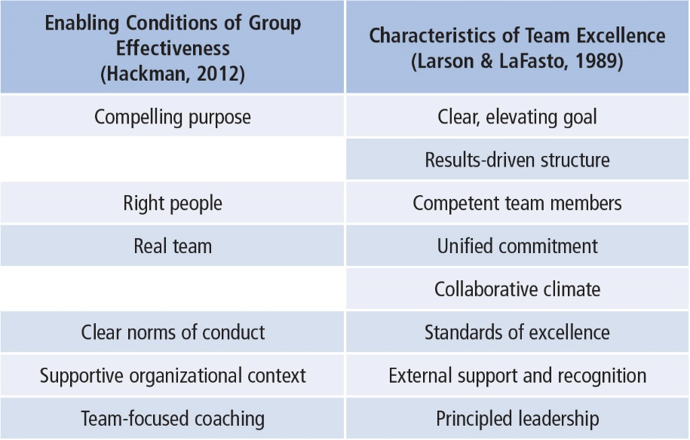
Team Effectiveness
Notes:
Table 14.1: Comparison of Theory and Research Criteria of Team Effectiveness

Slide 9
Team Effectiveness
Clear, Elevating Goal
  Clear so that one can tell whether performance objective has been met
  Motivating or involving so that members believe it is worthwhile and important
Results-Driven Structure
  Need to find the best structure to achieve goals
    Clear team member roles
    Good communication system
    Methods to assess individual performance
    An emphasis on fact-based judgments

Slide 10
Team Effectiveness
Core Competencies
    Ability to do the job well
    Problem-solving ability

Slide 11
Team Effectiveness
Competent Team Members
    Components
      Right number and mix of members
      Members must be provided
        Sufficient information
        Education and training
      Requisite technical skills
      Interpersonal and teamwork skills
    Team Factors
      Openness
      Supportiveness
      Action orientation
      Positive personal style

Slide 12
Team Effectiveness
Unified Commitment
Teams need a carefully designed and developed sense of unity or identification (team spirit)
Collaborative Climate
Trust based on openness, honesty, consistency, and respect
Integration of individual actions
Teams contribute to collective success by
    Coordinating individual contributions
    Team leaders making communication safe
    Team leaders demanding and rewarding collaborative behavior
    Team leaders guiding the team’s problem-solving efforts
    Team leaders managing their own control needs

Slide 13
Team Effectiveness
Standards of Excellence
  Regulated Performance
      Facilitates task completion and coordinated action
      Stimulates a positive pressure for members to perform at highest levels
  How Accomplished
      Requiring results (clear expectations)
      Reviewing results (feedback/resolve issues)
      Rewarding results (acknowledge superior performance)

Slide 14
Team Effectiveness
External Support and Recognition
  Regulated Performance
  Teams supported by external resources are
        Given the material resources needed to do their jobs
        Recognized for team accomplishments
        Rewarded by tying those rewards to team members’ performance, not individual achievement

Slide 15
Team Effectiveness
Principled Leadership influences team effectiveness through four sets of processes (Zaccaro et al., 2001)
    Cognitive--Facilitates team’s understanding of problems confronting them
    Motivational--Helps team become cohesive and capable by setting high performance standards and helping team to achieve them
    Affective--Assists team in handling stressful circumstances by providing clear goals, assignments, and strategies
    Integrative--Helps coordinate team’s activities through matching member roles, clear performance strategies, feedback, and adapting to environmental changes

Slide 16
Leadership Decision 1
Should I Monitor the Team or Take Action?
Leaders can
  Diagnose, analyze, or forecast problems (monitoring) or take immediate action to solve a problem
  Focus on problems within the group (internal) or which problems need intervention
  Make choices about which solutions are the most appropriate
Effective leaders have the ability to determine what interventions are needed, if any, to solve team problems
All members of the team can engage in monitoring
Leaders differ in timing of taking action

Slide 17
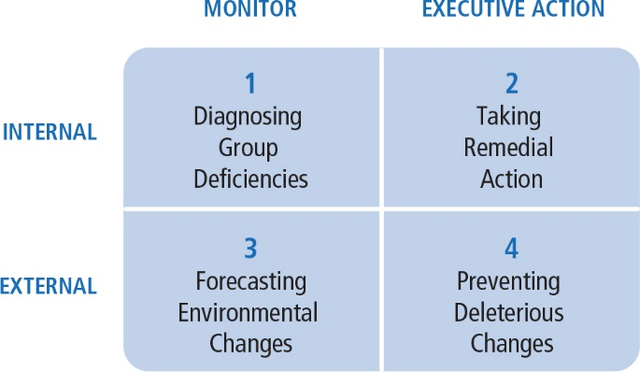
Leadership Decisions
Notes:
Figure 14.2: McGrath’s Critical Leadership Functions

Slide 18
Leadership Decision 2
Should I Intervene to Meet Task or Relational Needs?
Task
Getting job done
Making decisions
Solving problems
Adapting to change
Making plans
Achieving goals
Maintenance Functions
Developing positive climate
Solving interpersonal problems
Satisfying members’ needs
Developing cohesion
Even more challenging in virtual teams

Slide 19
Leadership Decision 2
Should I Intervene to Meet Task or Relational Needs?
Special challenges of virtual teams
  Leaders should begin with face-to-face meetings to facilitate trust
  Hold regular, organized team meetings
  Not be too task focused
  Work to develop relationships among team members
  Know which technologies are best suited for which task

Slide 20
Leadership Decision 3
Should I Intervene Internally or Externally?
Leader must
  Determine what level of team process needs leadership attention:
  Use internal task or relational team dynamics, if
    Conflict between group members
    Team goals unclear
  Use external environmental dynamics, if
    Organization not providing proper support to team

Slide 21
Leadership Actions
Leadership Functions--performed internally or externally
Internal Leadership Actions
External Leadership Actions
Task
Goal focusing
Structuring for results
Facilitating decision making
Training
Maintaining standards
Relational
Coaching
Collaborating
Managing conflict
Building commitment
Satisfying needs
Modeling principles
Environmental
Networking
Advocating
Negotiating support
Buffering
Assessing
Sharing information

Slide 22
Internal Task Leadership Actions
Set of skills or actions leader might perform to improve task performance:
  Goal focusing (clarifying, gaining agreement)
  Structuring for results (planning, visioning, organizing, clarifying roles, delegating)
  Facilitating decision making (informing, controlling, coordinating, mediating, synthesizing, issue focusing)
  Training team members in task skills (educating, developing)
  Maintaining standards of excellence (assessing team and individual performance, confronting inadequate performance)

Slide 23
Internal Relational Leadership Actions
Set of actions leader needs to implement to improve team relationships:
  Coaching team members in interpersonal skills
  Collaborating (including, involving)
  Managing conflict and power issues (avoiding confrontation, questioning ideas)
  Building commitment and esprit de corps (being optimistic, innovating, envisioning, socializing, rewarding, recognizing)
  Satisfying individual member needs (trusting, supporting, advocating)
  Modeling ethical and principled practices (fair, consistent, normative)

Slide 24
External Environmental Leadership Actions
Set of skills or behaviors leader needs to implement to improve environmental interface with team:
  Networking and forming alliances in environment (gather information, increase influence)
  Advocating and representing team to environment
  Negotiating upward to secure necessary resources, support, and recognition for team
  Buffering team members from environmental distractions
  Assessing environmental indicators of team’s effectiveness (surveys, evaluations, performance indicators)
  Sharing relevant environmental information with team

Slide 25
How Does the Team Leadership Approach Work?
Focus of team leadership
Strengths
Criticisms
Application

Slide 26
Team Leadership
Model provides a cognitive map to identify group needs and offers suggestions on appropriate corrective actions.
Model assists leader in making sense of the complexity of groups and provides suggested actions to improve group effectiveness.

Slide 27
Strengths
Focus on real-life organizational group work; model is useful for teaching
Provides a cognitive guide that assists leaders in designing and maintaining effective teams
Recognizes the changing role of leaders and followers in organizations
Can be used as a tool in group leader selection

Slide 28
Criticisms
Model is incomplete. Additional skills might be needed
May not be practical as the model is complex and doesn’t provide easy answers for difficult leader decisions
Fails to consider teams that have distributed leadership, where team members have a range of skills, and where roles may change
More focus required on how to teach and provide skill development in areas of diagnosis and action taking

Slide 29
Application
Useful in leader decision-making
Can be used as a team diagnostic tool

