Slide 2
Gender and Leadership
Chapter 15

Slide 3
Overview
Women and Leadership Perspective
The Glass Ceiling Turned Labyrinth
Evidence of the Leadership Labyrinth
Understanding the Labyrinth
Gender Differences in Leadership Styles and Effectiveness
Navigating the Labyrinth

Slide 4
Gender and Leadership Approach Description
Historical View
Gender and leadership
  Researchers ignored issues related to gender and leadership until the 1970s
  Scholars started by asking “Can women lead?”
  Changed by women in leadership
    Presence of women in corporate and political leadership
    Highly effective female leaders--PepsiCo’s CEO, GM’s CEO, General Ann Dunwoody, and so on.

Slide 5
Gender and Leadership Approach Description
    Historical View
    Current research primary questions
      Do men and women lead differently?
      Are men more effective leaders than women?
      Why are women underrepresented in elite leadership roles?

Slide 6
The Glass Ceiling Turned Labyrinth
Women
    Currently outnumber men in higher education--57% of bachelor’s degrees, 60% of master’s degrees, more than 50% of doctorates, nearly half of professional degrees (Catalyst, 2017).
    Make up nearly half of the U.S. labor force--47%
    Still are underrepresented in upper echelons of America’s corporations and political system

Slide 7
The Glass Ceiling Turned Labyrinth
Women
  Represent only 5.4% of Fortune 500 CEOs (Brown, 2017)
  Hold only 20.2% of Fortune 500 board seats (Catalyst, 2017)

Slide 8
The Glass Ceiling Turned Labyrinth
Women in Politics
  105 of the 535 seats in the U.S. Congress = 19.6%
  21%: Senate; 19.3%: House of Representatives
  Women of color occupy just 38 seats (Center for Women and Politics, 2017a,b)
  World average of women’s representation in national legislatures or parliaments is 23.3%. The United States is ranked 101st out of 193 countries (Inter-Parliamentary Union, 2017).
  High-ranking U.S. women military officers = 6.9% (U.S. Dept. of Defense, 2014)

Slide 9
The Gender Gap in Leadership
Global phenomenon whereby women are disproportionately concentrated in lower level and lower authority leadership positions than men. (Powell & Graves, 2003)
Three types of explanations

Slide 10
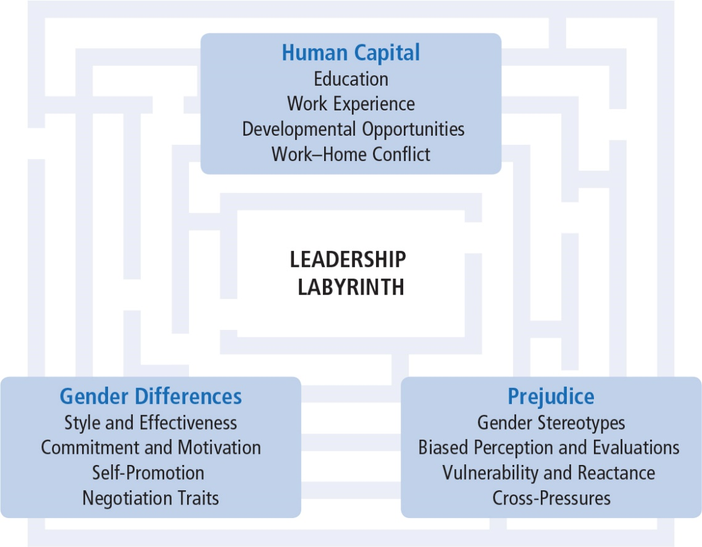
Understanding the Labyrinth
Notes:
Figure 15.1: Understanding the Leadership Labyrinth

Slide 11
Understanding the Labyrinth
Human Capital Differences
  Pipeline Problem--Women have less education, training, and work experience than men resulting in a dearth of qualified women.
  Pipeline is not empty but leaking--Explanation that women haven’t been in managerial positions long enough for natural career progression to occur (Heilman, 1997); not supported by research.
  Domestic division of labor--Explanation that women self-select out of leadership tracks by choosing “mommy track” positions that do not funnel into leadership positions (Belkin, 2003; Ehrlich, 1989; Wadman, 1992); not supported by research (Eagly & Carli, 2004).

Slide 12
Understanding the Labyrinth
Women
  do have somewhat less work experience and continuity than men, largely due to disproportionate responsibility women assume for child rearing and domestic duties
  respond to work-home conflicts by not marrying, not having children, becoming “superwomen,” taking leaves of absence or working part time
  who use flextime and workplace leave are often marginalized; taking time off from a career makes reentry difficult (Williams, 2010)

Slide 13
Understanding the Labyrinth
Women
    occupy more than half of all management and professional positions (Catalyst, 2017) but have fewer developmental opportunities
    Have fewer responsibilities in the same jobs as men
    are less likely to receive encouragement, be included in key networks, and receive formal job training than their male counterparts
    confront greater barriers to establishing informal mentor relationships
    are more likely to be put in precarious leadership situations associated with greater risk and criticism

Slide 14
Understanding the Labyrinth
Gender Differences in Leadership Styles and Effectiveness
  Gender = social meaning ascribed to biological sex categories
  Differences between men and women often assumed to be natural consequence of innate differences
  Contrary to stereotypical expectations, women leaders aren’t less task oriented or more interpersonal than men leaders.
  Women do lead in a more participative manner than men.
  Adaptive style because women are devalued when they lead in a masculine manner, occupy a typically masculine role, or when evaluators are male.

Slide 15
Understanding the Labyrinth
Transformational leadership
  Women’s styles tend to be more transformational than men’s.
  Even as transformational leaders, they are valued less than men.
  Women engage in more contingent behavior than men.
  Women tend to emphasize social values that promote others’ welfare to a greater extent than men.

Slide 16
Effectiveness of Male and Female Leaders
Men and women equally effective overall
Men and women more effective in roles congruent with their gender
Women less effective than men when role is masculinized (military), when supervising large numbers of men, or when rated by men
Somewhat more effective in education, government, social service; substantially more effective in middle management

Slide 17
Commitment to Employment and Motivation to Lead
Men and women show same level of identification and commitment to paid employment roles.
Men and women both view roles as workers as secondary to partner and parent roles.
Women less likely to promote themselves for leadership positions.
Women less likely to emerge as group leaders; more likely to serve as social facilitators.
Men place more importance on power-related goals, associate power with less negative outcomes, and are more likely to take advantage of opportunities for professional advancement.
Men more likely to ask for what they want; women less likely to negotiate or self-promote and receive more backlash when they do.

Slide 18
Understanding the Labyrinth
Prejudice
  gender bias stemming from stereotyped expectations--“women take care and men take charge”
Stereotypes = cognitive shortcuts that influence the way people process information regarding groups and group members.
Gender stereotypes include beliefs about the attributes of men and women and prescribe how men and women ought to be.

Slide 19
Understanding the Labyrinth
Gender Stereotypes
  Pervasive, well documented, and highly resistant to change (Dodge, Gilroy, & Fenzel, 1995; Heilman, 2001)
  Men are stereotyped with agentic characteristics
    confidence, assertiveness, independence, rationality, and decisiveness
  Women are stereotyped with communal characteristics
    concern for others, sensitivity, warmth, helpfulness, and nurturance (Deaux & Kite, 1993; Heilman, 2001)

Slide 20
Understanding the Labyrinth
Gender stereotypes explain numerous findings:
  Women facing cross-pressures to be tough but not too “manly”
  Greater difficulty for women to be viewed as effective in top leadership roles (Eagly & Karau, 2002)
  Penalties for women who violate gender stereotypes (for example, Price Waterhouse vs. Ann Hopkins; media coverage of 2008 Hillary Clinton presidential run)
  Decision-makers influenced by homosocial reproduction, a tendency for a group to reproduce itself in its own image (for example, Male leaders choosing male successors)
  People high in social dominance orientation show stronger preference for leaders who are White and male (Hoyt & Simon, 2016)

Slide 21
Understanding the Labyrinth
How Stereotypes Affect Women Themselves
Pressure of tokenism (Kanter, 1977) and being scrutinized.
Women may assimilate to stereotype OR may counter the stereotype. Depends on
  leader’s self-efficacy
  explicitness of the stereotype
  type of task
  gender composition of the group
  power of the leader
  whether stereotype threats are combined

Slide 22
Understanding the Labyrinth
Intersectionality = People who have multiple identities (gender, ethnicity, sexual orientation, etc.)
  Have different leadership experiences
  Black women may experience bias in leadership positions differently than White women or Black men; sometimes advantaged; sometimes disadvantaged

Slide 23
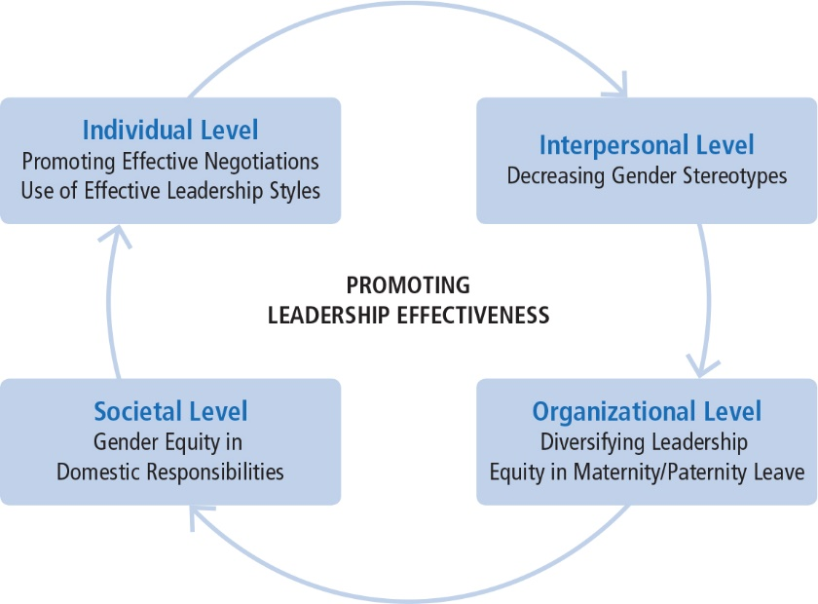
Navigating the Labyrinth
Notes:
Figure 15.2: Leadership Effectiveness

Slide 24
Navigating the Labyrinth
Factors contributing to leadership effectiveness and rise of female leaders
    Culture of many organizations is changing
    Gendered work assumptions are being challenged
    Organizations valuing flexible workers and diversity of top managers and leaders
    Developing effective and supportive mentoring relationships
    Increasing parity in domestic responsibilities
    Negotiating for valued positions and resources

Slide 25
Navigating the Labyrinth
Factors contributing to leadership effectiveness and rise of female leaders
  Women’s foray into entrepreneurship (women-owned businesses = 31% of privately owned firms)
  Improving perceptions of women’s leadership by combining communal and agentic qualities
  Adopting transformational leadership style
  Becoming more assertive without losing their femininity

Slide 26
Women and Leadership
Strengths
Criticisms
Application

Slide 27
Strengths
Understanding the research in gender and leadership can help promote more women into upper echelons of leadership
Developing a more androgynous style of democratic leadership
Research on gender and leadership is productive in both dispelling myths about the gender gap and shining a light on aspects of the gender barrier that are difficult to see and therefore are overlooked
Understanding many components of the labyrinth will give us the tools necessary to combat this inequality from many perspectives
Research addresses larger, more significant considerations about gender and social systems

Slide 28
Criticisms
Leadership researchers should put a greater emphasis on understanding the role of gender, ethnicity, and sexual orientation in leadership processes.
Researchers should examine the differences in the impact of gender, ethnicity, and sexual orientation on leadership.
Research in gender issues and leadership is predominantly in Western contexts and should be expanded into other global regions.
Research on gender and leadership should be expanded to include closing the gender gap at home.

Slide 29
Application
Make it easier for women to reach top positions by
  Understanding obstacles that make up the labyrinth
  Initiating tactics to eradicate inequality
Prejudice still a factor and needs to be addressed with awareness
Women can manage biased perceptions of their leadership by enacting individualized consideration and inspirational motivation
Using effective negotiation techniques can enhance leadership advancement
Changes in organizational culture, women’s career development, mentoring opportunities, and increased numbers of women in strategic positions will increase presence of women in prominent leadership roles.

