Slide 2
Culture and Leadership
Chapter 16

Slide 3
Overview
Culture and Leadership Description
Culture Defined
Related Concepts
Dimensions of Culture
Clusters of World Cultures
Characteristics of Clusters
Leadership Behavior and Culture Clusters
Universally Desirable and Undesirable Leadership Attributes
Culture and Leadership

Slide 4
Culture and Leadership Description
Culture and Leadership--focuses on a collection of related ideas rather than a single unified theory
Globalization:
  Increased after World War II
  Increased interdependence between nations
    Economic, social, technical, political
  Has created many challenges
    Need to design multi-national organizations
    Identify and select leaders for these organizations
    Manage organizations with culturally diverse employees

Slide 5
Culture and Leadership Description
Five cross-cultural competencies for Leaders (Adler Bartholomew, 1992)
  Understand business, political, and cultural environments worldwide
  Learn the perspectives, tastes, trends, and technologies of many cultures
  Be able to work simultaneously with people from many cultures
  Be able to adapt to living and communicating in other cultures
  Need to learn to relate to people from other cultures from a position of equality rather than superiority

Slide 6
Culture Defined
Culture:
  learned beliefs, values, rules, norms, symbols, and traditions that are common to a group of people
  shared qualities of a group that make them unique
  is the way of life, customs, and scripts of a group of people
Terms related to culture:
  Multicultural--approach or system that takes more than one culture into account
  Diversity--existence of different cultures or ethnicities within a group or organization

Slide 7
Ethnocentrism
  The tendency for individuals to place their own group (ethnic, racial, or cultural) at the center of their observations of the world
  Perception that one’s own culture is better or more natural than other cultures
  Is a universal tendency, and each of us is ethnocentric to some degree
Ethnocentrism can be a major obstacle to effective leadership
  Prevents people from understanding or respecting other cultures

Slide 8
Prejudice
  A largely fixed attitude, belief, or emotion held by an individual about another individual or group
    based on faulty or unsubstantiated data
  Involves inflexible generalizations that are resistant to change or evidence
  Is self-oriented rather than other-oriented
  Leaders face the challenge of dealing with their own prejudices and those of followers
    Can be toward the leader or leader’s culture
    Can face followers who represent culturally different groups, and they may have their own prejudices toward one another
  A skilled leader needs to find ways to negotiate with followers from various cultural backgrounds

Slide 9
Dimensions of Culture
  Hall (1976) reported that a primary characteristic of cultures is degree of focus--on the individual (individualistic) or on the group (collectivistic)
  Trompenaars (1994) classified an organization’s culture into two dimensions:
    Egalitarian-hierarchical--degree to which cultures exhibit shared power versus hierarchical power
    Person-task orientation--extent to which cultures emphasize human interaction versus focusing on tasks
  Hofstede (1980, 2001) benchmark research identified five major dimensions on which cultures differ

Slide 10
Dimensions of Culture
House et al.’s (2004) research on the relationship between culture and leadership resulted in the GLOBE research program
  Initiated in 1991--this program involved more than 160 investigators
  Used quantitative methods to study the responses of 17,000 managers in more than 950 organizations, 62 different cultures
  Developed a classification of cultural dimensions--identified nine cultural dimensions

Slide 11
Nine Cultural Dimensions
  Uncertainty Avoidance
Extent to which a society, organization, or group relies on established social norms, rituals, and procedures to avoid uncertainty
For example, United States promotes entrepreneurship; Middle Eastern countries value careful business negotiations built on long-term trusted relationships
Power Distance
Degree to which members of a group expect and agree that power should be shared unequally
Which power bases (legitimate, expert, etc.) are preferred in a culture
For example, India caste system where everyone has his/her “rightful place”

Slide 12
Nine Cultural Dimensions
    Institutional Collectivism
Degree to which an organization or society encourages institutional or societal collective action
For example, North Korean Supreme Leader Kim Jong-II, who uses military to oversee development of cultural values of collective effort and non-material incentives
      In-Group Collectivism
Degree to which people express pride, loyalty, and cohesiveness in their organizations or families
For example, some Middle Eastern cultures regard family and religious affiliation above all else; honor killings of family members who have disgraced or defied the paternal leader of the family

Slide 13
Nine Cultural Dimensions
  Gender Egalitarianism
Degree to which an organization or society minimizes gender role differences and promotes gender equality
For example, in Sweden, men and women share power equally. Extensive welfare system allows both sexes to balance work and family life
Assertiveness
  Degree to which people in a culture are determined, assertive, confrontational, and aggressive in their social relationships
  For example, German managers use straightforward and direct language; conflict and confrontational discussion are acceptable workplace behaviors

Slide 14
Nine Cultural Dimensions
Future Orientation
  Extent to which people engage in future-oriented behaviors such as planning, investing in the future, and delaying gratification
  For example, many Middle Eastern countries are concerned with traditional values and ways of doing things; North Americans believe they can plan and control the future and idealize change for the sake of changing
Performance Orientation
  Extent to which an organization or society encourages and rewards group members for improved performance and excellence
  For example, standardized testing in U.S. schools

Slide 15
Nine Cultural Dimensions
Humane Orientation
  Degree to which a culture encourages and rewards people for being fair, altruistic, generous, caring, and kind to others.
  For example, Switzerland’s helpfulness to others during and after WW I and WW II. The country espouses tolerance and responsibility as central educational goals.

Slide 16
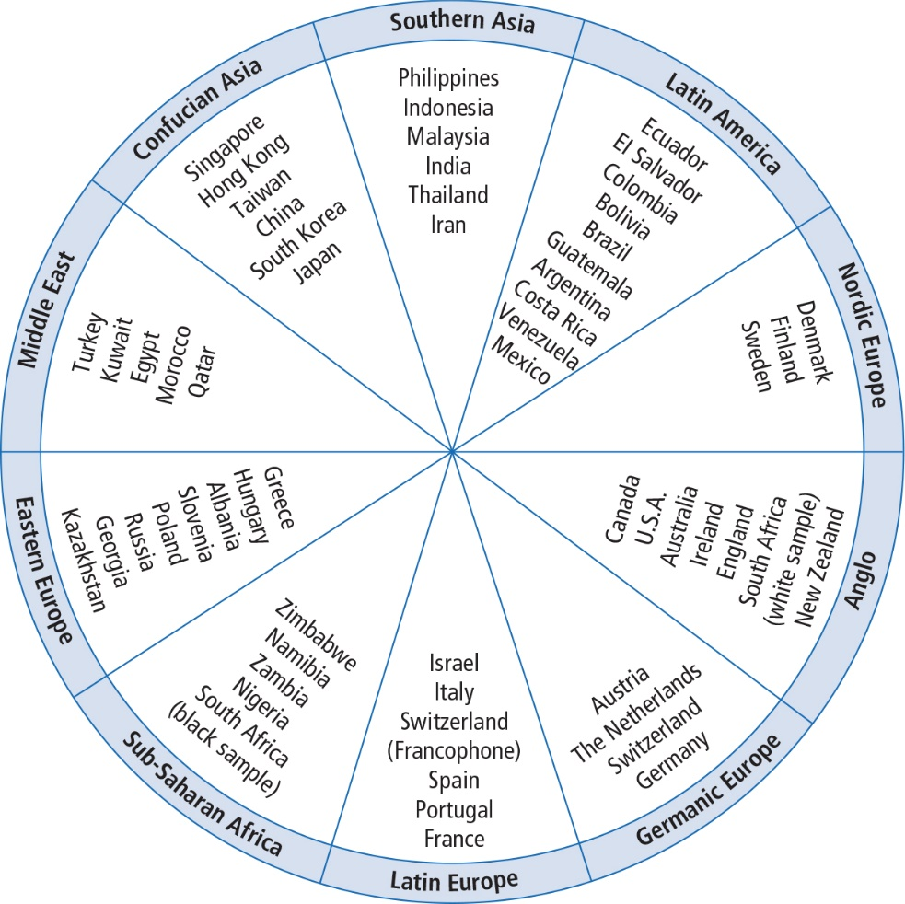
Clusters of World Cultures
Notes:
Figure 16.1: Country Clusters According to GLOBE

Slide 17
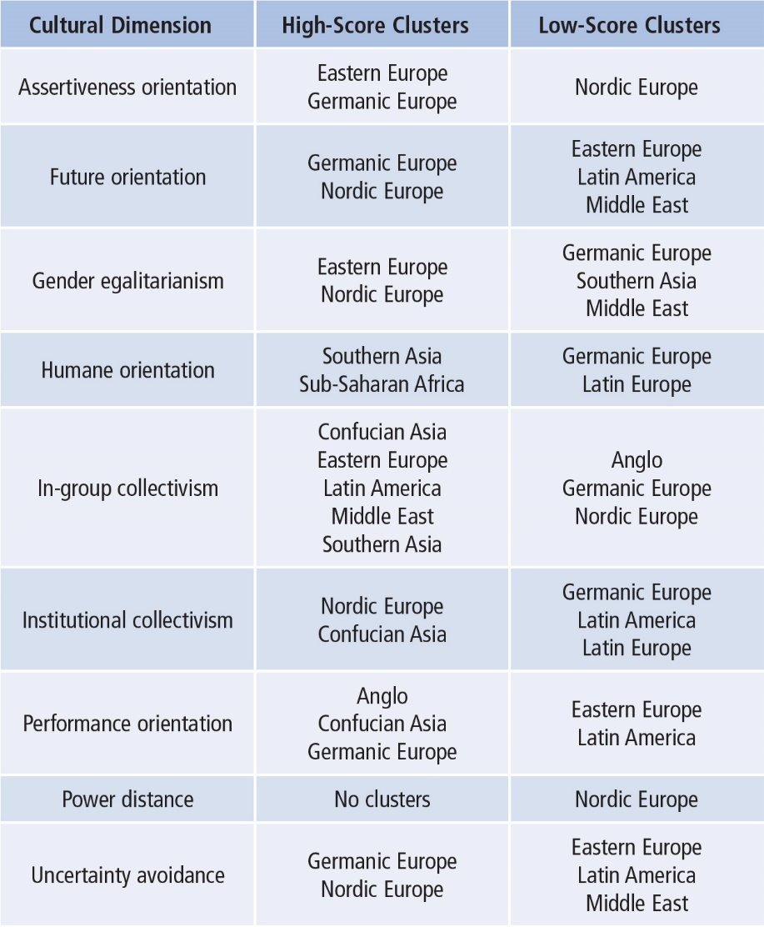
Characteristics of Clusters
Notes:
Table 16.1: Cultural Clusters Classified on Cultural Dimensions

Slide 18
Characteristics of Clusters
Characteristics include
Anglo--competitive and result oriented
Confucian Asia--result driven, encourage group working together over individual goals
Eastern Europe--forceful, supportive of co-workers, treat women with equality
Germanic Europe--value competition and aggressiveness and are more result oriented
Latin America--loyal and devoted to their families and similar groups

Slide 19
Characteristics of Clusters
Characteristics include
Latin Europe--value individual autonomy
Middle East--devoted and loyal to their own people, women afforded less status
Nordic Europe--high priority on long-term success, women treated with greater equality
Southern Asia--strong family and deep concern for their communities
Sub-Sahara Africa--concerned and sensitive to others, demonstrate strong family loyalty

Slide 20
Leadership Behavior and Culture Clusters
GLOBE research identified six global leadership behaviors
  Charismatic/value-based leadership reflects the ability to inspire, to motivate, and to expect high performance from others based on strongly held core values.
  Team-oriented leadership emphasizes team building and a common purpose among team members.
  Participative leadership reflects the degree to which leaders involve others in making and implementing decisions.

Slide 21
Leadership Behavior and Culture Clusters
  Humane-oriented leadership emphasizes being supportive, considerate, compassionate, and generous.
  Autonomous leadership refers to independent and individualistic leadership, which includes being autonomous and unique.
  Self-protective leadership reflects behaviors that ensure the safety and security of the leader and the group.

Slide 22
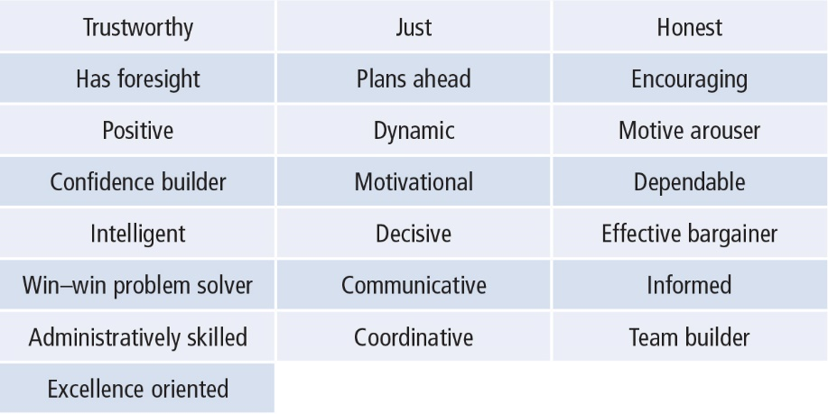
Desirable Leadership Attributes
Notes:
Table 16.2: Universally Desirable Leadership Attributes

Slide 23
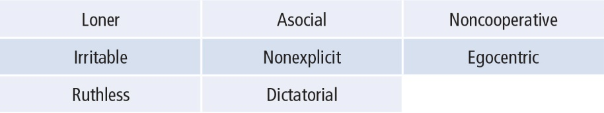
Undesirable Leadership Attributes
Notes:
Table 16.3: Universally Undesirable Leadership Attributes

Slide 24
Culture and Leadership
Strengths
Criticisms
Application

Slide 25
Strengths
GLOBE study is a major study and, to date, the only study to analyze how leadership is viewed by cultures in all parts of the world.
Findings from GLOBE are valuable because they emerge from a well-developed, quantitative research design.
GLOBE studies provide a classification of cultural dimensions that is more expansive than the commonly used Hofstede classification system.
GLOBE studies provide useful information about what is universally accepted as good and bad leadership.
GLOBE studies provide a foundation for subsequent studies of cross-cultural leadership.
The study of culture and leadership underscores the complexity of the leadership process and how it is influenced by culture.

Slide 26
Criticisms
Research does not provide a clear set of assumptions and propositions that can form a single theory about the way culture relates to leadership or influences the leadership process.
Labels and definitions of cultural dimensions and leadership behaviors are somewhat vague, difficult at times to interpret or to fully comprehend the findings about culture and leadership.
Subsequent research has found that GLOBE cultural dimensions are often contradictory and don’t measure the same qualities when used in quantitative studies.
This study focuses on what people perceive to be leadership and ignores a large body of research that frames leadership in terms of what leaders do (e.g., transformational leadership, path–goal theory, skills approach).

Slide 27
Criticisms
Researchers in the GLOBE study measured leadership with subscales that represented a very broad range of behaviors and as a result compromised the precision and validity of the leadership measures.
The GLOBE studies tend to isolate a set of attributes that are characteristic of effective leaders without considering the influence of the situational effects.

Slide 28
Application
The findings about culture can help leaders understand their own cultural biases and preferences.
Different cultures have different ideas about what they want from their leaders, and these findings help our leaders adapt their styles to be more effective in different cultural settings.
The findings can help global leaders communicate more effectively across cultural and geographic boundaries.
Information on culture and leadership can be used to build culturally sensitive websites, design new employee orientation programs, conduct programs in relocation training, and improve global team effectiveness.

