Slide 1
Erasmus Mundus Work and Organizational Psychology
Winter School
Winter school program with the University of Valencia
  Student stories

Slide 2
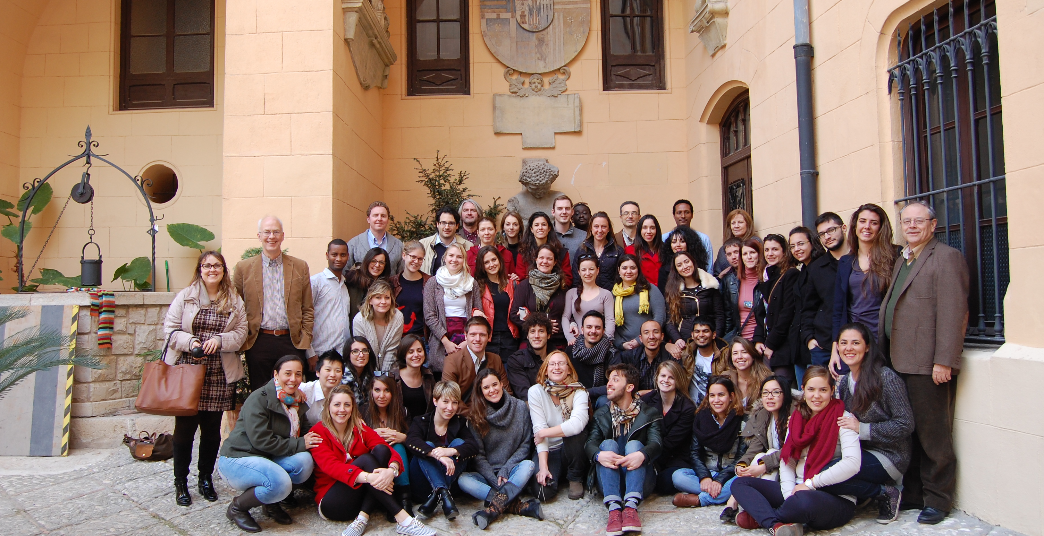
Winter School 2014
(Feb. 16-Mar 1)
Charles Glover
Salvatore Zappala
Kathy Ford
Jose Maria Peiro
Erik Andriessen
Jake Hunter
Luisa Sersch
Greg Kowalewski
Eva Lira
Katie Wrenn

Slide 3
WS Modules
Module 1: Contextual Factors
Module 2: State of the Art
Module 3: Design of Interventions
Module 4: Workshop on implementing intervention
Module 5: Ethics/Fairness; organizational justice

