Slide 2
Chapter 1
Organizations, Work, and Applied Psychology

Slide 3
Learning Goals (1 of 4)
1-1: Describe what an organization is and how applied psychology can help organizations make the wisest use of the people who staff them.
1-2: Define the terms applied psychology, talent management, human resource management, and personnel psychology and understand how they differ.

Slide 4
Learning Goals (2 of 4)
1-3: Explain how demographic changes and diversity will affect recruitment and staffing.
1-4: Understand the managerial implications of generational diversity.

Slide 5
Learning Goals (3 of 4)
1-5: Illustrate how technology and globalization are changing work and organizations.
1-6: Describe the difference between job security and employment security, as well as the implications of each one for individuals and organizations.

Slide 6
Learning Goals (4 of 4)
1-7: Explain the changing roles of managers and workers as the structure and design of organizations continue to evolve.
1-8: Describe how the digital revolution will affect the workplace of the future, and identify emerging research needs in that area.

Slide 7
The Pervasiveness of Organizations (1 of 5)
Organization
Collection of people working together in a division of labor to achieve common purpose
System of inputs, throughputs, and outputs
People basic ingredients of all organizations
Notes:
Learning Goal: 1-1: Describe what an organization is and how applied psychology can help organizations make the wisest use of the people who staff them.

Slide 8
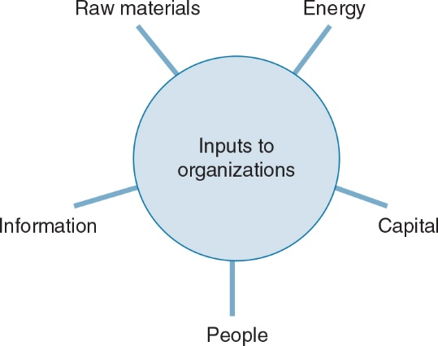
The Pervasiveness of Organizations (2 of 5)
Notes:
Learning Goal: 1-1: Describe what an organization is and how applied psychology can help organizations make the wisest use of the people who staff them.

Slide 9
The Pervasiveness of Organizations (3 of 5)
Applied psychology
Applying psychological principles to practical problems in organizations
Talent management
Organizations anticipate and meet needs for talent in strategic jobs
Notes:
Learning Goal: 1-2: Define the terms applied psychology, talent management, human resource management, and personnel psychology and understand how they differ.

Slide 10
The Pervasiveness of Organizations (4 of 5)
Human resources management
Comprises staffing, retention, development, adjustment, and managing change
Notes:
Learning Goal: 1-2: Define the terms applied psychology, talent management, human resource management, and personnel psychology and understand how they differ.

Slide 11
The Pervasiveness of Organizations (5 of 5)
Personnel psychology
Individual differences in behavior and job performance
Methods for measuring and predicting such differences
Notes:
Learning Goal: 1-2: Define the terms applied psychology, talent management, human resource management, and personnel psychology and understand how they differ.

Slide 12
Differences in Jobs
A large variety of goods and services
Manufacture of tangible products
Provision of less tangible services
Notes:
Learning Goal: 1.1: Describe what an organization is and how applied psychology can help organizations make the wisest use of the people who staff them.

Slide 13
Differences in Performance
People are a substantial investment
Differences in people include
Size, weight, physical dimensions
Aptitudes and abilities
Personality
Interests
Psychological dimensions
Notes:
Learning Goal: 1.1: Describe what an organization is and how applied psychology can help organizations make the wisest use of the people who staff them.

Slide 14
A Utopian Ideal
Assess each individual’s aptitudes, abilities, personality, and interests
Profile these characteristics
Place all individuals in jobs perfectly suited to them and to society
Notes:
Learning Goal: 1.1: Describe what an organization is and how applied psychology can help organizations make the wisest use of the people who staff them.

Slide 15
Point of View (1 of 3)
In a free society, every individual, regardless of race, age, gender, disability, religion, national origin, or other characteristics, has a fundamental and inalienable right to compete for any job for which he or she is qualified.
Notes:
Learning Goal: 1.1: Describe what an organization is and how applied psychology can help organizations make the wisest use of the people who staff them.

Slide 16
Point of View (2 of 3)
Society can and should do a better job of making the wisest and most humane use of its human resources.
Notes:
Learning Goal: 1.1: Describe what an organization is and how applied psychology can help organizations make the wisest use of the people who staff them.

Slide 17
Point of View (3 of 3)
Individuals working in the field of human resources and managers responsible for making employment decisions must be as technically competent and well informed as possible, since their decisions will materially affect the course of individual livelihoods and lives.
Notes:
Learning Goal: 1.1: Describe what an organization is and how applied psychology can help organizations make the wisest use of the people who staff them.

Slide 18
Personnel Psychology and Talent Management in Perspective (1 of 3)
Engineering psychologist
Human aspects of design of tools, machines, work spaces, information systems, and aspects of the work environment
Notes:
Learning Goal: 1-2: Define the terms applied psychology, talent management, human resource management, and personnel psychology and understand how they differ.

Slide 19
Personnel Psychology and Talent Management in Perspective (2 of 3)
Social psychologist
Studies power and influence, attitude change, communication in groups, and individual and group social behavior
Notes:
Learning Goal: 1-2: Define the terms applied psychology, talent management, human resource management, and personnel psychology and understand how they differ.

Slide 20
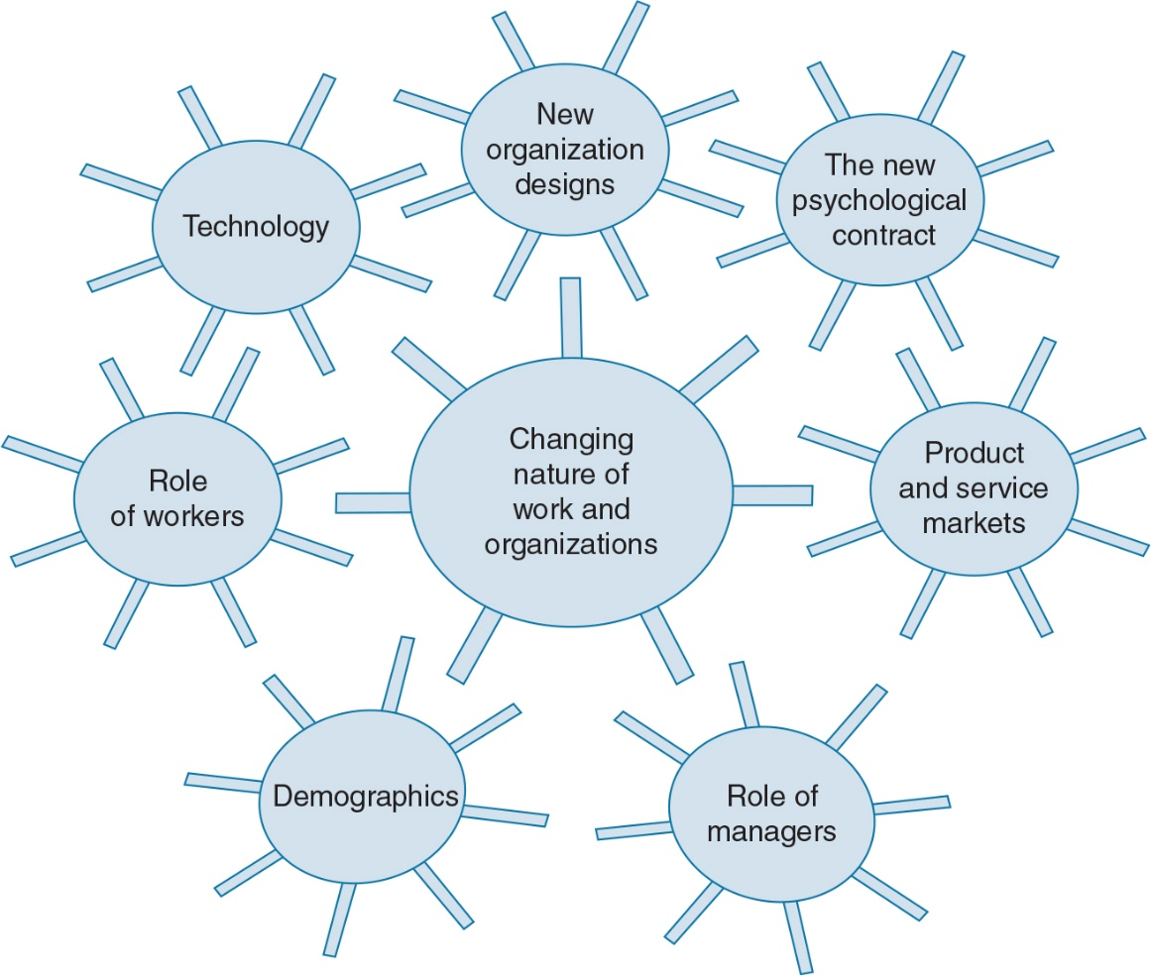
Personnel Psychology and Talent Management in Perspective (3 of 3)
Notes:
Learning Goal: 1-5: Illustrate how technology and globalization are changing work and organizations.

Slide 21
The Globalization of Product/Services Markets (1 of 2)
Globalization
Ability of any individual or company to compete, connect, exchange, or collaborate globally
Increasing workforce flux
More diversity
Technical skills less defining
Notes:
Learning Goal: 1-5: Illustrate how technology and globalization are changing work and organizations.

Slide 22
The Globalization of Product/Services Markets (1 of 2)
White- and blue-collar jobs wiped out permanently
Corporate downsizing
Change and uncertainty new psychological contract
Notes:
Learning Goals:
1-5: Illustrate how technology and globalization are changing work and organizations.
1-6: Describe the difference between job security and employment security, as well as the implications of each one for individuals and organizations.

Slide 23
Effects of Technology (1 of 2)
Cloud and mobile computing
Big data and machine learning
Sensors and intelligent manufacturing
Advanced robotics and drones
Clean-energy technologies
Notes:
Learning Goal: 1-5: Illustrate how technology and globalization are changing work and organizations.

Slide 24
Effects of Technology (2 of 2)
Ubiquitous computing
Computational technology permeates almost everything, enabling new ways of connecting people, computers, and objects
Process of creative destruction
Used to enable or to constrain people at work
Changing nature of competition, work, and employment
Notes:
Learning Goal: 1-5: Illustrate how technology and globalization are changing work and organizations.

Slide 25
Changes in Structure and Design
Premised on constant change, not stability
Organized around networks, not rigid hierarchies
Built on shifting partnerships and alliances, not self-sufficiency
Constructed on technological advantages, not bricks and mortar
Notes:
Learning Goal: 1-8: Describe how the digital revolution will affect the workplace of the future, and identify emerging research needs in that area.

Slide 26
Changing Roles of Managers and Workers (1 of 2)
Managers explain and communicate how their organizations create value
Leadership in digital age not about control, but comfort with uncertainty
Notes:
Learning Goal: 1-7: Explain the changing roles of managers and workers as the structure and design of organizations continue to evolve.

Slide 27
Changing Roles of Managers and Workers (2 of 2)
Agility: collaborative innovation to solve unstructured problems
Talent-on-demand: central feature of “gig” economy
Notes:
Learning Goal: 1-7: Explain the changing roles of managers and workers as the structure and design of organizations continue to evolve.

Slide 28
Changing Demographics (1 of 2)
Women at all levels
More multiethnic, multicultural workers
Older and younger workers
More workers with disabilities
Robots
Contingent workers
Notes:
Learning Goals:
1-3: Explain how demographic changes and diversity will affect recruitment and staffing.
1-4: Understand the managerial implications of generational diversity.

Slide 29
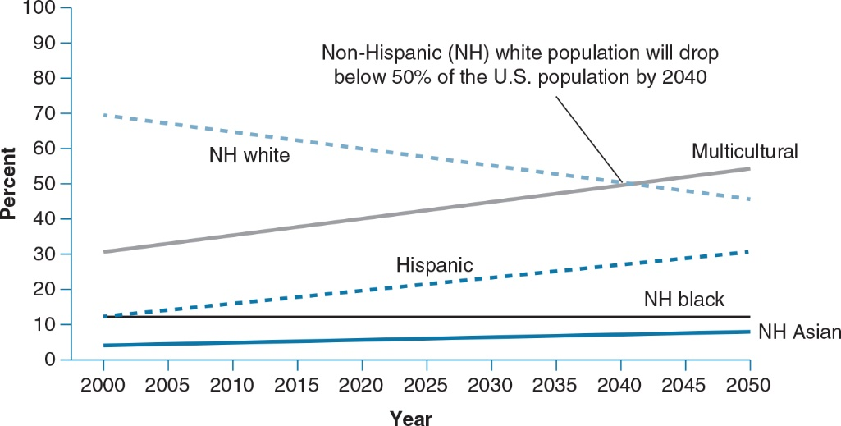
Changing Demographics (2 of 2)
Notes:
Learning Goal: 1-3: Explain how demographic changes and diversity will affect recruitment and staffing.

Slide 30
Implications for Organizations and Their People
Add positive economic benefits to producing goods or delivering services
Skills of workforce distinguishable from competitors
Skills not easily duplicated
Notes:
Learning Goal: 1-8: Describe how the digital revolution will affect the workplace of the future, and identify emerging research needs in that area.

Slide 31
Evidence-Based Implications for Practice

