Slide 2
Chapter 1
Organizations, Work, and Applied Psychology

Slide 3
8 Learning Goals (1 of 4)
1-1: Define Organization and
How applied psychology helps management make good decisions about people
people/ process/ technology
1-2: Define & compare differences:
talent management
human resource management
personnel psychology

Slide 4
Learning Goals (2 of 4)
1-3: How demographic changes and diversity will affect recruitment and staffing.
1-4: managerial implications of generational diversity.

Slide 5
Learning Goals (3 of 4)
1-5: How technology and globalization are changing work and organizations.
1-6: Job security v. employment security, and implications of each for employees and organizations.
Notes:
.

Slide 6
Learning Goals (4 of 4)
1-7 changing roles of managers and workers with changing
structure and design of organizations
1-8: digital revolution effects on work and…
emerging research needs in that area.

Slide 7
The Pervasiveness of Organizations (1 of 5)
Organization (PPT)
“Collection of people working together
in a division of labor
to achieve common purpose
System of inputs, throughputs, and outputs
People - basic ingredients along with…
Process
Technology
What are some examples of organizations?

Slide 8
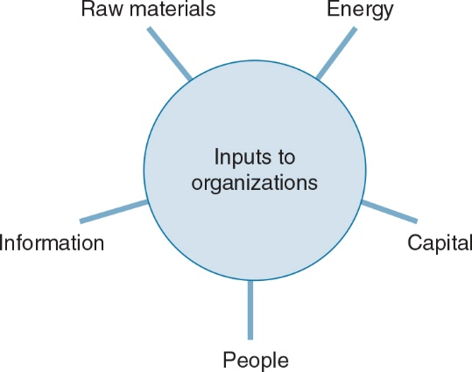
The Pervasiveness of Organizations (2 of 5)

Slide 9
The Pervasiveness of Organizations (3 of 5)
Applied psychology
Applying psychological principles to practical problems in organizations
Talent management
Organizations anticipate and meet needs for talent in strategic jobs

Slide 10
The Pervasiveness of Organizations (4 of 5)
Human resources management
Generalists functions (nuts and bolts)
staffing,
retention,
development,
adjustment, and
managing change

Slide 11
The Pervasiveness of Organizations (5 of 5)
Personnel psychology
Problem solving (with psychology science)
Individual differences in
behavior and job performance
Methods for
measuring and predicting such differences
How do each of the interface with “O” side?

Slide 12
Differences in Jobs
Work brings about large variety of goods and services…
Some jobs we don’t think about
Sports
Entertainers
Politicians
Illegal drug dealers (“Breaking Bad”)
Some others? (hint: Lillian Gilbreth)

Slide 13
Differences in Performance Outcomes
People are a substantial investment
employee attributes
Size, weight, physical dimensions
Aptitudes and abilities
Personality
Interests
Psychological dimensions
Which side of Lewin’s equation?
Which are variable / constant / enduring?

Slide 14
A Utopian Ideal
Assess each individual’s attributes
Profile them
Place each in the perfect org/job fit
Selection vs. Placement
Should we select for the
Person or the job?

Slide 15
Point of View (1 of 3)
In a free society, every individual, regardless of race, etc. or other characteristics, has a
fundamental and inalienable right to compete for any job for which he or she is qualified.
Who says? Where does this come from?
Civil rights acts and 14th Amendment

Slide 16
Point of View (2 of 3)
Society can and should do a better job of making the wisest and most humane use of its human resources.
What are some
“wise” choices?
“humane choices”
Ways and mechanisms to make it happen?
Notes:
.

Slide 17
Personnel Psychology and Talent Management in Perspective (1 of 3)
Engineering psychologist
-Human aspects of
design of tools, machines, work spaces, information systems, and aspects of the work environment
What are some other terms for Engineering Psychologist?
Whose names comes to mind?

Slide 18
Personnel Psychology and Talent Management in Perspective (2 of 3)
Social psychologist
Studies power and influence,
attitude change,
communication in groups, and
individual and group social behavior

Slide 19
Point of View (3 of 3)
Thought questions on the:
Psychological Contract”
What IS it and how has it changed over the past few decades?
What are some things that make it “fair for both employers and workers?

Slide 20
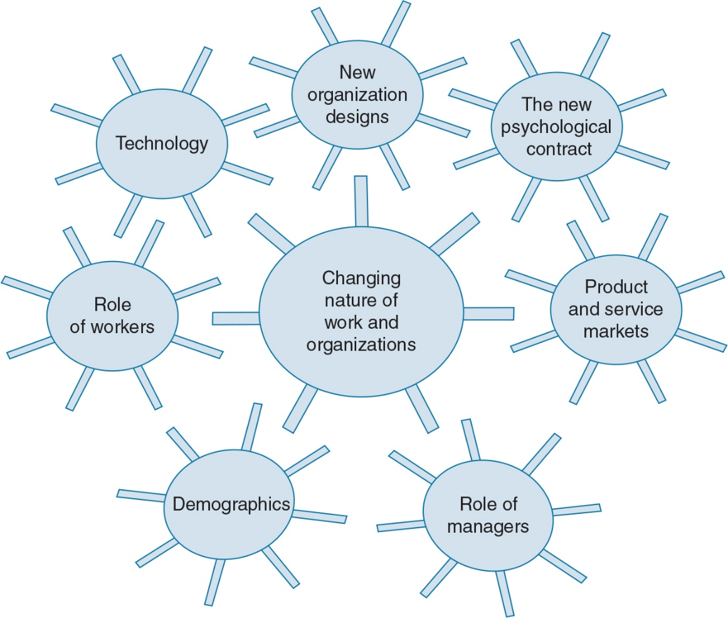
Personnel Psychology and Talent Management in Perspective (3 of 3)

Slide 21
Changing Global Work Environment 2 of 2)
Technology
Ubiquitous computing
Organizational structure and design
Managers – subordinates roles
Some ways Covid has affected structure and design?
Workforce demographics

Slide 22
Changing Roles of Managers and Workers (2 of 2)
Agility: collaborative innovation to solve unstructured problems
Talent-on-demand: central feature of “gig” economy
Remote v. on site?
Some examples of how

Slide 23
Changing Demographics (1 of 2)
Women at all levels
More multiethnic, multicultural workers
Older and younger workers
More workers with disabilities
Robots
Contingent workers

Slide 24
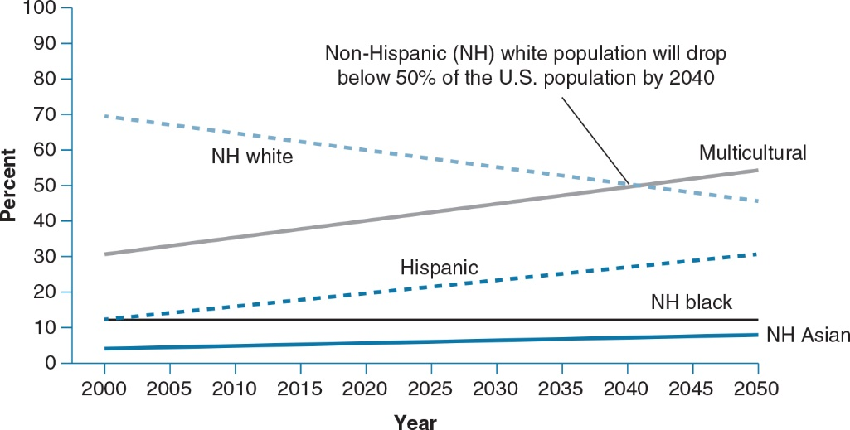
Changing Demographics (2 of 2)

Slide 25
Implications for Organizational Change
For
People
Processes
Technology
A new world of work -
How exciting is this for IOs! ☺

Slide 26
Evidence-Based Implications for Practice

