Slide 1
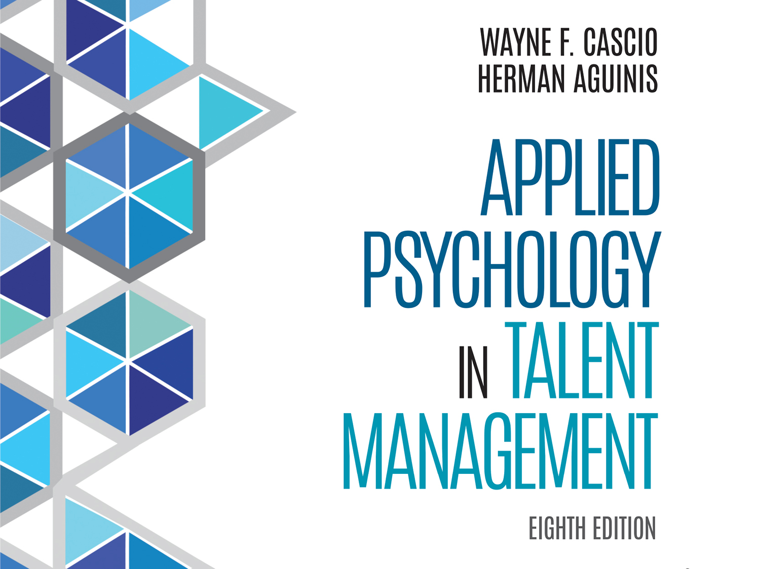

Slide 2
Chapter 2
The Law and Talent Management

Slide 3
Learning Goals (1 of 3)
2-1: Describe the framework of the U.S. legal system.
2-2: Describe alternative legal routes for complaints against an employer’s employment practices.

Slide 4
Learning Goals (2 of 3)
2-3: Explain the two major legal theories of unfair employment discrimination.
2-4: Understand the major legal principles that define key civil rights laws.
2-5: Identify the six exemptions to Title VII coverage.

Slide 5
Learning Goals (3 of 3)
2-6: Define sexual harassment and identify preventive steps employers should take.
2-7: Know when you can and cannot justify “English-only” rules in the workplace.
2-8: Understand how to prevent age-discrimination claims when downsizing or terminating workers for cause.

Slide 6
The United States Legal System (1 of 4)
United States Constitution supreme law
Powers not given to federal government reserved for the states
Legislative branch (Congress) enacts laws (statutes) considered primary authority
Notes:
Learning Goal: 2-1: Describe the framework of the U.S. legal system.

Slide 7
The United States Legal System (2 of 4)
Judicial power of United States
Supreme Court
Lower courts: U.S. District Courts
12 U.S. Courts of Appeals
State court structure parallels federal court structure
Notes:
Learning Goal: 2-1: Describe the framework of the U.S. legal system.

Slide 8
The United States Legal System (3 of 4)
EEO complaints
Informal, out-of-court settlement with employer
State and local fair employment practice commissions
Federal regulatory agencies
Federal and state district courts
Notes:
Learning Goal: 2-2: Describe alternative legal routes for complaints against an employer’s employment practices.

Slide 9
The United States Legal System (4 of 4)
Notes:
Learning Goal: 2-2: Describe alternative legal routes for complaints against an employer’s employment practices.

Slide 10
Unfair Discrimination: What Is It? (1 of 3)
Discrimination
Unfair advantage (or disadvantage) to a particular group in comparison to other groups
Unequal (disparate) treatment based on intention to discriminate
Adverse impact (unintentional) discrimination
Notes:
Learning Goal: 2-3: Explain the two major legal theories of unfair employment discrimination.

Slide 11
Unfair Discrimination: What Is It? (2 of 3)
Disparate treatment theory
Direct evidence of intention to discriminate
Circumstantial evidence of intention to discriminate
Mixed-motive cases
Notes:
Learning Goal: 2-3: Explain the two major legal theories of unfair employment discrimination.

Slide 12
Unfair Discrimination: What Is It? (3 of 3)
Notes:
Learning Goal: 2-3: Explain the two major legal theories of unfair employment discrimination.

Slide 13
Legal Framework for Civil Rights Requirements (1 of 3)
Nondiscrimination laws
Public and private sectors
Employment agencies
Unions
Joint labor–management committees
Executive orders
Government contractors and subcontractors
Notes:
Learning Goal: 2-4: Understand the major legal principles that define key civil rights laws.

Slide 14
Legal Framework for Civil Rights Requirements (2 of 3)
Federal laws
U.S. Constitution--Thirteenth and Fourteenth Amendments
Civil Rights Acts of 1866 and 1871
Equal Pay Act of 1963
Title VII of the Civil Rights Act of 1964
Age Discrimination in Employment Act of 1967
Notes:
Learning Goal: 2-4: Understand the major legal principles that define key civil rights laws.

Slide 15
Legal Framework for Civil Rights Requirements (3 of 3)
Federal laws
Immigration Reform and Control Act of 1986
Americans with Disabilities Act of 1990
Civil Rights Act of 1991
Family and Medical Leave Act of 1993
Uniformed Services Employment and Reemployment Rights Act of 1994
Notes:
Learning Goal: 2-4: Understand the major legal principles that define key civil rights laws.

Slide 16
The U.S. Constitution
Thirteenth Amendment
Prohibits slavery and involuntary servitude
Fourteenth Amendment
Guarantees equal protection of the law for all citizens
Notes:
Learning Goal: 2-4: Understand the major legal principles that define key civil rights laws.

Slide 17
The Civil Rights Acts
Act of 1866
Right to make and enforce contracts for employment
Act of 1871
Right to sue in federal court if deprived of rights or privileges
Act of 1991
Protection of workers in all aspects of employment
Notes:
Learning Goal: 2-4: Understand the major legal principles that define key civil rights laws.

Slide 18
Equal Pay for Equal Work Regardless of Sex
Equal Pay Act of 1963
Men and women should be paid the same for doing the same type of work
Differentials in pay can be based upon any factor other than sex
Notes:
Learning Goal: 2-4: Understand the major legal principles that define key civil rights laws.

Slide 19
Equal Pay for Jobs of Comparable Worth
Rate of pay in a female dominated field tends to be lower than rate of pay in male dominated field
Is there a bias in jobs held by women?
Should pay be equal based upon comparable work?
Notes:
Learning Goal: 2-4: Understand the major legal principles that define key civil rights laws.

Slide 20
Equal Employment Opportunity
Title VII of the Civil Rights Act of 1964
Established EEOC
Nondiscrimination on the basis of race, color, religion, sex, or national origin
Retaliation and employment advertising
Suspension of government contracts and back-pay awards
Notes:
Learning Goal: 2-4: Understand the major legal principles that define key civil rights laws.

Slide 21
Title VII Exemptions
Bona Fide Occupational Qualifications
Seniority Systems
Preemployment Inquiries
Testing
Preferential Treatment
Veterans’ Preference Rights
National Security
Notes:
Learning Goal: 2-5: Identify the six exemptions to Title VII coverage.

Slide 22
Age Discrimination in Employment Act of 1967 (1986)
Specifically proscribes discrimination on the basis of age for employees age 40 and over unless the employer can demonstrate that age is a BFOQ for the job in question
Notes:
Learning Goal: 2-8: Understand how to prevent age-discrimination claims when downsizing or terminating workers for cause.

Slide 23
Immigration Reform and Control Act of 1986
Cannot hire or employ persons not authorized to work in the United States
Requires verification of identity and work authorization within 3 days of hire
Notes:
Learning Goal: 2-4: Understand the major legal principles that define key civil rights laws.

Slide 24
Americans With Disabilities Act 1990 (2008)
Prohibits discrimination of qualified individual with disability
Ability to perform essential functions without accommodation
Prohibits mitigating measures in determining impairment
Notes:
Learning Goal: 2-4: Understand the major legal principles that define key civil rights laws.

Slide 25
Civil Rights Act of 1991 (1 of 2)
Key Provisions
Monetary damages and jury trials
Adverse impact (unintentional discrimination) cases
Protection in foreign countries
Racial harassment
Challenges of consent decrees
Mixed-motive cases
Notes:
Learning Goal: 2-4: Understand the major legal principles that define key civil rights laws.

Slide 26
Civil Rights Act of 1991 (2 of 2)
Key Provisions
Seniority systems
Race-norming
Extension to U.S. Senate and appointed officials
The Family and Medical Leave Act
Uniformed Services Employment and Reemployment Rights Act
Notes:
Learning Goal: 2-4: Understand the major legal principles that define key civil rights laws.

Slide 27
Enforcement of the Laws: Regulatory Agencies
Regulatory agencies
State Fair Employment Practices Commissions
Equal Employment Opportunity Commission (EEOC)
Office of Federal Contract Compliance Programs (OFCCP)
Notes:
Learning Goal: 2-2: Describe alternative legal routes for complaints against an employer’s employment practices.

Slide 28
Employment Case Law: General Principles (1 of 8)
Judicial branch interprets laws and determines enforcement
1964 Civil Rights Act: ability tests
Personal background information
Employment history
Notes:
Learning Goal: 2-3: Explain the two major legal theories of unfair employment discrimination.

Slide 29
Employment Case Law: General Principles (2 of 8)
Sex discrimination
Title VII: both sexes equal opportunity to compete for jobs
Sexual orientation
Pregnancy discrimination
Notes:
Learning Goal: 2-6: Define sexual harassment and identify preventive steps employers should take.

Slide 30
Employment Case Law: General Principles (3 of 8)
Sex discrimination
Sexual harassment
Quid pro quo (you give me this; I’ll give you that)
Hostile work environment (intimidating, hostile, or offensive atmosphere)
Notes:
Learning Goal: 2-6: Define sexual harassment and identify preventive steps employers should take.

Slide 31
Employment Case Law: General Principles (4 of 8)
Preventive actions by employers
Statement from CEO sexual harassment not tolerated
Publicized definition of sexual harassment
Effective complaint procedure
Statement of sanctions for violators
Notes:
Learning Goal: 2-6: Define sexual harassment and identify preventive steps employers should take.

Slide 32
Employment Case Law: General Principles (5 of 8)
Preventive actions by employers
Protection for those who make charges
Investigate every claim of harassment
Preserve investigative information
Train managers and supervisors
Follow-up
Notes:
Learning Goal: 2-6: Define sexual harassment and identify preventive steps employers should take.

Slide 33
Employment Case Law: General Principles (6 of 8)
Age discrimination
Within protected age group (over 40 years of age)
Doing satisfactory work
Discharged despite satisfactory work performance
Younger person filled position
Notes:
Learning Goal: 2-8: Understand how to prevent age-discrimination claims when downsizing or terminating workers for cause.

Slide 34
Employment Case Law: General Principles (7 of 8)
“English only” rules
EEOC: blanket English-only rules that lack business justification amount to unlawful national-origin discrimination
Employer must show legitimate business need for English-only
Notes:
Learning Goal: 2-7: Know when you can and cannot justify “English-only” rules in the workplace

Slide 35
Employment Case Law: General Principles (8 of 8)
Seniority
Legitimate seniority systems take precedence over affirmative action
Preferential selection
Diversity efforts are good; quotas are not
Notes:
Learning Goal: 2-3: Explain the two major legal theories of unfair employment discrimination.

Slide 36
Evidence-Based Implications for Practice

