Slide 1
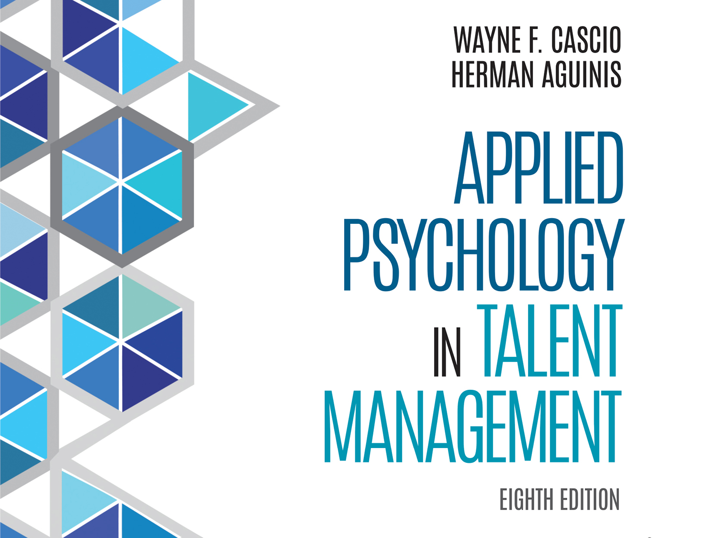

Slide 2
Chapter 3
People, Decisions, and the Systems Approach

Slide 3
Learning Goals (1 of 4)
3-1: Explain why it is important always to take into account the costs as well as the anticipated consequences of decisions.
3-2: Identify what makes decision or utility theory unique.

Slide 4
Learning Goals (2 of 4)
3-3: Understand the difference between organizations as open versus closed systems.
3-4: Describe how concepts from supply-chain analysis might apply to the staffing process.

Slide 5
Learning Goals (3 of 4)
3-5: Explain what it means to optimize staffing outcomes.
3-6: Describe the employment process as a network of sequential, interdependent decisions.

Slide 6
Learning Goals (4 of 4)
3-7: Identify key interactions among the various elements of the employment process.
3-8: Explain how organizational exit influences, and is influenced by, prior phases in the employment process.

Slide 7
Costs and Consequences of Decisions (1 of 8)
Utility theory
Costs and expected consequences of decisions always taken into account
Linkages between employment practices and ability to achieve strategic objectives of organization
Notes:
Learning Goal: 3-1: Explain why it is important always to take into account the costs as well as the anticipated consequences of decisions.

Slide 8
Costs and Consequences of Decisions (2 of 8)
Utility theory
Specifies evaluations by means of payoff matrix or conversion of criterion to utility units
Values plainly revealed and open to criticism
Notes:
Learning Goal: 3-2: Identify what makes decision or utility theory unique.

Slide 9
Costs and Consequences of Decisions (3 of 8)
Utility theory
Provides framework for making decisions
Defines goals
Enumerates expected consequences or outcomes of decision
Attaches differing utilities or values to each
Notes:
Learning Goal: 3-2: Identify what makes decision or utility theory unique.

Slide 10
Costs and Consequences of Decisions (4 of 8)
Organizations as systems
System
Collection of interrelated parts
Unified by design
Created to attain one or more objectives
Notes:
Learning Goal: 3-3: Understand the difference between organizations as open versus closed systems.

Slide 11
Costs and Consequences of Decisions (5 of 8)
Organizations as systems
Closed-system
Problems divided into component parts and solved
Internal operation of organization
Tends to ignore outside environment
Notes:
Learning Goal: 3-3: Understand the difference between organizations as open versus closed systems.

Slide 12
Costs and Consequences of Decisions (6 of 8)
Organizations as systems
Open systems
Continual interaction with multiple, dynamic environments
Continuous import of inputs
Notes:
Learning Goal: 3-3: Understand the difference between organizations as open versus closed systems.

Slide 13
Costs and Consequences of Decisions (7 of 8)
Notes:
Learning Goal: 3-3: Understand the difference between organizations as open versus closed systems.

Slide 14
Costs and Consequences of Decisions (8 of 8)
Systems thinking
Scan and sense changes in outside environment
Bridge and manage critical boundaries and areas of interdependence
Develop appropriate strategic responses
Notes:
Learning Goal: 3-3: Understand the difference between organizations as open versus closed systems.

Slide 15
A Systems View of the Staffing Process (1 of 3)
Supply-chain analysis
Optimize costs against price and time
Achieve levels of expected quality/quantity and risks associated with variations in quality/quantity
Notes:
Learning Goal: 3-4: Describe how concepts from supply-chain analysis might apply to the staffing process.

Slide 16
A Systems View of the Staffing Process (2 of 3)
Notes:
Learning Goal: 3-4: Describe how concepts from supply-chain analysis might apply to the staffing process.

Slide 17
A Systems View of the Staffing Process (3 of 3)
Optimizing staffing outcomes
Cost of enhanced recruitment
Costs of each offer (salary, benefits, professional development, and work-life fit)
Strong similarity between systems thinking and supply-chain logic
Notes:
Learning Goal: 3-5: Explain what it means to optimize staffing outcomes.

Slide 18
A Systems View of the Broader Employment Process (1 of 8)
Open-system, decision-theoretic model
Sequential strategy
Each decision an attempt to discover what should be done with one or more individuals
Decisions form long chain
Notes:
Learning Goal: 3-6: Describe the employment process as a network of sequential, interdependent decisions.

Slide 19
A Systems View of the Broader Employment Process (2 of 8)
Open-system, decision-theoretic model
Different recruitment, selection, and training strategies used for different jobs
Various phases in process highly interdependent, as feedback loops indicate
Notes:
Learning Goal: 3-6: Describe the employment process as a network of sequential, interdependent decisions.

Slide 20
A Systems View of the Broader Employment Process (3 of 8)
Employment process
Work analysis
Strategic workforce planning
Recruitment
Initial screening
Notes:
Learning Goal: 3-7: Identify key interactions among the various elements of the employment process.

Slide 21
A Systems View of the Broader Employment Process (4 of 8)
Employment process
Selection
Training and development
Performance management
Notes:
Learning Goal: 3-7: Identify key interactions among the various elements of the employment process.

Slide 22
A Systems View of the Broader Employment Process (5 of 8)
Organizational exit
Involuntary
Termination for cause
Forced layoff
At discretion of organization
Notes:
Learning Goal: 3-8: Explain how organizational exit influences, and is influenced by, prior phases in the employment process.

Slide 23
A Systems View of the Broader Employment Process (6 of 8)
Organizational exit
Voluntary
Retirement
Voluntary buyout in context of employment downsizing
Employee control over timing of departure
Notes:
Learning Goal: 3-8: Explain how organizational exit influences, and is influenced by, prior phases in the employment process.

Slide 24
A Systems View of the Broader Employment Process (7 of 8)
Organizational exit
Involuntary termination organization processes
Communication
Participation
Control
Planning
Support
Notes:
Learning Goal: 3-8: Explain how organizational exit influences, and is influenced by, prior phases in the employment process.

Slide 25
A Systems View of the Broader Employment Process (8 of 8)
Organizational exit
Due process, personal control, and procedural justice key variables
Organizational exit influences, and influenced by, prior phases in employment process
Notes:
Learning Goal: 3-8: Explain how organizational exit influences, and is influenced by, prior phases in the employment process.

Slide 26
Evidence-Based Implications for Practice

