Slide 1


Slide 2
Chapter 5
Performance Appraisal and Management

Slide 3
Learning Goals (1 of 8)
Design PMS for multiple purposes
PA v. Performance Management
What’s the difference?
Why is the PA essential?
Challenges of Performance Mgt Systems
  (PMS)
Notes:
PMS: continuous process of identifying, measuring, and developing the performance of individuals and teams and aligning performance with the strategic goals of
PA -systematic description job-relevant strengths and weaknesses within and between employees or groups. Data to guide performance
1. Essential: for legal protection…
.2. have metrics for evidence (data) of wkr perform to objectives
3. Objective evidence to Guide performance (self generated if possible)

Slide 4
Learning Goals (6 of 8)
Graphic Rating scales for
  jobs and types of performance dimensions, e.g. BARS, BOS
  factors that affect appraisals, and design PMS
Conducting a PA and GS interview.

Slide 5
Purposes Served for Organization(1 of 2)
PMS purposes served
  Examples?
  Strategic
  Communication
  Employment decisions
  Criteria in HR research
  Which of these depend upon JA?
Notes:
strategy: link wkr activities to mission/goals
Comm –reciprocal feedbk between wkrs & mgt (crucial to guide performance)
Employment decisions – promo/terminate/discipline/ reward
serve as predictors and consequences (outcomes)
CRITERIA: in test validation, e.g.
E

Slide 6
PMS Purposes Served for Organization(2 of 2)
Feedback and personal development
  Organizational diagnosis, maintenance, and development
  Keep proper records
    Which are…archival data/info
    Useful to YOU as a consultant!

Slide 7
Realities and Challenges of PMS (1 of 2)
Four Appraisal realities
  1. Defense against
    disparate effects of employment actions
  2. Have consequences
    Difficult to assign accurate, merit-based performance ratings
Notes:
nothing more consequential for a termination for cause – for both wkr and mgt!
The more complex the job, the more difficulty …esp in Remote work

Slide 8
Realities and Challenges of PMS (2 of 2)
Four realities
  3. Influenced by
    political / inderpersonal consequences of actions
    Examples?
  4. Implementation of PMS
    takes time and effort
Notes:
conflicting role of super as JUDGE and COACH
What in common did Accenture, Deloitte, MS, Gap Eli Lilly have?

Slide 9
Fundamental Requirements of PMS (1 of 2)
PMS important characteristics
  Congruence with strategy
    Balanced Scorecard
  Thoroughness
  Practicality
  Meaningfulness
  Specificity
  Examples relevant to your org?
Notes:
Balanced Scorecard

Slide 10
Fundamental Requirements (2 of 2)
More PMS characteristics
  Discriminability
  Reliability and validity
  Inclusiveness
  Fairness and acceptability
  Examples relevant to your org?
Notes:
what are the levels expected for rel and val?
Fairness and acceptability - perceptions are important

Slide 11
State-of-the-Science PMS (1 of 3)
Benefits for employees
  Increased self-esteem (and efficacy)
  Help to Understand
    behaviors and results required for jobs/positions (role clarity)
    Help them guide their performance
      maximize their strengths and minimize weaknesses

Slide 12
State-of-the-Science PMS (2 of 3)
Benefits for managers
  Increase motivation to perform
  Insight into subordinates
  Differentiation between good and poor performers
  Clearer communication to employees about employees’ performance

Slide 13
State-of-the-Science PMS (3 of 3)
Benefits for organizations
  Increased appropriateness of administrative actions
  Reduction in employee misconduct
  Better protection from lawsuits
  Enhanced employee engagement

Slide 14
Who Shall Rate? (1 of 2)
Immediate supervisor
Peers ..especially….
  those who provide input and receive output
What are some weaknesses?
Subordinates
Self
Clients served
Notes:
Peers and clients= to get a 360 view of the criterion space
CMV proglem Conway, -2010 r. 38 cf to self .22 among perf dimensions (halo)
Peer nominations to discover Best practices/ HPWAs
But problems with negative team ratings cohesiveness.
Using Cis can reduce friendship bias – specific behaviors/ incidents
BWARE of dual purposes
Self (more lenient with western/ v. Taiwan less lenient)
Problem with client ratings….representativeness (Cascio not mentioned)

Slide 15
Table 5.2: Sources and Uses of Appraisal Data
Use | Source
 | Supervisor | Peers | Subordinates | Self | Clients Served
Employment decisions | x | – | x | – | x
Self-development | x | x | x | x | x
HR research | x | x | – | – | x

Slide 16
360 degree Essentials
Relevant content:
  clear and aligned with strategic organizational goals.
Data credibility:
  Each source capable to assess dimensions
Accountability:
  each source must be motivated to provide valid information
Participation:
  organization-wide rather than in specific units. .
Notes:
What motivation tactics would you use? For subordinates rating supervisor for promotion?

Slide 17
360 degree
Agreement and equivalence across sources
Inter-rater agreement:
-within dimensions = Convergent validity
-across dimensions = Divergent validity
Why are ratings among supervisors, peers, subordinates always so low?
They see different facets of the ratee’s performance
But. We should expect the underlying the construct underlying the measure to be equivalent across raters

Slide 18
360 Agreement & Equivalence
Why are ratings among supervisors, peers, subordinates always so low?
They see different facets of the wkr’s performance …so
don’t expect high agreement…but…
We should expect the construct underlying the measure to be equivalent across raters
Notes:
lack of measurement equivalence means that the underlying characteristics being measured are not on the same psychological measurement scale,

Slide 19
360 Agreement & Equivalence
(solutions)
Hybrid Multitrait-multirater analysis (Fig. 5.1)
  Only those who see the dimension rater them (Borman, 1974)
CFA (confirmatory factor analysis)
  (Williams et al., 2010)
IRT (Item –response theory)

Slide 20
Judgmental Biases in Rating
Judgmental biases
  systematic measurement error on part of rater
  Leniency and severity
  Central tendency
  Halo
  Resume information
  Stereotype
  Why are systemic errors easier to deal with than random errors?
Notes:
could systematic “error” not be error? In teamwork, if one team member cannot write well (specific competency), is it not unreasonable to expect them to be a good writer if others in the team can write well? Here is where it may be useful to move from Job to work analysis (job crafting, etc.)
Wy is leniency a problem for validity? 77% of Fortune 100 companies
Cf dual use (admin v. dev) 1/3 SD higher for admin Jawahar & Williams ‘97 Ppsy
How would you control for leniency? FC System not popular (Schleicher, Bull, Green ‘09
Critical Incidents can be usedgood
Is the assumption of “performance is normally distributed” a reasonable one?

Slide 21
Types of Performance Measures
Objective measures
  Production data
  Employment data
  Related to results
Subjective measures
  Depend on human judgment
  Which are more valid?
    (trick question)
Notes:
depends -

Slide 22
Rating Systems: Relative and Absolute (1 of 3)
What’s the difference?
Relative (employee comparison)
  Rank ordering
  Paired comparison
  Forced distribution
  Which ones are dependent and independent?
Notes:
One compares Ind to other (relative) the other to themselves

Slide 23
Rating Systems: Relative and Absolute (2 of 3)
Absolute
  Essays
  Behavior checklists
  Critical incidents
  Graphic rating scales
  BARS & BOS
  Which ones are dependent? Independent?

Slide 24
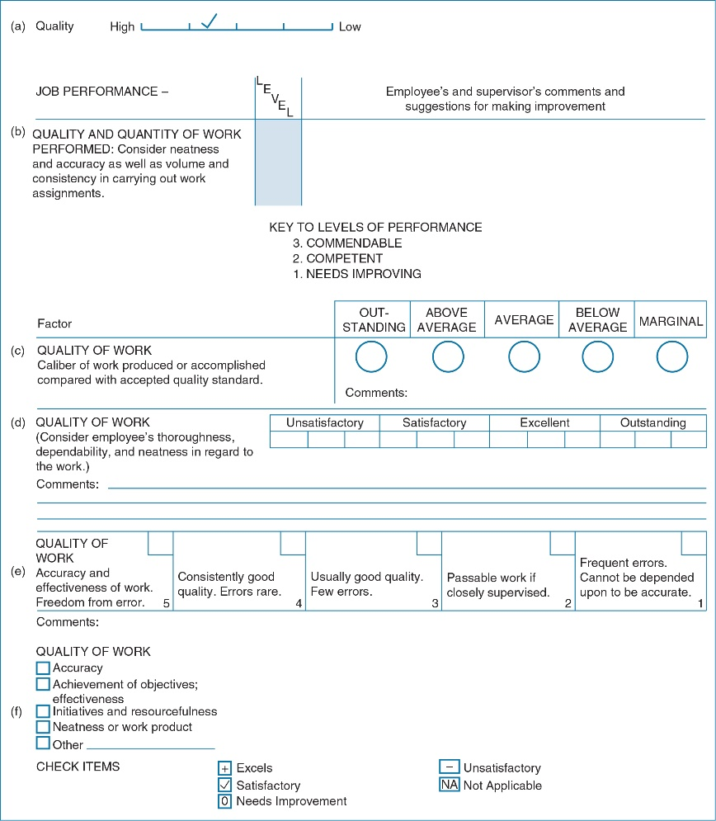
Rating Systems: Relative and Absolute (3 of 3)
Notes:
which one is best? “e”
Big problem is the more specific and objective , the more confounded by factors not under the control of the ratee

Slide 25
Factors Affecting Subjective Appraisals (1 of 2)
Personal characteristics
  Gender
  Race
  Age
  Education level
  Low self-confidence
  Interests, social insight, intelligence
  Personality characteristics

Slide 26
BARS
Be sure to read this section

Slide 27
Factors Affecting Subjective Appraisals Tables 5.4, 5.5, 5.6
Job-related variables
  Accountability
  Job experience
  Performance level
  Leadership style
  Organizational position
  Rater knowledge of ratee and job
  Prior expectations and information
  Stress

Slide 28
Evaluating Team Performance
Individual performance
Individuals’ behaviors and skills that contribute to team performance
  Work or service teams
  Project teams
  Network teams

Slide 29
Rater Training
To improve observational skills of raters
To reduce or eliminate judgmental biases
To improve ability to communicate
  performance information in objective and constructive manner

Slide 30
Social, Emotional, and Interpersonal Context of PMS
Issues to be explored further:
  Social power, influence, and leadership
  Trust
  Social exchange
  Group dynamics
  Close interpersonal relationships
Notes:
.

Slide 31
Appraisal and GS Interviews (1 of 3)
Before interview
  Communicate frequently with subordinates
  Get training in performance appraisal
  Judge your own performance first
  Encourage subordinates to prepare
  Be exposed to priming information

Slide 32
Appraisal and GS Interviews (2 of 3)
During interview
  Encourage subordinate participation
  Judge performance
  Be specific
  Be an active listener
  Avoid destructive criticism and threats to employee’s ego
  Set mutually agreeable and formal goals

Slide 33
Appraisal and GS Interviews (3 of 3)
After interview
  Communicate frequently with subordinates about their performance
  Periodically assess progress toward goals
  Make organizational rewards contingent on performance
Notes:
Learning Goal: 5-8: Place performance appraisal and management systems within a broader social, emotional, and interpersonal context. Conduct a performance appraisal and goal-setting interview.

Slide 34
Thought Questions
s
Why do PMS fail?
Difference between PA and PMS?
When is agreement across sources highly desirable? When would you expect—or even desire—a lack of agreement?
When would you recommend PM at the group level?
Assume a team-structured organization.
  What role, if any, would a PMS based on individual behaviors results play with respect to a team-based performance management system?

Slide 35
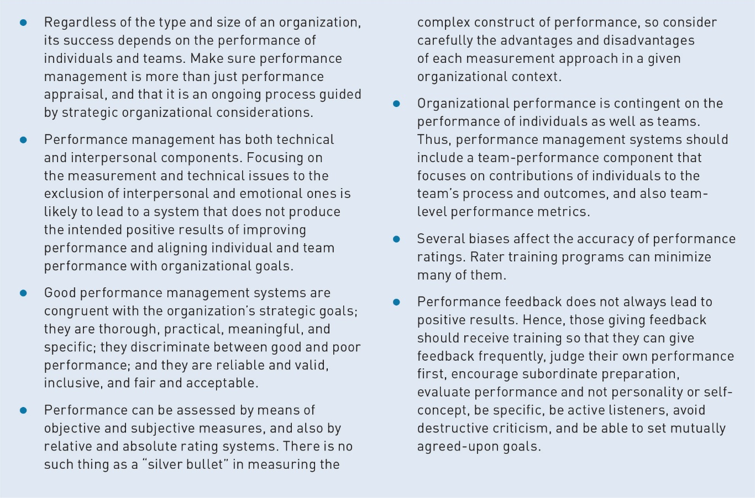
Evidence-Based Implications of Practice

