Slide 2
Chapter 6
Measuring and Interpreting Individual Differences

Slide 3
Learning Goals
Scales of measurement .
What type of data / when to use each
IRT for item analysis & CTT
Reliability Estimates –when to use each
test–retest, parallel forms, internal consistency, interrater reliability t
to assess different sources of error (e.g., time, items, raters).
Notes:
Classical test theory (item analysis)

Slide 4
Learning Goals
Individual scores relative to norms
Types of test for different purposes
E.g power, timed, aptitude, achievement
Coefficient of determination /non
Common Method Variance (CMV)
Standard error of measurement
σ _{Meas} = σ _{x} √ 1 − r _{x x}

Slide 5
Learning Goals
Generalizability theory
relative contribution of sources of error.
Create measures to
minimize the detrimental effects of scale coarseness
Consider norms and other contextual issues.

Slide 6
What is Measurement?
Measurement
“Assignment of numerals to objects or events according to rules”
Answer the question “How much?”
Four types of scales used for psychological measurement

Slide 7
Scales of Measurement
Qualitative
In terms of kind (sex, hair color)
classification
Quantitative
In terms of frequency, amount, or degree
Measurement
Examples of each?

Slide 8
Ordinal Scales
Allows classification by category
Provides indication of magnitude
Yelp -Four stars rating…
Nominal or ordinal?
Tricky one…. Why? -Classification but
…with an underlying continuum
Tied ranks
Notes:
Ranking - tied ranks

Slide 9
Scales
Which ones can you use parametric stats for?
Interval
ratio

Slide 10
Scales Used in Applied Psychological Measurement in Applied Psych
nominal- or ordinal-level scales
Hey.. What about interval?
Ordinal-level measures
Intelligence, aptitude, personality, and performance scales
What scale are “forced choice” when used for merit raises?

Slide 11
Item analysis to build a test
Traditional item analysis
Classical Test theory (CTT)
distractor analysis
Item difficulty
Item discrimination
What should the average difficulty level be?
Is item discrimination a bad thing?

Slide 12
Item analysis to build a test (2 of 3)
IRT Item response theory
Quickly assess test taker’s ability
Doesn’t’ waste time on easy items
Avoids embarrassment for the less able
Easy to assess group differences (or bias)

Slide 13
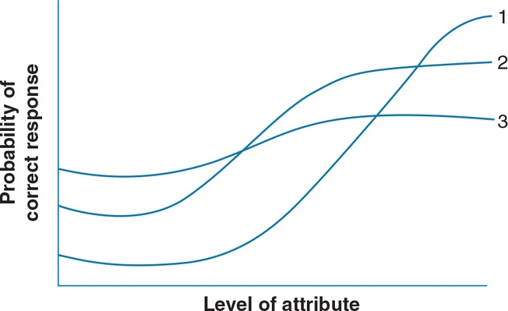
IRT item characteristics Fig 6.1

Slide 14
Reliability as Consistency
Reliability of a measurement procedure
Freedom from unsystematic errors of measurement
Measurement errors reduce reliability

Slide 15
Estimation of Reliability Know these
Test–retest
Parallel (or alternate) forms
Internal consistency (alpha coefficient)
Split-half reliability estimates
Stability and equivalence
Inter-rater reliability
Intra-rater reliability

Slide 16
Estimation of Reliability Know these
Coefficient of determination r²
% of variance shared by
The test and criterion
Coefficient of Non-determination (1- r²)
% of variance not shared by
The test and criterion
What are they for a validity coef r = .5 ?

Slide 17
Interpretation of Reliability
Range of individual differences
Difficulty of the measurement procedure
Size and representativeness of sample
Standard error of measurement (SEM)
σ _{Meas} = σ _{x} √ 1 − r _{x x}
Can you plug in the values for
X and r _{x x} ?

Slide 18
Generalizability Theory (1 of 2)
The reliability of a test score as
precision with which that score, or sample…
represents a more generalized population value

Slide 19
Interpreting the Results of Measurement Procedures (1 of 2)
Percentile rank of a given raw score
Percentage in norm group who fall below it
Standard scores
z scores (distance of each raw score from mean in standard deviation units)

Slide 20
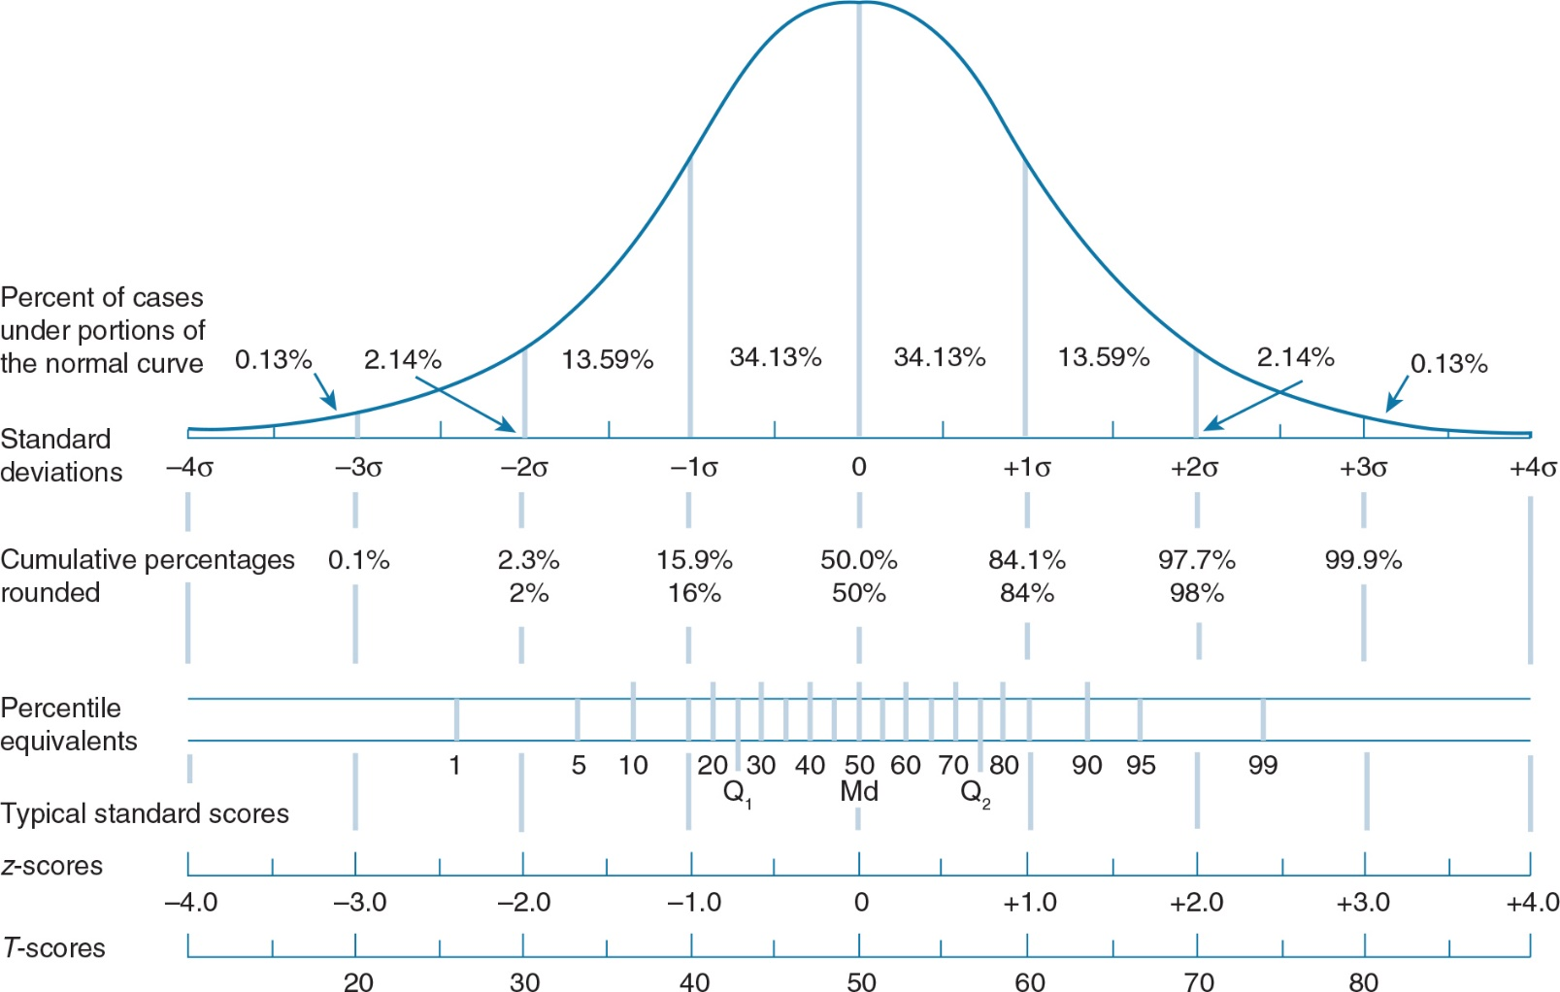
Interpreting the Results of Measurement Procedures (2 of 2)

