Slide 1
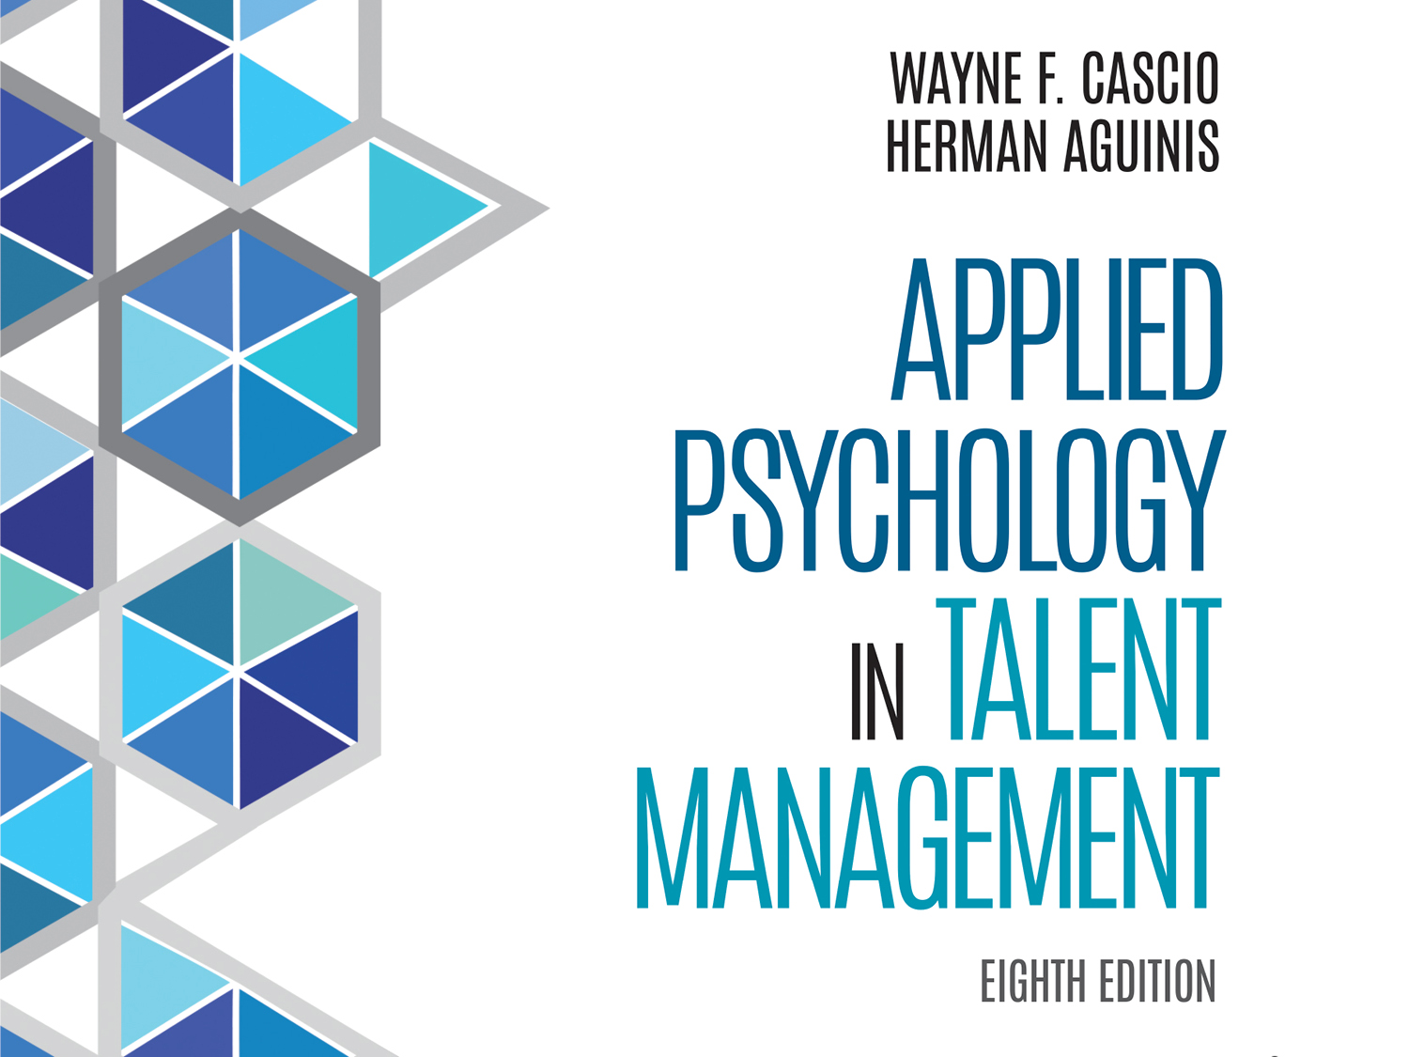

Slide 2
Chapter 8
Fairness in Employment Decisions

Slide 3
Learning Goals (1 of 4)
8-1: Assess the presence of differential validity, differential prediction, and adverse impact.

Slide 4
Learning Goals (2 of 4)
8-2: Design and conduct a state-of-the-science differential prediction study.
8-3: Anticipate possible trade-offs between validity and adverse impact.
8-4: Plan and execute strategies aimed at reducing adverse impact.

Slide 5
Learning Goals (3 of 4)
8-5: Implement test-score banding based on technical and legal guidelines.
8-6: Distinguish among different types of fairness perceptions and create selection systems that address each.

Slide 6
Learning Goals (4 of 4)
8-7: Conceptualize fairness as a technical but also a social and interpersonal concept
8-8: Use the latest knowledge regarding test fairness to inform HR practices and public policy.

Slide 7
Assessing Differential Validity (1 of 4)
There is no point in investigating differential validity in the absence of overall pattern of predictor–criterion scores that allows for prediction of relevant criteria
Notes:
Learning Goal: 8-1: Assess the presence of differential validity, differential prediction, and adverse impact.

Slide 10
Assessing Differential Validity (2 of 4)
Differential validity and adverse impact
Adverse impact
Members of one group selected at substantially greater rates than members of another group
Unethical to use selection device that has not been validated
Notes:
Learning Goal: 8-1: Assess the presence of differential validity, differential prediction, and adverse impact.

Slide 11
Assessing Differential Validity (3 of 4)
Differential validity and adverse impact
Numerous possibilities when heterogeneous groups combined in making predictions
When differential validity exists, use of single regression line, cut score, or decision rule can lead to serious errors in prediction
Notes:
Learning Goal: 8-1: Assess the presence of differential validity, differential prediction, and adverse impact.

Slide 12
Assessing Differential Validity (4 of 4)
Differential validity: the evidence
Significant difference between validity coefficients obtained for two subgroups
Correlations found in one or both groups significantly different from zero
Notes:
Learning Goal: 8-1: Assess the presence of differential validity, differential prediction, and adverse impact.

Slide 19
Differential Validity: The Evidence
Exists when
there is a significant difference between the validity coefficients obtained for two subgroups
the correlations found in one or both of these groups are significantly different from zero
Notes:
Learning Goal: 8-1: Assess the presence of differential validity, differential prediction, and adverse impact.

Slide 20
Assessing Differential Prediction and Moderate Variables (1 of 6)
Possibility of differential prediction in selection procedures central issue in fairness and equal employment opportunity (EEO)
These issues require equivalence of prediction systems for different groups
Notes:
Learning Goal: 8-2: Design and conduct a state-of-the-science differential prediction study.

Slide 21
Assessing Differential Prediction and Moderate Variables (2 of 6)
Differential prediction: the evidence
Until the late 2000s, evidence indicated an overall lack of differential prediction based on ethnicity and gender for cognitive abilities and other types of test
Notes:
Learning Goal: 8-2: Design and conduct a state-of-the-science differential prediction study.

Slide 22
Assessing Differential Prediction and Moderate Variables (3 of 6)
Problems in testing differential prediction
Intercept-based differences favoring minority-group members may be statistical artifact
Slope-based test is typically conducted at low levels of statistical power
Notes:
Learning Goal: 8-2: Design and conduct a state-of-the-science differential prediction study.

Slide 23
Assessing Differential Prediction and Moderate Variables (4 of 6)
Using meta-analysis
Meta-analysis can mitigate the low-power problem of individual studies
Meta-analysts prefer to cumulate correlation coefficients, as opposed to regression coefficients, across studies
Notes:
Learning Goal: 8-2: Design and conduct a state-of-the-science differential prediction study.

Slide 24
Assessing Differential Prediction and Moderate Variables (5 of 6)
Suggestions for improvement
Recent research: numerous statistical artifacts decrease ability to detect differential prediction, even when it exists in the population
Nature and direction of differential prediction varies across contexts
Notes:
Learning Goal: 8-2: Design and conduct a state-of-the-science differential prediction study.

Slide 25
Assessing Differential Prediction and Moderate Variables (6 of 6)
Factors that affect differential prediction:
Stereotype threat
Lack of common cultural frame of reference and identity across groups
Differential recruiting, mentoring, and retention interventions across groups
Notes:
Learning Goal: 8-2: Design and conduct a state-of-the-science differential prediction study.

Slide 26
Further Considerations (1 of 8)
There is a negative relationship between validity and adverse impact is incorrect in many situations
To minimize adverse impact, HR researchers and practitioners should strive to produce unbiased, valid tests
Notes:
Learning Goal: 8-3: Anticipate possible trade-offs between validity and adverse impact.

Slide 27
Further Considerations (2 of 8)
Adverse impact based on ethnicity found for some tests, particularly cognitive abilities
When adverse impact is found, HR specialists strive to use alternative tests with similar levels of validity, but less adverse impact
Notes:
Learning Goal: 8-4: Plan and execute strategies aimed at reducing adverse impact.

Slide 28
Further Considerations (3 of 8)
Test administration strategies
Improve recruiting strategy for minorities
Use cognitive abilities in combination with noncognitive predictors
Use multiple regression and other methods for combining predictors into a composite
Notes:
Learning Goal: 8-4: Plan and execute strategies aimed at reducing adverse impact.

Slide 29
Further Considerations (4 of 8)
Test administration strategies
Use measures of specific, as opposed to only general, cognitive abilities
Use differential weighting for various criterion facets
Use alternate modes of presenting test stimuli
Notes:
Learning Goal: 8-4: Plan and execute strategies aimed at reducing adverse impact.

Slide 30
Further Considerations (5 of 8)
Test administration strategies
Enhance face validity
Implement test-score banding to select among the applicants
Notes:
Learning Goals:
8-4: Plan and execute strategies aimed at reducing adverse impact.
8-5: Implement test-score banding based on technical and legal guidelines.

Slide 31
Further Considerations (6 of 8)
Test-score banding
Method for referring candidates for selection
Addresses broader goal of test fairness
Appropriateness of test-based constructs or rules that underlie decision-making or distributive justice
Notes:
Learning Goal: 8-5: Implement test-score banding based on technical and legal guidelines.

Slide 32
Further Considerations (7 of 8)
Sliding-band method
Attempt to reconcile economic and social objectives
Individuals within specific score range, or band, regarded as having equivalent scores
Based on assumption that no test is perfectly reliable
Notes:
Learning Goal: 8-5: Implement test-score banding based on technical and legal guidelines.

Slide 33
Further Considerations (8 of 8)
Criterion-referenced banding model
Equivalence regarding predictor scores equated with equivalence regarding criterion scores
Use of validity evidence and reliability information
Bandwidth
Inclusion of criterion information
Notes:
Learning Goal: 8-5: Implement test-score banding based on technical and legal guidelines.

Slide 34
Fairness and the Interpersonal Context of Employment Testing (1 of 3)
When applicants and examinees perceive unfairness, perceptions of organization and perceptions of testing procedures affected negatively
Perceptions of unfairness likely to motivate test takers to initiate litigation
Notes:
Learning Goal: 8-6: Distinguish among different types of fairness perceptions and create selection systems that address each.

Slide 35
Fairness and the Interpersonal Context of Employment Testing (2 of 3)
Distributive
Perceptions of fairness of outcomes
Procedural
Perceptions of fairness of procedures used to reach a hiring decision
Notes:
Learning Goal: 8-6: Distinguish among different types of fairness perceptions and create selection systems that address each.

Slide 36
Fairness and the Interpersonal Context of Employment Testing (3 of 3)
Conduct technical analyses on the data
Take into account perceptions of people subjected to the system
Applicants’ personality profiles related to their perceptions of fairness
Notes:
Learning Goal: 8-7: Conceptualize fairness as a technical but also a social and interpersonal concept.

Slide 37
Fair Employment and Public Policy (1 of 2)
Unfair discrimination
Recruitment practices
Selection practices
Compensation
Placement
Training and orientation
Performance management
Notes:
Learning Goal: 8-8: Use the latest knowledge regarding test fairness to inform HR practices and public policy.

Slide 38
Fair Employment and Public Policy (2 of 2)
Public interest in measurement:
Diagnosing needs
Assessing qualifications to do
Protecting against false credentials
Notes:
Learning Goal: 8-8: Use the latest knowledge regarding test fairness to inform HR practices and public policy.

Slide 39
Evidence-Based Implications for Practice

