Slide 2
Chapter 9
Analyzing Jobs and Work

Slide 3
Learning Goals (1 of 3)
9-1: Explain what job or work analysis is and the many purposes for which it is used.
9-2: Distinguish the terms task, duty, position, job, and job family from each other.
9-3: Distinguish work-oriented from worker-oriented descriptors.

Slide 4
Learning Goals (2 of 3)
9-4: Identify seven key choices that exist in the analysis of work.
9-5: Establish legally defensible minimum qualifications.
9-6: Construct appropriate interview questions for analyzing work.

Slide 5
Learning Goals (3 of 3)
9-7: Know when to use personality-based job analysis.
9-8: Compare and contrast job or work analysis to competency modeling

Slide 6
Definition, Professional Standards (1 of 2)
Work analysis
Gathering, documenting, and analyzing:
Work content (tasks, responsibilities, or outputs)
Worker attributes related to its performance (knowledge, skills, abilities, personal characteristics or KSAOs)
Context in which work performed
Notes:
Learning Goal: 9-1: Explain what job or work analysis is and the many purposes for which it is used.

Slide 7
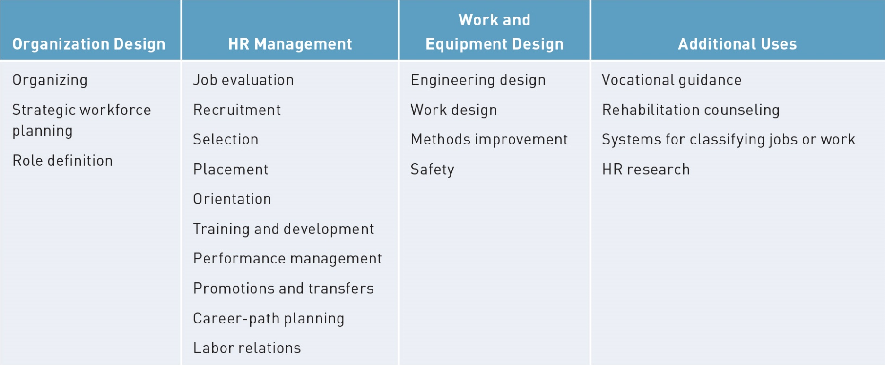
Definition, Professional Standards (2 of 2)
Notes:
Learning Goal: 9-1: Explain what job or work analysis is and the many purposes for which it is used.

Slide 8
Terminology (1 of 7)
Element
Smallest unit work that can be divided without analyzing separate motions, movements, and mental processes involved
Task
Distinct work activity carried out for a distinct purpose
Notes:
Learning Goal: 9-2: Distinguish the terms task, duty, position, job, and job family from each other.

Slide 9
Terminology (2 of 7)
Duty
Large segment of work performed by individual; may include any number of tasks
Position
One or more duties performed by a given individual in a given firm at a given time
Notes:
Learning Goal: 9-2: Distinguish the terms task, duty, position, job, and job family from each other.

Slide 10
Terminology (3 of 7)
Job
Group of positions similar in significant duties
Job family
Group of two or more jobs that call for similar worker characteristics or contain parallel work tasks determined by job analysis
Notes:
Learning Goal: 9-2: Distinguish the terms task, duty, position, job, and job family from each other.

Slide 11
Terminology (4 of 7)
Occupation
Similar jobs found in different organizations at different times
Vocation
Similar to occupation; more likely to be used by a worker than by an employer
Career
Sequence of positions, jobs, or occupations one person engages in during his or her working life
Notes:
Learning Goal: 9-2: Distinguish the terms task, duty, position, job, and job family from each other.

Slide 12
Terminology (5 of 7)
Work analysis choices
Activities or attributes
General or specific
Qualitative or quantitative
Taxonomy based or blank slate
Notes:
Learning Goal: 9-4: Identify seven key choices that exist in the analysis of work.

Slide 13
Terminology (6 of 7)
Work analysis choices
Observers or incumbents and supervisors
Single-job or multiple-job comparison
Descriptive or prescriptive
Notes:
Learning Goal: 9-4: Identify seven key choices that exist in the analysis of work.

Slide 14
Terminology (7 of 7)
Work analysis choices
Work oriented: techniques that focus solely on activities or what gets done (tasks)
Worker oriented: techniques that focus on how the work gets done
Notes:
Learning Goal: 9-3: Distinguish work-oriented from worker-oriented descriptors.

Slide 15
Defining the Job
Job description
Written statement of what a worker does, how he or she does it, and why
Job title
Activities and procedures
Working conditions and physical environment
Social environment
Conditions of employment
Notes:
Learning Goal: 9-2: Distinguish the terms task, duty, position, job, and job family from each other.

Slide 16
Job Specifications
Job specifications
KSAOs necessary to perform a type of work
Identify personal characteristics valid for screening, selection, and placement
Scales are applied to tasks and KSAs and criteria for defining the domains for MQs
Notes:
Learning Goal: 9-5: Establish legally defensible minimum qualifications.

Slide 17
Reliability and Validity of Work Analysis Information
Interrater reliability
Degree raters agree on components of target work role or job, or extent their ratings covary
Intrarater reliability
Measure of stability
Notes:
Learning Goal: 9-1: Explain what job or work analysis is and the many purposes for which it is used.

Slide 18
Obtaining Information About Jobs and Work (1 of 3)
Job observation
For jobs that require a great deal of manual, standardized, short-cycle activities
Job performance
For jobs that job analyst can learn readily
Notes:
Learning Goal: 9-1: Explain what job or work analysis is and the many purposes for which it is used.

Slide 19
Obtaining Information About Jobs and Work (2 of 3)
Interviewing questions
Related to purpose of analysis
Wording clear and unambiguous
Should not “lead” respondent or be “loaded”
Should not ask for knowledge or information interviewee doesn’t have or for personal or intimate material
Notes:
Learning Goal: 9-6: Construct appropriate interview questions for analyzing work.

Slide 20
Obtaining Information About Jobs and Work (3 of 3)
SME panels
Questionnaires
Position Analysis Questionnaire
Fleishman Job Analysis Survey (F-JAS)
Critical incidents
Notes:
Learning Goal: 9-6: Construct appropriate interview questions for analyzing work.

Slide 21
Other Sources of Job Information and Job Analysis Methods (1 of 5)
Job Analysis Wizard (JAW)
Capitalizes on advances in computer technology and availability of sophisticated information search-and-retrieval methods
Notes:
Learning Goal: 9-7: Know when to use personality-based job analysis.

Slide 22
Other Sources of Job Information and Job Analysis Methods (2 of 5)
Personality-based job analysis (PBJA)
Useful for cross-functional and difficult-to-define work that cannot be described in terms of simple tasks or discrete KSAs
Notes:
Learning Goal: 9-7: Know when to use personality-based job analysis.

Slide 23
Other Sources of Job Information and Job Analysis Methods (3 of 5)
Big Five personality traits
Neuroticism
Extraversion
Openness to experience
Agreeableness
Conscientiousness
Notes:
Learning Goal: 9-7: Know when to use personality-based job analysis.

Slide 24
Other Sources of Job Information and Job Analysis Methods (4 of 5)
Competency models
Identify variables related to organizational fit
Identify personality characteristics consistent with organization’s vision
Focuses on broader characteristics of individuals
Notes:
Learning Goal: 9-8: Compare and contrast job or work analysis to competency modeling.

Slide 25
Other Sources of Job Information and Job Analysis Methods (5 of 5)
Work analysis for “star” performers
Cognitive Task Analysis (CTA)
Selection of the participants
Elicitation of knowledge
Analysis and representation of the knowledge
Notes:
Learning Goal: 9-8: Compare and contrast job or work analysis to competency modeling.

Slide 26
Occupational Information (1 of 3)
O*Net
Multiple descriptor domains that provide “multiple windows” into the world of work
Common language of work and worker descriptors that covers entire spectrum of occupations
Notes:
Learning Goal: 9-3: Distinguish work-oriented from worker-oriented descriptors.

Slide 27
Occupational Information (2 of 3)
O*Net
Description of occupations based on a taxonomy from broad to specific
Comprehensive content model that integrates the previous three principles
Notes:
Learning Goal: 9-3: Distinguish work-oriented from worker-oriented descriptors.

Slide 28
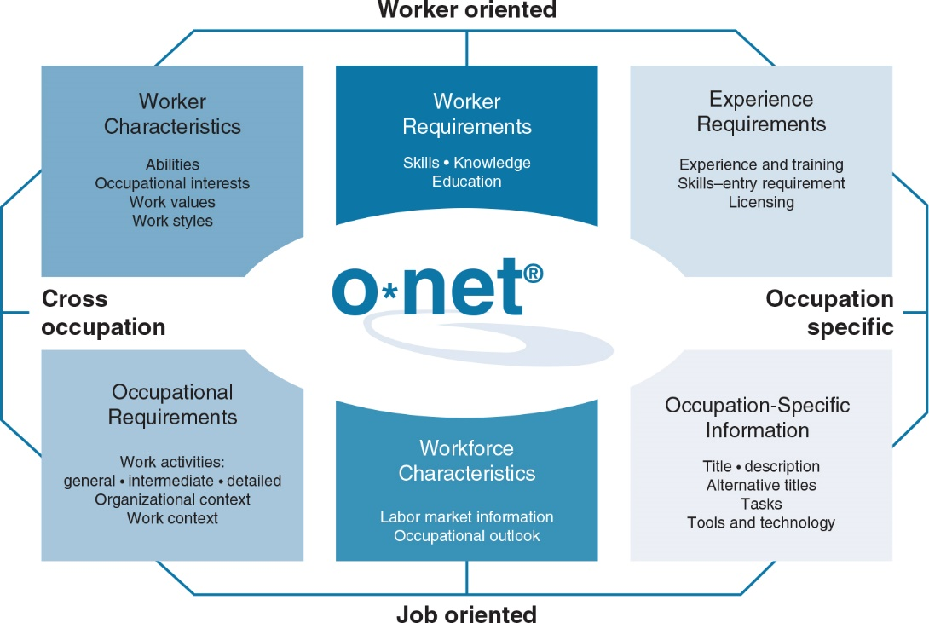
Occupational Information (3 of 3)
Notes:
Learning Goal: 9-3: Distinguish work-oriented from worker-oriented descriptors.

Slide 29
Evidence-Based Implications for Practice (1 of 4)
Begin by defining clearly the purpose for collecting such information.
Choose multiple methods that best suit the purpose identified.

Slide 30
Evidence-Based Implications for Practice (2 of 4)
If using panels of subject matter experts, be sure to include a broad cross-section of experience.
If using interviews, be sure to include both incumbents and supervisors, and take the time to train interviewers in interviewing techniques.

Slide 31
Evidence-Based Implications for Practice (3 of 4)
If using personality-based job analysis, be sure to incorporate frame-of-reference training.
Recognize that competency models are not substitutes for job or work analysis. Both include a range of useful information across the practice continuum.

Slide 32
Evidence-Based Implications for Practice (4 of 4)
When establishing minimum qualifications for education or experience, be sure to assess content-oriented evidence of validity using methods described in this chapter

