Slide 2
Chapter 9
Analyzing Jobs and Work

Slide 3
Learning Goals (1 of 3)
job vs. work analysis and the purposes
Distinguish between
task,
duty,
position,
job, and
job family

Slide 4
Job and Work Analysis learning goals
Distinguish between
Work-oriented
Worker -oriented descriptors.

Slide 5
Learning Goals (2 of 3)
seven key choices in
analysis of work.
legally defensible
minimum qualifications.
appropriate
interview questions JA interview

Slide 6
Learning Goals (3 of 3)
when to use personality-based
job analysis.
Compare and contrast
job or work analysis to
competency modeling

Slide 7
Definition, Professional Standards (1 of 2)
Work analysis
Gathering, documenting, and analyzing:
Work content (tasks, responsibilities, or outputs)
Worker attributes related to its performance (knowledge, skills, abilities, personal characteristics or KSAOs)
Aka ‘Competencies”
Context in which work performed
Notes:
.

Slide 8
Work has Changed!
What are some new ways “work” has changed since the advent of the
Internet? and
COVID 19?
Globalization?
How has it affected
recruitment?
selection?

Slide 9
Work Analysis three features
Content
Tasks, responsibilities, outputs (results)
Worker attributes (“p”side – Lewin)
KSAOs (or competencies)
Context (“e” side – Lewin)
Supervision/ climate/ environment
What are some examples of important ones for each?

Slide 10
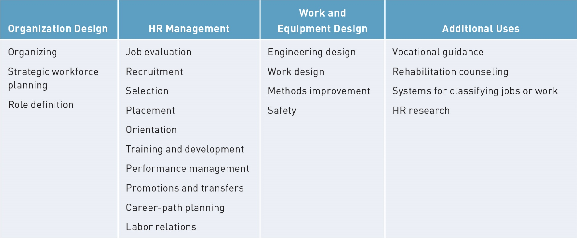
Definition, Professional Standards (2 of 2)

Slide 11
Terminology (1 of 7)
Element
Smallest unit work that can be divided without analyzing separate motions, movements, and mental processes involved
Task
Distinct work activity carried out for a distinct purpose
Example of each for your job?

Slide 12
Terminology (2 of 7)
Duty
Large segment of work performed by individual; may include any number of tasks
Position
One or more duties performed by a given individual in a given firm at a given time
Example of a duty from your job?

Slide 13
Terminology (3 of 7)
Job
Group of positions similar in significant duties
Job family
Group of two or more jobs that call for similar worker characteristics or contain parallel work tasks determined by job analysis

Slide 14
Terminology (4 of 7)
Occupation
Similar jobs across organizations
Vocation (more of a calling)
Similar to occupation; more likely to be used by a worker than employer
Career
Sequence of jobs, one engages in
Who has more than one career?

Slide 15
Terminology Need to consider for your JA (5 of 7)
Work analysis choices (7)
Activities or attributes
General or specific
Qualitative or quantitative
Taxonomy based or blank slate
PAQ or F-JAS (e.g. )
Make a list of these and next two slides
And make conscious choices for each of the nine

Slide 16
Terminology (3 more)
Work analysis choices
5. Observers or
incumbents and supervisors
Why would both be good?
6. Single-job or multiple-job comparison
7. Descriptive or prescriptive
What’s the difference?

Slide 17
Terminology (last 2)
Work analysis choices
Work oriented: (tasks) (activities)
What (outcomes) gets done
Worker oriented: (“p” side attributes)
How the work (outcomes) get done
Notes:
Learning Goal: 9-3: Distinguish work-oriented from worker-oriented descriptors.

Slide 18
Defining the Job
Job description
You’ll need to develop your own for each team
See text to find out what goes in it!!!
Written statement of
What, How and Why a task is done
Job title
Activities and procedures
Working conditions and physical environment
Social environment
Conditions of employment
Notes:
Learning Goal: 9-2: Distinguish the terms task, duty, position, job, and job family from each other.

Slide 19
Job Specifications
What is required to perform it
KSAOs (or) Competencies
personal characteristics valid for
screening,
selection, and
placement
How would screening and selection differ if “placement” is a consideration?
Notes:
with what kind of recruitment would placement be used? When looking For specific job or the person?
Ex. Military

Slide 20
Job Specifications
Scales to assess (quantify)
Tasks
KSAOs
criteria -
for defining the domains for MQs
What are MQs?
Give an example
How important is 20/20 vision for sewing machine operators?
Notes:
Min quals for sewing machine operators ? Sight 20/20
Why important to consider?
MQs may differ for geo region, dif populations / basketball/ HT give examples
Cf basketball in Russia v. Kenya
Levine / May /Ulm, Gordon ‘97 P psyc dev MQ
Buster, Ruth, Bobko ’05; dev content-oriented evidence for ed and exp.

Slide 21
Link Job Spec Tasks
Why link KSAOs to Tasks/ duties?
For Performance Management (PA)
Connect competency to
task performance and outcome (results)
For Legal protection
Avoid allegations re: job relatedness

Slide 22
Reliability and Validity of Work Analysis Information
Interrater reliability
Degree raters agree on components of target work role or job, or extent their ratings covary
Intrarater reliability
Measure of stability (rate-rerate)
What level of r is acceptable?
What are some sources of unreliability?
Notes:
Analysts best/ incumbents lowerst (Dierdorff & Wilson, 2003).
All sorts (16) sources of inaccuracy (Morgeson and Campion (1997) self presentation, social sources (in focus groups)

Slide 23
Obtaining Information About Jobs and Work (1 of 3)
Job observation
For jobs that require a great deal of manual, standardized, short-cycle activities
BE sure to follow fig 9.6 sentence structure for writing task statements !!!!!
WHAT – WHY -HOW – WKR FUNCTIONS
Job performance
For jobs that job analyst can learn readily
Notes:
Not a science (Guion, ‘98) always subjective

Slide 24
Obtaining Information About Jobs and Work (2 of 3)
Interviewing questions
Related to purpose of analysis
Wording clear and unambiguous
Don’t “lead” (loaded question)
Don’t ask for knowledge or information
Interviewee doesn’t have
Notes:
GoodWill ex. Not to “lead”SME.

Slide 25
Obtaining Information About Jobs and Work (3 of 3)
SME panels
Questionnaires
PAQ
Fleishman Job Analysis Survey (F-JAS)
Critical incidents
What’s different about the PAQ and F-JAS?
Notes:
Finite list of attributes
axonomy-based approaches in which relatively general work activities apply to a broad range of work.

Slide 26
Other Sources of Job Information and Job Analysis Methods (1 of 5)
Job Analysis Wizard (JAW)
Capitalizes on advances in
computer technology and
availability of sophisticated information search-and-retrieval methods

Slide 27
Other Sources of Job Information and Job Analysis Methods (2 of 5)
Personality-based job analysis (PBJA)
for cross-functional and
difficult-to-define work that
cannot be described in terms of simple tasks or discrete KSAs

Slide 28
Other Sources of Job Information and Job Analysis Methods (3 of 5)
Big Five personality
What are they?
Neuroticism
Extraversion
Openness to experience
Agreeableness
Conscientiousness
Notes:
Learning Goal: 9-7: Know when to use personality-based job analysis.

Slide 29
Other Sources of Job Information and Job Analysis Methods (4 of 5)
Competency models
Identify variables related to organizational fit
Identify personality characteristics consistent with organization’s vision
Focuses on broader characteristics of individuals
Notes:
Learning Goal: 9-8: Compare and contrast job or work analysis to competency modeling.

Slide 30
Other Sources of Job Information and Job Analysis Methods (5 of 5)
Work analysis for “star” performers
To ID “best practices”
Cognitive Task Analysis (CTA)
- to ID invisible tasks
Selection of the participants
Elicitation of knowledge
Analysis and representation of the knowledge
Notes:
Star performers to find “best practices

Slide 31
Occupational Information (1 of 3)
O*Net Multiple descriptor domains that
provide “multiple windows” into the world of work
Common language of work and worker descriptors that covers entire spectrum of occupations

Slide 32
Occupational Information (2 of 3)
O*Net Description of occupation
….based on a …
taxonomy from broad to specific
Comprehensive content model that integrates the previous three principles
Notes:
Learning Goal: 9-3: Distinguish work-oriented from worker-oriented descriptors.

Slide 33
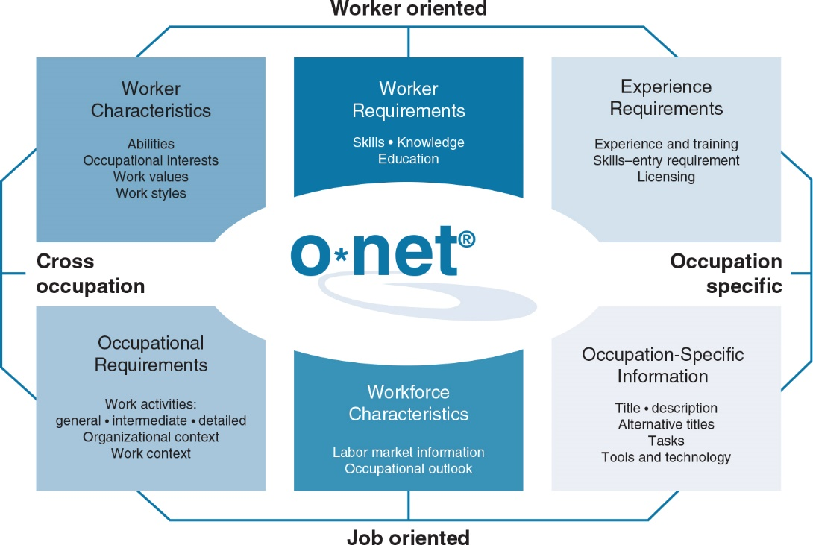
Occupational Information (3 of 3)

