Slide 2
Chapter 10
Strategic Workforce Planning

Slide 3
Learning Goals (1 of 4)
10-1: Describe the four components of the strategic workforce planning process and explain how they work together.
10-2: Explain the relationship between strategic business plans and strategic workforce plans.

Slide 4
Learning Goals (2 of 4)
10-3: Compare and contrast traditional and values-based approaches to developing strategy.
10-4: Identify key talent management issues that arise at various business-planning horizons.

Slide 5
Learning Goals (3 of 4)
10-5: Describe the multiple uncertainties that characterize supply and demand forecasts.
10-6: Know the steps to take to avoid a crisis in leadership succession.

Slide 6
Learning Goals (4 of 4)
10-7: Identify when it makes more sense to “buy” rather than “make” talent.
10-8: Explain the kinds of information to collect when evaluating newly established versus well-established strategic workforce planning systems.

Slide 7
What Is Strategic Workforce Planning? (1 of 6)
Strategic workforce planning
Anticipate and respond to needs emerging within and outside the organization
Determine priorities
Allocate resources where they can do the most good
Notes:
Learning Goal: 10-1: Describe the four components of the strategic workforce planning process and explain how they work together.

Slide 8
What Is Strategic Workforce Planning? (2 of 6)
Strategic workforce planning
Talent inventory
Workforce forecast
Action plans
Control and evaluation
Notes:
Learning Goal: 10-1: Describe the four components of the strategic workforce planning process and explain how they work together.

Slide 9
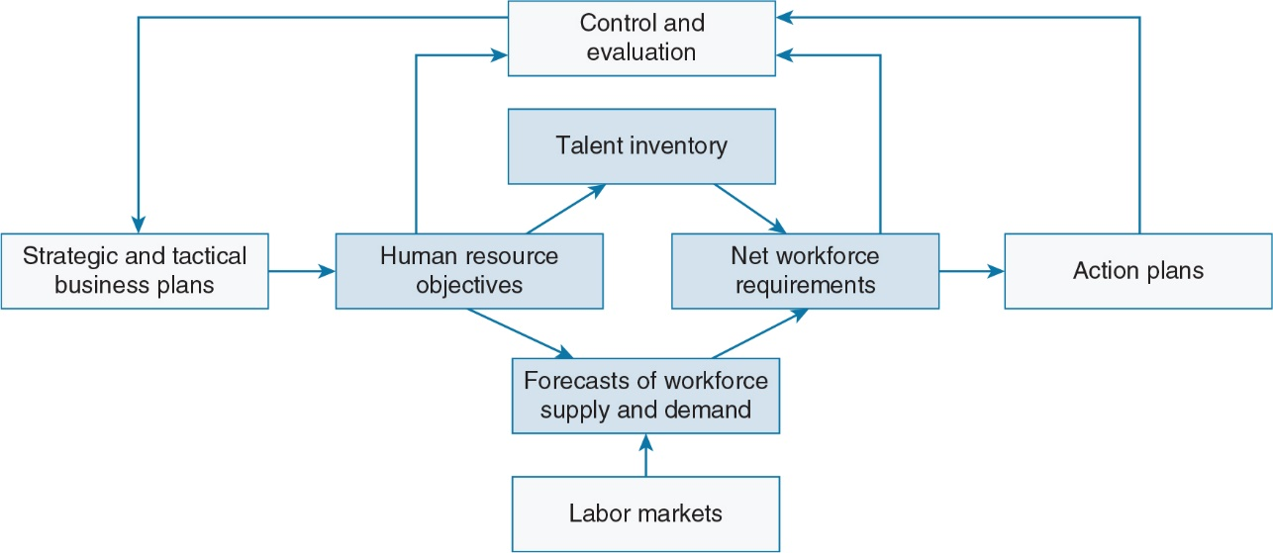
What Is Strategic Workforce Planning? (3 of 6)
Notes:
Learning Goal: 10-1: Describe the four components of the strategic workforce planning process and explain how they work together.

Slide 10
What Is Strategic Workforce Planning? (4 of 6)
Strategic planning
Define company philosophy
Formulate company and sub-unit statements of identity, purpose, and objectives
Evaluate company’s strengths, weaknesses, opportunities, and threats
Notes:
Learning Goal: 10-2: Explain the relationship between strategic business plans and strategic workforce plans.

Slide 11
What Is Strategic Workforce Planning? (5 of 6)
Strategic planning
Determine organization design
Develop appropriate strategies for achieving objectives
Devise programs to implement strategies
Notes:
Learning Goal: 10-2: Explain the relationship between strategic business plans and strategic workforce plans.

Slide 12
What Is Strategic Workforce Planning? (6 of 6)
Alternative, or values-based, approach
Fundamental values energizing and capable of unlocking human potential of people
Use these values to develop management policies and practices that express organizational values
Notes:
Learning Goal: 10-3: Compare and contrast traditional and values-based approaches to developing strategy.

Slide 13
Talent Inventory (1 of 3)
Talent inventory
Fundamental requirement of SWP system
Organized database of existing skills, abilities, career interests, and experience of current workforce
Notes:
Learning Goal: 10-4: Identify key talent management issues that arise at various business-planning horizons.

Slide 14
Talent Inventory (2 of 3)
Talent inventory information
Current position information
Previous positions in company
Other significant work experience
Education
Language skills and international experience
Notes:
Learning Goal: 10-4: Identify key talent management issues that arise at various business-planning horizons.

Slide 15
Talent Inventory (3 of 3)
Talent inventory information
Training and development programs attended
Community or industry leadership responsibilities
Current and past performance appraisal data
Disciplinary actions
Awards received
Notes:
Learning Goal: 10-4: Identify key talent management issues that arise at various business-planning horizons.

Slide 16
Forecasting Workforce Supply and Demand (1 of 6)
Workforce forecasts
Anticipating supply of human resources, inside and outside organization, at future time period
Anticipating organizational demand for various types of employees
Notes:
Learning Goal: 10-5: Describe the multiple uncertainties that characterize supply and demand forecasts.

Slide 17
Forecasting Workforce Supply and Demand (2 of 6)
External workforce supply
Several agencies make projections of external labor-market conditions and future occupational supply
Gauge both future supply of workers in a particular field and future demand for workers
Notes:
Learning Goal: 10-5: Describe the multiple uncertainties that characterize supply and demand forecasts.

Slide 18
Forecasting Workforce Supply and Demand (3 of 6)
Internal workforce supply
Current workforce provides base from which to project future supply of workers
Form of risk management
Notes:
Learning Goal: 10-5: Describe the multiple uncertainties that characterize supply and demand forecasts.

Slide 19
Forecasting Workforce Supply and Demand (4 of 6)
Leadership-succession planning:
Set a planning horizon
Assess current performance and readiness for promotion
Identify replacement candidates
Identify career-development needs
Integrate career goals of individuals with company goals
Notes:
Learning Goal: 10-6: Know the steps to take to avoid a crisis in leadership succession.

Slide 20
Forecasting Workforce Supply and Demand (5 of 6)
Succession planning key objectives:
Identify top talent
Develop pools of talent for critical positions
Identify development plans for key leaders
Notes:
Learning Goal: 10-6: Know the steps to take to avoid a crisis in leadership succession.

Slide 21
Forecasting Workforce Supply and Demand (6 of 6)
Primary causes of CEO succession:
Poor performance
Scapegoating
Strategic shift
Planned succession
Unexpected succession
Notes:
Learning Goal: 10-6: Know the steps to take to avoid a crisis in leadership succession.

Slide 22
Workforce Demand (1 of 3)
Pivotal jobs
Centrality to organization’s strategy; potential for significant variation in performance between average and top performer
Potentially significant impact on strategic objectives when quantity of people who occupy those roles increases
Notes:
Learning Goal: 10-5: Describe the multiple uncertainties that characterize supply and demand forecasts.

Slide 23
Workforce Demand (2 of 3)
Accuracy in forecasting
Varies considerably by firm and by industry
5% to 35% error factor
Depends on degree of flexibility in staffing workforce
Notes:
Learning Goal: 10-5: Describe the multiple uncertainties that characterize supply and demand forecasts.

Slide 24
Workforce Demand (3 of 3)
“Make-or-buy” decision
To avoid mismatch costs, balance “make” and “buy”
Often more cost-effective to buy rather than to make
Notes:
Learning Goal: 10-7: Identify when it makes more sense to “buy” rather than “make” talent.

Slide 25
Control and Evaluation (1 of 3)
Function of control and evaluation
Guide SWP activities through time
Identify deviations from plan and their causes
Goals and objectives are yardsticks in measuring performance
Notes:
Learning Goal: 10-8: Explain the kinds of information to collect when evaluating newly established versus well-established strategic workforce planning systems.

Slide 26
Control and Evaluation (2 of 3)
Sampling and measuring performance
Examination of costs of current practices
Employee and management perceptions of results
Analysis of costs and variations in costs under alternative decisions
Notes:
Learning Goal: 10-8: Explain the kinds of information to collect when evaluating newly established versus well-established strategic workforce planning systems.

Slide 27
Control and Evaluation (3 of 3)
Responsibility for workforce planning
SWP basic responsibility of every line manager in organization
Success rests on quality of action programs established to achieve HR objectives and ability to implement these programs
Notes:
Learning Goal: 10-8: Explain the kinds of information to collect when evaluating newly established versus well-established strategic workforce planning systems.

Slide 28
Evidence-Based Implications for Practice (1 of 4)
Recognize that organizations compete just as fiercely in talent markets as they do in financial and customer markets.
Plan for people in the context of managing a business strategically, recognizing the tight linkage between HR and business strategies.

Slide 29
Evidence-Based Implications for Practice (2 of 4)
View the four components of a SWP system--a talent inventory, forecasts of workforce supply and demand, action plans, and control and evaluation--as an integrated system, not as unrelated activities.

Slide 30
Evidence-Based Implications for Practice (3 of 4)
With respect to leadership succession, recognize that the CEO must drive the talent agenda. It all begins with commitment from the top.
Identify and communicate a common set of leadership attributes to promote a common set of expectations for everyone in the organization about what is expected of leaders.

Slide 31
Evidence-Based Implications for Practice (4 of 4)
Keep to a regular schedule for performance reviews, broader talent reviews outside one’s functional area, and the identification of talent pools for critical positions.
Link all decisions about talent to the organization’s business strategy.

