Slide 1
Assessment of Training and Experience: Technology for Assessment
Peter W. Foltz
Pearson
pfoltz@pearsonkt.com
www.pearsonkt.com
Notes:
Technology plays a critical role in the creation of effective training and assessment approaches that better model performance in real-life contexts. Computer-based interactive simulations and virtual worlds provide realistic training and experiences that can train and test higher-level thinking and communication skills and the job abilities that are typically needed in the 21st century workplace. These technologies further drive the need for new assessment technologies for automated written and spoken language assessment. Such technologies are becoming more widely used for assessing the quality of oral and written expression as well as the degree of domain knowledge and performance skills. This talk will discuss how technology is being applied and addresses the promise of more efficient testing in more realistic contexts while maintaining high levels of accuracy.
Goal of the talk will be to discuss some of the directions assessment technology is going and how it is used.

Slide 2
Overview
What aspects in T&Es are amenable to automated analysis to improve accuracy and/or efficiency?
Natural language processing approaches applied to open-ended responses
Some examples related to T&Es and scoring open-ended responses to writing and situation assessment
Implications for applying automated assessment methods for (and beyond) T&Es

Slide 3
Approaches to T&E Data
Application blanks, résumés
T&E Checklists
  Task-based questionnaire (TBQs)
  KSA-based questionnaire (KSABQs)
Accomplishment Records (ARs)
  Write about experience, proficiencies and job-related competencies
Scoring
  Point based methods vs. holistic methods
Notes:
Perhaps the most ubiquitous T&E data collection method is the application blank. Application blanks are used to collect specific information about an applicant’s work history and educational background. Résumés can be substituted for an application blank and may describe the major duties associated with each position in the work history, specific coursework, special skills and credentials, and other qualifications.What aspects in T&Es are amenable to automated analysis to improve accuracy and/or efficiency

Slide 4
Applicant Responses (ARs)
Applicants provide “accomplishments” that demonstrate their level of proficiency within job –related competencies
  Accomplishments are “specific, verifiable behavioral examples of performance”
Most appropriate for higher level positions that require
  Experience
  Management
  Writing skills
  Reasoning, problem solving, knowledge
Advantage over other approaches: requires generation not recognition
Human rating approach
  Holistic 4-6 point scale
  Scored holistically on rubrics
  Overall, presentation, knowledge, messaging, grammar/mechanics, ….

Slide 5
Language skills, experience and domain knowledge
A candidate’s expression of spoken and written language is a reflection of their domain knowledge, experience as well as their language ability
  True for essays, job situation tests, as well as ARs
  Decoding processes, syntactic processing,, word/idea combination, comprehension, …
  With practice, proceduralized skills become more automated
  With automaticity, more available working memory for higher-level processing
    Comprehension, synthesis, problem solving, organization, …
You can’t write or say it if you don’t know it.
Notes:
You can’t write or speak about what you don’t know. if you don’t know the language well You can’t comprehend or generate in a facile way,.

Slide 6
A challenge for assessment
Hand scoring written responses is time consuming, hard to train for high reliability
Technology must meet this challenge
  Convert written and spoken performance into measures of skills and abilities
  Reliable, valid, efficient, cost effective.
  Able to be applied to a range of assessment items
    Content. not just writing ability:
    ARs
    Skills, Writing ability, Communication Ability, Problem Solving, Critical Thinking, SJTs ….
    Engaging and realistic items that train and test people within the context and content for the workplace
  Able to be incorporated into existing assessment workflow
Notes:
What are complex cognitive skills: Comprehending, using within appropriate context, shnthesizing, problem solving, and creating effective communication.
that being ICT literate is much more than just having good technology skills. It is learning core subjects with application of these learning skills and communication tools.

Slide 7
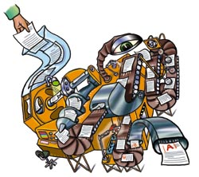
Automated scoring of written responses

Slide 8
Automated scoring: How it works
Measures the quality of written responses by determining language features that human scorers use and how those features are combined and weighed to provide scores
System is trained on 200+ human scored essays and “learns” to score like the human scorers
Measures
  Content
    Semantic analysis measures of similarity to prescored essays, ideas, examples, ….
  Style
    Appropriate word choice, word and sentence flow, fluency, coherence, ….
  Mechanics
    Grammar, word usage, punctuation, spelling, …
Any new essay is compared against all 200 prescored essays to determine score.

Slide 9
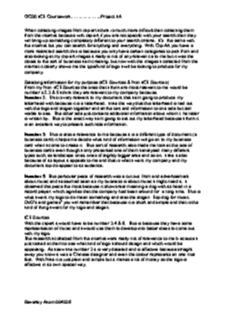



Development
Human Scorers
System is “trained” to predict human scores
Validation
Expert human ratings
Very highly correlated
Machine scores

Slide 10
How it works: Content-based scoring
Content scored using Latent Semantic Analysis (LSA)
  Machine-learning technique using
  sophisticated linear algebra
  Enormous computing power
to capture the “meaning” of written English:
Knows that
  Surgery is often performed by a team of doctors.
  On many occasions, several physicians are involved in an operation.
mean almost the same thing even though they share no words.
Enables scoring the content of what is written rather than just matching keywords
Used as a psychological model for studying acquisition of language
Technology is also widely used for search engines, spam detection, tutoring systems….
Notes:
Underlying technology is used in search engines, spam detection, tutoring systems

Slide 11
Scoring Approach
Can score holistically, for content, and for individual writing traits
Content
Development
Response to the prompt
Effective Sentences
Focus & Organization
Grammar, Usage, & Mechanics
Word Choice
Development & Details
Conventions
Focus
Coherence
Messaging
Reading Comprehension
Progression of ideas
Style
Point of view
Critical thinking
Appropriate examples, reasons and other evidence to support a position.
Sentence Structure
Skill use of language and accurate and apt vocabulary
Detects off-topic and unusal essays and flags them for human scoring
Notes:
IEA can score almost any trait that is scored on the basis of a textual answer.
The biggest constraint is that human raters must score the trait reliably in order to train IEA.
Unfortunately human trait scores tend to be less reliably scored than holistic, and strongly correlated with each other and with holistic scores.

Slide 12
Automated accomplishment record scoring
1) Initial steps same as human-based assessment
  Job Analysis
  Develop inventory
  Administer to collect sample ARs (100-200+)
  Develop AR rating scales and score by experts
2) Develop automated scoring system
  Train system on samples with expert scores
  Test generalization on held-out set of data for reliability
    Reliability of expert scorers to automated scoring
  Deploy
Potential for this approach for Application Blanks
Notes:
e job analysis data should specify job dimensions or competencies. Once the job analysis is com-plete, the AR inventory can be developed (Step 2). An AR inventory provides targeted performance dimension definitions and typically requests specific information for each competency or job dimension listed, including: a general statement of the accomplishment, a precise description of exactly what was done,

Slide 13
Implications for scoring ARs for T&Es
Performance of scoring ARs
  Scores on multiple traits
    Presentation (Organization and Structure)
    Grammar, Usage, Mechanics
    Message (Content)
    Overall
    Others….
Actual test results
  Agrees with human raters at same rate as human raters (correlation, exact agreement)

Slide 14
Generalization of approach to other automated assessments writing
Can be used to assess general competencies and domain knowledge/skills
  Writing ability
  Language skills
  Cognitive ability
  Job/Technical Knowledge
  Problem solving skill
  Leadership
Notes:
Won’t be able to go into the details about how it works, will give just a bit on how well it works, but like to show where technology is going for automated assessents.

Slide 15
Writing scoring in operation
National/International Assessments and placement
  College Board Accuplacer® test
  Pearson Test of Academic English
  Corporate and Government placement and screening
  Versant Professional
State Assessments
  South Dakota, Maryland
Writing Practice
  Prentice Hall; Holt, Rinehart, and Winston Language Arts
  Kaplan SAT practice
  GED practice essays
  WriteToLearn®
Notes:
Gaining wider acceptance. Now widely used in k-12 educational system. Some State tests, GMAT, College Board, Accuplacer. Used in some
Can be used a second scorer or only scorer

Slide 16
Some examples of its use relevant to job performance assessment
Classroom and Standardized testing essays
Situational assessments and memo writing for DOD
Scoring Physician patient notes
Language testing and translations
  Email writing
  Translation quality

Slide 17
Reliability for GMAT Test Set
Notes:
GMAT Issue Prompt (College Graduate)
“Everywhere, it seems, there are clear and positive signs that people are becoming more respectful of one another’s differences.” In your opinion, how accurate is the view expressed above? Use reasons and/or examples from your own experience, observations, or reading to develop your position.
Training set N:403
Test set N: 283
There was opportunity for a wide variety of different good and bad answers, including different discussions of different examples reaching different conclusions and using fairly disjoint vocabularies, and at least an apparent opportunity for novel and creative answers to have received appropriate scores from the human judges. Although it was therefore thought that the LSA approach might be of limited value, the method was nevertheless applied. To our surprise, it worked quite well. The reliabilities for the IEA matched the reliabilities for the well-trained readers.

Slide 18
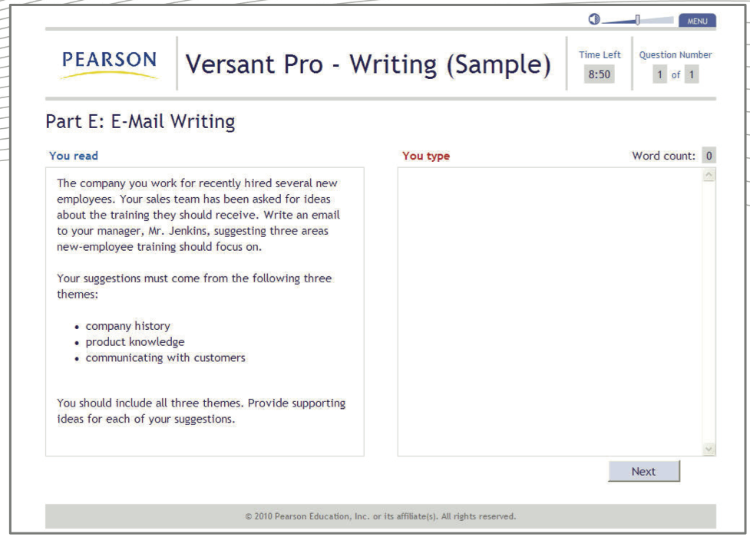
Email writing in Versant Professinal
Notes:
Vpro for writing designed to measure the candidate’s ability to understand and use english in workplace contexts. General to industry and job category. How well can they processand write english efficiently

Slide 19
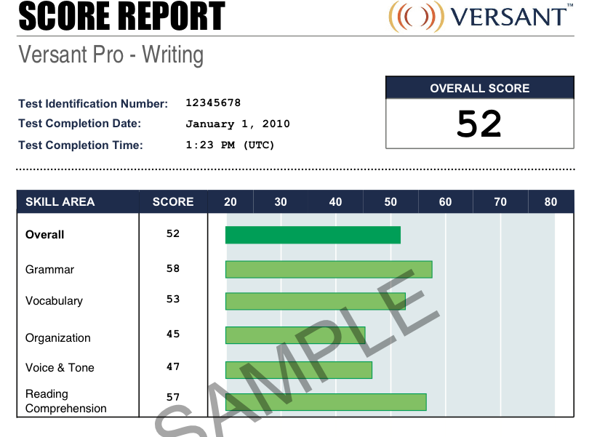

Slide 20
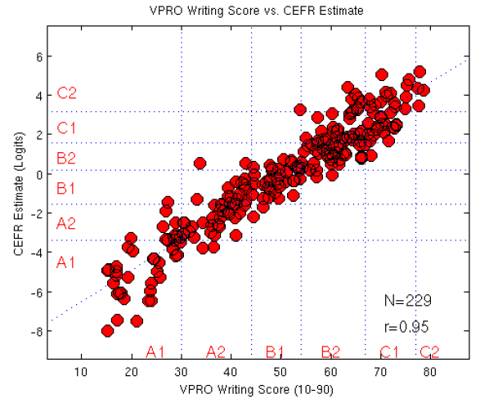
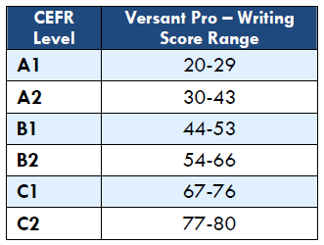
Versant Pro Writing scores compared to the Common European Framework for Writing
Notes:
Basic, Proficient, Independent

Slide 21
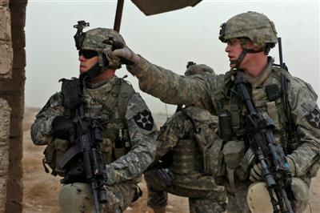

Assessment of critical thinking and problem solving through writing
Assess trainee decision-making through having officers write responses to realistic scenarios
Tacit Leadership Knowledge Scenarios
You are a new platoon leader who takes charge of your platoon when it returns from a lengthy combat deployment. All members of the platoon are war veterans, but you did not serve in the conflict. In addition, you failed to graduate from Ranger School. You are concerned about building credibility with your soldiers. What should you do?
Notes:
Karen Cator Military: Technology is a force multiplier
Military has embraced new training technology. In a sense, they are the most concerned about 21st Century skills
“Think Like a commander”

Slide 22
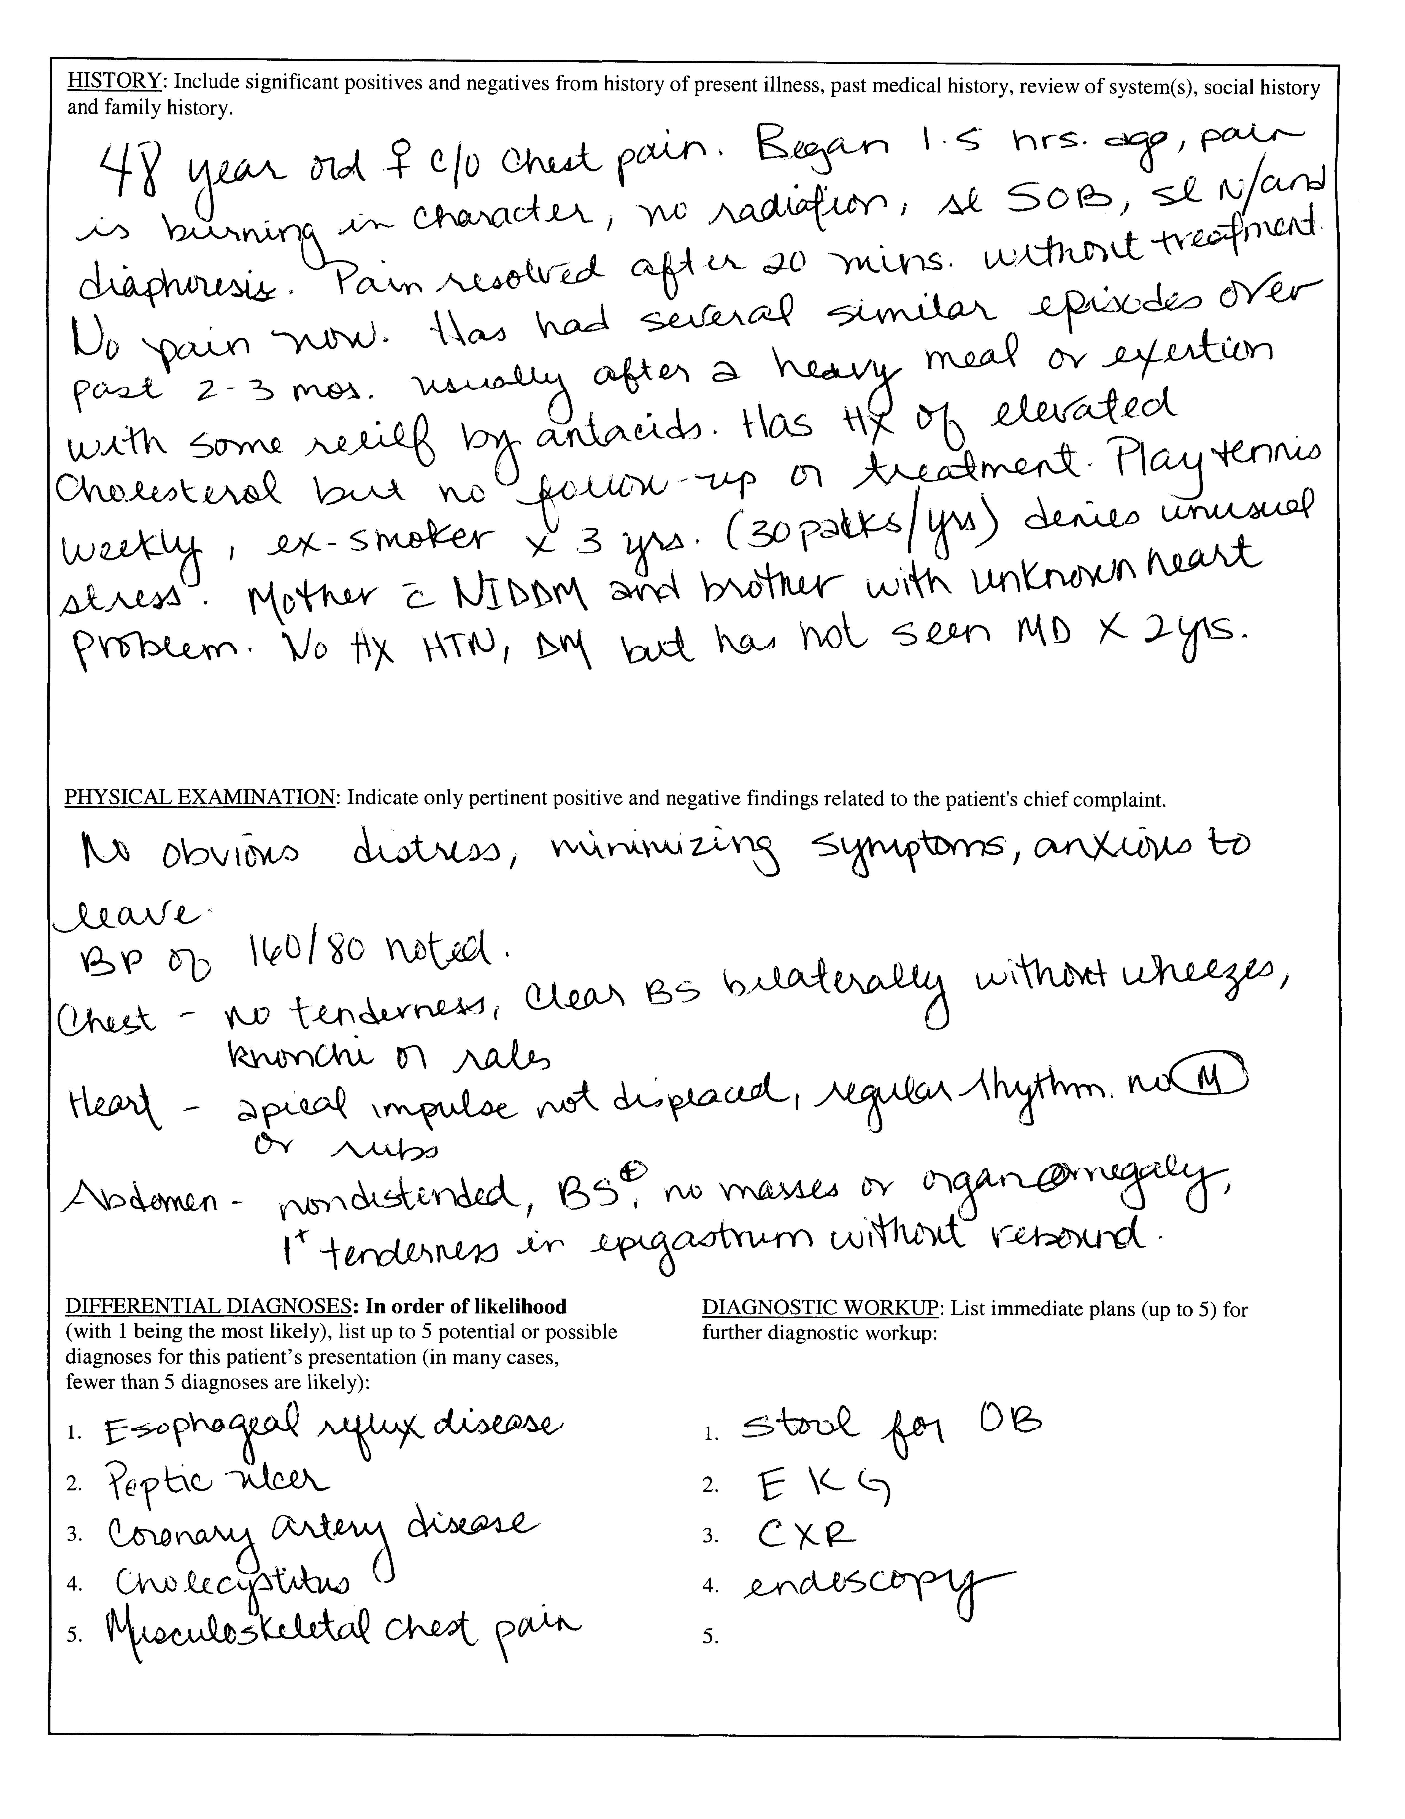
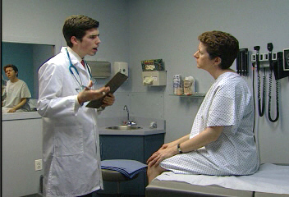
Automated Scoring of Diagnostic Skills
National Board of Medical Examiners study
Doctors in training conduct interviews of actors playing patients and then write a patient notes
Clinical skills
  taking a medical history,
  performing an appropriate physical examination, communicating effectively with the patient,
  clearly and accurately documenting the findings and diagnostic hypotheses from the clinical encounter
  ordering appropriate diagnostic studies.
A test of trainee’s relevant skills in realistic situations
Notes:
Doctors in training conduct interviews of actors playing patients and then write a patient notes
Clinical skills include taking a medical history, performing an appropriate physical examination, communicating effectively with the patient, clearly and accurately documenting the findings and diagnostic hypotheses from the clinical encounter, and ordering appropriate diagnostic studies.
A test of trainee’s relevant skills in realistic situations

Slide 23
Patient Note Reliability Results

Slide 24
Why use automated scoring?
Consistency
  A response that is graded a 2 today is a 2 tomorrow is a 2 in three months
Objectivity
Efficiency
  Responses are evaluated in seconds
  Reports can be returned more quickly
  Costs can be reduced
Reliability and Validity
Can detect off-topic, inappropriate and “odd” responses
Notes:
Doesn’t get tired, board, lazy, cranky, distracted and applies the rubric the same way every time.

Slide 25
Conclusions
Automated scoring technology is coming of age
    Written and Spoken language assessment
Approach proven in K-12, Higher Education
Expanding more slowly into job assessment
Assesses ARs, competencies, language ability and higher level cognitive skills
  Mimics human approach to judgment
  Testing abilities and skills related to job performance
  Tasks relevant to the context of the workplace
Automated scoring can be used for accurate and efficient assessment

