Slide 1
Chapter One
Introduction to Training & Development

Slide 2
Objectives
Discuss the forces influencing the workplace and learning and explain how training can help companies deal with these forces
Draw a figure or diagram and explain how training, development, informal learning, and knowledge management contribute to business success
Discuss various aspects of the training design process

Slide 3
Objectives
Describe the amount and types of training occurring in U.S. companies
Discuss the key roles for training professionals
Identify appropriate resources for learning about training research and practice

Slide 4
Importance of Training
There are many challenges and opportunities in the workplace today
Training equips individuals with necessary knowledge, skills, and abilities
Training serves to attract employees to companies, engages, them, and promotes retention
Training helps to create a competitive advantage

Slide 5
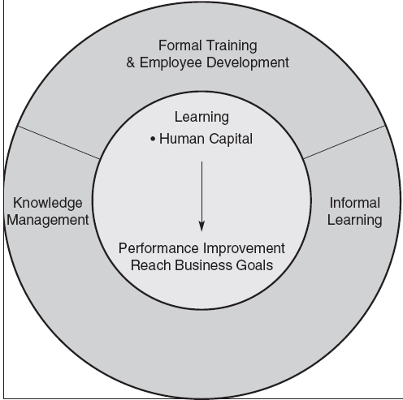
Key Components of Learning

Slide 6
Key Components of Learning
Learning
Acquiring knowledge, skills, competencies, attitudes, or behaviors
Human Capital
Knowledge
Advanced skills
System understanding and creativity
Motivation to deliver high-quality products and services

Slide 7
Key Components of Learning
Training
Facilitates learning job-related competencies, knowledge, skills or behavior
Development
Future focused—includes formal education, job experiences, relationships, and assessments
Formal Training and Development
Developed and organized by the company

Slide 8
Key Components of Learning
Informal learning
Learner initiated
Occurs without a trainer or instructor
Motivated by an intent to develop
Does not occur in a formal learning setting
Breadth, depth, and timing is controlled by the employee

Slide 9
Key Components of Learning
Explicit Knowledge
Well documented, easily articulated, and easily transferred from person-to-person
Primary focus of formal training
Tacit Knowledge
Personal knowledge based on individual experiences that is difficult to codify
Facilitated by informal learning

Slide 10
Key Components of Learning
Knowledge Management
Tools, processes, systems, structures, and cultures to improve the creation, sharing, and use of knowledge

Slide 11
Systematic Training Design

Slide 12
ADDIE
Analysis
Design
Development
Implementation
Evaluation

Slide 13
Questions
Why is it important to systemically design training?
What are the limitations of the ISD and ADDIE models?
What should you do in practice?

Slide 14
Forces Impacting Learning
Economic cycles
Globalization
Value of intangible assets and human capital
Focus on links to business strategy
Changing demographics and diversity
Generational differences
Talent management
Customer service and quality emphasis
New technology
High-performance models of work systems

Slide 15
Economic Cycles
In difficult times, companies may be tempted to reduce training expenditures
However, doing so may be detrimental
For example, companies that used more selective staffing and training before the recession of 2009 performed better and recovered more quickly

Slide 16
Globalization
Global companies must find talented employees
Expatriates require training for success
Individuals from different countries come to the U.S. for low-skill work and highly technical positions
There are pros and cons of outsourcing

Slide 17
Intangible Assets

Slide 18
Implications
Knowledge workers are becoming more important
A greater focus on employee engagement is needed
There is an increasing need for companies to become “learning organizations”

Slide 19
Links to Business Strategy
Given the importance of intangible assets and human capital, training has greater strategic importance
Training is no longer an isolated function, but rather an integral part of business success
Different companies have different strategic training needs—one size does not fit all

Slide 20
Racial and Ethnic Diversity
The U.S. labor force will continue to grow more racially and ethnically
The projected annual growth rates are higher for Hispanics and “other groups” than for African Americans
By 2022, the workforce is projected to by 78% Caucasian

Slide 21
The Aging Workforce
Insert Figure 1.3

Slide 22
Five Generations at Work in 2022
Traditionalist
Baby Boomers
Generation X
Generation Y—Millennials
Generation Z—Digital Natives

Slide 23
Managing Diversity
Communicating effectively
Coaching, training, and developing
Providing performance feedback that is free of stereotypes
Recognizing and responding to generational differences
Allowing employees of all backgrounds to be creative and innovative

Slide 24
Talent Management
Systematic, planned, and strategic effort by a company to attract, retain, develop, and motivate highly skilled talent
Key components
acquiring and assessing employees
learning and development
performance management and compensation

Slide 25
Talent Management
It’s important for a number of reasons:
Changes in demand for certain occupations and jobs
Cognitive and interpersonal skill requirements
Anticipated retirement of baby boomers
Developing managerial talent

Slide 26
Service & Quality Emphasis
Total Quality Management (TQM)
Companywide effort to continuously improve the ways people, machines, and systems accomplish work
Quality Standards
Malcolm Baldrige National Quality Award
ISO 9000:2000

Slide 27
Baldrige Award Criteria
Leadership
Measurement, analysis, and knowledge management
Strategic planning
Workforce focus
Operational focus
Results
Customer focus

Slide 28
Service & Quality Emphasis
Six Sigma
Measuring, analyzing, improving, and then controlling processes once they have been brought within the narrow six sigma quality tolerances or standards

Slide 29
New Technology
Technology has changed how we train
Training can occur at any time, anywhere
Training is more consistent and more realistic
More individuals can now be trained
Knowledge can be shared by readily
Trainers roles have evolved
Many organizations used blended training methods

Slide 30
Challenges with New Technology
Not all trainees may be comfortable with technology
It may be difficult to engage trainees and ensure compliance with training
Some trainees may desire greater “live” interaction with trainers

Slide 31
High Performance Systems
Work teams
Employees interact to assemble a product or provide a service
Cross training
Training employees in a range of skills to fill roles needed to be performed
Virtual teams
Teams separated by time, geographic, and organizational boundaries

Slide 32
Snapshot of Training Practices
Direct expenditures have remained stable
Increased demand for specialized learning that includes professional or industry-specific content
Use of technology-based learning has increased
Self-paced online learning is the most common technology-based learning

Slide 33
Snapshot of Training Practices
Technology-based learning has helped improve learning efficiency
Technology-based learning has resulted in a larger employee–learning staff member ratio
The percentage of services distributed by external providers has remained the same since 2010

Slide 34
BEST Award Winners
Training supports business strategy
Visible support from top management
Efficiency in training
All employees with access to training on an as-needed basis
Variety of learning opportunities
Measurement of training effectiveness
Use of non-training solutions

Slide 35
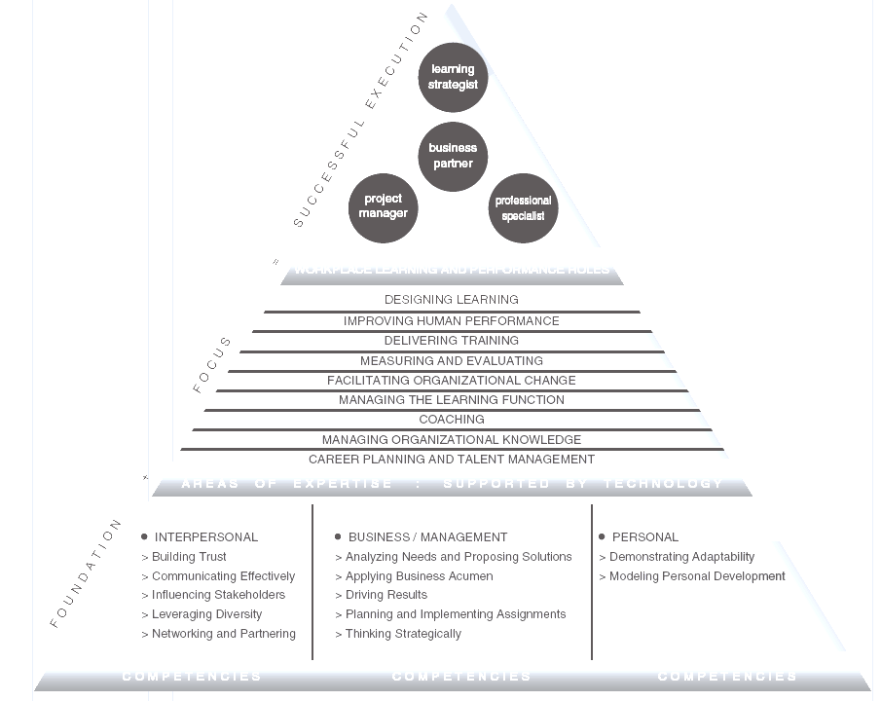
ATD Competency Model

Slide 36
Training Roles
Learning Strategist
Determines how learning can be used to align with business strategy
Business Partner
Uses business knowledge and industry expertise to create training that improves performance

Slide 37
Training Roles
Project Manager
Plans and monitors delivery of learning and performance solutions to support the business
Professional Specialist
Designs, develops, delivers, and evaluates learning and performance systems

Slide 38
Professional Associations
Association for Talent Development (ATD)
Academy of Human Resource Development (AHRD)
Society for Human Resource Management (SHRM)
Society for Industrial and Organizational Psychology (SIOP)
Academy of Management (AOM)
International Society for Performance Improvement (ISPI)

