Slide 1
Winter School: UB Student Perspective
2017-2018 Erasmus Mundus Winter School
Jay Souder

Slide 2
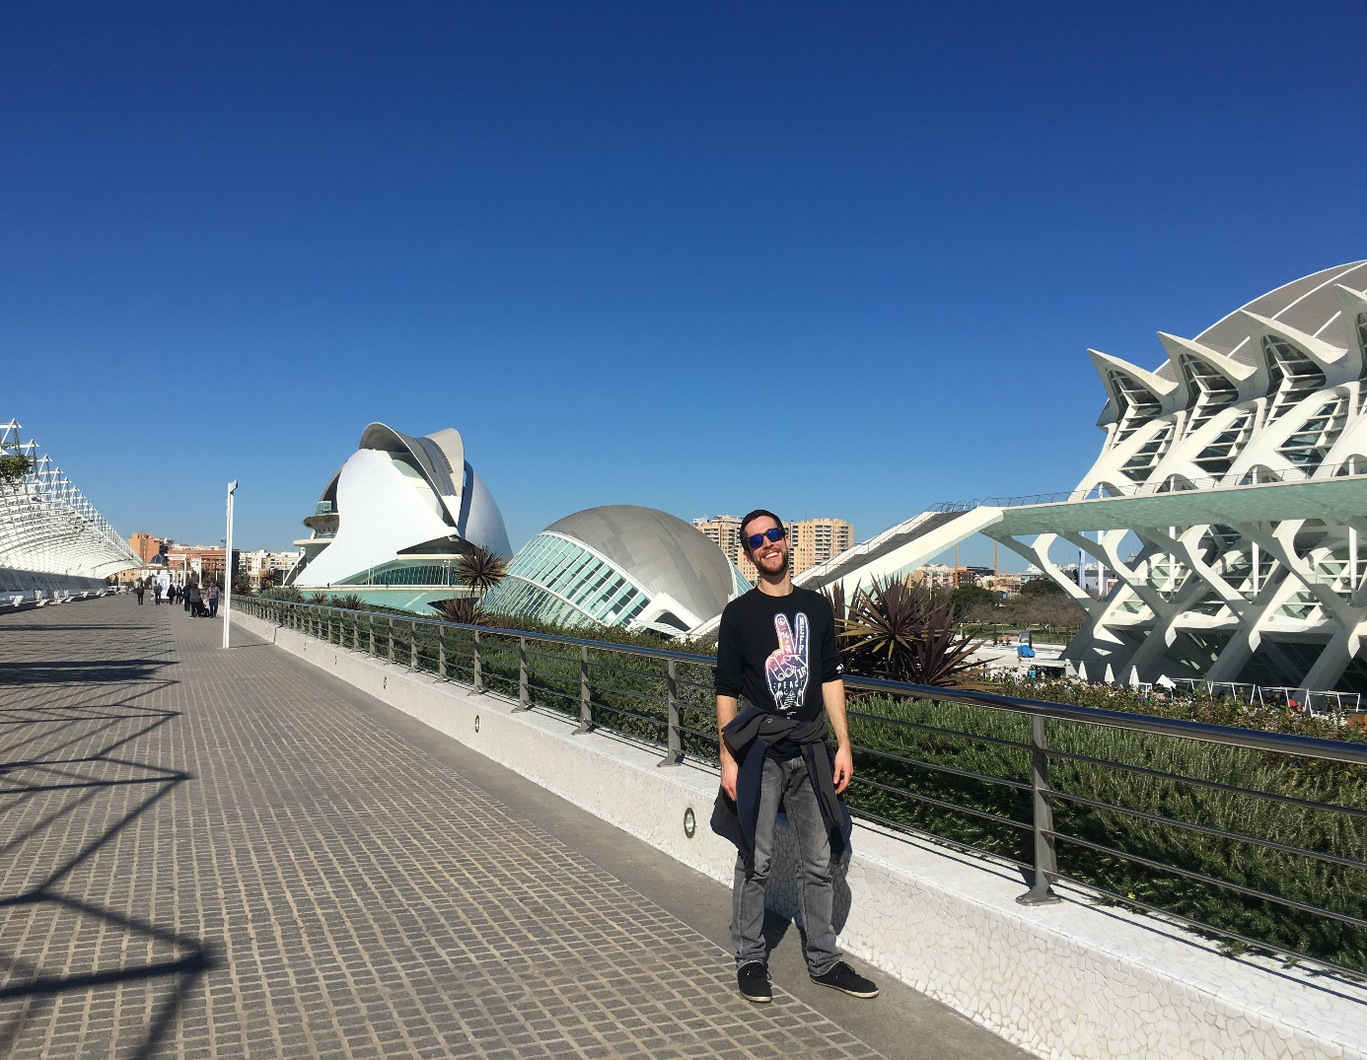
Presentation Overview
Application Process
Preparing for Winter School
Global Virtual Teams (GVTs)
In-Residence Phase
Final Assignment

Slide 3
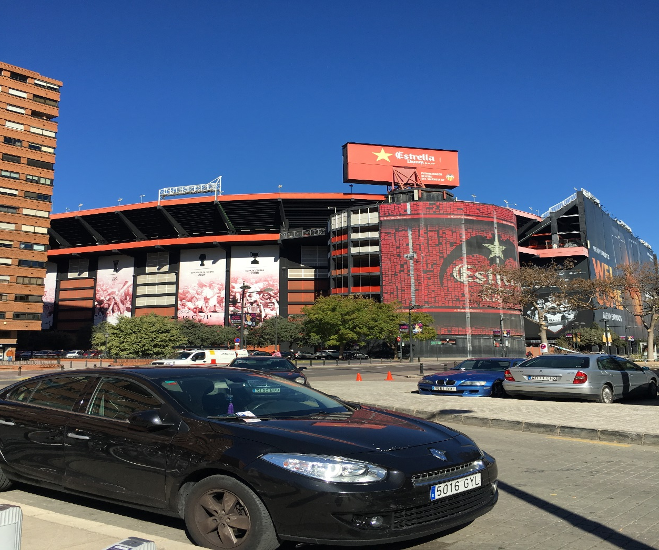
Valencia, Spain

Slide 4
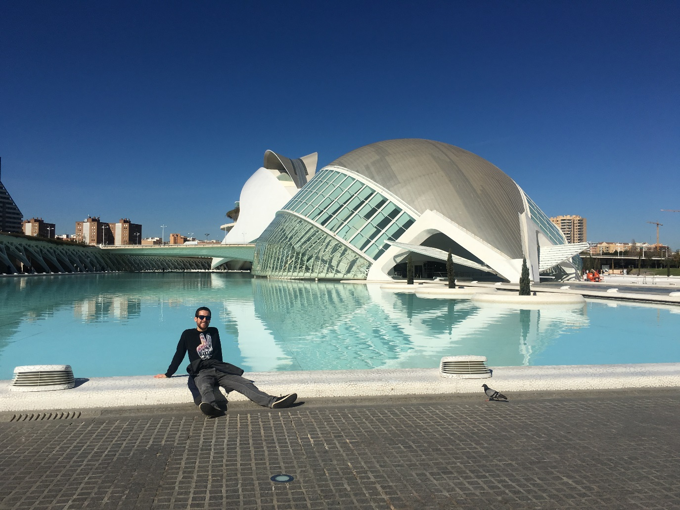
Application Process
Application/CV
Letter of Recommendation
Cost ~ $1,500
Flight: $590
Travel Insurance: $43
Lodging: $543
Other: $300

Slide 5
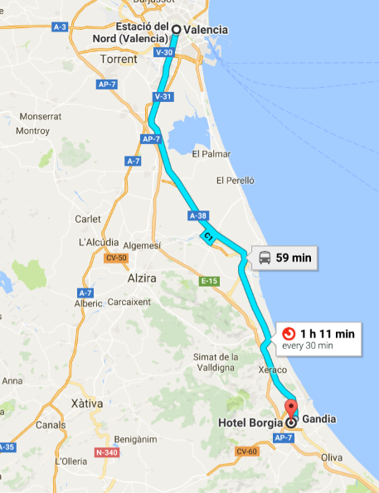
Preparing for Winter School
Academic Preparation
Balancing UB and Winter School
Time Zones, GVTs, and Cultural Barriers
Travel Preparation
Flights and layovers, Passport, Lodging
Personal Preparation
Has anybody recently been abroad?
Does anybody speak Spanish?

Slide 6
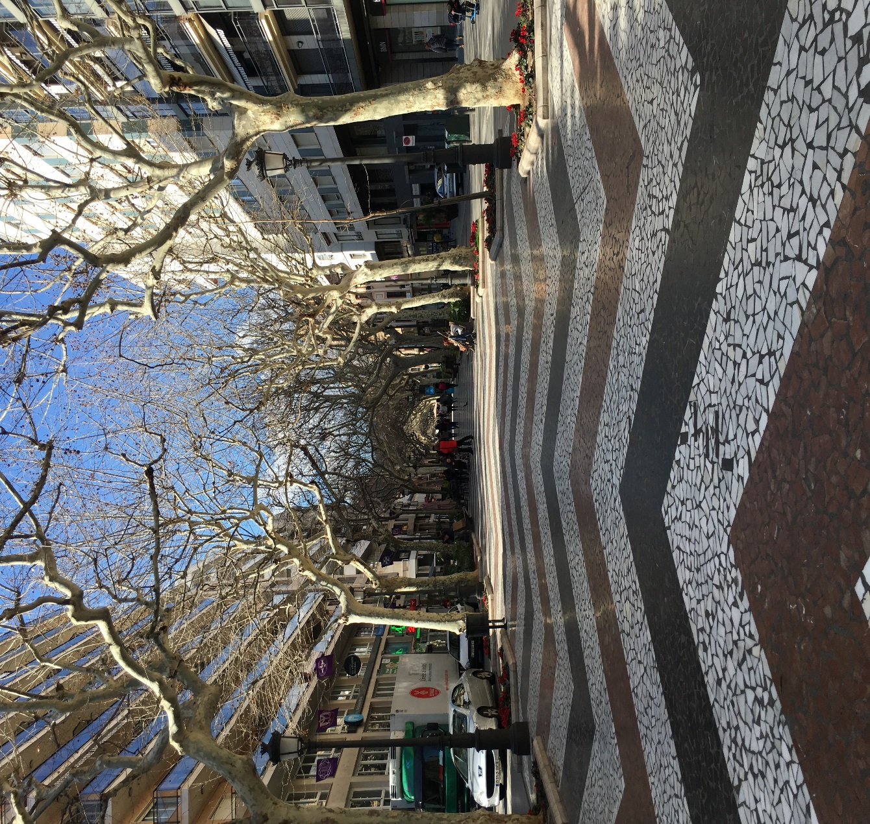
Gandia, Spain

Slide 7
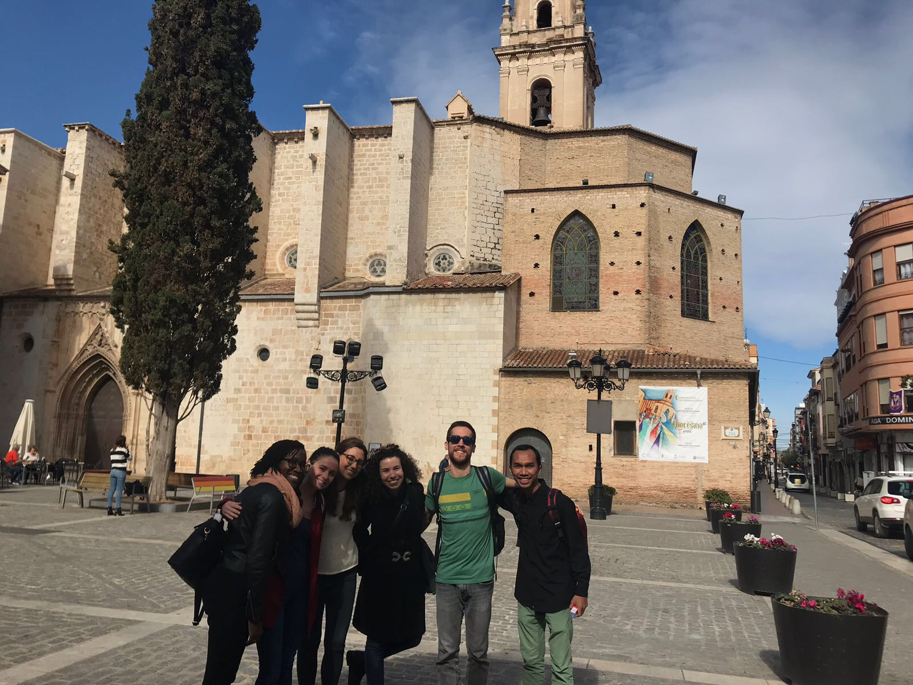
Global Virtual Teams (GVTs) in the Winter School
November – February (3 months)
5 modules (1 in-residence)
Group projects
Literature review and assigned readings
Aula Virtual
Erasmus Mundus version of Sakai
Online teamwork
WhatsApp, Skype, Google Docs
Meeting with Professors

Slide 8
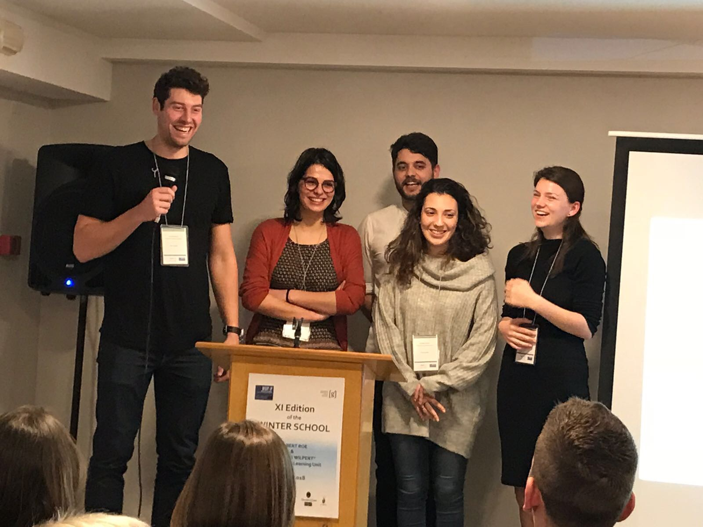
In-Residence Phase
February 19th – March 2nd
Valencia to Gandia
Hotel Borgia
Gandia
Beach town
Las Falles

Slide 9
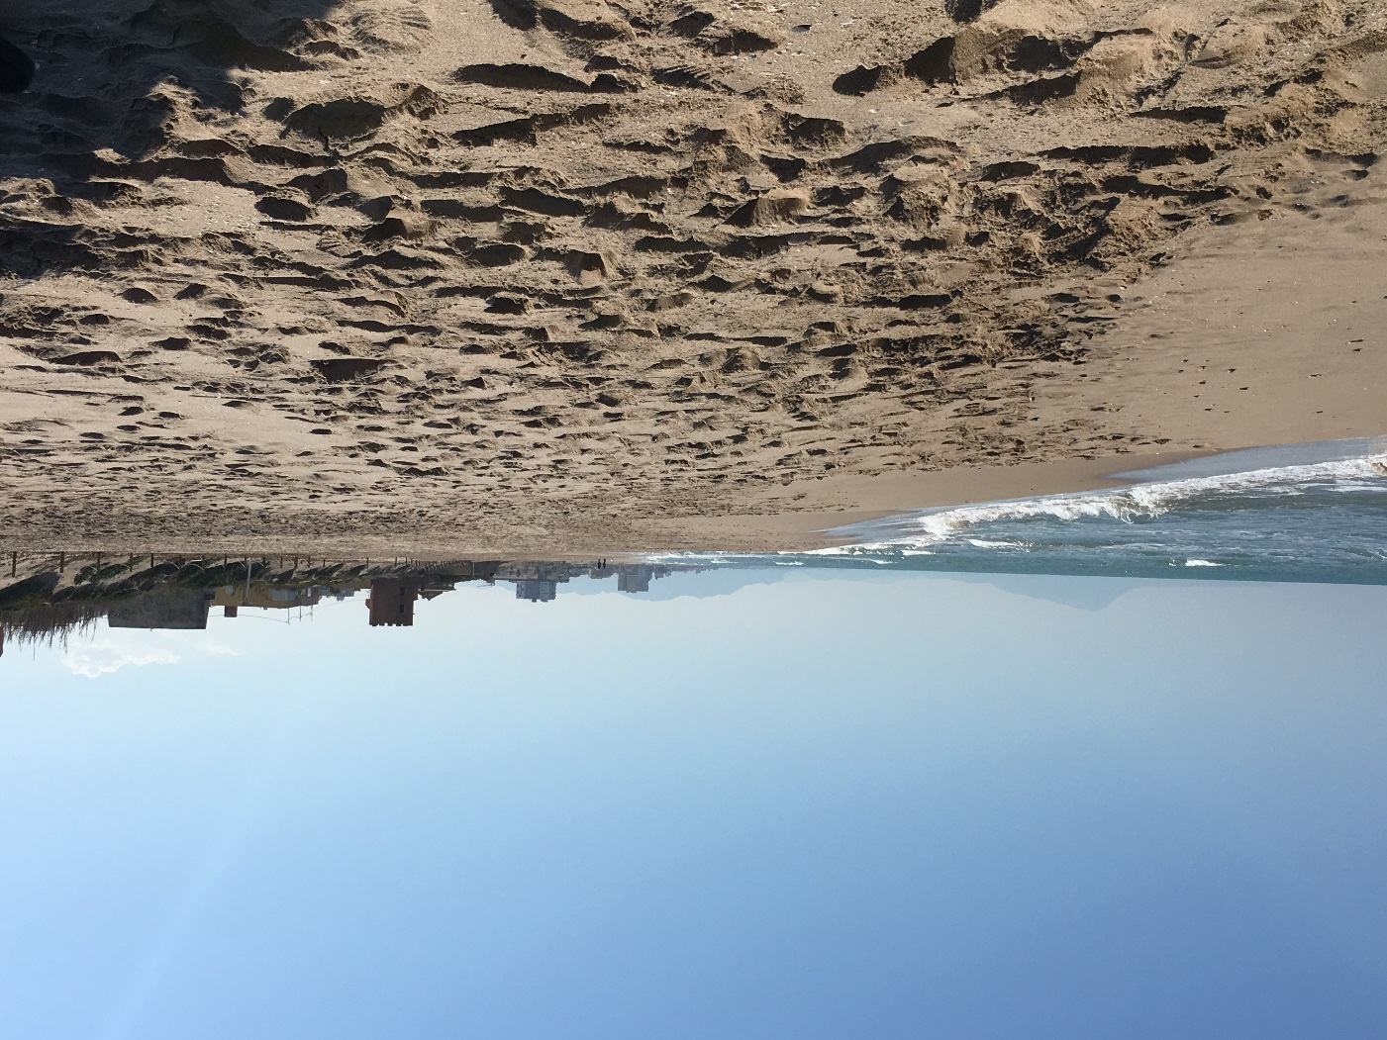
Vamos a la playa!

Slide 10
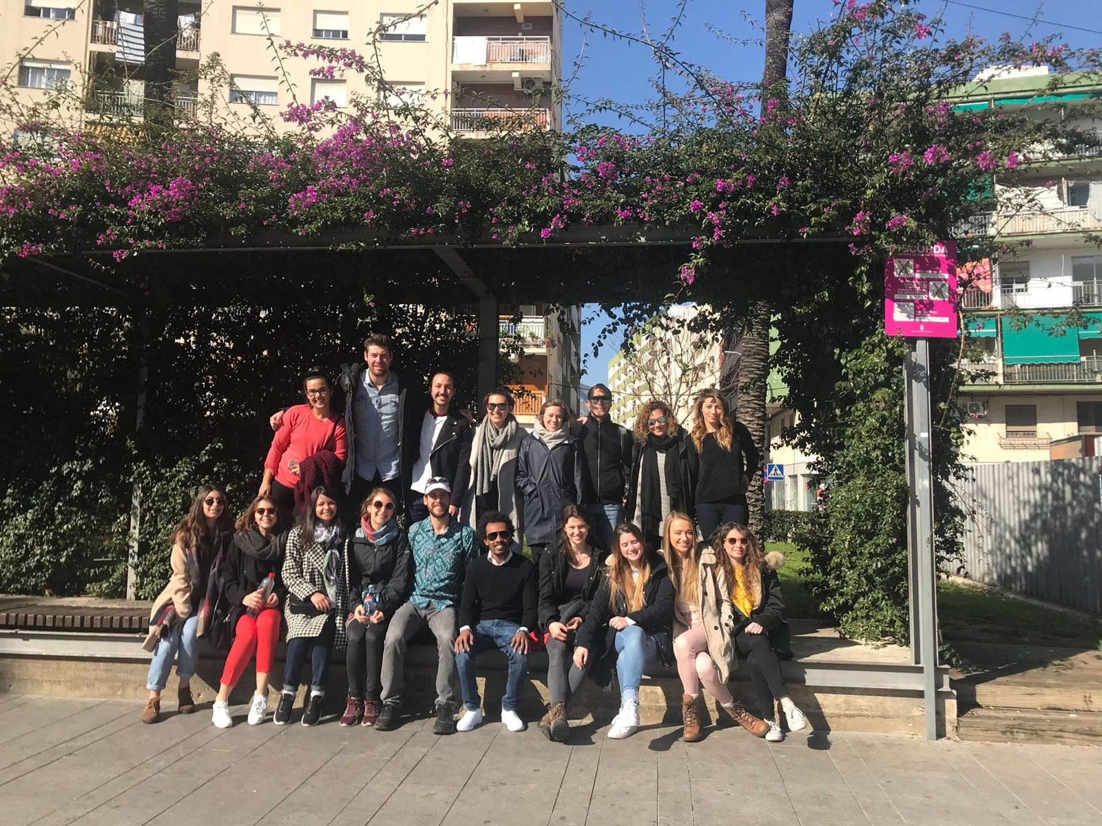

Slide 11
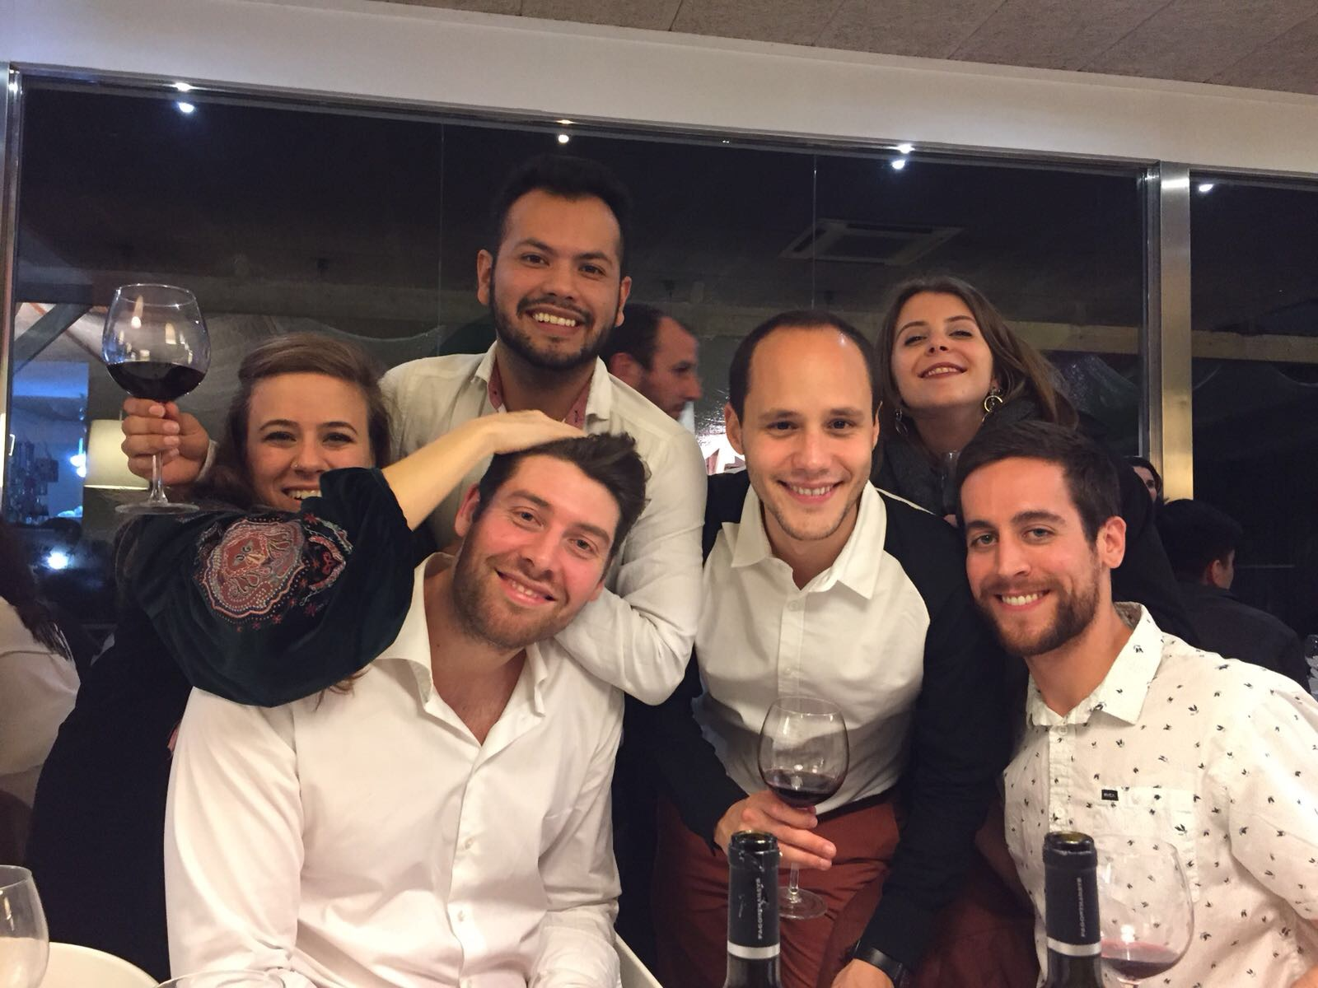
Final Assignment & In-residence
Daily schedule
Week 1:
Class seminars by visiting professors
Workshops
Travel weekend
Week 2:
Focus on Intervention Design
Presentation and awards

Slide 12
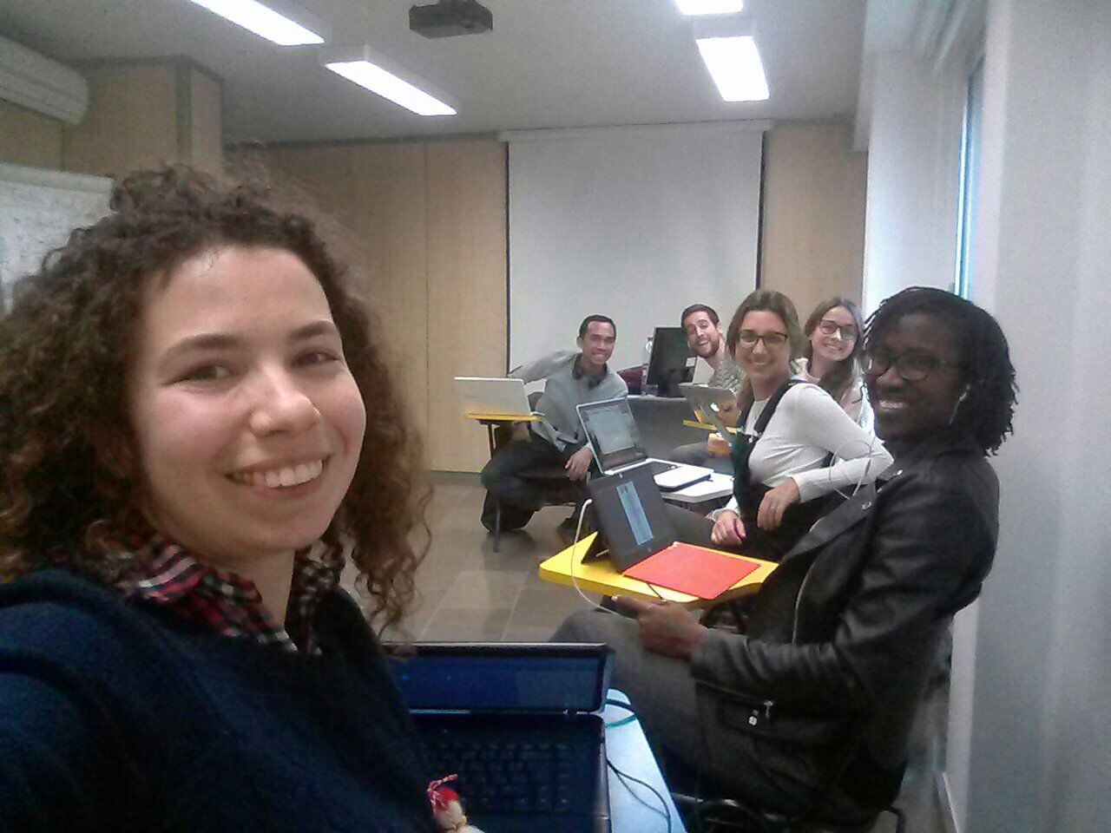

Slide 13
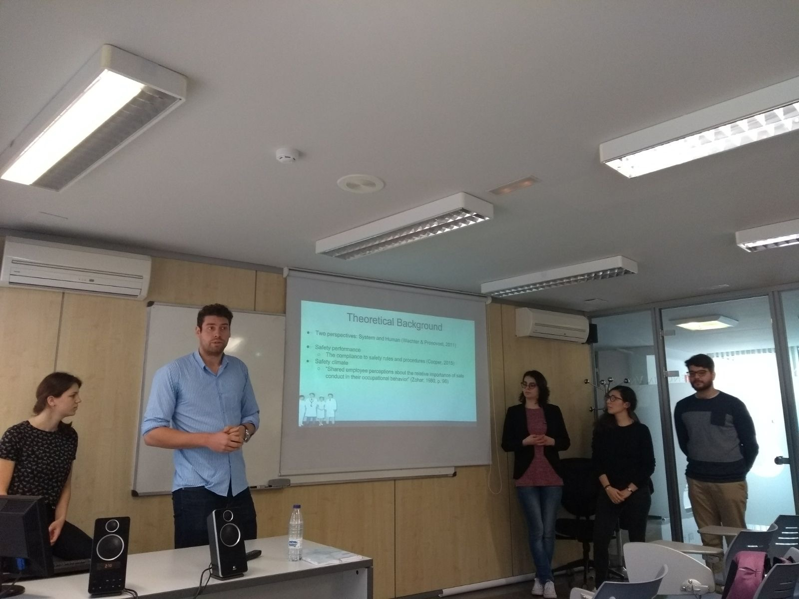
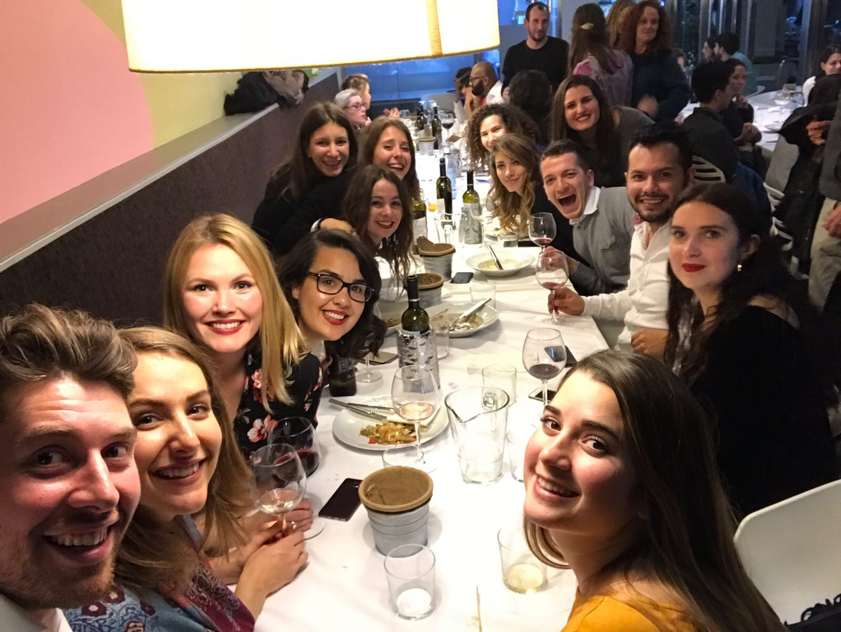

Slide 14
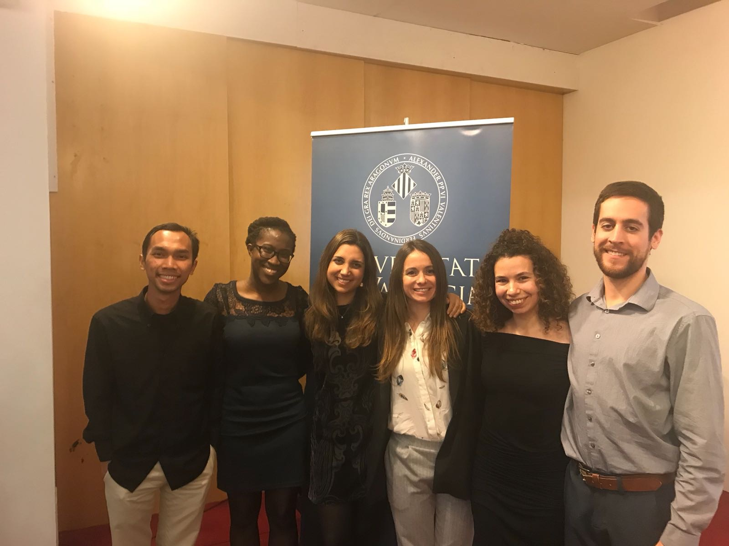

Slide 15
Thank you!

