Slide 1
PowerPoint
It doesn’t have to suck
Michael Shochet
Langsdale Library
mshochet@ubalt.edu
http://ubalt.libguides.com/powerpoint

Slide 2
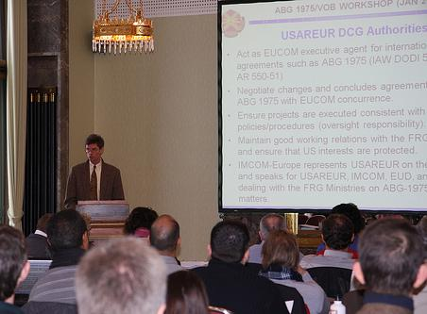
by USACE Europe District on Flickr
Notes:
Envision yourself giving a successful presentation. This is probably not the vision you had. You already know a lot of what not to do when designing presentations.

Slide 3
Notes:
So, what are things that don’t work well in presentations

Slide 4
Evil

Slide 5
“Step Right Up” by Telstar Logistics on Flickr
Notes:
As Tufte says, PowerPoint turns everything into a sales pitch

Slide 6
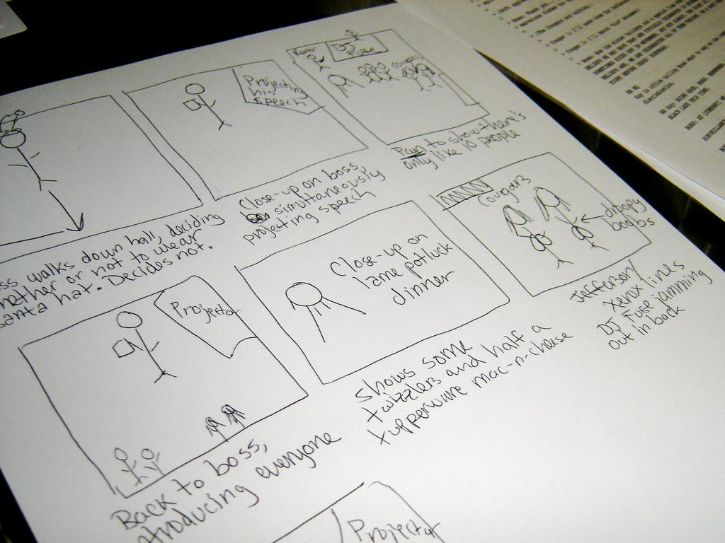
storytelling
Storyboard by ekai on Flikr
Notes:
I suggest using this as a conceptualization. Think of your presentation as a story. Maybe even a form of digital storytelling. Can you think of anyone who was good at this?

Slide 7
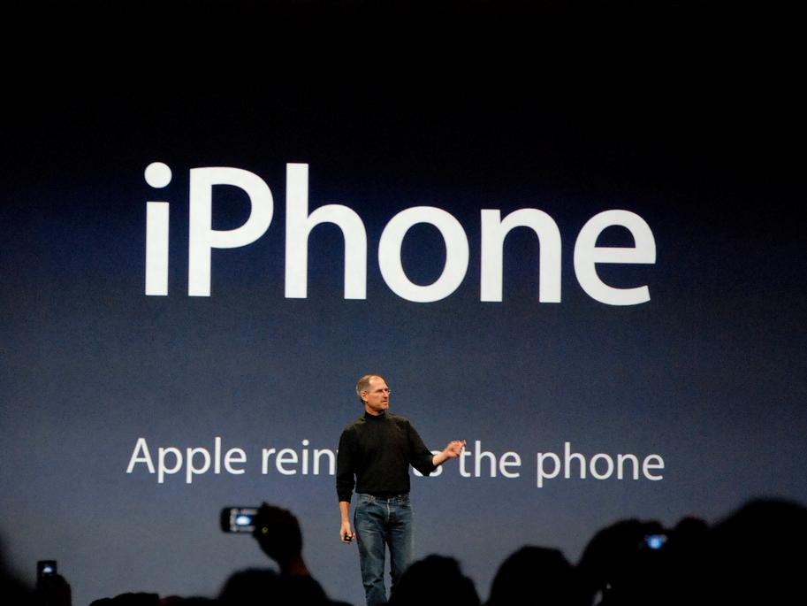
Img0061 by blakespot on Flickr
Notes:
Steve Jobs was very god at telling a story about why you would need Apples new product. This is a better way to envision your presentation.

Slide 8
Notes:
Think of good presentations you have seen what made them good? They probably had an engaging speaker and offered a mix of modalities for delivering the message(i.e. using video, having in class exercises)

Slide 9
slides
handout
Notes:
This approach means that your slideshow is not a handout. You won’t have enough detail in your slides for them to stand on their own. Although you might be able to pull it off with a liberal use of the notes field.

Slide 10
Notes:
Programs like pecha kucha put restrictions on presentations (20 slides, 20 seconds per slide) and often wind up with better presentations. Why is this?

Slide 11
Simplify
Notes:
What we learn from this is that Simplification is the key to a good powerpoint. Simplification is not simple. It is the stripping out or removing of anything that is unnecessary

Slide 12
Rose petals on snow Are made brighter by contrast Please, no spinny things.
- Lynda Del Genis
Kalte Hände , Warme Liebe ..... by *Lie on Flickr
Notes:
Working within strict guidelines can help the presenter focus on what really matters

Slide 13
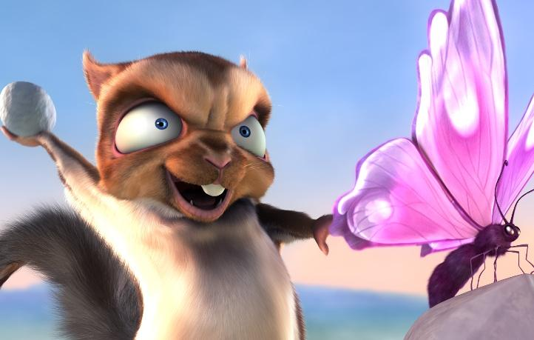
(c) copyright Blender Foundation
www.bigbuckbunny.org
Do No Harm
Notes:
This is an overriding principle. PowerPoint is a tool you can use to enhance a presentation. You don’t need it, you can choose to use it if it helps.

Slide 14
One Point
buddha bokeh by Loving Earth on Flickr
Notes:
Principle #1: Each slide should make one point and focus on just that slide.

Slide 15
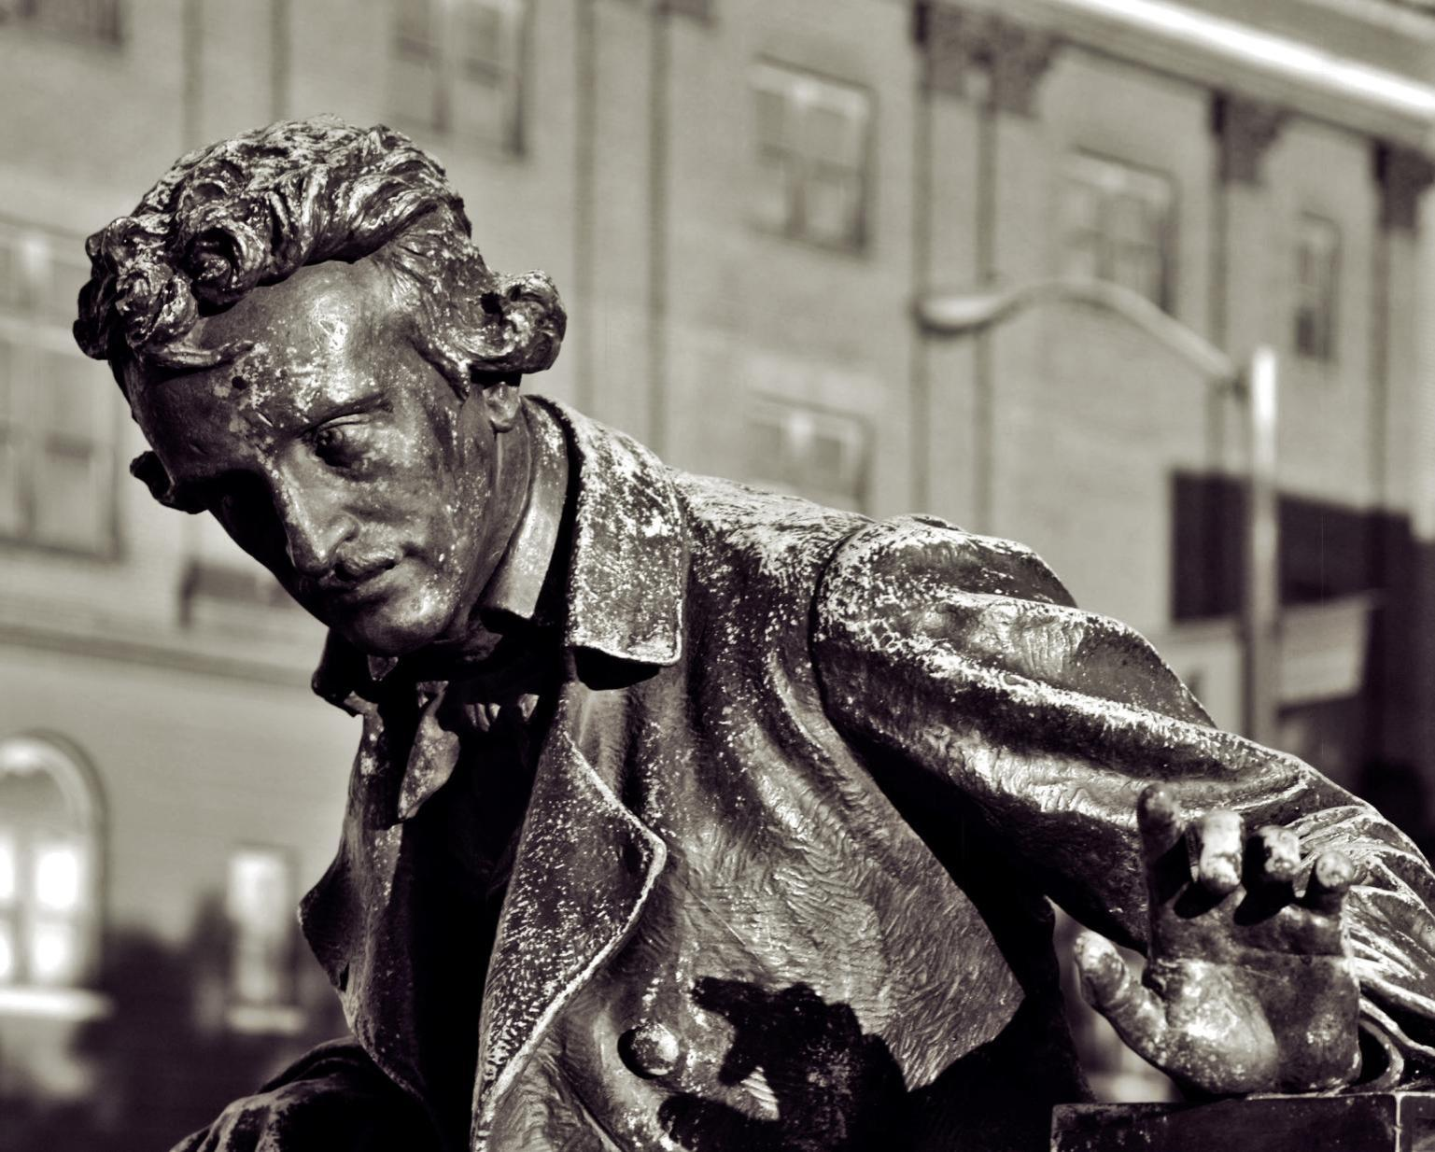
In the whole composition there should be no word written of which the tendency … is not to the one pre-established design.
Edgar Allen Poe
pondering poe..... by dcJohn on Flickr
Pondering Poe by dcJohn on Flickr
Notes:
Everything in your slide should reinforce your point. If it does not, take it out.

Slide 16
Notes:
So how do we simplify? Use good design principles to have your slides reinforce your point. Not to detract from it. You do not want your audience to have to work to understand your point, you want the focus to be on your point. By the way, don’t be afraid to use a blank slide.

Slide 17
www.technicallyfunny.com
Notes:
Life after death by powerpoint

Slide 18
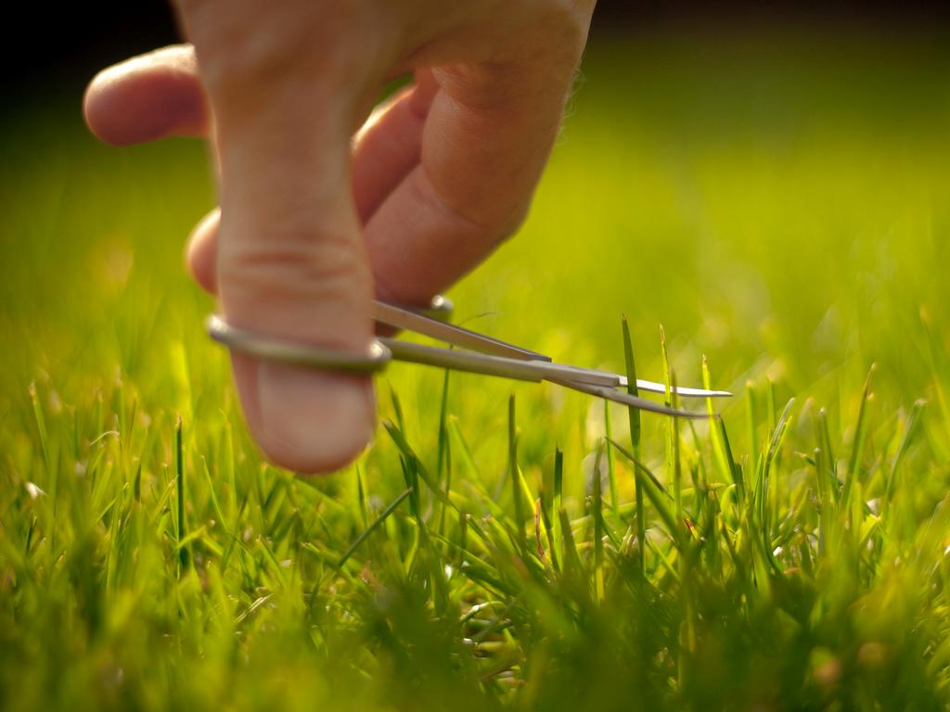
Some people say I am obsessed with my lawn by Jez Page on Flickr
Notes:
Paring down to what is essential

Slide 19
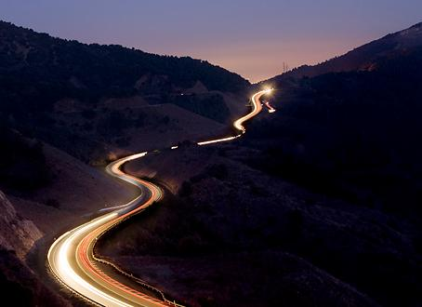
Exercise Restraint
Remove
anything unnecessary
Notes:
As you make your slides, exercise restraint. Once you are done, go back and remove anything that is unneeded.

Slide 20
Consciously
Use Whitespace
Notes:
To avoid clutter. Clutter adds noise, reduces clarity and makes slide hard to read and follow. Even a template design can add clutter.

Slide 21
Consciously
Use Whitespace
Notes:
Even a standard template introduces unnecessary clutter

Slide 22
Notes:
How do you get there in practice. You want to avoid clutter by using whitespace and simplifying all of your design choices, including the use of fonts, color. By the way, don’t be afraid to use a blank slide.

Slide 23
fonts
Notes:
Practical suggestions for fonts, colors and use of images

Slide 24
Fonts:
Keep it in the Family
Family in Arizona after sundown by pyrat wesly on Flickr
Notes:
Choose one font and only use fonts from a single font family. You cam emphasize things using bold, italics, etc.

Slide 25
Serif
Sans-Serif
Yin + Yang by h.koppdelaney on Flickr
Notes:
You can use an additional font for accent/emphasis, but make sure you do NOT use 2 serif or 2 sans-serif fonts. Whichever “type” is your primary, use the other for accent.

Slide 26
Make it BIG
Notes:
You can use an additional font for accent/emphasis, but make sure you do NOT use 2 serif or 2 sans-serif fonts. Whichever “type” is your primary, use the other for accent.

Slide 27
Rainbow by
jakerome on Flickr
Notes:
Choose a simple color scheme and stick with it.

Slide 28
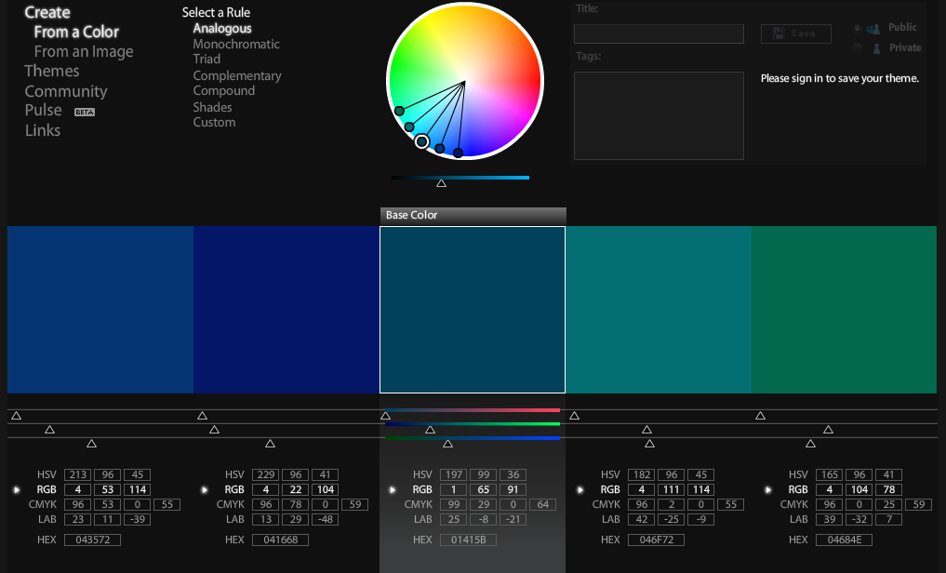
Color http://kuler.adobe.com/

Slide 29
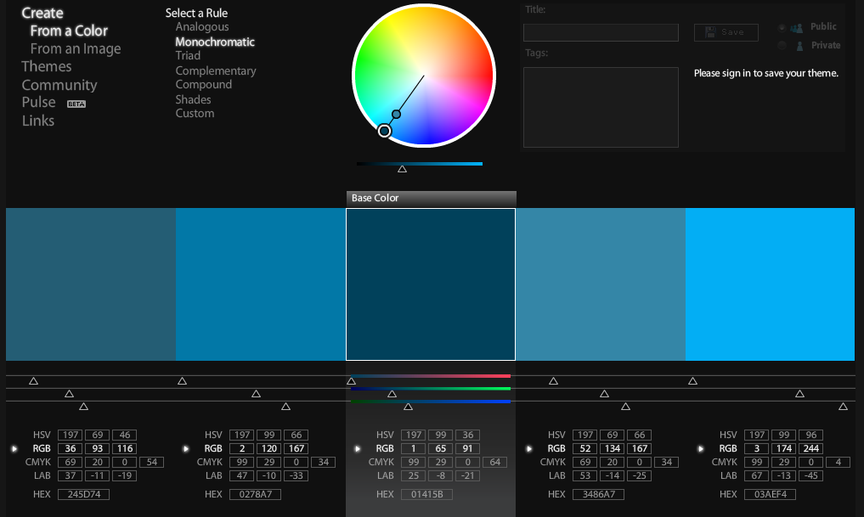
Monocromatic http://kuler.adobe.com/

Slide 30
Monochrome
with one Color

Slide 31
Images
Notes:
There is evidence that images related to your point makes them easier to remember

Slide 32
One point
buddha bokeh by Loving Earth on Flickr
Notes:
A picture that covers the entire frame will usually be more powerful. Also, the audience will often be drawn to the picture, so you want to the picture to draw people’s eyes to the text.

Slide 33
One Point
buddha bokeh by Loving Earth on Flickr
Notes:
A smaller image is less powerful

Slide 34
One point
buddha bokeh by Loving Earth on Flickr
Notes:
Try to place text, so it works with the picture. People will look at the image first, so you want the picture to lead the audience’s eyes to your text.

Slide 35
One point
buddha bokeh by Loving Earth on Flickr
Notes:
Not here

Slide 36
One point
Notes:
Even worse

Slide 37
Rotation
buddha bokeh by Loving Earth on Flickr
Notes:
Rotating text can add interest in some circumstances.

Slide 38
Notes:
Life after death by powerpoint

Slide 39
Readability
buddha bokeh by Loving Earth on Flickr
Notes:
This is hard to read on the photo background

Slide 40
Readability
buddha bokeh by Loving Earth on Flickr
Notes:
Having a solid color background helps the text be readable.

Slide 41
Rose petals on snow Are made brighter by contrast Please, no spinny things.
- Lynda Del Genis
Kalte Hände , Warme Liebe ..... by *Lie on Flickr
Notes:
Working within strict guidelines can help the presenter focus on what really matters

Slide 42
(c) copyright Blender Foundation
www.bigbuckbunny.org
Semi- Transparent Backgrounds
Notes:
You can make the text background semi-transparent if you want the image to show through, but still have the text readable.

Slide 43
One Point
buddha bokeh by Loving Earth on Flickr
Notes:
Each slide should make one point and focus on just that slide.

Slide 44
Charts, Graphs and Statistics

Slide 45
Books Sales Per Year
(in millions of dollars)
Year | E-Books | Print Books
2002 | 2.1 | 3,897.7
2003 | 6.0 | 3,835.3
2004 | 9.3 | 3,794.7
2005 | 16 | 5,058.5
2006 | 25.2 | 5,036.4
2007 | 31.7 | 5,457.9
2008 | 61.3 | 5,158
2009 | 169.5 | 5,127.1
2010 | 441.3 | 4,864.0
Source:
American Publisher's Association

Slide 46
E-Book Sales have doubled in each of the past 3 years.
Sales in millions of dollars
Year | E-Books
2005 | 16
2006 | 25.2
2007 | 31.7
2008 | 61.3
2009 | 169.5
2010 | 441.3
Source:
American Publisher's Association

Slide 47
Book Sales in February 2011
In millions of dollars

Slide 48
E-Books accounted for almost 30% of February 2001 Book Sales
Children/
YA
E-Books
Adult

Slide 49
Book Sales
In millions of dollars
Source:
American Publisher's Association

Slide 50
One point
buddha bokeh by Loving Earth on Flickr
Notes:
Try to place text, so it works with the picture. People will look at the image first, so you want the picture to lead the audience’s eyes to your text.

Slide 51
Book Sales
In millions of dollars
Source:
American Publisher's Association

Slide 52
Sales of printed books have flattened
In millions of dollars
Source:
American Publisher's Association

Slide 53
Sales of e-books have skyrocketed
In millions of dollars
In millions of dollars
Source:
American Publisher's Association

Slide 54
E-Book account for an increasingly large percentage of book sales.
Source:
American Publisher's Association

Slide 55
Feb 2011: 30%
Kindle with Books by peteoshea on Flickr

Slide 56
Slides
=
Paper or Handout
Notes:
There is evidence that images related to your point makes them easier to remember

Slide 57
Finding Images
Notes:
Creative Commons licenses often allow for non-commercial use. Flickr has a creative commons search. US Government photos are free from copyright as are photographs before 1923. Do not use clip art.

Slide 58
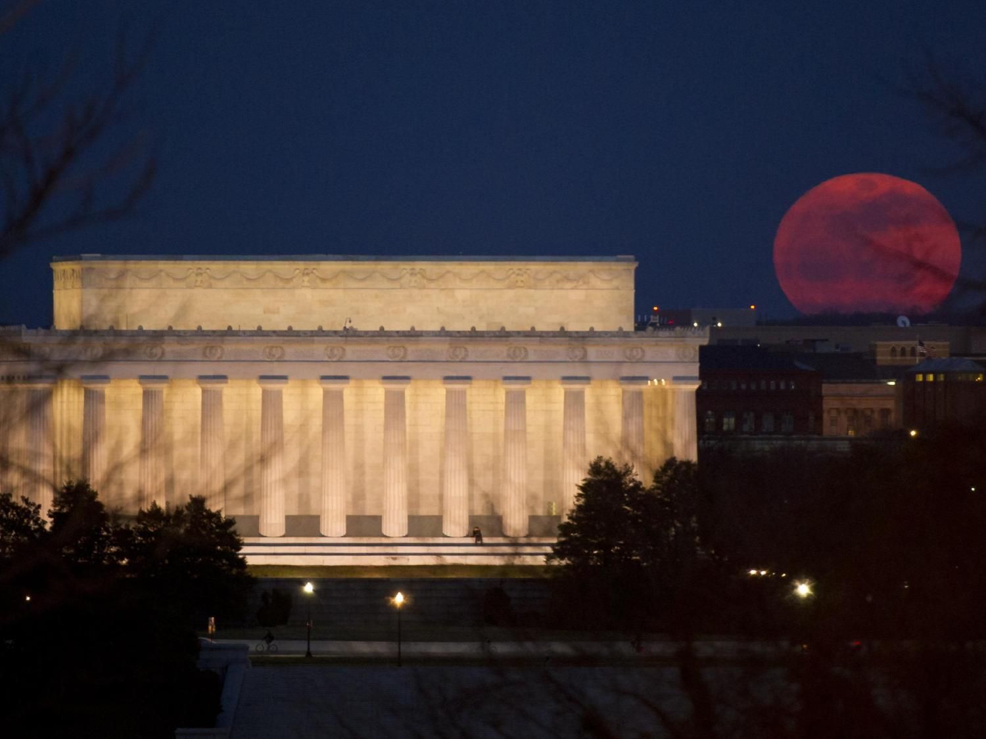
Public Domain
Notes:
Works in the public domain include those produced by the U.S. government and its employees in their official capacity. So official photos from NASA websites and the National Park Service website are in the public domain. Also, any pictures taken before 1923 are in the public domain, since the copyright on them has expired.

Slide 59
Notes:
People can choose to put a creative commons license on their work, which often allows for noncommercial use if attribution is given.

Slide 60
Flickr: Creative Commons
Notes:
Flickr has a Creative Commons filter. You can sometimes get better photos from Flickr by sorting your results by “interestingness” instead of relevance.

Slide 61
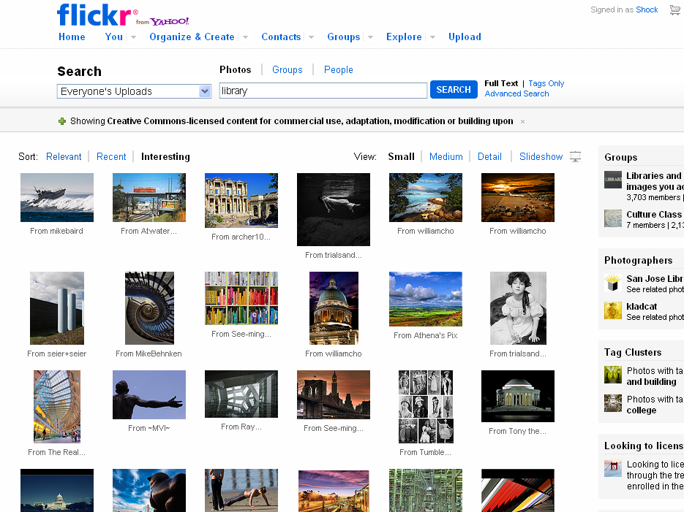

Slide 62
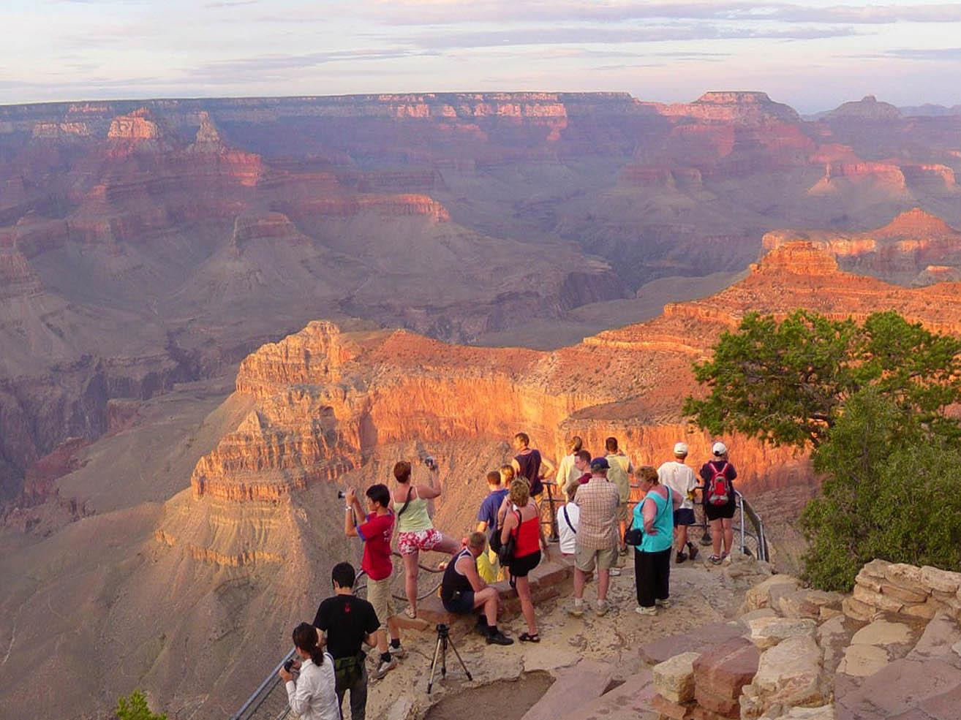
take your own

Slide 63
storyboard
Storyboard by ekai on Flikr

Slide 64
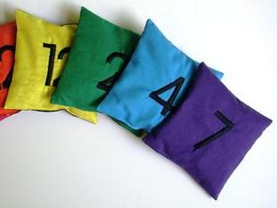
Count and Spell Color Recognition Beanbags – NUMBERS by EraPhernalia Vintage on Flickr
Choose
Color + Font

Slide 65
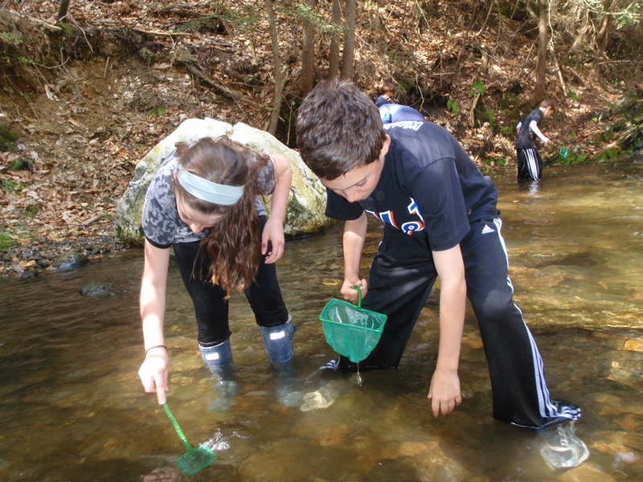
Find Images
Searching for macroinvertebrates by the Horace Mann School on Picassa
Notes:
Searching using the library databases will help you find more reliable and academically rigorous material.

Slide 66
Remove Excess
Some people say I am obsessed with my lawn by Jez Page on Flickr

Slide 67
Hands in the air - in concert by ` marfis75 on Flickr

Slide 68
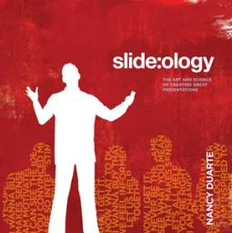
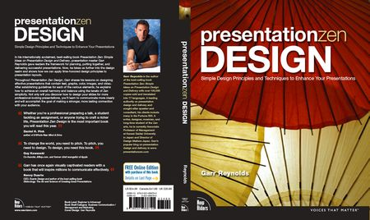
http://ubalt.libguides.com/powerpoint
Hands in the air - in concert by ` marfis75 on Flickr

