Slide 1
MGMT400 Library Instruction
Michael Shochet
mshochet@ubalt.edu
410-837-4277
Photo: New York Public Library by Thomas Hawk on Flickr

Slide 2
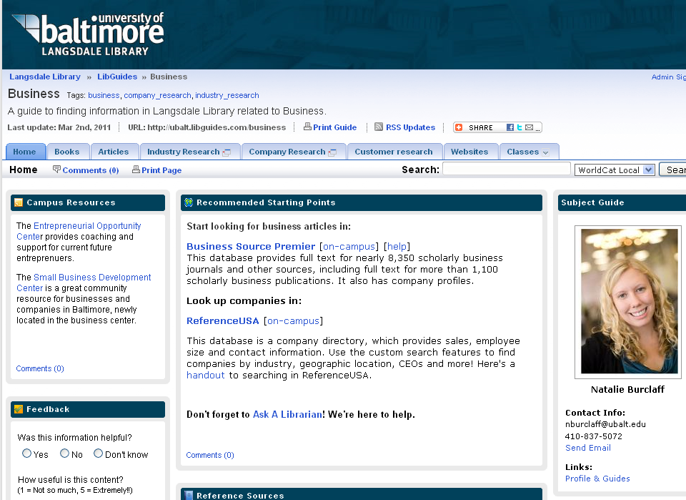
http://ubalt.libguides.com/business

Slide 3
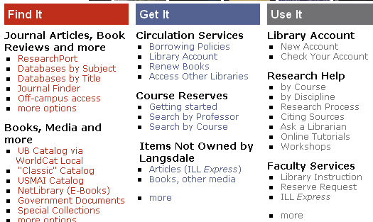
Library Account
http://langsdale.ubalt.edu
Click on “New Account”
Notes:
This is how you get a library account that lets you access the library databases from off-campus

Slide 4
Overview
Boolean Search
Finding Articles
Finding Books

Slide 5
Process
Define
Search
Evaluate
Organize
Write
Notes:
This is a process for doing research. Obviously, at some point the cycle stops, but after your initial research, you might identify holes, gaps or new questions that you want to answer. These will lead to a redefinition of the problem statement and a new round of searching.

Slide 6
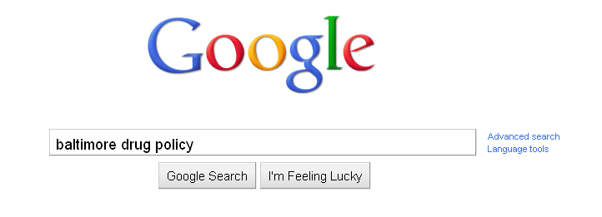
Notes:
For most searches in our daily lives, we go to Google and type in some terms. This often works. But, what happens when it doesn’t work. What should you do?

Slide 7
BOOLEAN
OR
AND
NOT

Slide 8
OR
E x p a n d s
Notes:
If your search gets too few results, try using OR to get more.

Slide 9
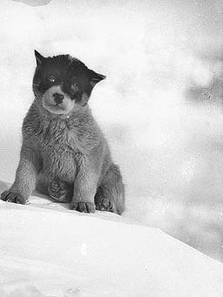
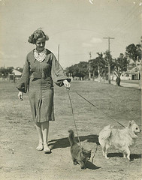
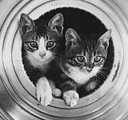
cat OR dog

Slide 10
AND
Narrows
Notes:
If you get too many results, try using AND to get fewer results.

Slide 11
cat AND dog

Slide 12
cat NOT dog

Slide 13
Notes:
There are problems with using language as search terms. Words have many different meanings and often many different words can be used to mean the same thing. So thinking critically about the words you choose, as well as using AND and OR can really help improve your search results.

Slide 14
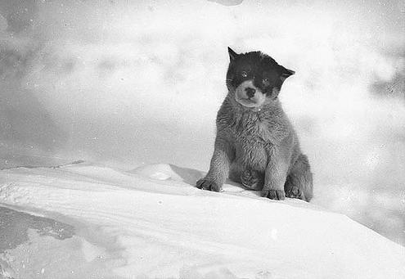
Pup
Notes:
A search for “dog” would not find this picture that was labeled with “pup”…

Slide 15
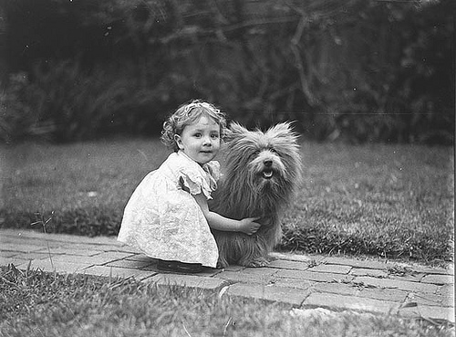
Scottish
Terrier
Notes:
or this one labeled as “Scottish Terrier”…

Slide 16
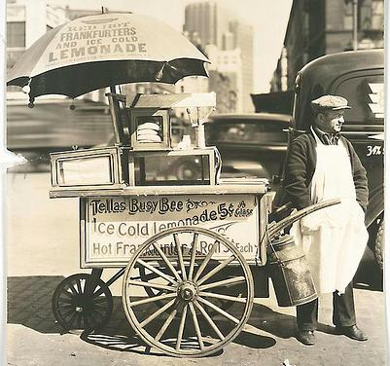
Notes:
… but you would get this hot dog cart.

Slide 17
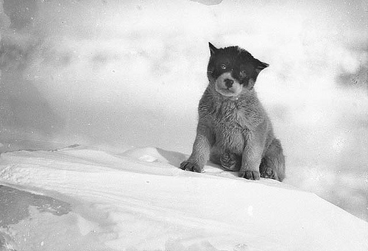
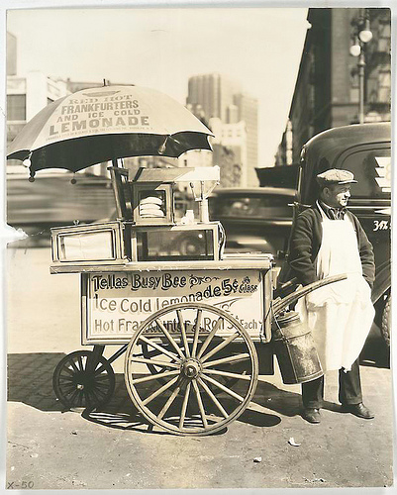
dog

Slide 18
Drug Policy in Baltimore
Concept 1
Concept 2
Concept 3
Synonyms
Related terms
Broader Terms
Narrower Terms
Notes:
As an exercise, think about this search topic. Brainstorm different terms you can use in your search.

Slide 19
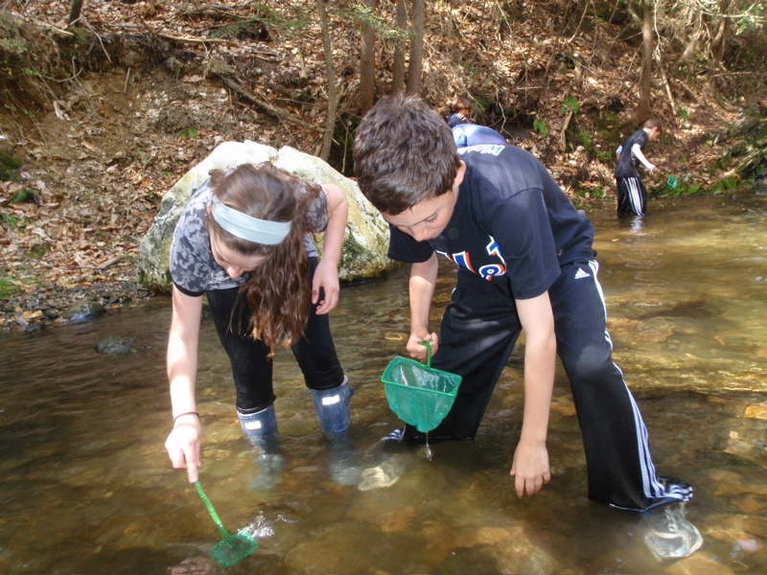
Where to Search
Searching for macroinvertebrates by the Horace Mann School on Picassa
Notes:
Searching using the library databases will help you find more reliable and academically rigorous material.

Slide 20
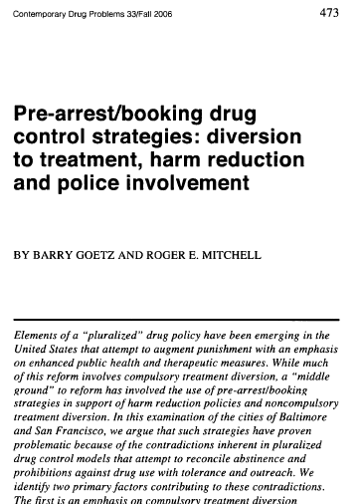
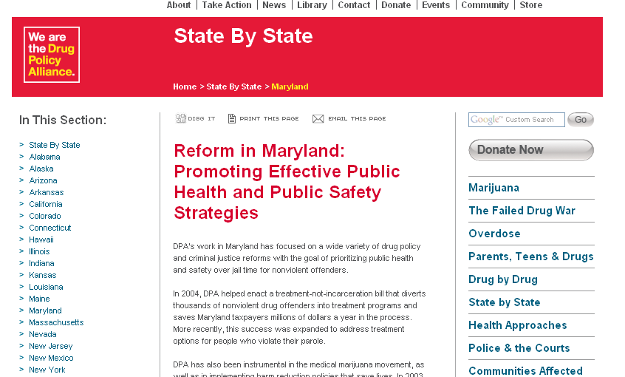
( baltimore OR maryland ) and drug policy
Academic Search Premier
Google
Notes:
Articles in the library databases are from peer reviewed scholarly journals as well as reputable newspapers and magazines. The scholarly material is much more scientifically rigorous than what you might find on the web, and is really what a literature review should focus on. While you can find some scholarly sources on the internet, you have to work much harder to determine a web site’s credibility. There are plenty of organizations with a very strong bias whose pages will show up. Above is the first result of a search for ( baltimore OR maryland ) and drug policy in Academic Search Premier which is a scholalry journal article, compared to the same search in Google which gives you a page for an organization trying to relax the drug laws. The reports on this site may be OK, but they have an obvious bias and were not subject to the independent peer review process that an academic journal requires.

Slide 21
Finding Articles
Databases:
Public Affairs Index (government)
ABI/Inform (business)
Business Source Premier
Academic Search Premier (general)
Criminal Justice Periodicals
Notes:
Here are some library databases that can be useful. You can find this list on the class coursepage http://ubalt.libguides.com/aecontent.php?pid=94587&sid=1542010
Try using some of your search terms in one of the databases above. You will have to play around with what works, adding some terms, dropping some others. For example, if you start to investigate a specific policy implemented in Baltimore, it may be the case that there hasn’t been research on the local implementation. In that case, you would drop the “Baltimore or Maryland” concept in order to see any analysis of a particular policy, many of which would be applicable to our loca

Slide 22
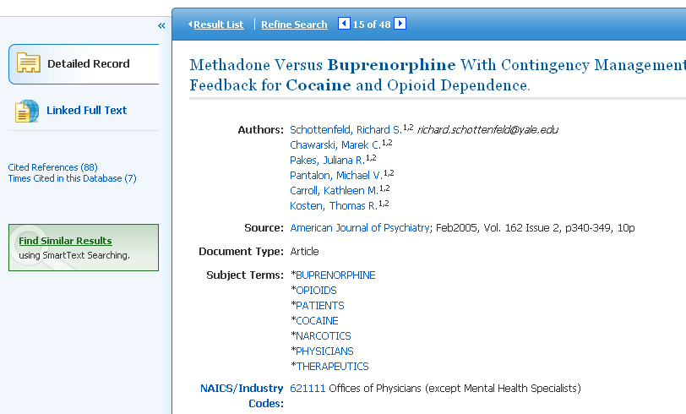
Subject Terms
Notes:
You can use the subject terms in an article to refine your results.

Slide 23
Getting Articles
Do we own it?
Off-Campus
Log in to “Research Port” with barcode
Notes:
If an article is available in an abstract form only, you can use the “Find It” button to see in Langsdale has access to a copy, or to order it through ILL.

Slide 24
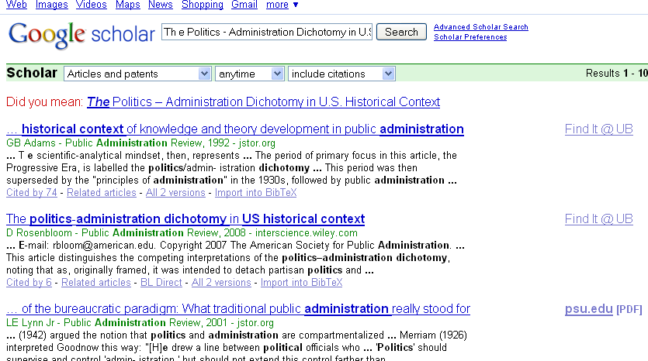
Google Scholar
Notes:
Google Scholar attempts to identify scholarly journals. You can find similar articles by looking at which articles cited one that you like

Slide 25
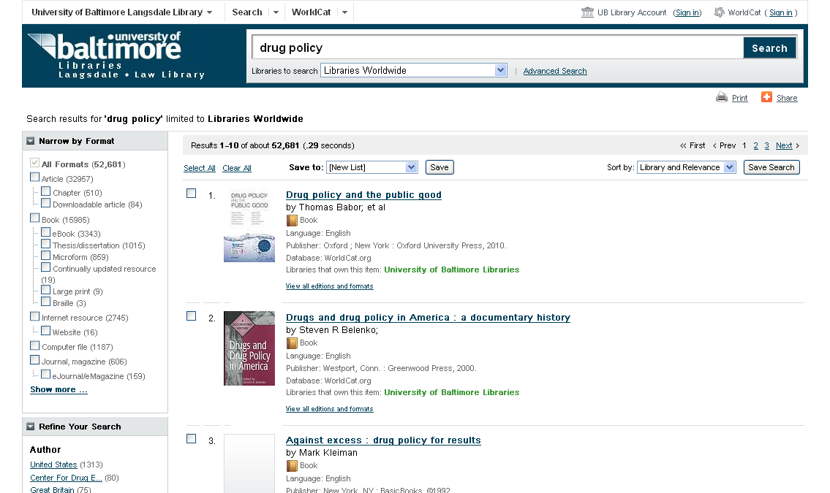
Books: Worldcat Local
Notes:
WorldCat Local will help you find books in Langsdale Library. Note that you are searching through title, author, subjects headings and sometimes the table of contents and a brief description. You are not searching through the full text.

Slide 26
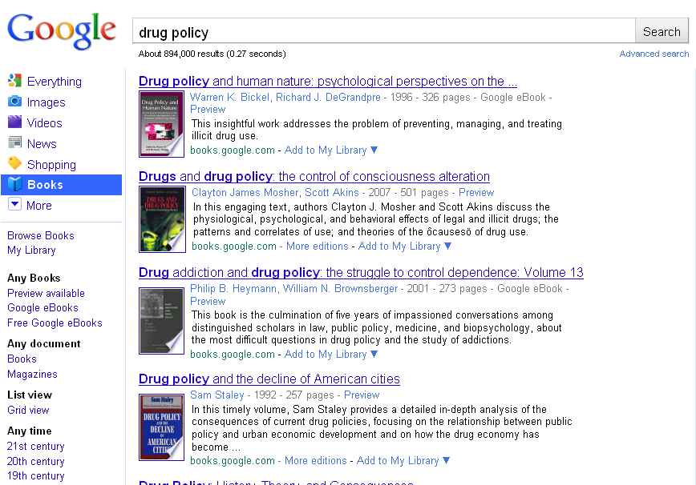
Google Books
Notes:
Note that with Google Books, you ARE searching through the full text.

Slide 27
Review
Boolean Search
Finding Articles
Finding Books

