Slide 1
Writ 300 Bus1
Michael Shochet
mshochet@ubalt.edu
http://tinyurl.com/lj6c7bg

Slide 2
Questions
How do I judge reliability of a source?
How can I tell if an article is peer reviewed
How can I find peer review articles? …on my topic?
http://tinyurl.com/lj6c7bg

Slide 3
Authority
Who is the author?
What are his/her credentials?
Who is the publisher/sponsoring agency?
Is the publisher/sponsor reputable?

Slide 4
Accuracy
Are there spelling/grammar errors?
Has it been fact checked?
ARE THERE CITATIONS?
Can you verify the information in other sources?

Slide 5
Objectivity
What is the author’s point of view?
What is the bias?
What is the author’s purpose?
reporting facts
persuasive speech

Slide 6
Currency
When was this written?
Has it been updated?
Are links working?

Slide 7
Coverage
What topic is covered?
How much detail is given?
Is it important/does it really relate to your topic?

Slide 8
How a writer uses sources: BEAM model
Background
Establish facts
Exhibits
Explanations, Interpretations, Analysis
Arguments
Logical arguments made about the topic
Models
Framework or perspective for examining a topic

Slide 9
Search Strategy #1: BOOLEAN

Slide 10
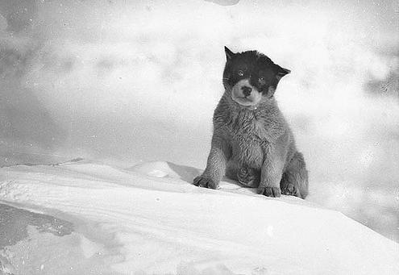
Pup
Notes:
A search for “dog” would not find this picture that was labeled with “pup”…

Slide 11
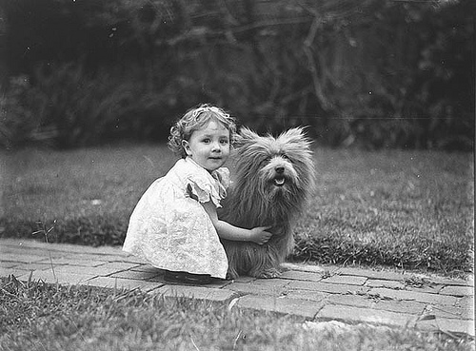
Scottish
Terrier
Notes:
or this one labeled as “Scottish Terrier”…

Slide 12
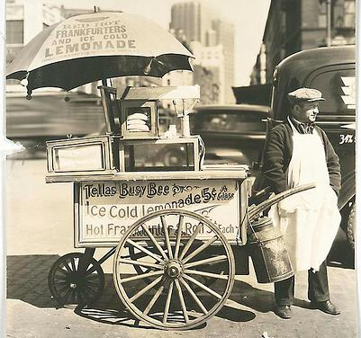
Hot Dog Cart
Notes:
… but you would get this hot dog cart.

Slide 13
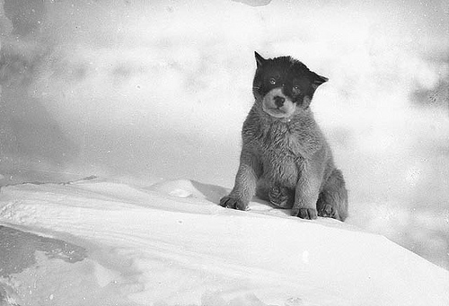
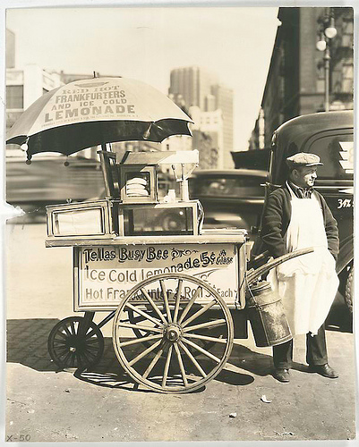
dog

Slide 14
BOOLEAN OR AND NOT

Slide 15
OR
E x p a n d s
Notes:
If your search gets too few results, try using OR to get more.

Slide 16
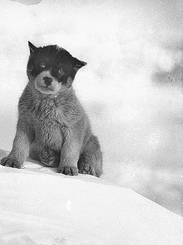
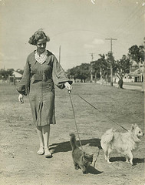
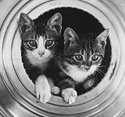
cat OR dog

Slide 17
AND
Narrows
Notes:
If you get too many results, try using AND to get fewer results.

Slide 18
cat AND dog

Slide 19
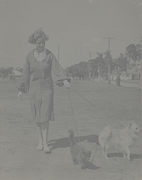
cat NOT dog

Slide 20
What is the impact of employees using the internet for personal use at work?

Slide 21
Search Strategy #2: Subject Searching

Slide 22
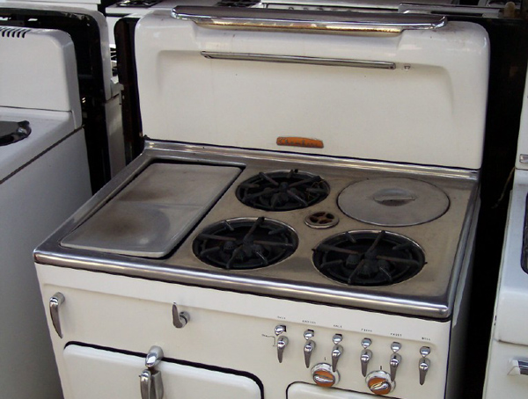

Slide 26
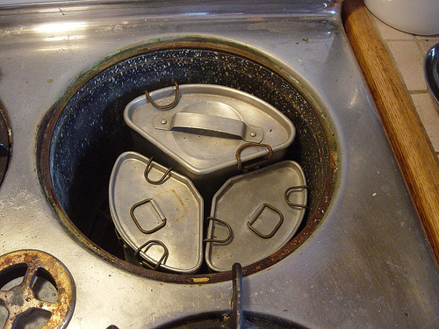

Slide 27
Chambers
Pots

Slide 28
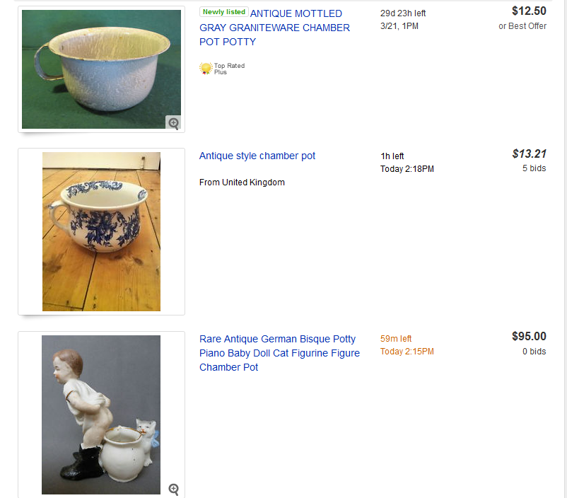

Slide 29
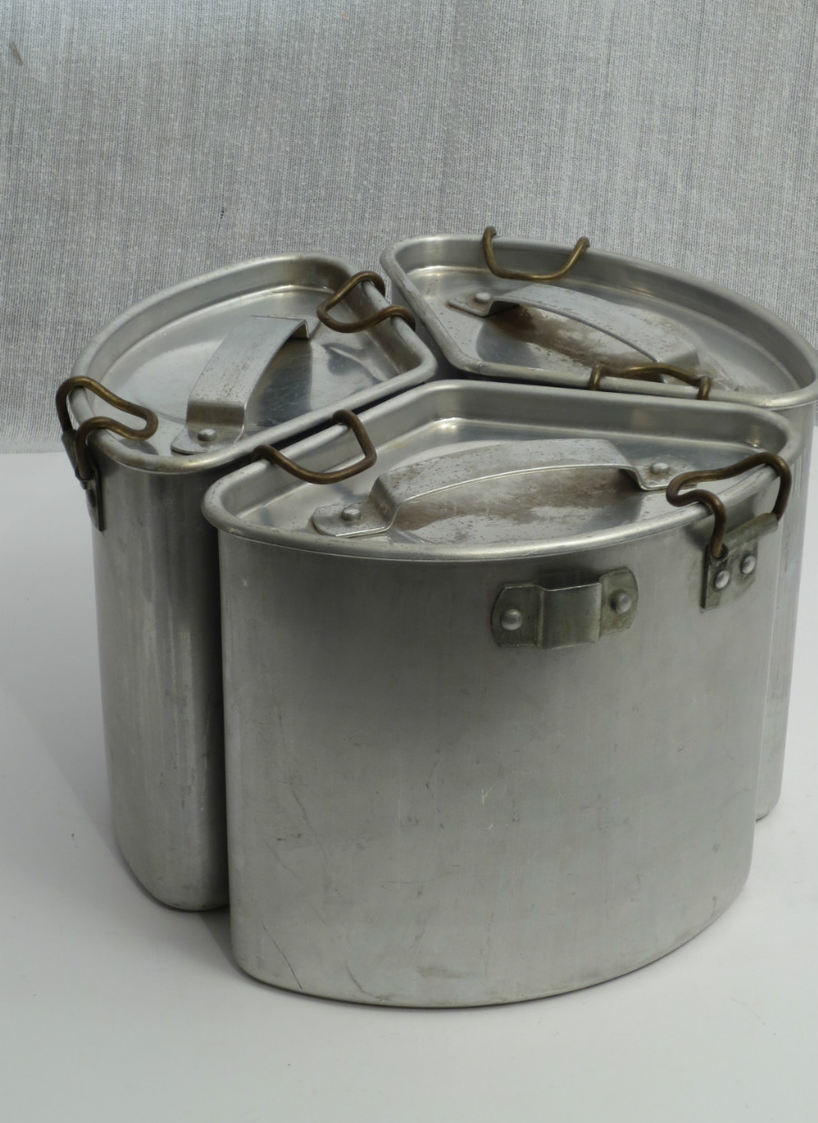

Slide 31
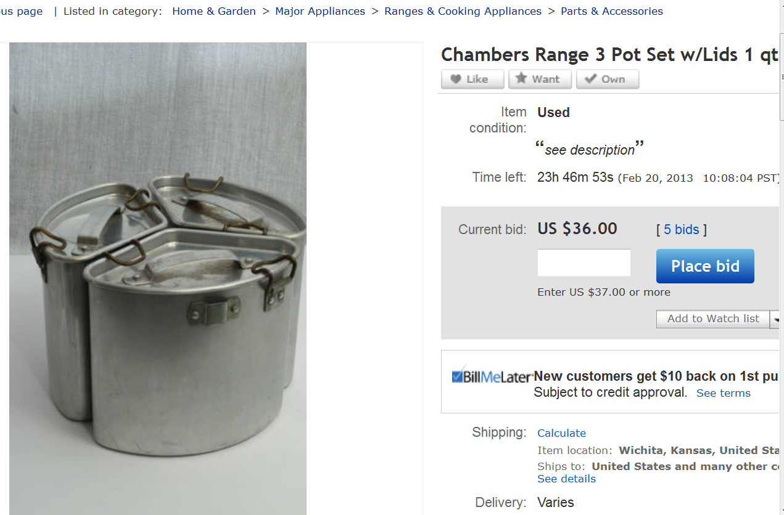

Slide 32
