Slide 1
Writ 300
Michael Shochet
mshochet@ubalt.edu

Slide 2
6
9

Slide 3
Authority
Who is the author?
What are his/her credentials?
Who is the publisher/sponsoring agency?
Is the publisher/sponsor reputable?

Slide 4
Accuracy
Are there spelling/grammar errors?
Has it been fact checked?
ARE THERE CITATIONS?
Can you verify the information in other sources?

Slide 5
Objectivity
What is the author’s point of view?
What is the bias?
What is the author’s purpose?
reporting facts
persuasive speech

Slide 6
Currency
When was this written?
Has it been updated?
Are links working?

Slide 7
Coverage
What topic is covered?
How much detail is given?
Is it important/does it really relate to your topic?

Slide 8
Searching Toolkit
BOOLEAN
Thesaurus/Subject Headings
Citations

Slide 9
Types of sources
Books
Scholarly Journal Articles
Trade Journals
Popular magazines
Newspaper Articles

Slide 10
Search Strategy #1: BOOLEAN

Slide 11
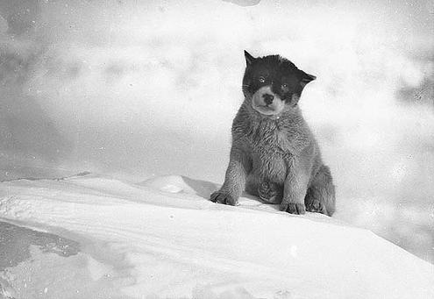
Pup
Notes:
A search for “dog” would not find this picture that was labeled with “pup”…

Slide 12
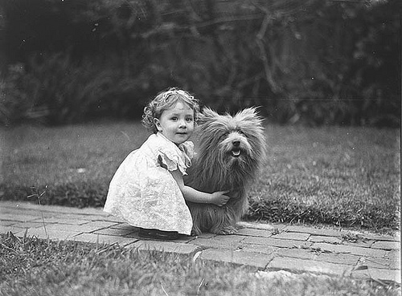
Scottish
Terrier
Notes:
or this one labeled as “Scottish Terrier”…

Slide 13
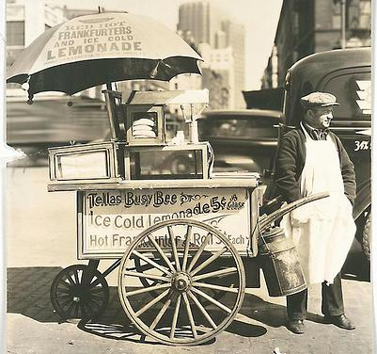
Hot Dog Cart
Notes:
… but you would get this hot dog cart.

Slide 14
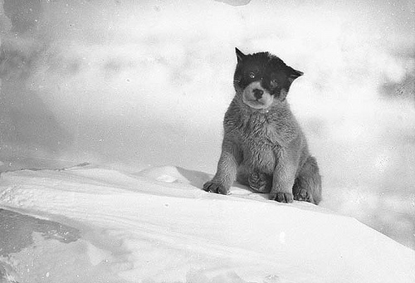
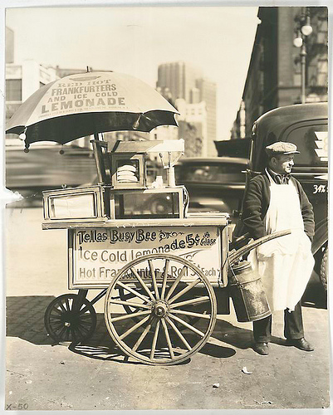
dog

Slide 15
BOOLEAN OR AND NOT

Slide 16
OR
E x p a n d s
Notes:
If your search gets too few results, try using OR to get more.

Slide 17
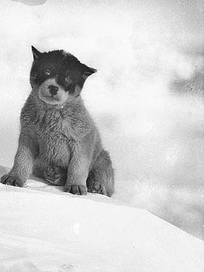
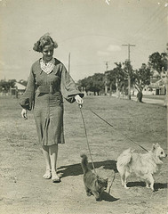
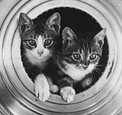
cat OR dog

Slide 18
AND
Narrows
Notes:
If you get too many results, try using AND to get fewer results.

Slide 19
cat AND dog

Slide 20
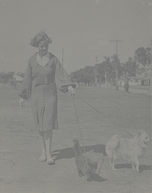
cat NOT dog

Slide 21
When kids are bullied, does it change the way they act when they get older?

Slide 23
Search Strategy #2: Subject Searching

Slide 24
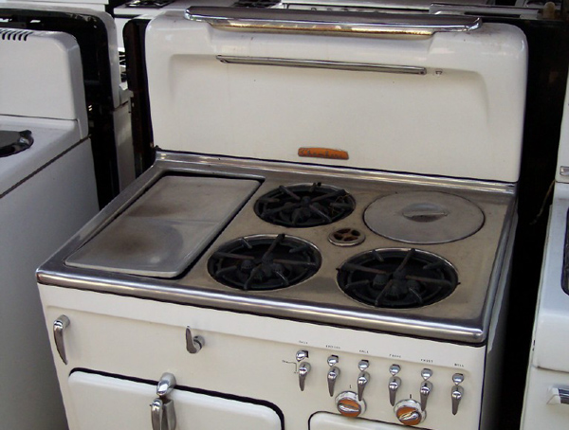

Slide 28
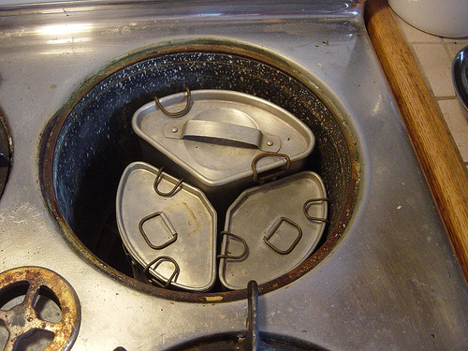

Slide 29
Chambers
Pots

Slide 30
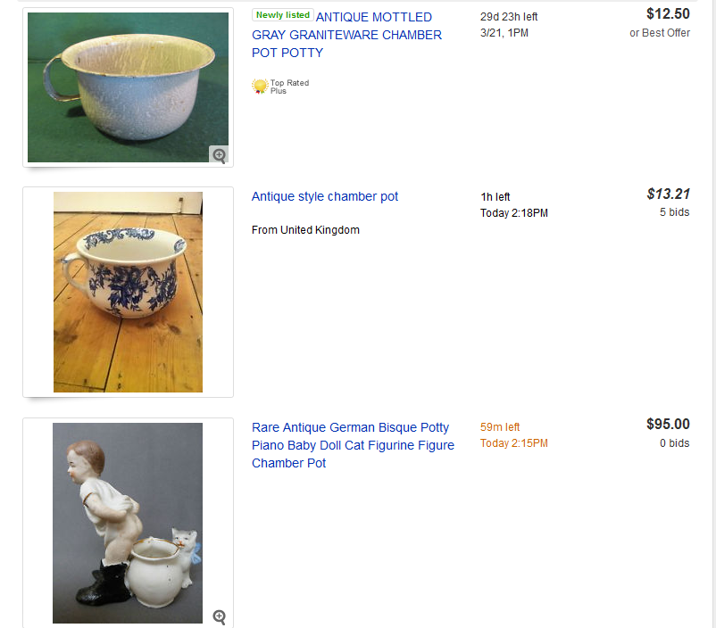

Slide 31
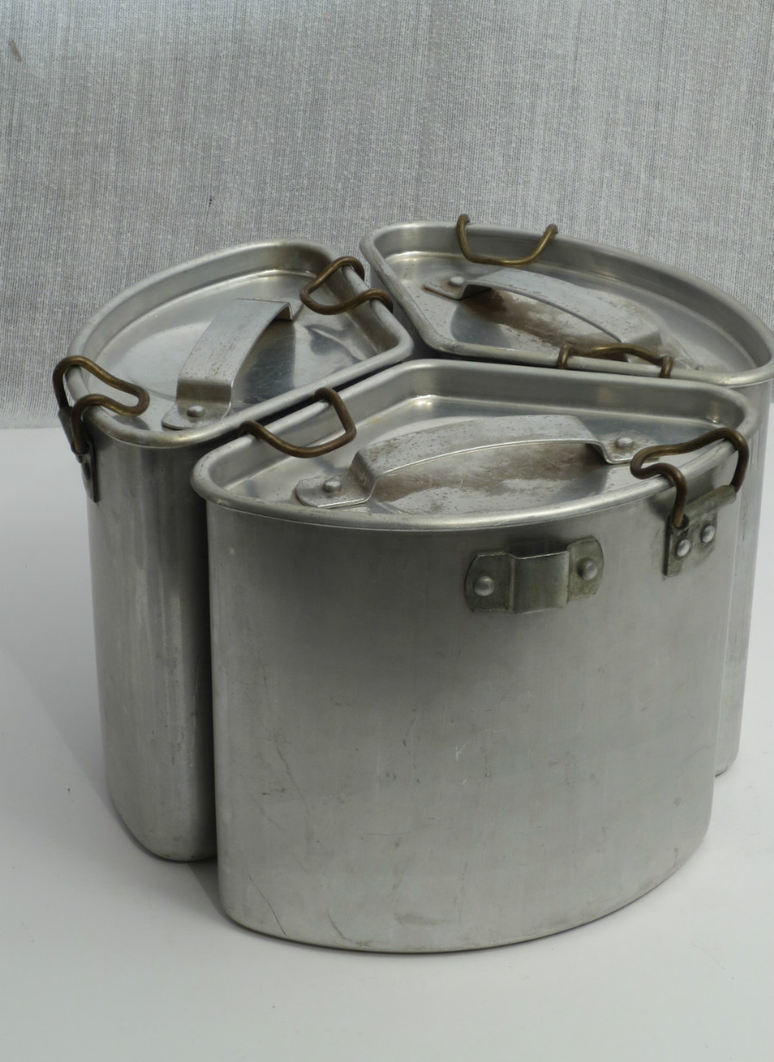

Slide 32
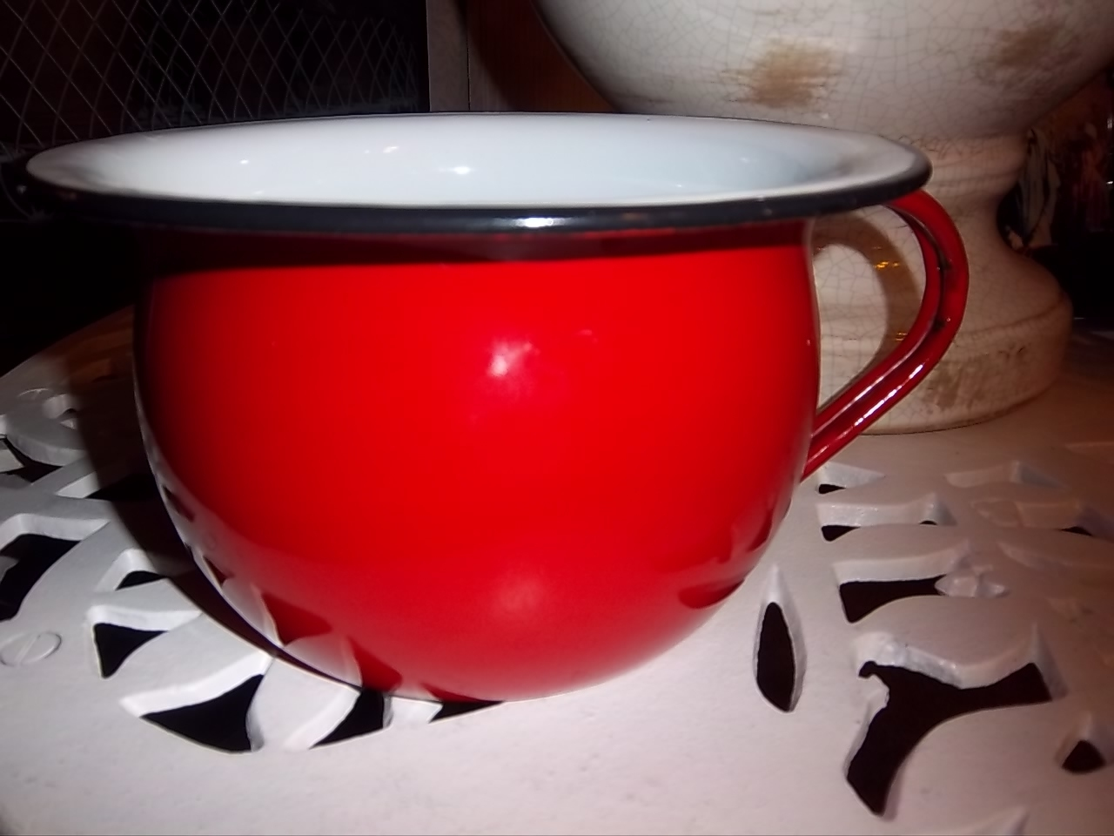

Slide 33
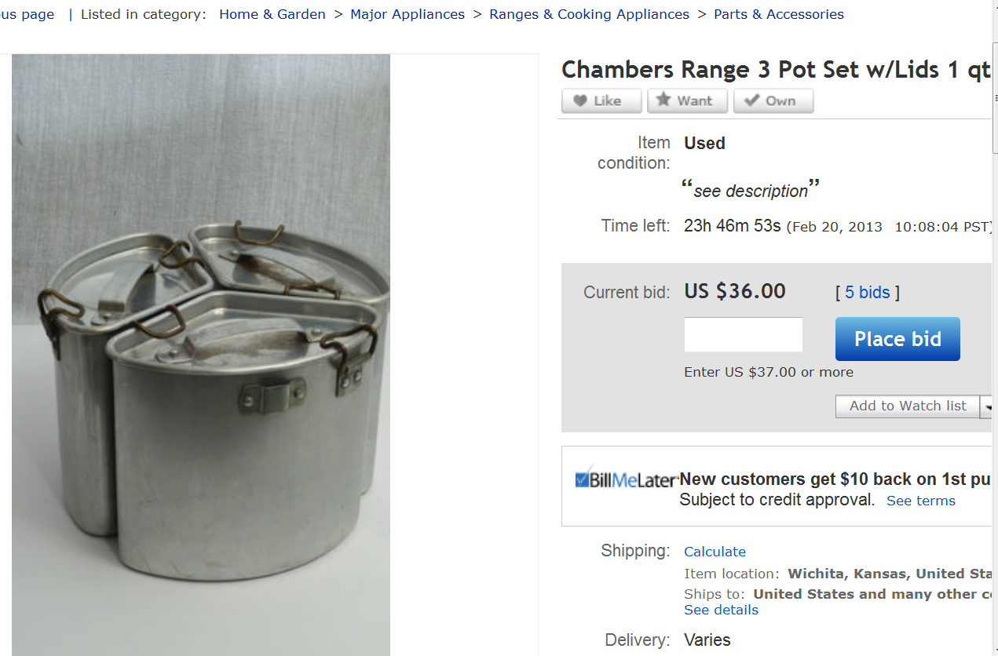

Slide 34
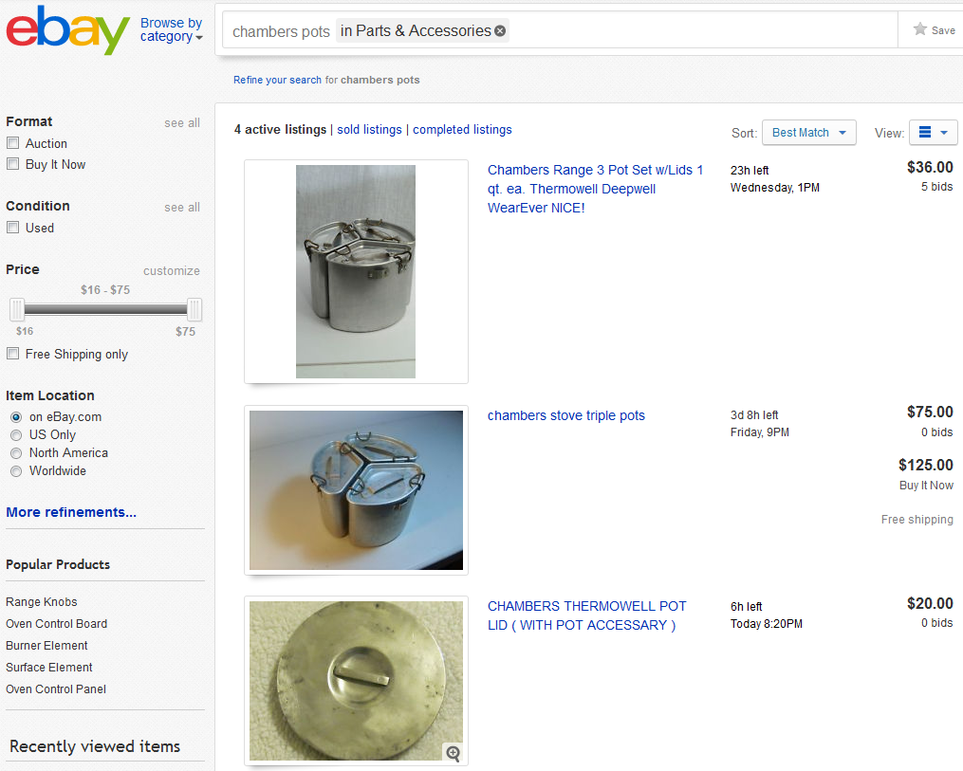

Slide 35
Search Strategy #3: Citations

Slide 37
Practice Topics
Does allowing students to submit assignments electronically negatively affect attendance?
What are the effects of aging on short term memory loss?
Does the hair color of a waitress affect how much she will make in tips?
Your own topic

Slide 38
Getting started
Gale Encyclopedia of Mental Health
Encyclopedia of Adolescence
Psychology Basics
Encyclopedia of Creativity

