Slide 1
BEAMing up information for WRIT 300
Michael Shochet Langsdale Library mshochet@ubalt.edu

Slide 2
Objectives
To name five criteria to consider when deciding whether to use a particular information source in your paper.
To apply principles in deciding how and whether you will use an information source in your paper

Slide 3
C
R
A
A
P

Slide 4
Currency
Relevance
Authority
Accuracy
Purpose
Date of publication in relation to topic
Hold this thought
Author, Publisher
Citations, Attribution
Inform, Persuade, Entertain, Audience

Slide 5
BEAM
Background
Exhibit
Argument
Method

Slide 6
Background
Facts you present as undisputed, that you want your reader to know

Slide 7
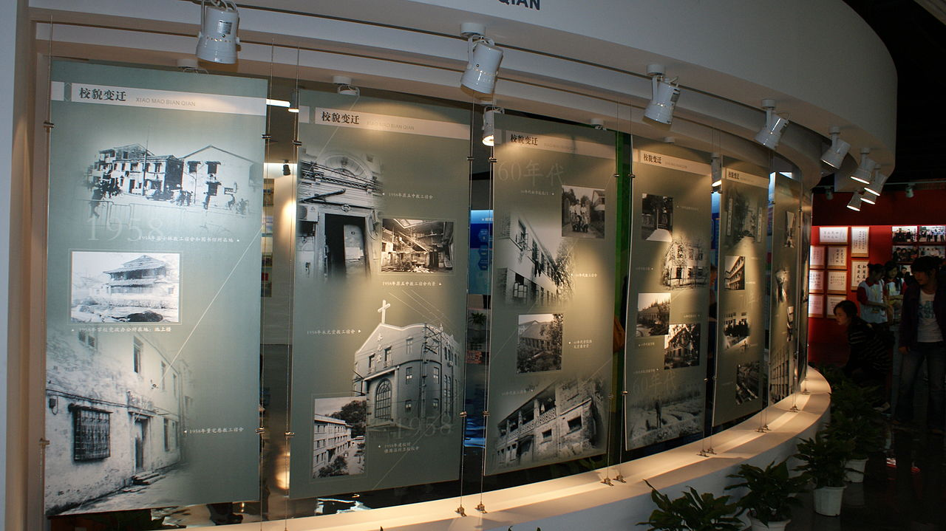
Exhibit
Information that you use to explain and support your point of view

Slide 8
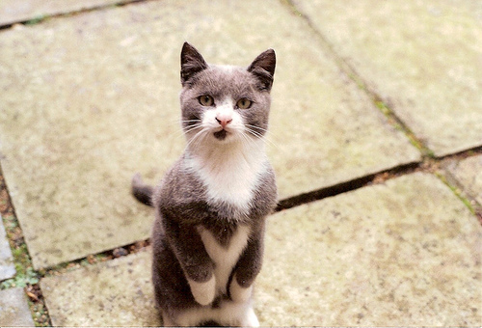
Arguments
Positions taken by others that you want to address by either refuting or supporting.

Slide 9
Method
A theory or lens you use to analyze information

Slide 10
Adam Ruins Everything: Security
https://youtu.be/-LDzOi1dyAA
What is the thesis statement?
How does he use sources?

Slide 11
TSA airport screenings are not effective at stopping terrorist
"Actually, there's very little evidence the TSA has ever stopped a terrorist or found a real bomb.“
Lapidos, Juliet. "Does the TSA Ever Catch Terrorists?" Slate. Slate, 18 Nov. 2010. Web.
Background
Exhibit
Argument
Method

Slide 12
TSA airport screenings are not effective at stopping terrorist
"What has stopped terrorist attacks? All the other safety measures we've added since 9/11. Like reinforced cockpit blast doors."
Hawley, Kip. "Why Airport Security Is Broken -- And How To Fix It." Editorial. Wall Street Journal [New York] 15 Apr. 2012, Saturday Essay ed.: Web.
Background
Exhibit
Argument
Method

Slide 13
TSA airport screenings are not effective at stopping terrorist
"When Homeland Security tested them, the TSA failed to find mock weapons and explosives 95% of the time."
Fishel, Justin, Pierre Thomas, Mike Levine, and Jack Date. "EXCLUSIVE: Undercover DHS Tests Find Security Failures at US Airports." Good Morning America. ABC. New York, New York, 1 June 2015. ABC News. Web.
Background
Exhibit
Argument
Method

Slide 14
TSA airport screenings are not effective at stopping terrorist
Statements from security expert Bruce Schneier:
Illusion of security is harmful if we have to sacrifice other rights just to get this illusion. The security practices in plain view makes them easy to circumvent. Spending so much money on ineffective security practices diverts money that could be spent on more effective countermeasures.
Background
Exhibit
Argument
Method

Slide 15
 | Where to find these?* | Examples of what you might find.
Background | Encyclopedias Introductions of Books and Articles | What is the history of airport screenings? Numbers of people who are screened?
Exhibit | Lots of places | Examples of security screenings in other areas that might be applied to airports.
Argument | Scholarly Journal Articles Op-Ed pieces Anywhere people are likely to state opinions | Full Body Scanners are effective deterrents because…
Method | Mostly find in scholarly journal articles and books | Situational Familiarity Theory
* You can find any of these in a variety of sources, but some are more likely to be found in specific types of works

Slide 16
Your turn
Look at the 2 articles you are given
Would you use these in a paper? (CRAPP test)
How would you use information from this article? (BEAM)
How can you change your topic?

